Slide 1
Image Captioning: A Comparative Evaluation of Neural Network Models
Team Members:
Sai Kumar Kalisetty
Shashidhar Reddy
Onkar Kunte
Abhinav

Slide 2
Introduction
Exploring the capabilities of the human visual system through automated image captioning.
Benefits of applications that can interpret and verbalize scenes in plain text.
Dual-functionality model:
1)BERT-Transformer
2)Rasnet18-Transformer based Pytorch(CNN)
3)CNN-RNN

Slide 3
Objectives
Model Comparison: To compare and analyze the performance of various neural network architectures, including but not limited to CNN-LSTM models, Transformer-based models, and attention mechanism integrated models, for the task of generating descriptive captions for images.
Domain Variability: To evaluate the robustness and adaptability of each model across different domains and subjects within the Flickr dataset, ensuring that the models can handle a wide variety of images and scenes.
Performance Metrics: To use advanced evaluation metrics such as BLEU (Bilingual Evaluation Understudy), ROUGE (Recall-Oriented Understudy for Gisting Evaluation), and others to quantitatively assess the quality of the generated captions in terms of relevance, coherence, and grammatical correctness.
Descriptive Statistics

Slide 4
Dataset
Modified Flickr8k Dataset
8000 images, each annotated with 5 sentences via AMT.
1000 for validation, testing.
Modified the dataset using different domain categories

Slide 5
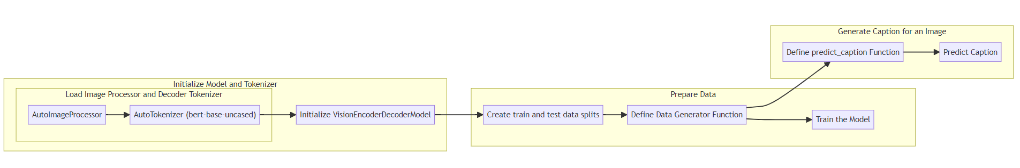
Methodology - BERT-Transformer
1.Initialize Model and Tokenizer:
Load Image Processor and Decoder Tokenizer:
AutoImageProcessor: Load the automatic image processor to preprocess input images, preparing them for the model.
AutoTokenizer (bert-base-uncased): Load the tokenizer for the BERT model, which will be used for processing text data and generating captions.
Initialize VisionEncoderDecoderModel: Set up the VisionEncoderDecoderModel, which combines vision (image processing) and language (decoding) capabilities. This model takes the processed images and generates captions using the BERT-based tokenizer.
Prepare Data:
Create train and test data splits: Segment the dataset into training and testing portions, ensuring the model has data for both learning and evaluation.
Define Data Generator Function: Establish a function to feed data into the model during training. This function will handle batching, preprocessing, and organizing the data.
Train the Model: Execute the training process using the defined data generator function on the training data split.
Generate Caption for an Image:
Define predict_caption Function: Create a function that takes an image as input and generates a caption. This function will utilize the trained model and the tokenizer for caption generation.
Predict Caption: Use the predict_caption function to produce captions for new images, demonstrating the model's capability to interpret and describe unseen visual content.

Slide 6
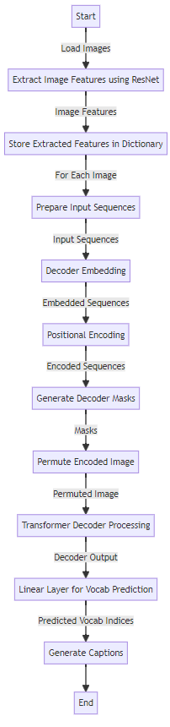
Methodology - Rasnet18-Transformer
Image Feature Extraction:
Utilize ResNet to extract features from images.
Store extracted features in a dictionary for efficient retrieval.
Preparation of Input Sequences:
Process and prepare input sequences for the decoder.
Implement tokenization and padding as necessary.
Decoder Processing:
Convert input sequences into embeddings.
Apply positional encoding to the embeddings.
Generate masks for the transformer decoder to handle padding.
Transformer Decoder:
Permute encoded image features to match decoder input format.
Process the sequences through the transformer decoder with image embeddings and masks.
Vocabulary Prediction:
Use a linear layer on the decoder output to predict vocabulary indices.
Map the indices to words to form captions.
Caption Generation:
Assemble words into coherent captions based on predicted indices.
Post-processing steps like removing special tokens or adjusting sentence structure.

Slide 7
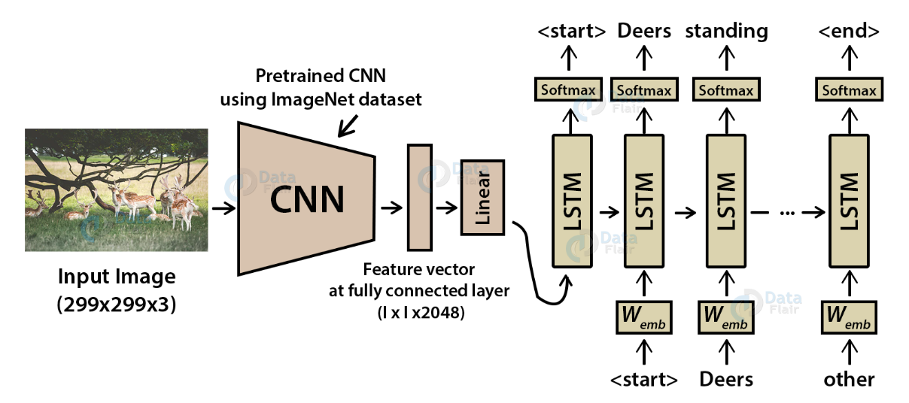
Methodology – CNN- LSTM
Input Image Processing: The architecture takes an input image of size 299×299×3299×299×3 (height, width, channels).
Pretrained CNN: The image is passed through a pretrained CNN (using ImageNet dataset) to extract features.
Feature Extraction: The CNN outputs a feature vector from the fully connected layer, typically of size 1×20481×2048.
Sequence Prediction: The feature vector is then fed into a sequence of LSTM layers.
LSTM Network: The LSTM layers generate a sequence of words to form a caption, one word at a time.
Word Embeddings: Each predicted word is embedded into a higher-dimensional space using Wemb​ to maintain semantic information.
Softmax Layer: A softmax function is applied at each step to choose the most probable word from the vocabulary.
Caption Generation: The process starts with an initial <start> token and ends when the <end> token is predicted, resulting in a complete caption like "Deers standing."
End-to-End Learning: The entire system is trained end-to-end with pairs of images and corresponding captions.
Application: This architecture is commonly used for automatic image captioning, aiding in tasks like accessibility for the visually impaired and content indexing.

Slide 8
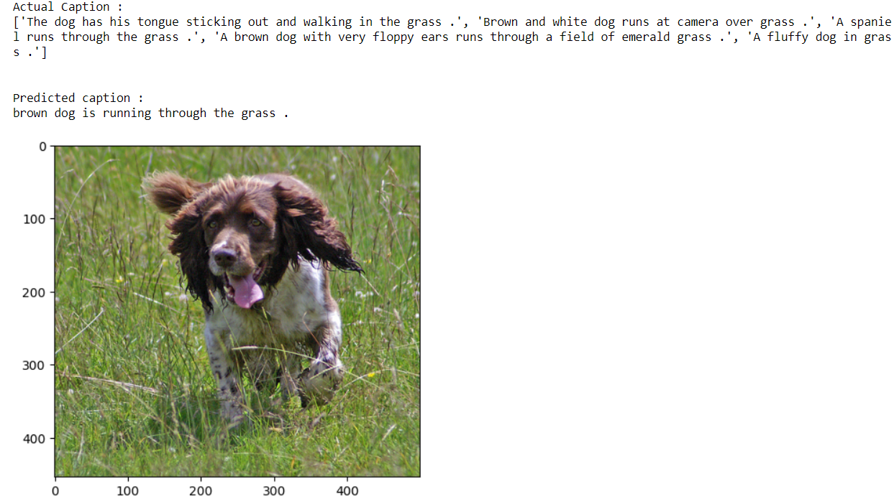
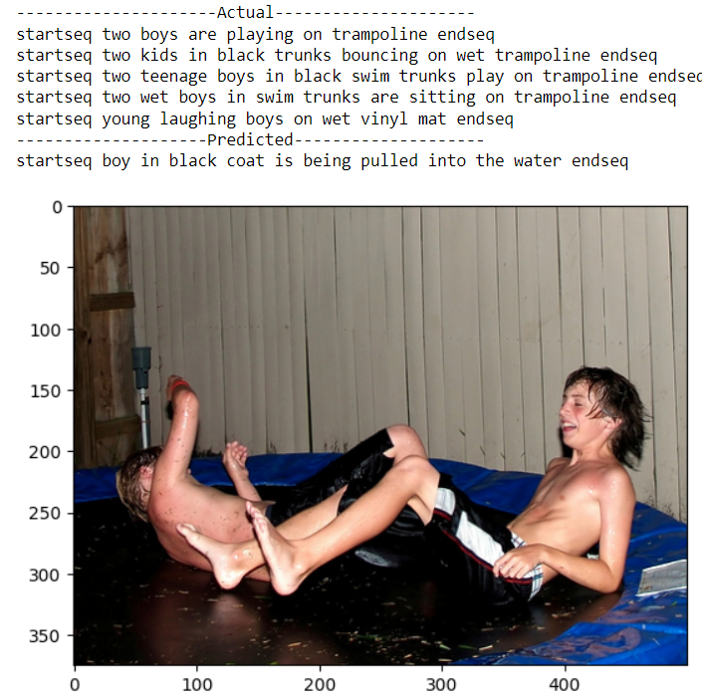
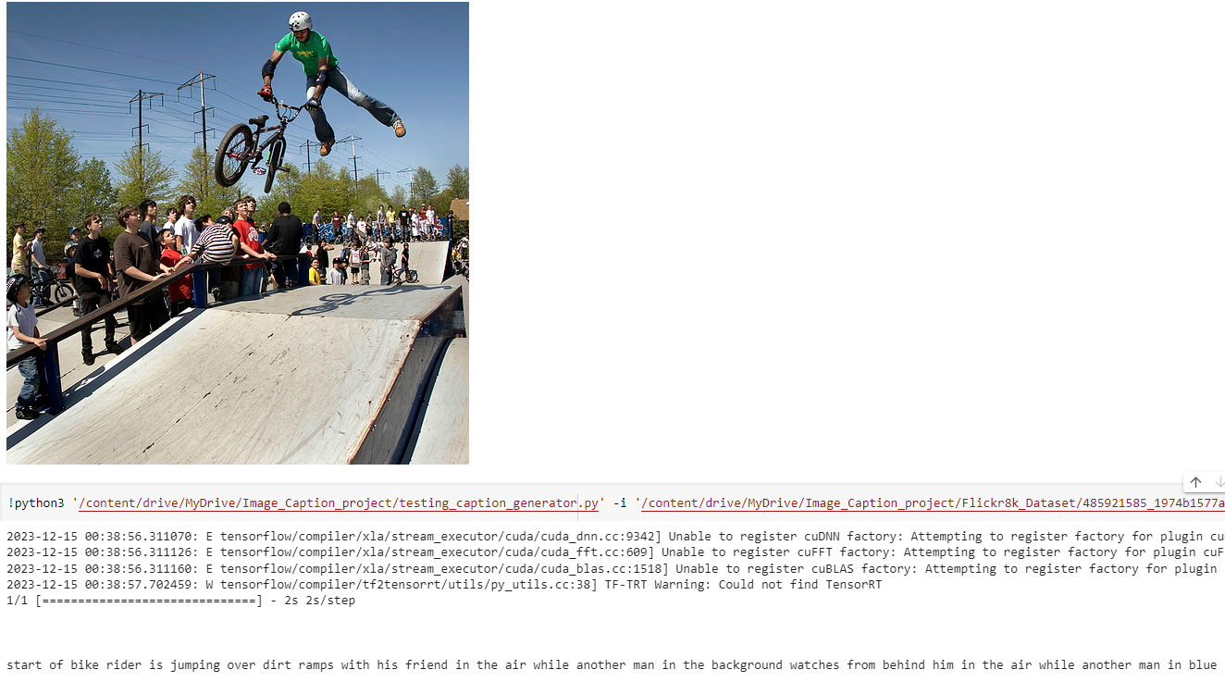
Results
RasNet-Transformer Result
BERT Result
CNN – RNN Result

Slide 9
Results
Models | Epoch | BLeU Score | ROUGE-L F Score
TransCapNet | 30 | 0.8637566835063555 | 0.941210414219524
BERT-Transformer | 20 | 0.541638 | 0.290246
CNN-LSTM | 20 | 3.328102437e-34 | 0.64298124657823
TransCapNet seems to be the best-performing model for image captioning, as it has the highest BLeU Score (0.8637566835063555) and ROUGE-L F Score (0.941210414219524).

Slide 10
Future work
Expanded Multimodal Capabilities: Explore the integration of various data inputs beyond static images, such as audio clips, video streams, and even sensory data, to enrich the context and accuracy of the generated captions. This would facilitate the creation of dynamic captions that can describe not just visual elements but also sounds, movements, and potentially even smells and textures, providing a multisensory narrative.
User Interface Enhancement: Design and develop an advanced user interface that is intuitive and accessible, allowing users to interact with the captioning system easily. The interface could include features like drag-and-drop for images and videos, real-time caption editing, and options for customizing the output style to suit different preferences and requirements.
Cross-Model Integration: Delve into the synergistic combination of different neural network models, such as the fusion of CNNs for feature extraction with Transformer models for sequence generation, to capitalize on the advantages of each approach. This research could lead to the development of a superior hybrid model that offers both high-quality feature representation and advanced language generation capabilities.

Slide 11
Thank you!

