Slide 1
The Front End Stack
As of 2019

Slide 2
A quick history lesson
HTML, CSS, and JavaScript throughout the years

Slide 3
HTML (Hypertext Markup Language)
Plain ol’ HTML files
Preprocessors (PHP, Jinja2, Handlebars)
HTML-in-JS (JSX, Angular, Vue.js)

Slide 4
CSS (Cascading Style Sheets)
External CSS files
Preprocessors (Sass, Less, Stylus)
CSS-in-JS (styled-components, glamor, emotion)
CSS-in-HTML (Inline styles)

Slide 5
JavaScript (the old parts)
One global scope
Namespacing
IIFE (Immediately Invoked Function Expression)
CommonJS modules (Node.js)

Slide 6
JavaScript (the new parts)
ES6 Modules
Dynamic imports
Entering the almighty webpack

Slide 7
webpack
Putting stuff together (aka module bundler)

Slide 8
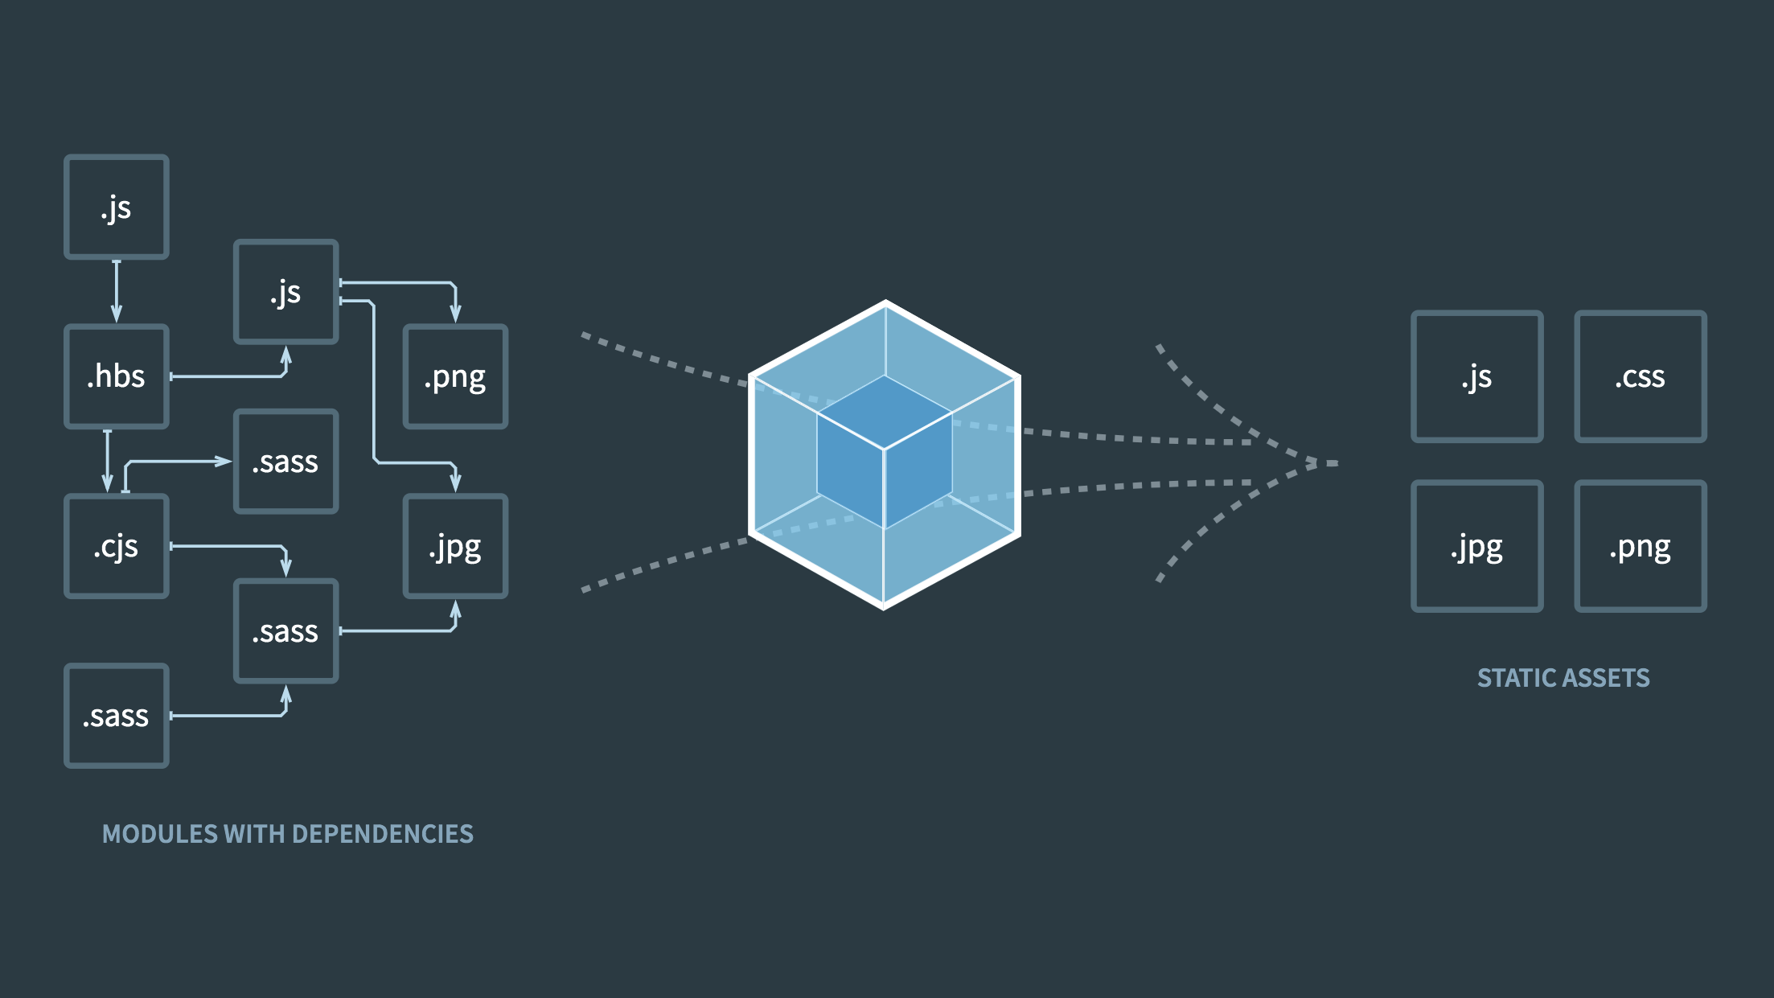

Slide 9
Babel
Transform something into usable JavaScript (aka compiler)

Slide 10
