Slide 1

ROYAL UNIVERSITY OF PHNOM PENH
Faculty of Engineering
Data Vault 2.0 Implementation for
Cambodia Tax System Data Warehouse
Using Medallion Architecture
A Final Report — Master of Science in Data Science and Engineering
Mr. Sot So
Supervisor: Mr. Chap Chanpiseth
February 2026
Notes:
Good morning/afternoon, committee members. My name is Sot So, and I will present my thesis on "Data Vault 2.0 Implementation for Cambodia Tax System Data Warehouse Using Medallion Architecture," supervised by Mr. Chap Chanpiseth. This research addresses the need for a modern, scalable data warehouse architecture for Cambodia's General Department of Taxation.

Slide 2
Outline
Ch 1
Introduction
Background, Problem, Objectives, Contributions
Ch 2
Literature Review
DV2, Medallion, Big Data, ETL, Related Work
Ch 3
Methodology
System Architecture, Source Design, ETL Control
Ch 4
Implementation
Staging → Bronze → Silver → Gold Pipeline
Ch 5
Results & Discussion
POC Evidence, 4 Challenges Addressed, Key Insights
Ch 6
Conclusion
Summary, Future Work
2 / 13
Notes:
This presentation follows a 6-chapter structure. I will cover the background and problem statement, literature review and research gap, methodology and system architecture, implementation details across 4 data warehouse layers, POC evidence addressing 4 key challenges, discussion of key insights, and conclude with future work recommendations. The defense will take approximately 20-25 minutes.

Slide 3
Background & Problem Statement
Background
4 Key Challenges
Cambodia GDT undergoing digital transformation
Growing tax data volumes require enterprise DW
Kimball star schema: rigid structure, costly schema changes
Inmon 3NF: complex ETL, slow analytical queries
Data Vault 2.0 offers agility, auditability, scalability
1. Schema Rigidity — regulatory changes break star schemas
2. Historical Tracking — limited audit trail in Kimball SCD2
3. Scalable ETL — monolithic pipelines, no error recovery
4. Business Rules Gap — no separation of raw vs derived
Aim & Objectives
1. Design & implement complete DV2 + Medallion DW for Cambodia tax system on SQL Server
2. Build 4-layer: Staging → Bronze (Raw Vault) → Silver (Business Vault) → Gold (Star Schema)
3. Develop ETL control framework with batch logging, watermark incremental loading, error handling
4. Validate architecture through POC demonstrations addressing 4 key challenges with evidence
5. Provide reproducible Technical Implementation Guide as companion artifact
6. Provide Source Database Verification document with evidence-based data quality validation
3 / 13
Notes:
Cambodia's GDT is undergoing digital transformation with growing data volumes. Traditional approaches have limitations: Kimball's star schema is rigid — regulatory changes require costly schema modifications. Inmon's 3NF approach produces complex ETL and slow analytical queries due to many joins. We identified 4 key challenges: schema rigidity when regulations change, limited audit trails, monolithic ETL with no error recovery, and no separation of raw data from business rules. Data Vault 2.0 addresses all 4 challenges through its hub-satellite-link architecture. Our study has 6 objectives, including building the complete 4-layer pipeline, ETL control framework, POC evaluation, and two companion documents for reproducibility and verification.

Slide 4

Research Gap & Contributions
Gap: Most DV2 studies are theoretical or domain-specific. No published end-to-end DV2 + Medallion implementation for government tax administration.
C1: Complete 4-layer implementation — 67 objects, 60 SSIS packages — first DV2 + Medallion for gov. tax
C2: Integrated ETL control framework with batch/step logging, watermark loading, error handling
C3: POC evaluation addressing 4 challenges with measurable before/after evidence on Cambodia tax domain
C4: Technical Implementation Guide — reproducibility artifact for SSIS deployment
C5: Source Database Verification + companion documents for full reproducibility
4 / 13
Notes:
The research gap is clear: most Data Vault 2.0 studies are theoretical or limited to specific domains. No published study provides an end-to-end DV2 + Medallion implementation for government tax administration. Our 5 contributions: C1 is the first complete 4-layer implementation with 67 objects and 60 SSIS packages. C2 provides integrated ETL control with batch and step-level logging. C3 is POC evaluation addressing all 4 challenges with measurable before/after evidence on the Cambodia tax domain. C4 provides a reproducible Technical Implementation Guide for SSIS deployment. C5 provides Source Database Verification plus companion documents for full reproducibility.

Slide 5
Literature Review
Data Vault 2.0 & Medallion
Big Data in Tax Administration
Hub/Link/Satellite separation [Linstedt, 2015]
PIT, Bridge, Business Vault for Silver layer
Medallion: Staging → Bronze → Silver → Gold
Insert-only, hash keys, full audit trail
5V's framework [Gandomi & Haider, 2015]
IRS, HMRC, AEAT adoption documented [CIAT, 2021]
Big Data analytics for tax fraud detection [Shukla, 2019]
DV2 bridges Big Data ↔ DW gap
ETL Frameworks & Data Quality
ETL Conceptual Modeling: process optimization, pipeline management [Vassiliadis et al., 2002]
Data Quality: CHECK constraints, referential integrity, NULL validation, error logging per layer
Watermark-based incremental loading: MAX(ModifiedDate) pattern for batch ETL
This study: control framework + watermark + per-step error isolation
5 / 13
Notes:
Our theoretical foundation rests on three pillars. First, Linstedt and Olschimke’s 2015 Data Vault 2.0 methodology [1], which defines the hub-satellite-link architecture, hash key generation using SHA-256, and insert-only loading patterns. Hultgren [6] further contributed practical guidance on agile development patterns. Second, the Medallion Architecture popularized by Databricks [2] and adopted by Microsoft Fabric [26], with Bronze, Silver, and Gold layers providing progressive data refinement. We adapted this for SQL Server by mapping Bronze to Raw Vault, Silver to Business Vault, and Gold to Star Schema. Third, the ETL literature by Vassiliadis et al. [19] and Microsoft SSIS documentation [4] guides our control architecture. We combine this with watermark-based incremental loading using the MAX ModifiedDate pattern [3][19]. Our contribution is integrating all three into a single framework with per-step error isolation.

Slide 6
Related Work & Research Gap
Study | Year | Strengths | Limitations | Our Gap Fill
Yessad & Labiod | 2016 | 3-way comparison (Inmon/Kimball/DV) | No implementation; purely theoretical | Complete impl. with POC evidence
Naamane & Jovanovic | 2016 | Empirical with telecom data | No medallion arch.; no Gold layer | 4-layer medallion + Gold star schema
Vines | 2024 | TPC-DS benchmark; performance focus | No domain-specific; no ETL control | Cambodia tax domain + ETL framework
Singh | 2025 | Resilience & adaptability | Theoretical analysis; no implementation | Full POC with measurable evidence
This Study | 2026 | DV2 + Medallion + ETL + POC eval | Simulated data (verified, 12-check) | First gov. tax DV2 end-to-end impl.
6 / 13
Notes:
This table compares 4 key related studies plus our research. Yessad and Labiod in 2016 compared Inmon, Kimball, and Data Vault theoretically but had no implementation. Naamane and Jovanovic in 2016 provided empirical comparison with telecom data but without medallion architecture or a Gold layer. Vines in 2024 is the most recent, using TPC-DS benchmarks for performance evaluation but without domain-specific application. Singh in 2025 analyzed architectural resilience but remained theoretical with no hands-on implementation. Our study is the first to combine DV2 + Medallion + ETL Control + POC evaluation in a government tax domain. The key gap: no published end-to-end DV2 + Medallion for government tax administration.

Slide 7
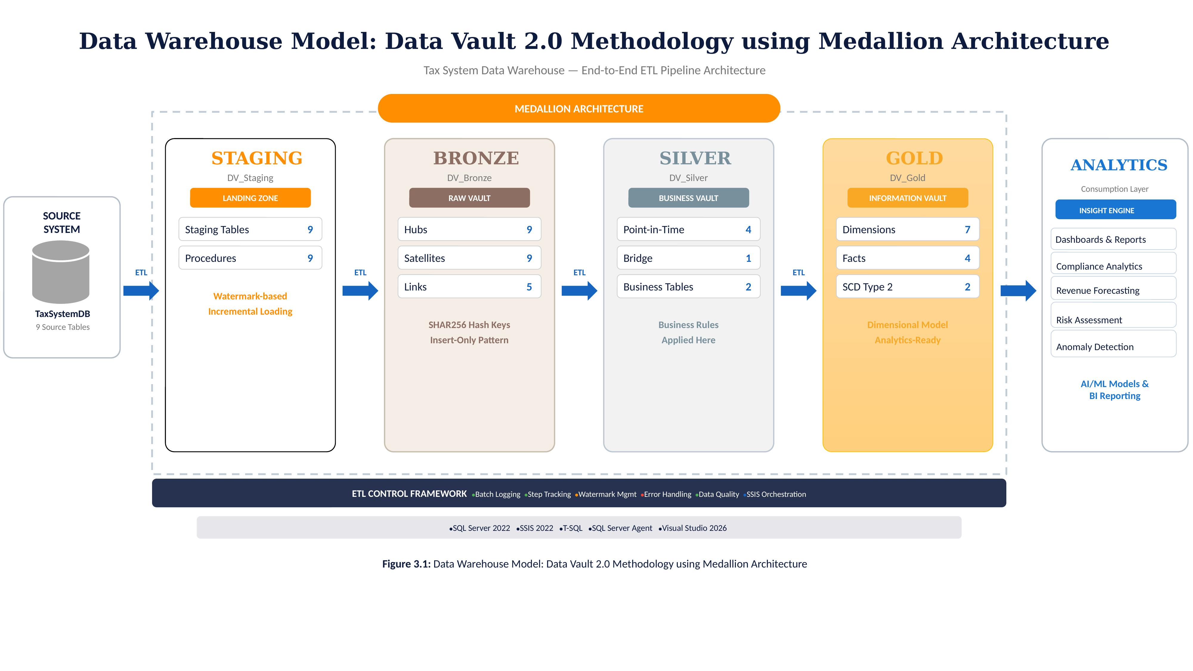
System Architecture
Figure 3.1: Data Warehouse Model — Data Vault 2.0 Methodology using Medallion Architecture
7 / 13
Notes:
The system architecture shows complete data flow from source to analytics. TaxSystemDB with 9 tables and 58,813 records, verified in our companion document. SSIS packages extract through 4 layers: Staging for temporary landing, Bronze Raw Vault with Hubs, Satellites, and Links using SHA-256 hash keys, Silver Business Vault with PIT tables, Bridge tables, and derived rules, Gold Star Schema with SCD Type 2 dimensions and fact tables. The ETL Control database orchestrates 49 steps with batch logging, step tracking, watermark management, and error handling.

Slide 8
Implementation — Four Layers
Staging (9)
Bronze (23)
Silver (6)
Gold (11)
Full: TRUNCATE → INSERT
Incr: Watermark delta
1:1 source mapping
9 Hubs: SHA-256 hash keys
9 SATs: HashDiff + SCD2
5 Links: Relationships
Insert-only audit trail
3 PIT: Temporal snapshots
1 Bridge: Pre-joined
2 BUS: Compliance scores
7 DIMs: SCD1 + SCD2
4 FACTs: Monthly, Payment
Snapshot, Audit
Star schema for BI
Master Orchestration — 49 Steps
Init
Batch
Staging
(9)
Hubs
(9)
SATs
(9)
Links
(5)
Silver
(6)
Gold
(11)
Close
Batch
→
→
→
→
→
→
→
8 / 13
Notes:
Detailed object breakdown across 4 layers. Staging: 9 tables with full and incremental loading. Bronze: 9 Hubs for business keys, 9 Satellites for descriptive attributes with hash diff change detection, 5 Links for relationships. Silver: 3 PIT tables for Point-In-Time lookups, 1 Bridge table, 2 Business Vault tables including ComplianceScore and MonthlyMetrics. Gold: 7 Dimensions (2 SCD Type 2 + 5 SCD Type 1), 4 Fact tables for monthly declarations, payments, snapshots, and declaration lifecycle. Total: 67 objects across 4 layers, 49 automated steps orchestrated by ETL Control Framework.

Slide 9
Source Database & Sample Data
TaxSystemDB — 9 Source Tables (3 Lookup + 3 Reference + 3 Transaction)
Table | Type | Description | Records
Category | Lookup | Taxpayer categories (Individual, SME, Corp) | 5
Structure | Lookup | Business structure types (Individual, Partnership, Corp) | 5
Activity | Lookup | Business activity sectors (Manufacturing, Service, etc.) | 5
Taxpayer | Reference | Registered taxpayers with TaxID, business name | 1,000
Officer | Reference | Tax collection officers with department | 10
Owner | Reference | Business owners with ownership percentages | ~1,956
MonthlyDeclaration | Transaction | Monthly tax declarations with revenue, tax, penalties | ~38,491
Payment | Transaction | Tax payments linked to declarations | ~13,733
AnnualDeclaration | Transaction | Annual tax declarations with yearly summaries | 2,785
Data Generator (02_TransactionData.sql): 1,000 taxpayers, 4 years (2020–2023), ~80% monthly filing rate, 58,813 records. Verified: 10 FKs, 19 CHECK constraints, 35 indexes, 0 orphans, 0 NULLs (see Source Database Verification document).
9 / 13
Notes:
The source database TaxSystemDB contains 9 tables in 3 categories: 3 lookup tables for categories, structures, and activities; 3 reference tables for taxpayers, owners, and officers; and 3 transaction tables for monthly declarations, annual declarations, and payments. The data generator script 02_TransactionData.sql produces 1,000 taxpayers across 5 categories, 4 years of data from 2020 to 2023, with ~80% monthly filing rate. Total records are 58,813. This data has been independently verified in our Source Database Verification companion document with a 12-point checklist: 10 foreign keys, 19 CHECK constraints, 35 indexes, zero orphan records across 7 relationships, zero NULLs on 8 critical columns, and unique TaxID verification.

Slide 10
POC Evidence — 4 Challenges Addressed
C1: Schema Rigidity
Problem: ALTER TABLE impacts multiple dependent objects
DV2: CREATE new Satellite only — zero impact on 60 SSIS packages
C2: Historical Tracking
Problem: Limited audit trail, no full version history
DV2: Insert-only SATs preserve ALL versions with HashDiff + timestamps
C3: Scalable ETL
Problem: Monolithic pipelines, no step-level logging or error recovery
DV2: ETL control with BatchLog/StepLog/ErrorLog, OnError Event Handlers
C4: Business Rules Gap
Problem: No separation of raw data from derived business logic
DV2: Silver applies business rules (ComplianceScore); Bronze preserves raw
10 / 13
Notes:
This slide maps each of our 4 key challenges to concrete POC evidence. Schema Rigidity: adding SAT_Taxpayer_Contact requires zero modifications to existing 23 objects, as demonstrated in POC 1. Historical Tracking: Satellites maintain complete insert-only history with no destructive updates. Every change creates a new row with hash diff detection, demonstrated in POC 2. ETL Control: 49-step pipeline with per-step error isolation. If a step fails, all prior steps are preserved and only the failed step needs re-execution, demonstrated in POC 3. Business Rules: Silver layer derived attributes like ComplianceScore are isolated from Bronze raw data, demonstrated in POC 4.

Slide 11
Conclusion
This research successfully designed, implemented, and evaluated a complete Data Vault 2.0 data warehouse for the Cambodia tax system using medallion architecture on Microsoft SQL Server.
Complete 4-layer architecture: 67 objects, 60 SSIS packages, 49 ETL steps across 6 databases
ETL pipeline: Full and incremental loading with watermark-based change detection and per-step error isolation
Gold layer star schema provides consumption-ready dimensional model for BI reporting
Performance benchmarking and scalability analysis identified as future work
POC validation: All 4 challenges (schema rigidity, history, scalable ETL, business rules) addressed
3 companion documents [32][33][34] provide full reproducibility with SQL scripts and SSMS screenshots
11 / 13
Notes:
Key achievements: complete 4-layer pipeline with 67 objects and 60 SSIS packages across 6 databases. Full and incremental loading validated through POC demonstrations. All 4 challenges addressed with implementation evidence. Performance benchmarking and scalability analysis identified as future work. Three companion documents provide full reproducibility. Three companion documents submitted: [32] Implementation Scenarios with step-by-step SQL scripts and SSMS screenshot evidence for Flexibility, Materialized Views, and Early Arriving Facts scenarios. [33] POC Implementation Guide with reproducible SQL scripts for POC demonstrations in Sections 5.2.1 through 5.2.4. [34] Source Database Verification with 12-point checklist, all passing.

Slide 12
Future Work & Recommendations
1. Real-time processing with CDC (Change Data Capture) for critical compliance monitoring tables
2. Production deployment with real GDT data — data quality validation, security classification, access controls
3. Performance benchmarking: ETL load times, query performance (Gold vs Raw Vault), scalability analysis with columnstore indexes
4. BI dashboard integration (Power BI, Metabase) consuming Gold layer star schema for tax analytics
5. Multi-source integration: customs, banking, e-invoicing via Same-As Links & Multi-Active Satellites
6. Advanced analytics: ML models on Gold layer for compliance risk scoring, revenue forecasting, fraud detection, and anomaly detection
12 / 13
Notes:
Three categories of future work. Short-term: integrate real GDT data with anonymized records, implement role-based access control and data encryption, add Power BI dashboards consuming Gold layer. Medium-term: real-time CDC for near-real-time compliance monitoring, performance benchmarking with columnstore indexes, table partitioning, and materialized views [27]. Long-term: multi-source integration with customs, banking, and e-invoicing via Same-As Links and Multi-Active Satellites, and advanced analytics with ML models on Gold layer for compliance risk scoring, revenue forecasting, and fraud detection. Methodological priority: quantitative performance benchmarking measuring ETL load times and query execution performance, identified as the key future work to strengthen conclusions.

Slide 13
Thank You
Questions & Discussion
Data Vault 2.0 Implementation for Cambodia Tax System Data Warehouse
Using Medallion Architecture
Mr. Sot So • Supervisor: Mr. Chap Chanpiseth
Royal University of Phnom Penh • February 2026
13 / 13
Notes:
Thank you for your attention. I am ready for questions. Key numbers: 67 objects, 60 SSIS packages, 49 ETL steps across 6 databases, 4 POC demonstrations validating all challenges, 12 source database verification checks all passed, 3 companion documents for full reproducibility. Companion documents submitted: [32] Implementation Scenarios with step-by-step SQL scripts and SSMS screenshot evidence for Flexibility, Materialized Views, and Early Arriving Facts scenarios. [33] POC Implementation Guide with reproducible SQL scripts for POC demonstrations in Sections 5.2.1 through 5.2.4. [34] Source Database Verification with 12-point checklist, all passing. All SQL scripts are independently reproducible.

