Slide 1

Blockchain-Based Crowdfunding Application
Submitted By
M Arya Sri Ganesh -245318733155
G Vishal -245318733139
MVS Pranavi -245318733153

Slide 2
Abstract
The issue of transparency and security is very paramount in any organization, especially in organizations providing crowdfunding platforms.
Therefore the intention is to provide a reliable, secured, transparent and decentralized solution by developing a blockchain-based crowdfunding web application.
This platform gives assurance to backers that returns will be guaranteed and also provides transparency between the backers and the start-ups

Slide 3
Introduction
This is a Blockchain-Based Crowdfunding Application, a multi-user application that allows the various start-ups to gain funding from renowned investors who will be called Backers.
The startups can create projects and send them for approval by the Admin user who is assigned to the work of approving or rejecting a project.
This crowdfunding application is like no other as it does not transfer the amount which is funded directly to the start-up, rather the amount is stored in a smart contract.

Slide 4
Crowdfunding
Crowdfunding is the technique of raising small amounts of money from a large number of individuals, usually over the Internet, to fund a project or endeavor.
Crowdfunding is a sort of crowd sourcing and alternative finance.

Slide 5
Blockchain
Blockchain is a specific type of database. Its storage method differs from that of a regular database; blockchains store data in blocks that are subsequently linked together.
A blockchain can hold a variety of data, but the most prevalent application so far has been as a transaction ledger.
The blockchain employed in this situation is in a decentralized manner, which means that no single person or group controls the system; rather, all users have collective control.
Decentralized blockchains are immutable, meaning that the data entered cannot be changed.
For this application, it means that transactions are permanently recorded and viewable to anyone.

Slide 6
Smart Contract
Smart contracts are computer programs that run when specific conditions are met and are stored on a blockchain.
They're commonly used to automate contract execution so that all parties may know the outcome right quickly, without the need for any intermediaries or wasted time.

Slide 7
Existing System
Not ensure the security of fundings done by the backers
Do not give a guarantee of completion of projects listed on
their website
Direct money transfer to the startups
Lead to potential losses to the investors

Slide 8
Proposed System
This application aims to eradicate this problem by using a method that ensures that the funding is wisely used and projects are completed.
The method devised, says that the total funded amount would not be transferred to the startup directly, instead , it would be stored in a smart contract.
Startups will have to complete certain pre- set milestones set by themselves.
So, each time a milestone is completed, an amount corresponding to one fraction of the total milestones will be transferred to the startup.

Slide 9
Let the total milestones to be completed for the project be n.
After each milestone is completed by the startup, 1/n times the total amount stored in the smart contract will be transferred to the startup.
The application will also provide transparency between the backers and the startups.
Money will be refunded to the backers in case the project is aborted in between.
The amount will be refunded based on the following
Let the total milestones to be completed for the project be n.

Slide 10
If no milestones have been completed yet and the project is aborted at this stage, then the whole amount that the backers funded is refunded to them immediately.
If the milestone that is completed is m and the project is aborted at this stage, then the amount refunded to the backers will be 𝑛−𝑚/n times the total amount funded by that particular backer.
Hence, by adopting this method, it is ensured that the backers’ funds are neither misused nor wasted.

Slide 11
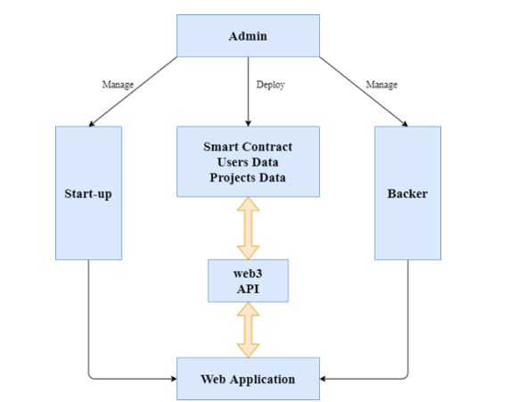
SYSTEM DESIGN Architecture Diagram

Slide 12
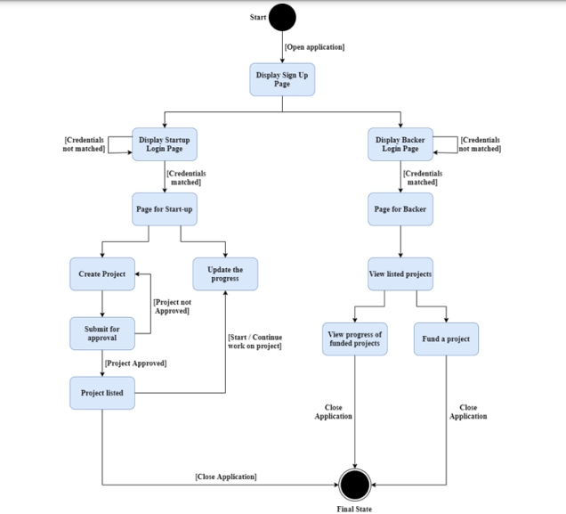
State diagram

Slide 13
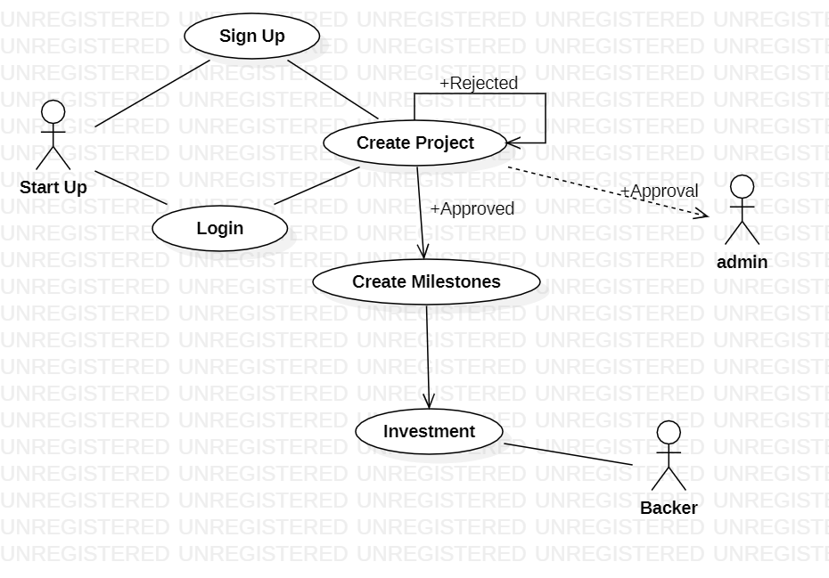
Use case diagram

Slide 14
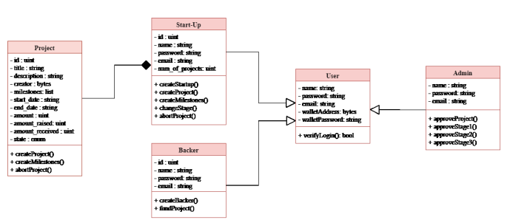
Class diagram

Slide 15
SOFTWARE REQUIREMENTS SPECIFICATION
Software Requirements
Operating System :Windows 7-10
Framework : Truffle, Bootstrap
Front-End Software : HTML5, CSS, JavaScript
Back-End Software : Ganache(Testing), Solidity(Programming Language)
Other Software : Meta Mask (Browser Extension)
Development Kit : Remix IDE, Truffle Suite
Hardware Requirements
Processor : Intel Pentium® Dual Core Processor (Min)
Speed : 2.9 GHz (Min)
RAM : 2 GB (Min)
Hard Disk : 2 GB (Min)

