Slide 1
Lending Club Credit Risk Modeling - “Maximize Profits”
Sundaresan Manoharan

Slide 2
Business Objectives
To help Lending Club identify members most likely to default on their loans, enabling better risk management, and higher portfolio profitability.
Maximizing profit is a multi-faceted challenge
Balance risk and reward
Keep costs low
Optimize customer/investor experience

Slide 3
Data Overview
Include for Modeling
Exclude for Modeling
Contains 10,000 rows and 28 columns.
Borrower Demographics
emp_title
emp_length
home_ownership
zip_code
addr_state
Financial Profile
annual_inc
verification_status
pymnt_plan
debt_to_income
policy_code
Loan Attributes
Id
is_bad
Notes
purpose_cat
purpose
Credit History
delinq_2yrs
earliest_cr_line
inq_last_6mths
mths_since_last_delinq
mths_since_last_record
open_acc
pub_rec
revol_bal
revol_util
total_acc
initial_list_status
collections_12_mths_ex_med
mths_since_last_major_derog
Target Variable
is_bad
Feature Selection
Based on EDA
Based on Domain Understanding
Feature Engineering
Removed unique identifiers
Removed free form text columns
Removed columns with missing values > 95%
Removed columns without domain info
Removed columns with high cardinality
Numerical columns are standardized
Numerical columns are imputed with Median values
Categorical columns are imputed with MISSING text
Dataset Insights
Strong class imbalance Good (0) – 87% | Default (1) – 13%
Not many loan related attributes present
Key Predictors - Credit History and Financial Profile features

Slide 4
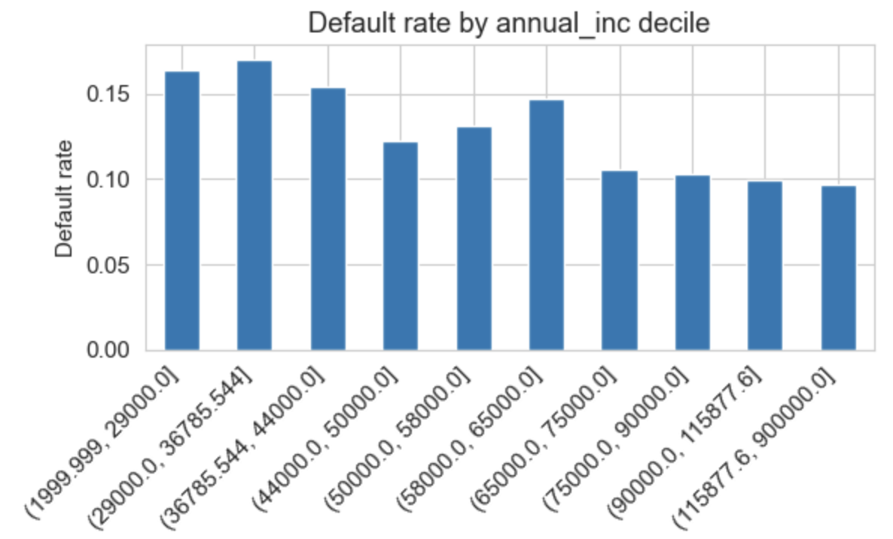
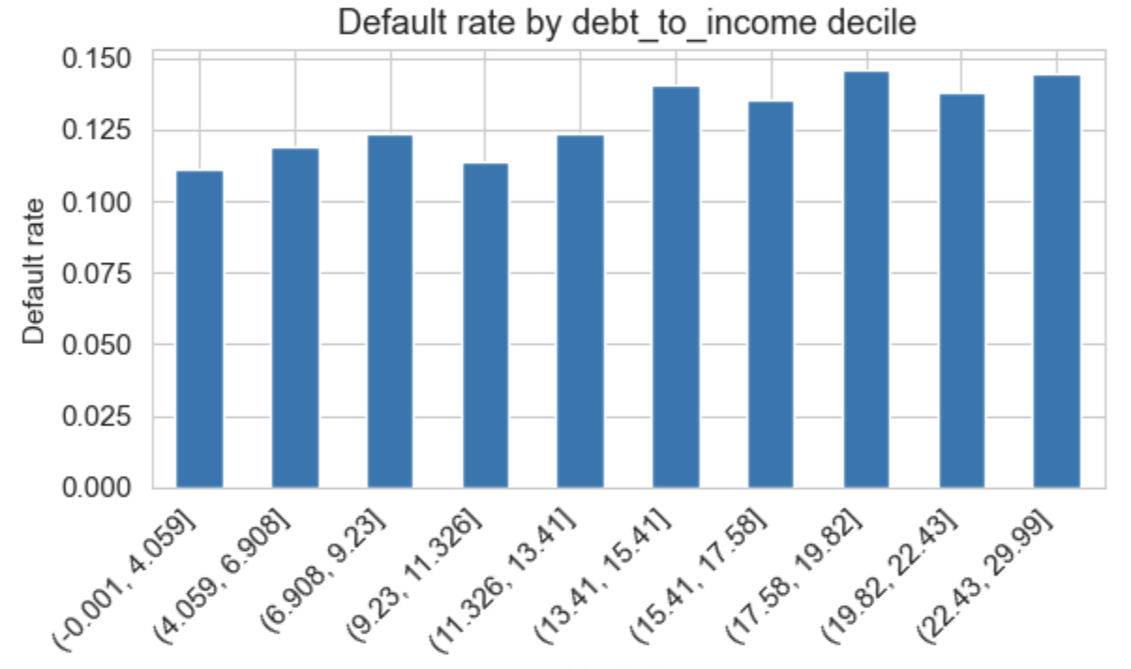
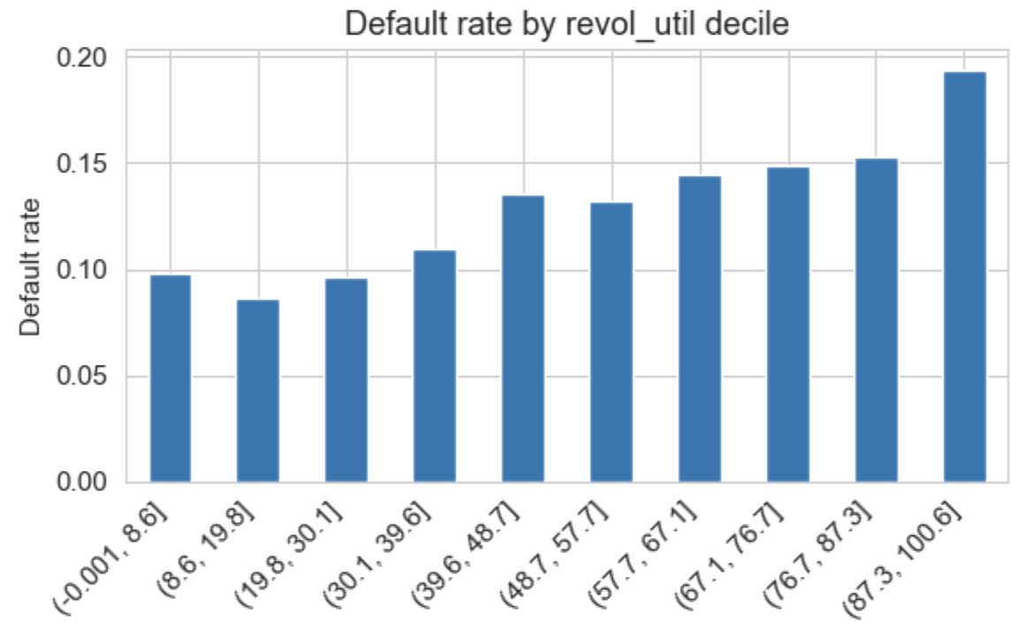
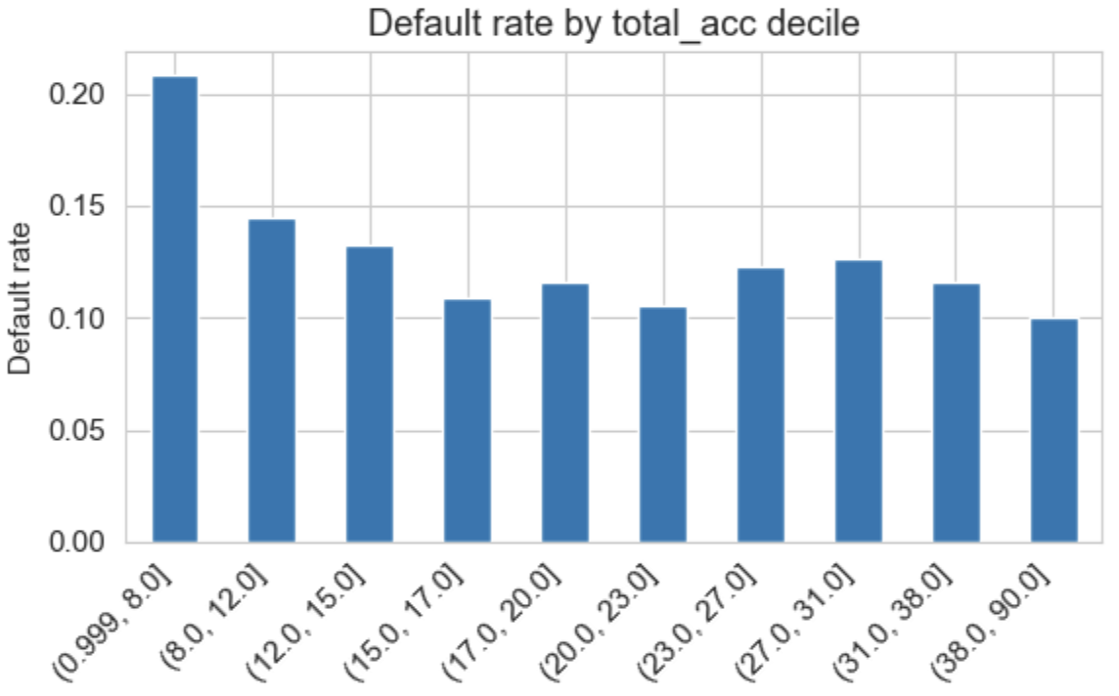
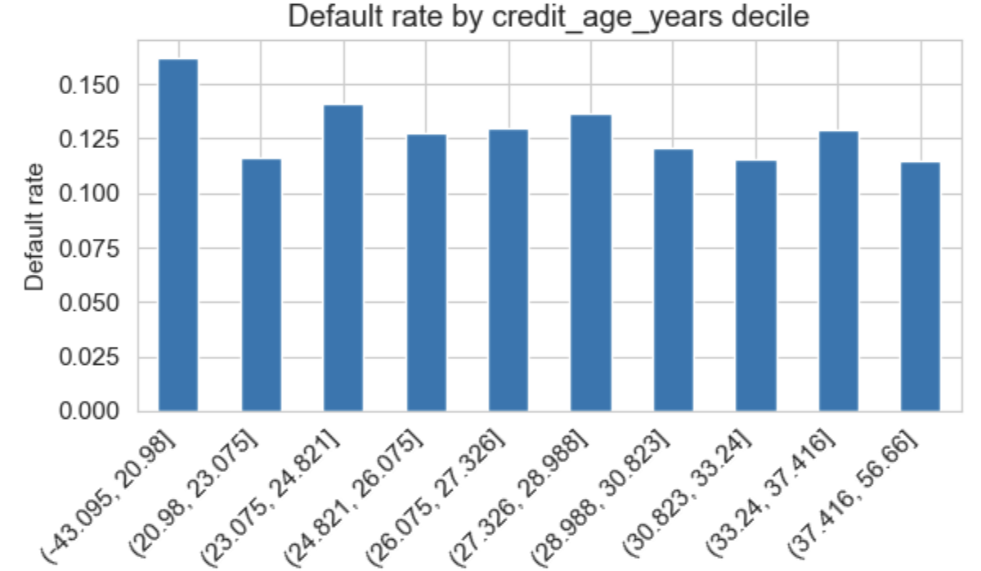
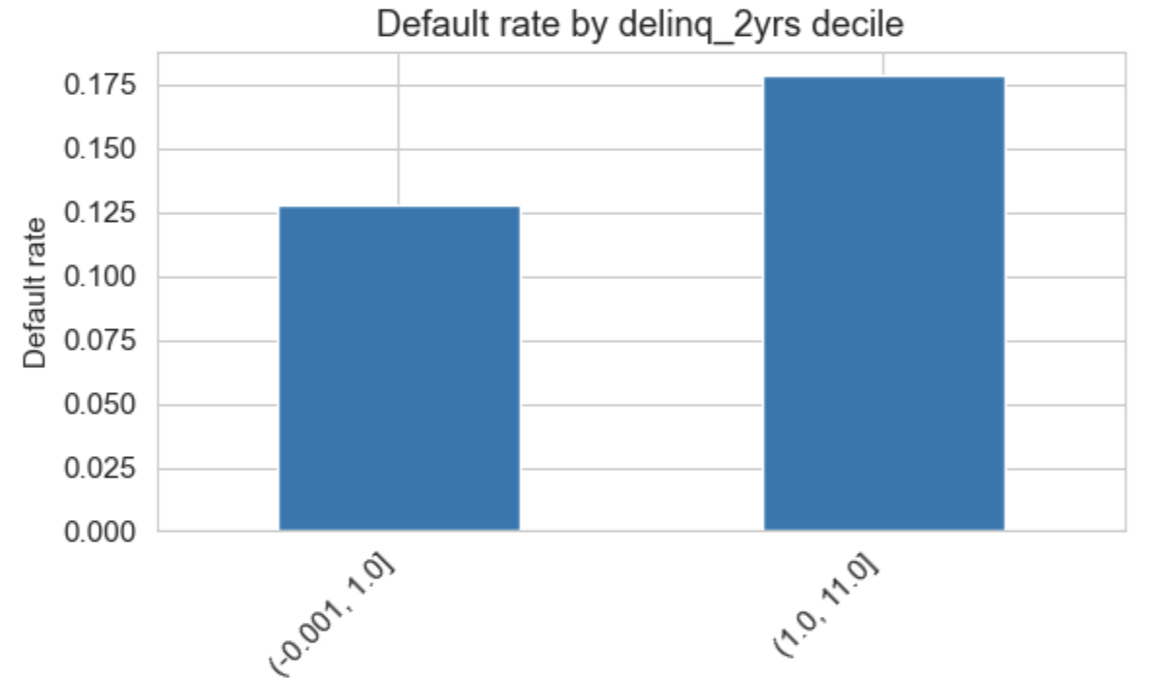
Key Insights
Higher Annual Income lowers the
chance of default.
Higher DTI shows most likely to default
High usage of Credit Utilization
shows 2x default rate.
Borrower with greater number of Credit Lines are less likely to default.
Having Credit Lines for longer time
shows less default risk.
Recent late payments increase the likelihood of default.

Slide 5
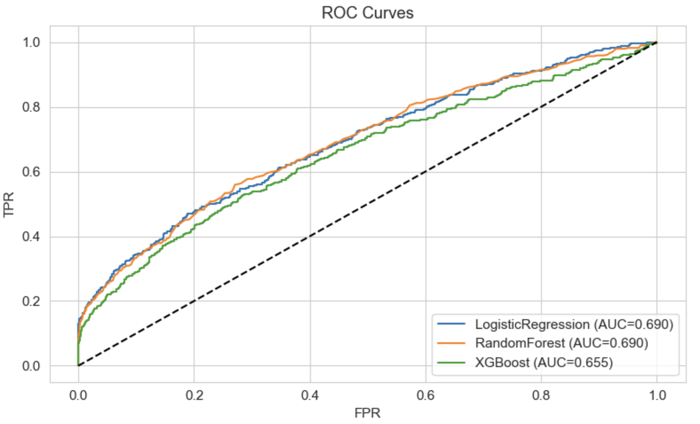
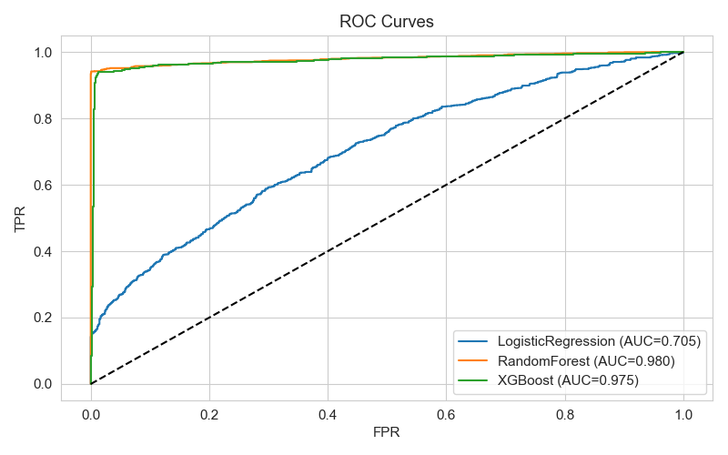
Model Performance
Three supervised models were trained on cleaned and engineered features.
Model | AUC | F1 | Recall
Logistic Regression | 0.69 | 0.32 | 0.54
Random Forest | 0.66 | 0.25 | 0.17
XGBoost | 0.69 | 0.15 | 0.08
Model | AUC | F1 | Recall
Logistic Regression | 0.705 | 0.62 | 0.57
Random Forest | 0.980 | 0.96 | 0.95
XGBoost | 0.975 | 0.93 | 0.96
Class Imbalance
Class Balanced

Slide 6
Summary
Business Recommendation(s)
Next Step(s)
Segment borrowers into personas: High Earners, Less Credit Utilization
Prioritize Low-Risk, High-Yield borrowers
Tighten Underwriting for High-Risk Segments
Adopt Risk-based pricing
Implement Early Warning & Collection Triggers to stop bleeding
Address Class Imbalance more effectively.
Enhance feature engineering.
Augment additional datasets.
Collect more loan data.
Optimize threshold of Profit Maximization.

Slide 7
Questions?
Thank You

