Slide 1
Lending Club Credit Risk Modeling - “Maximize Profits”
Sundaresan Manoharan

Slide 2
Business Objectives
To help Lending Club identify members most likely to default on their loans, enabling better risk management, and higher portfolio profitability.
Maximizing profit is a multi-faceted challenge
Balance risk and reward
Keep costs low
Optimize customer/investor experience

Slide 3
Data Overview
Include for Modeling
Exclude for Modeling
Contains 10,000 rows and 28 columns.
Borrower Demographics
emp_title
emp_length
home_ownership
zip_code
addr_state
Financial Profile
annual_inc
verification_status
pymnt_plan
debt_to_income
policy_code
Loan Attributes
Id
is_bad
Notes
purpose_cat
purpose
Credit History
delinq_2yrs
earliest_cr_line
inq_last_6mths
mths_since_last_delinq
mths_since_last_record
open_acc
pub_rec
revol_bal
revol_util
total_acc
initial_list_status
collections_12_mths_ex_med
mths_since_last_major_derog
Target Variable
is_bad
Feature Selection
Based on EDA
Based on Domain Understanding
Feature Engineering
Removed unique identifiers
Removed free form text columns
Removed columns with missing values > 95%
Removed columns without domain info
Removed columns with high cardinality
Numerical columns are standardized
Numerical columns are imputed with Median values
Categorical columns are imputed with MISSING text
Dataset Insights
Strong class imbalance Good (0) – 87% | Default (1) – 13%
Not many loan related attributes present
Key Predictors - Credit History and Financial Profile features

Slide 4
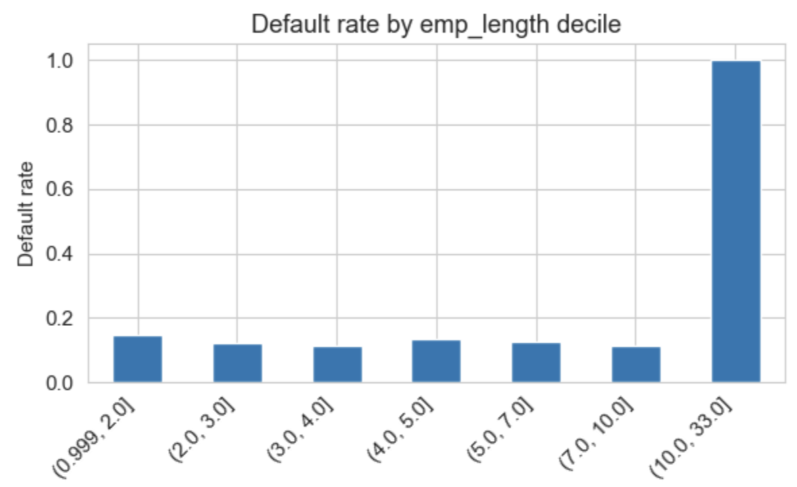
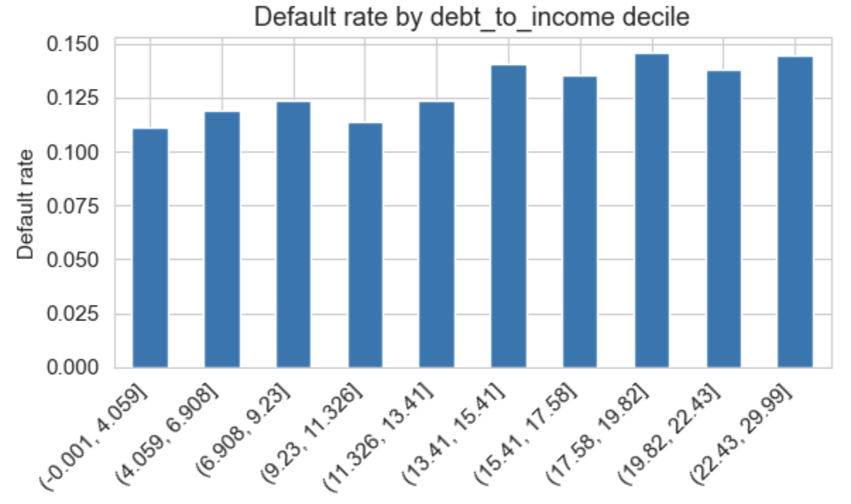
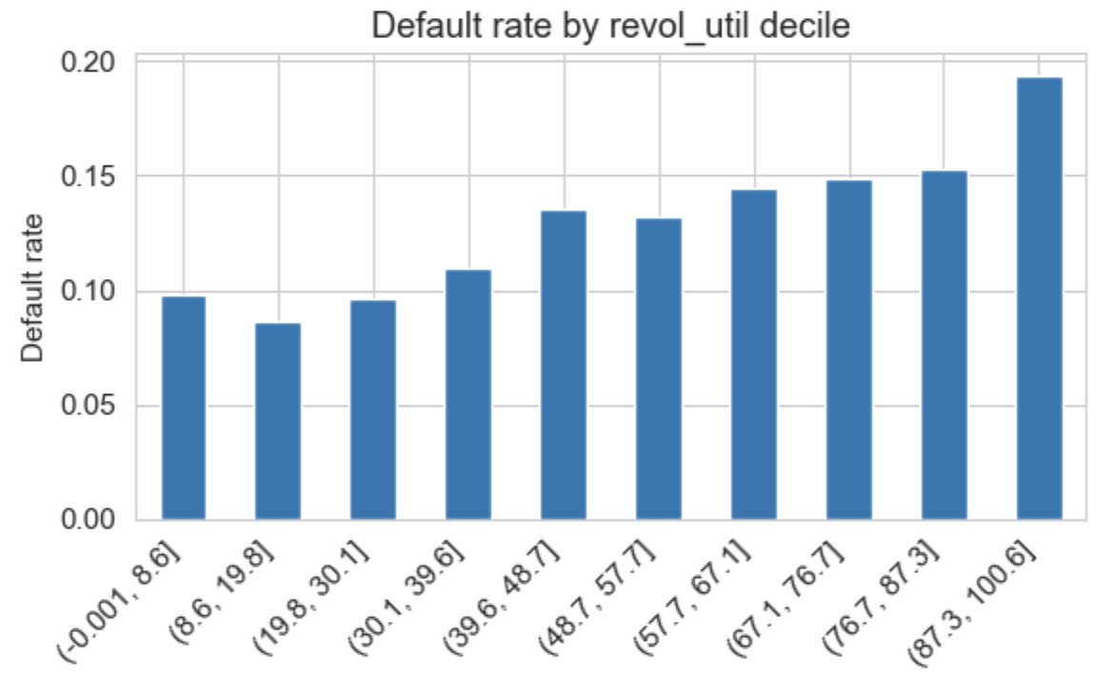
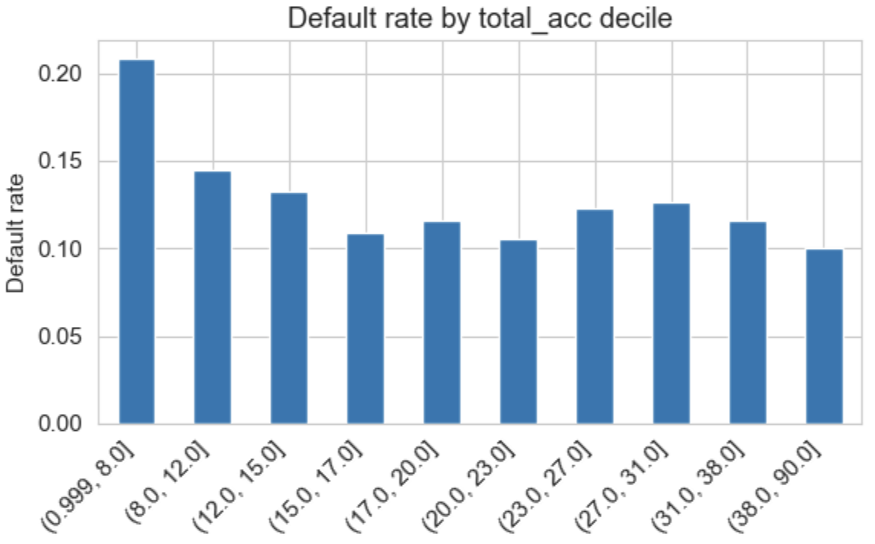
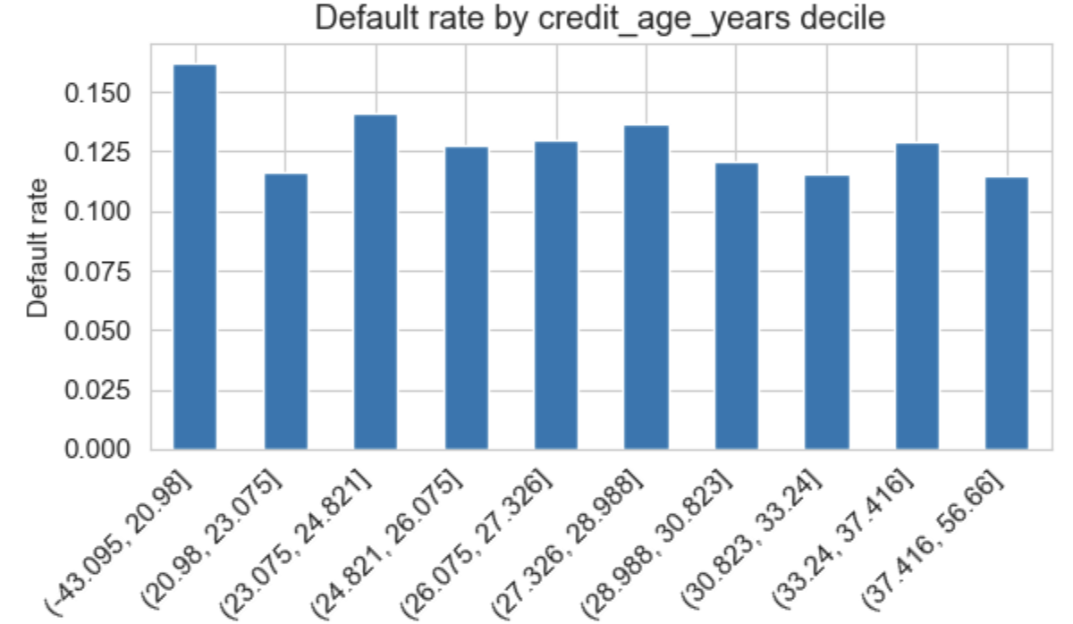
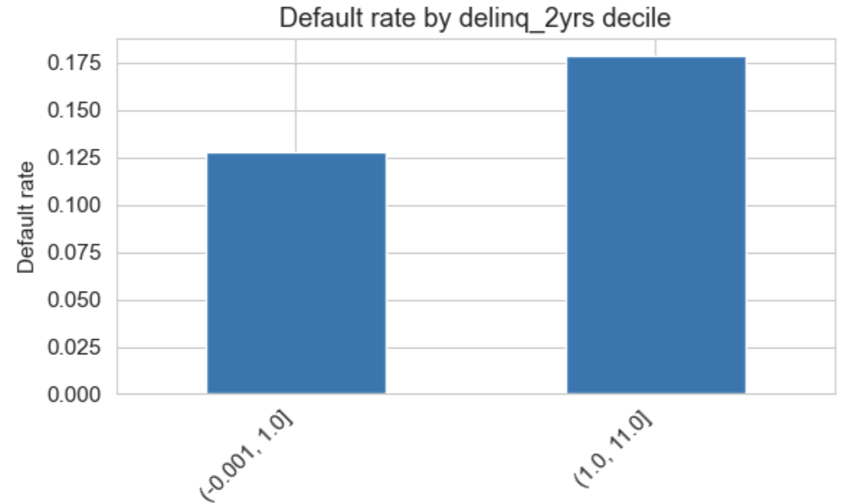
Key Insights
Employment length and annual income are negatively correlated with default.
Employment length and annual income are negatively correlated with default.
Employment length and annual income are negatively correlated with default.
Employment length and annual income are negatively correlated with default.
Employment length and annual income are negatively correlated with default.
Employment length and annual income are negatively correlated with default.

Slide 5
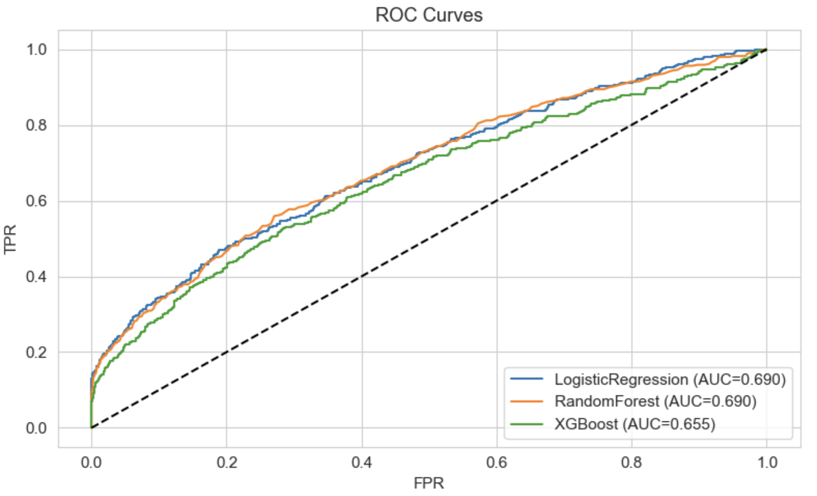
Model Performance
Credit Risk Modeling helps maximize profitability by predicting loan defaults, enabling smarter approvals, risk-based pricing, and optimized capital allocation.
Three supervised models were trained on cleaned and engineered features
Model | AUC | F1 | Recall
Logistic Regression | 0.69 | 0.32 | 0.54
Random Forest | 0.66 | 0.25 | 0.17
XGBoost | 0.69 | 0.15 | 0.08

Slide 6
Executive Summary
Business Recommendation(s)
Next Step(s)
Segment applicants (target low-risk: high income, low revol_util, low DTI)
Apply risk-based pricing: higher rates for higher predicted default probability.
Offer investor 'top safe loans' filter to improve returns.
Monitor fairness, performance drift; retrain quarterly.
Segment applicants (target low-risk: high income, low revol_util, low DTI)
Apply risk-based pricing: higher rates for higher predicted default probability.
Offer investor 'top safe loans' filter to improve returns.
Monitor fairness, performance drift; retrain quarterly.

Slide 7
Q&A

