Slide 1
EAD Project II: World Happiness index analysis
Miguel Tavares up200902937
Hélder Vieira up201503395
MDS

Slide 2
Dataset description
Hapiness Index of several countries from 2019
Most of the data retrieved through surveys

Slide 3
Dataset description
Features:
Score
GDP per capita
Social Support
Healthy life expectancy
Freedom to make life choices
Generosity
Perception of corruption

Slide 4
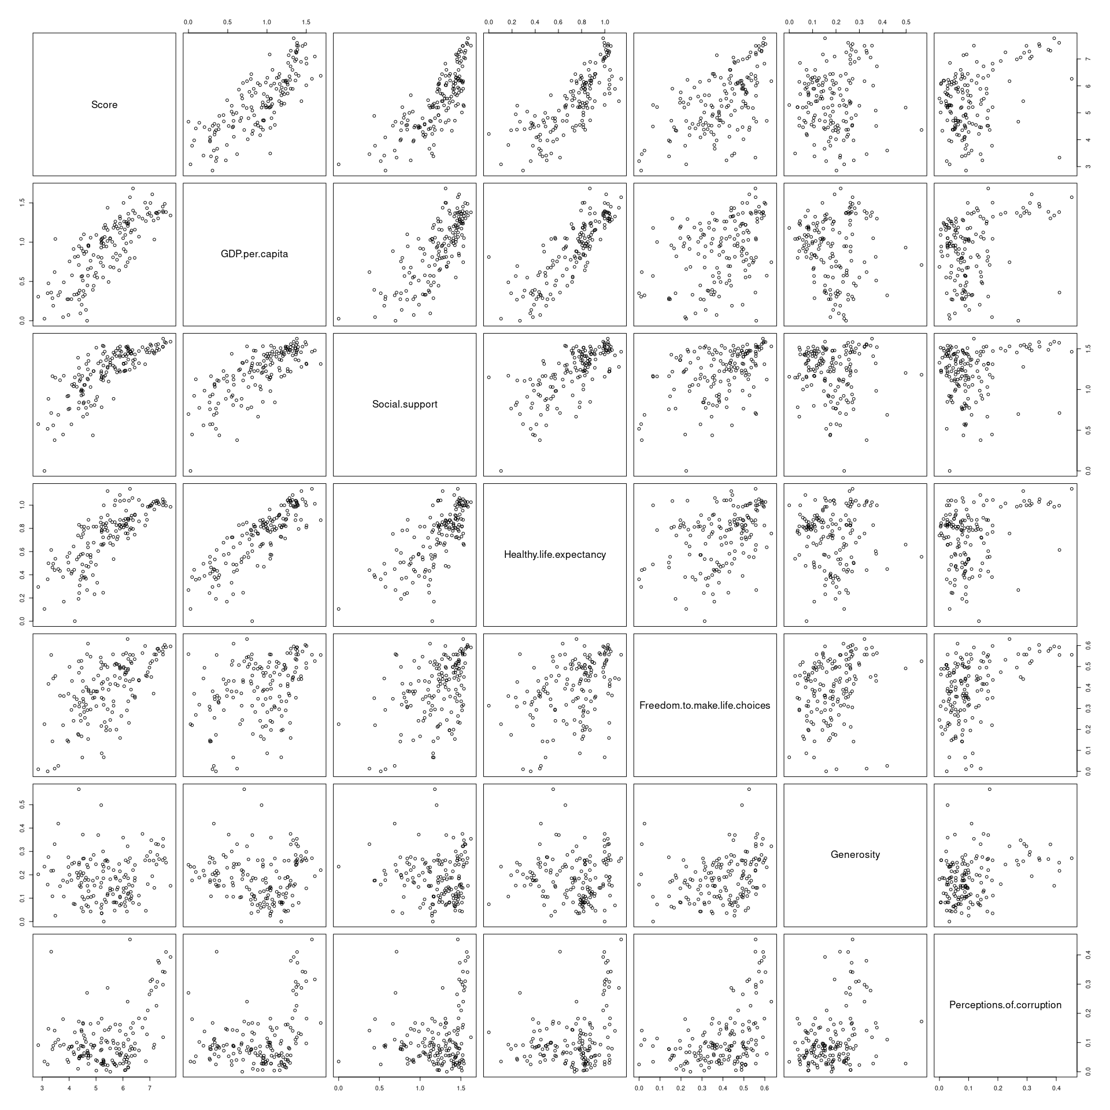

Slide 5
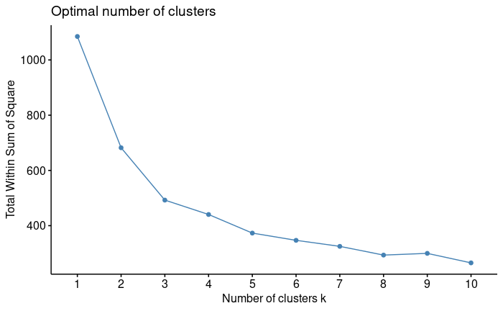
Kmeans Clustering
Elbow point: k = 3

Slide 6
Kmeans Clustering
Elbow point: k = 3

Slide 7
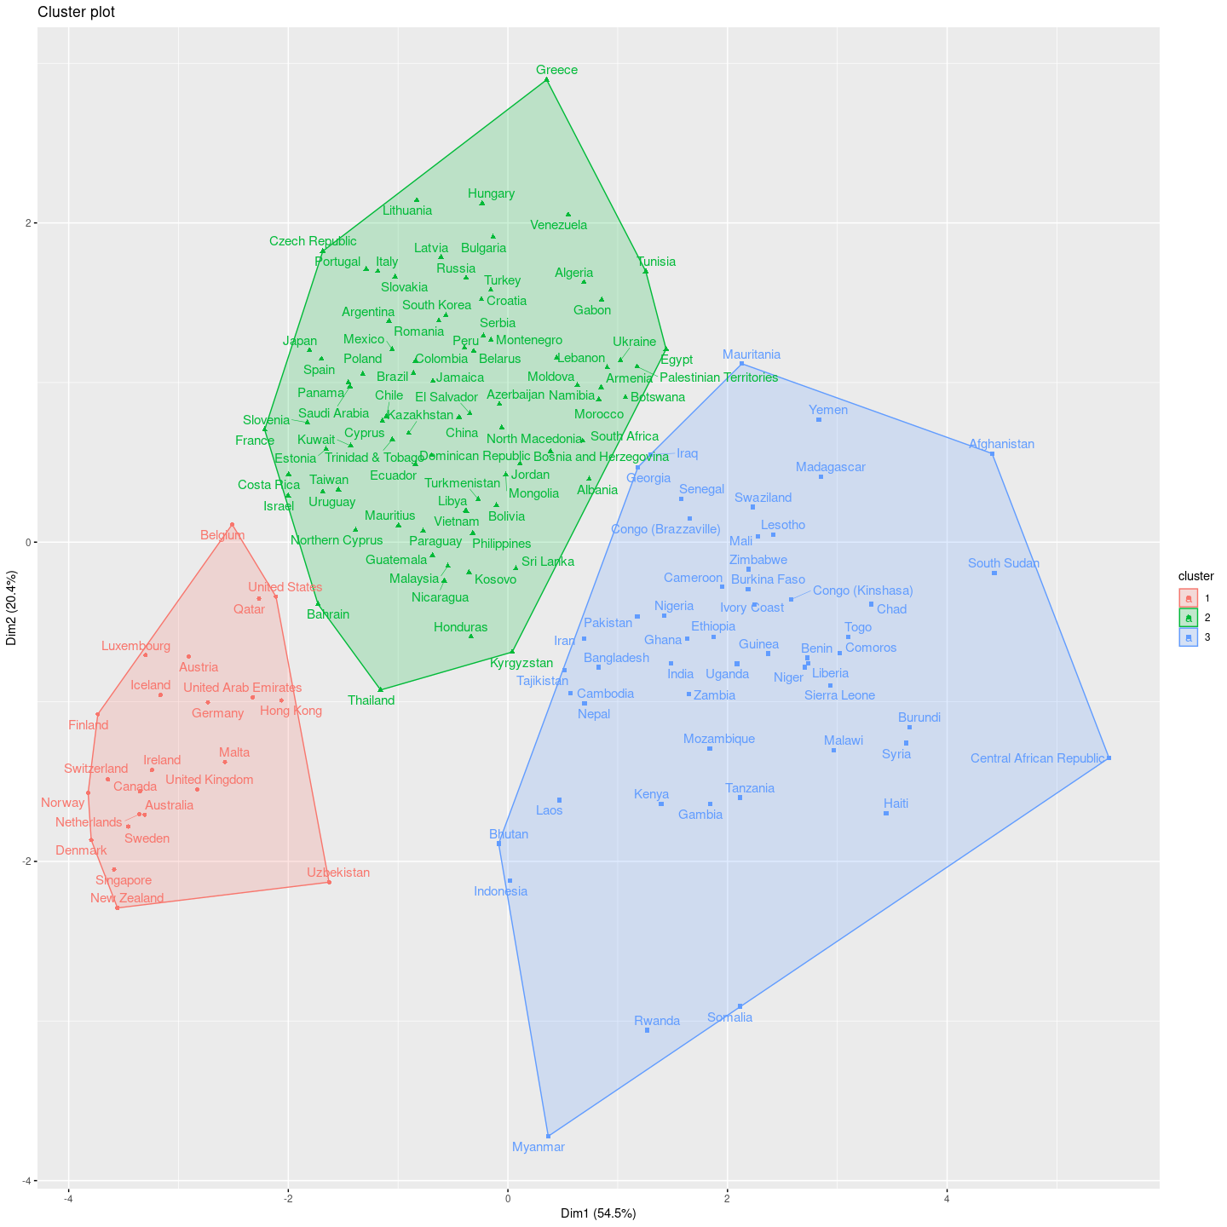
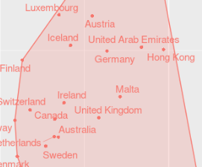
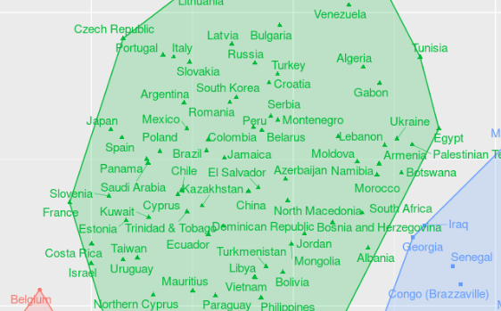
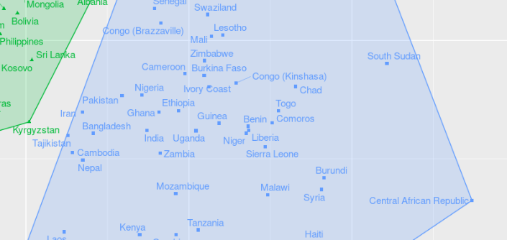
Kmeans Clustering

Slide 8
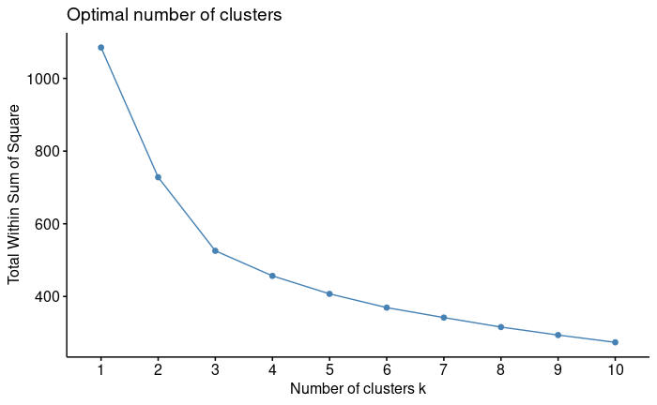
Hierarchical Clustering
Elbow point: k = 3

Slide 9
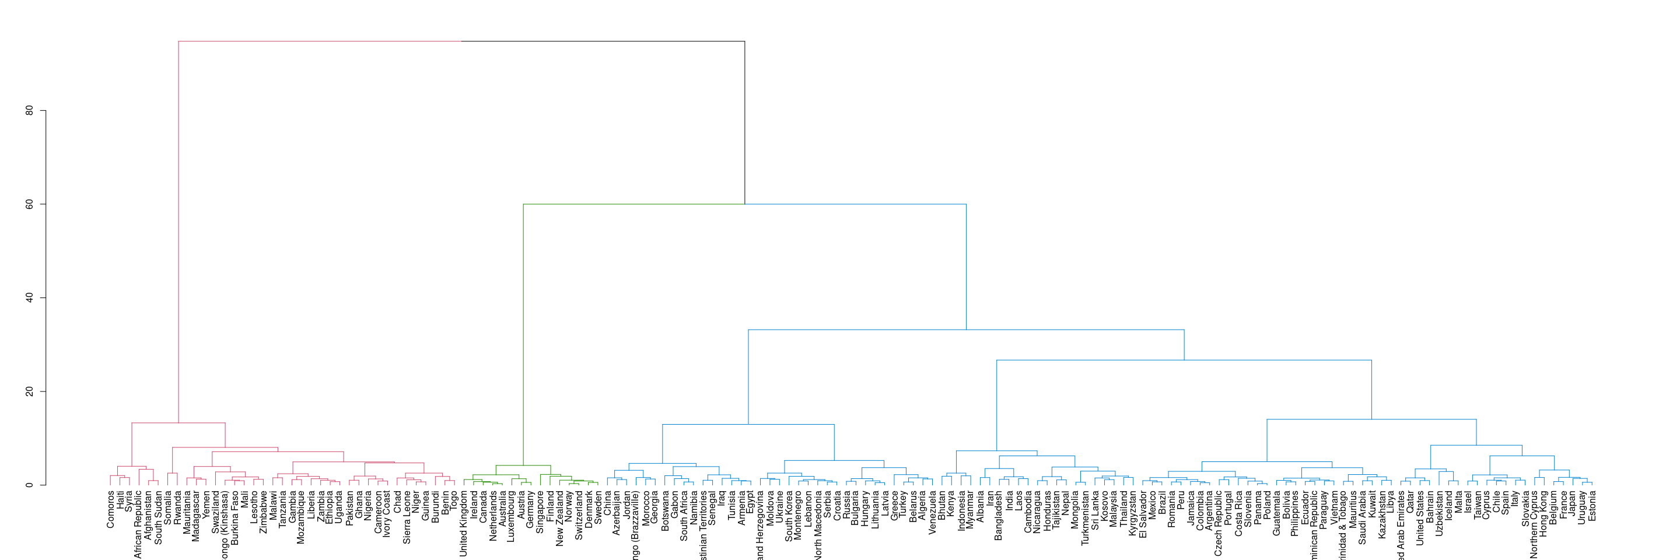
HIERARCHICAL Clustering

Slide 10
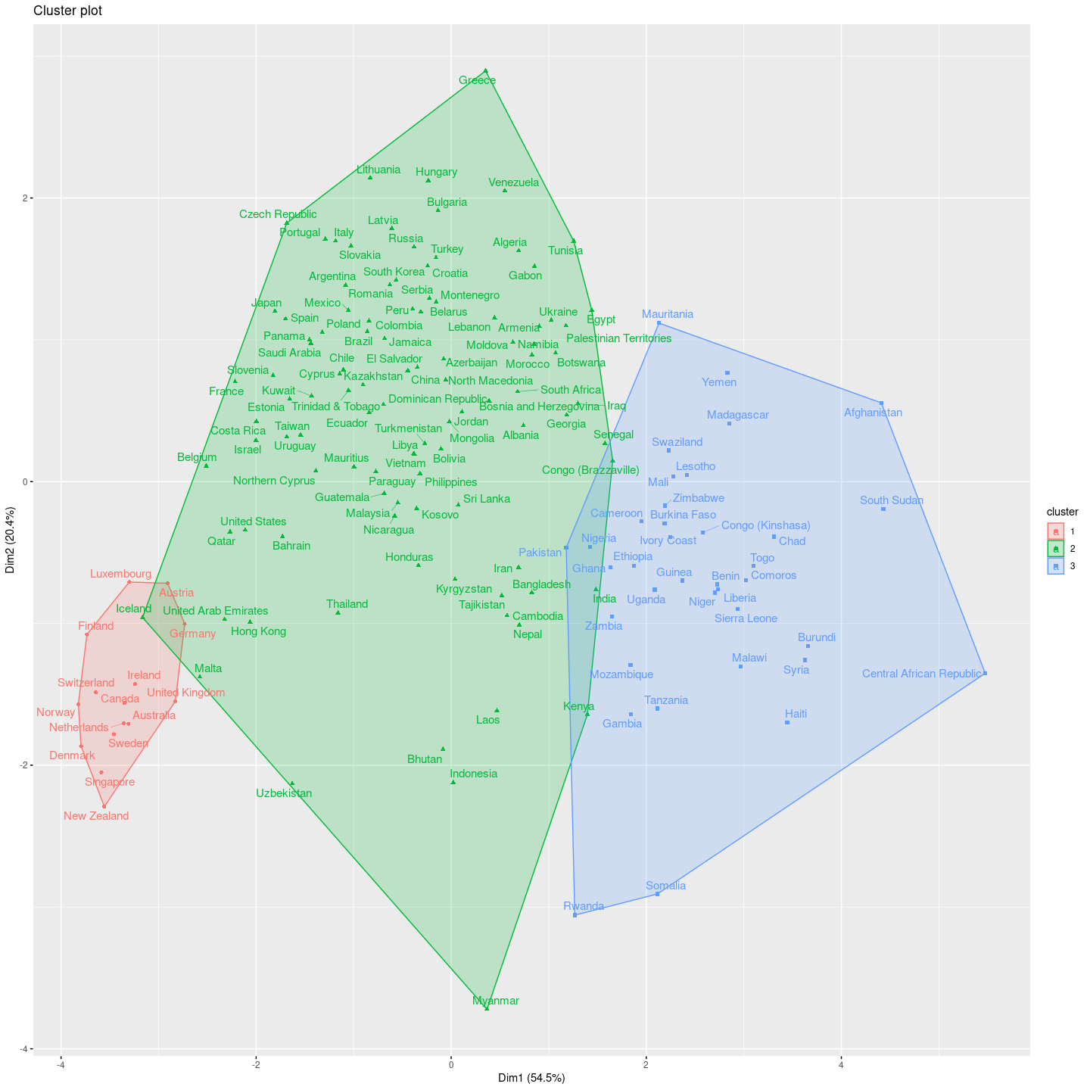
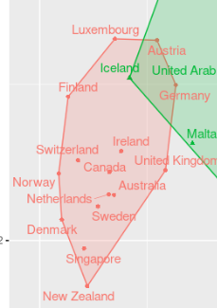
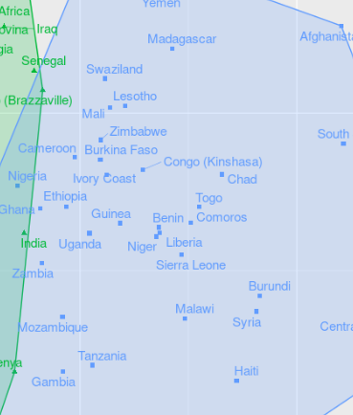
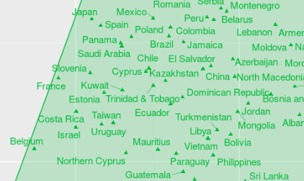
HIERARCHICAL Clustering

Slide 11
Clustering Comparison
 | Jaccard | Rand Index
Result | 0.6092326 | 0.7801489

Slide 12
Classification
Data from the PCA derived components was used (75% of the total variance explained by 2 components);
‘Continent’ was used as the target variable;
A stratified split with 60% of the data for train (95 countries) and 40% test (61 countries) was applied, a seed was used to allow results duplication;

Slide 13
Classification methods
LDA – Linear Discriminant Analysis
MLR- Multinomial Logistic Regression

Slide 14
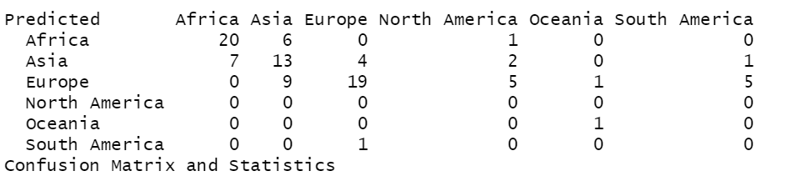
Classification - LDA
Training: It resulted in a 55.8% accuracy over the training data

Slide 15
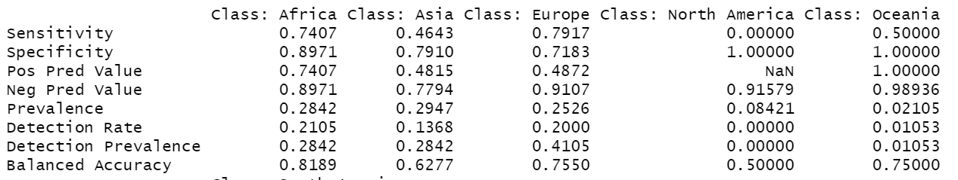
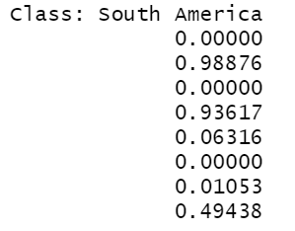
Classification – Lda
Class specific training results:

Slide 16
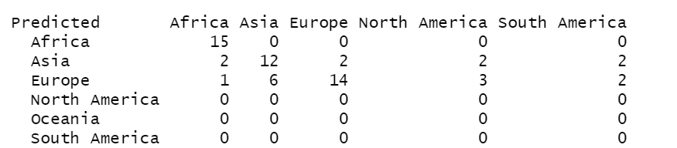
Classification - lda
Test:
The model scored 67 % in terms of test accuracy;

Slide 17
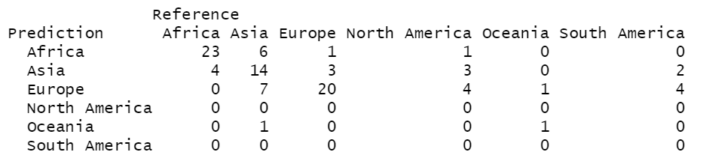
Classification - MLR
Training MLR resulted in a 61% accuracy over the training set

Slide 18
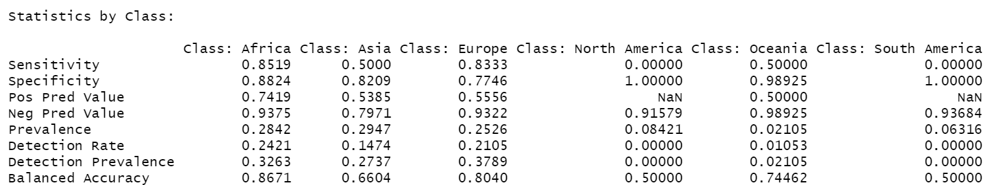
Classification - MLR
Specific class results:

Slide 19
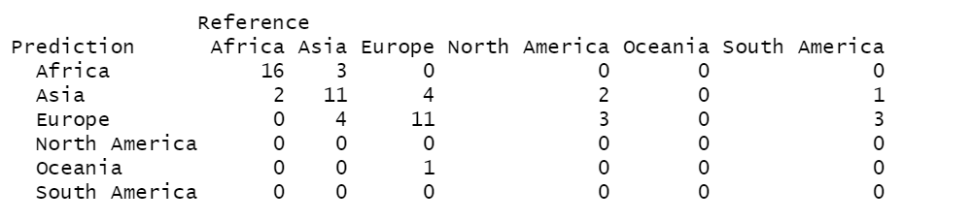
Classification - mlr
Test:
Accuracy: 62.3%

Slide 20
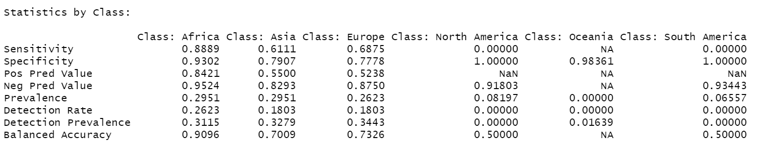
Classification - mlr
Specific class test results:

Slide 21
Model comparison
Both models had a similar performance with more than 60% accuracy for the test dataset;
Both classified relatively well countries that belong to Europe and Africa;
In the other continents the classification was worse, this can be explained by the fact that some of the continents like Oceania, South America and North America have a smaller representation in the dataset;
Parameter tuning could improve the obtained results;

