Slide 1
EAD Project II: World Happiness index analysis
Miguel Tavares up200902937
Hélder Vieira up201503395
MDS

Slide 2
Dataset description

Slide 3
Dataset description

Slide 4
Clustering

Slide 7
Classification
Data from the PCA derived components was used (75% of the total variance explained by 2 components);
‘Continent’ was used as the target variable;
A stratified split with 60% of the data for train (95 countries) and 40% test (61 countries) was applied, a seed was used to allow results duplication;

Slide 8
Classification methods
LDA – Linear Discriminant Analysis
MLR- Multinomial Logistic Regression

Slide 9
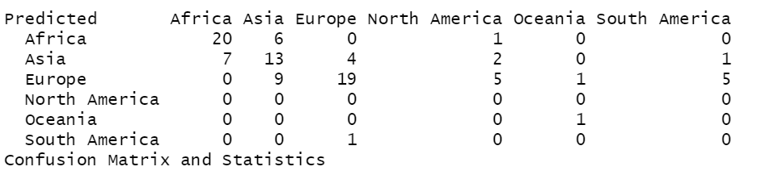
Classification - LDA
Training: It resulted in a 55.8% accuracy over the training data

Slide 10
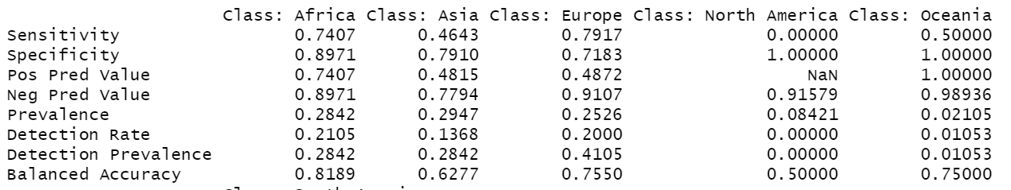
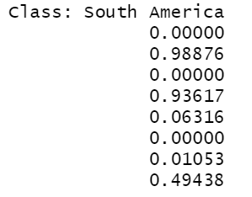
Classification – Lda
Class specific training results:

Slide 11
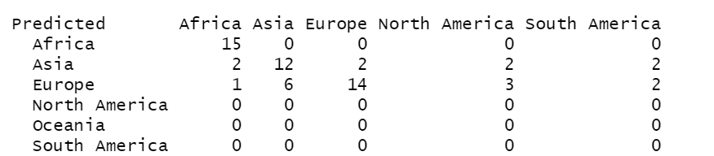
Classification - lda
Test:
The model scored 67 % in terms of test accuracy;

Slide 12
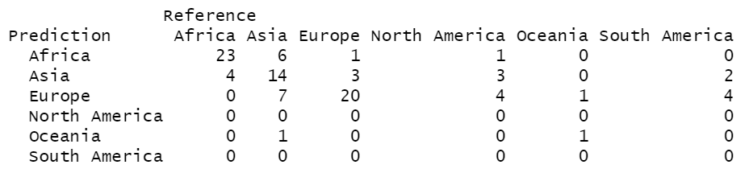
Classification - MLR
Training MLR resulted in a 61% accuracy over the training set

Slide 13
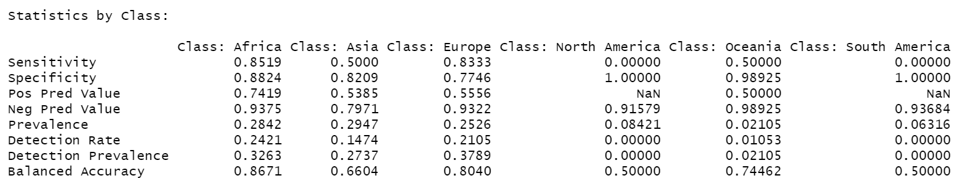
Classification - MLR
Specific class results:

Slide 14
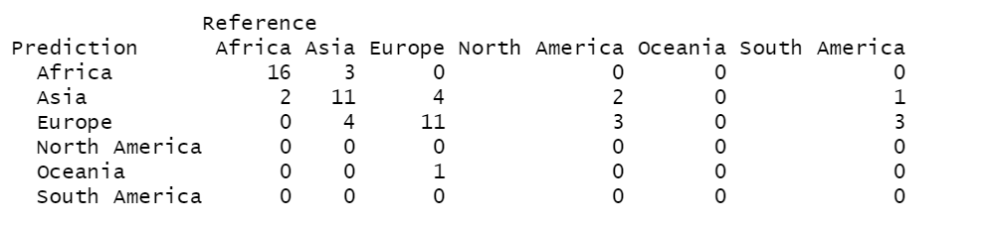
Classification - mlr
Test:
Accuracy: 62.3%

Slide 15
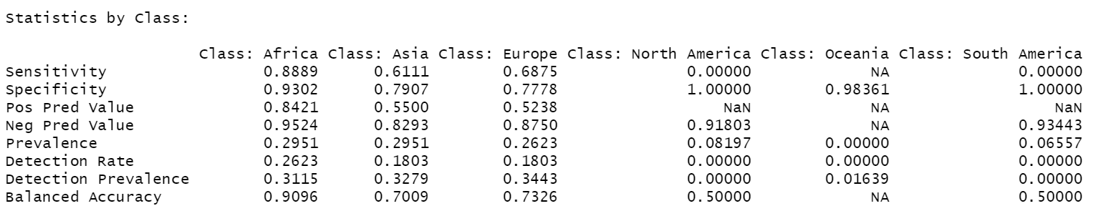
Classification - mlr
Specific class test results:

Slide 16
Model comparison
Both models had a similar performance with more than 60% accuracy for the test dataset;
Both classified relatively well countries that belong to Europe and Africa;
In the other continents the classification was worse, this can be explained by the fact that some of the continents like Oceania, South America and North America have a smaller representation in the dataset;
Parameter tuning could improve the obtained results;

