Slide 1
Python vs Ruby
Array Shuffle Problem CSE 451: Concepts of Programming Languages

Slide 2
The Problem
• Given a string s and an integer array indices of the same length
• Shuffle string so character at position i moves to indices[i]
•
• Example:
• Input: s = "art", indices = [1, 0, 2]
• Output: "rat"
•
• 'a' at index 0 → goes to index 1
• 'r' at index 1 → goes to index 0
• 't' at index 2 → stays at index 2

Slide 3
Python - Introduction
• Created by Guido van Rossum in 1991
• Multi-paradigm: Imperative, Object-Oriented, Functional
• Interpreted language (CPython implementation)
• Dynamic typing - variables allocated at runtime
• Known for clean, readable syntax
• Huge ecosystem with pip package manager
• Used in web dev, data science, AI, automation

Slide 4
Python - Technical Details
• Data Types:
• • Simple: int, float, bool, str, NoneType
• • Structured: list, tuple, dict, set, class objects
•
• Statement Types:
• • for x in iterable, for i in range(n)
• • while condition, if/elif/else
• • try/except/finally, with statement
•
• Subprograms:
• • Functions (def), Lambda expressions
• • Methods in classes, Exception handlers
• • Threading module for concurrency

Slide 5
Python - Strengths & Weaknesses
• Strengths:
• ✓ Easy to learn and read
• ✓ Huge library ecosystem (NumPy, Django, etc.)
• ✓ Great documentation and community
• ✓ Cross-platform compatibility
•
• Weaknesses:
• ✗ Slower than compiled languages
• ✗ GIL limits true multi-threading
• ✗ Mobile development not ideal
• ✗ Runtime errors instead of compile-time

Slide 6
Ruby - Introduction
• Created by Yukihiro Matsumoto in 1995
• Object-Oriented (everything is an object!)
• Interpreted language (MRI/YARV implementation)
• Dynamic typing - flexible variable allocation
• Philosophy: "Developer happiness"
• Famous for Ruby on Rails framework
• Flexible syntax - multiple ways to do things

Slide 7
Ruby - Technical Details
• Data Types:
• • Simple: Integer, Float, TrueClass, FalseClass, String, Symbol
• • Structured: Array, Hash, Range, Class objects
•
• Statement Types:
• • each, times, upto/downto loops
• • while/until, if/elsif/else/unless
• • begin/rescue/ensure for exceptions
•
• Subprograms:
• • Methods (def), Blocks { } and do/end
• • Procs and Lambdas
• • Threads for concurrency

Slide 8
Ruby - Strengths & Weaknesses
• Strengths:
• ✓ Elegant, expressive syntax
• ✓ Everything is an object - pure OOP
• ✓ Ruby on Rails for web development
• ✓ Great for DSLs (Domain Specific Languages)
•
• Weaknesses:
• ✗ Slower than Python in many cases
• ✗ Smaller community than Python
• ✗ Less popular outside web dev
• ✗ Debugging can be challenging

Slide 9
Code Comparison
Python
Ruby
def shuffle_string(s, indices): result = [''] * len(s) for i, char in enumerate(s): result[indices[i]] = char return ''.join(result) # Usage: shuffle_string("art", [1, 0, 2]) # Returns: "rat"
def shuffle_string(s, indices) result = Array.new(s.length, '') s.each_char.with_index do |char, i| result[indices[i]] = char end result.join end # Usage: shuffle_string("art", [1, 0, 2]) # Returns: "rat"

Slide 10
Language Comparison
Feature
Python
Ruby
Language Type
Multi-paradigm
Object-Oriented
Implementation
Interpreted (CPython)
Interpreted (MRI)
Variable Allocation
Dynamic
Dynamic
Array Creation
[''] * len(s)
Array.new(s.length, '')
Iteration
enumerate(s)
s.each_char.with_index
Block Syntax
indentation
do/end or { }
Join Array
''.join(list)
array.join

Slide 11
Algorithm Step-by-Step
• Input: s = "art", indices = [1, 0, 2]
• Result array starts empty: [_, _, _]
•
• Step 1: s[0] = 'a' → result[indices[0]] = result[1] = 'a'
• Result: [_, a, _]
•
• Step 2: s[1] = 'r' → result[indices[1]] = result[0] = 'r'
• Result: [r, a, _]
•
• Step 3: s[2] = 't' → result[indices[2]] = result[2] = 't'
• Result: [r, a, t]
•
• Final: "rat"

Slide 12
Challenges Faced
• Setting up Ruby on Windows:
• • Had to install RubyInstaller with DevKit
• • PATH configuration required
•
• Learning Ruby syntax:
• • Block syntax (do/end) was new coming from Python
• • each_char.with_index vs Python's enumerate()
•
• Testing:
• • Verified both solutions produce identical output
• • Created step-by-step visualizer for debugging

Slide 13
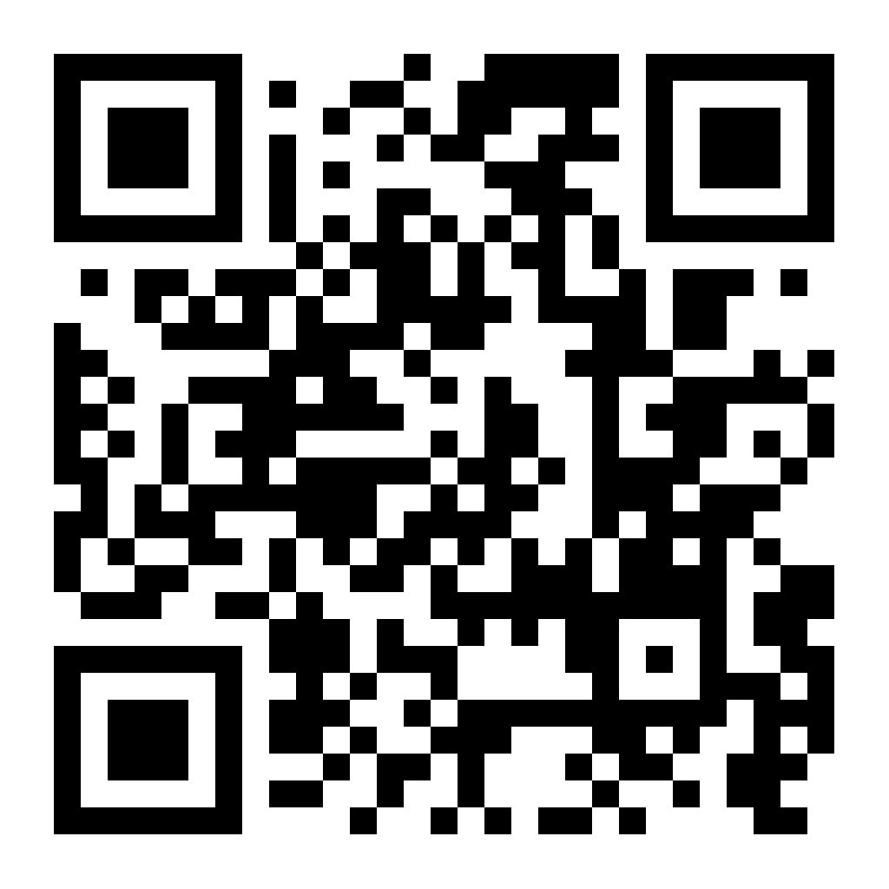
Try the Live Demo!
https://mvvhmxd.github.io/Python-vs-Ruby---Array-Shuffle-Problem/
Scan QR code or visit the link to see the interactive algorithm visualizer

Slide 14
Conclusion
• Both languages successfully solve the problem
• Same algorithm, different syntax
•
• Time Complexity: O(n)
• Space Complexity: O(n)
•
• Python: More explicit and widely used
• Ruby: More flexible and expressive
•
• Key insight: Understanding concepts matters more than syntax!

Slide 15
Thank You!
Questions?

