Slide 1


NAME: MADDULA VISHNU VARDHAN REDDY REG.NO: 11909034 COURSE CODE: INT248 COMPUTER SCIENCE AND ENGINEERING LOVELY PROFESSIONAL UNIVERSITY PUNJAB, INDIA
HEART FAILURE CLINICAL RECORDS PREDICTION

Slide 2
Introduction
According to the World Health Organization, cardiovascular diseases (CVDs) are the number one cause of death globally, taking an estimated 17.9 million lives each year, which accounts for 31% of all deaths worldwide. Of these deaths, 85% are due to heart attack and stroke. Heart failure is a common event caused by cardiovascular diseases.
The early detection of people with cardiovascular diseases or who are at high cardiovascular risk due to the presence of one or more risk factors is paramount to reducing deaths arising from heart failures. As a result, predictive models become indispensable.

Slide 3
Objective
The main objective of this project is to explore the Heart Failure Dataset, and to apply Random Forest Classifier models of machine learning on it. Create a Streamlit web app for whole architecture.

Slide 4
The Dataset
The dataset is composed by 299 patients with heart failure collected in 2015. For every patient were collected key parameters of their clinical picture which theoretically and realistically correlated with their status.
Age | Anaemia CPK |  | Diabetes | EF | HBP | P | SC | SS | Sex | Smoking Time |  | Death Event
75 | 0 | 582 | 0 | 20 | 1 | 265000 | 1.9 | 130 | 1 | 0 | 4 | 1
55 | 0 | 7861 | 0 | 38 | 0 | 263358 | 1.1 | 136 | 1 | 0 | 6 | 1
65 | 0 | 146 | 0 | 20 | 0 | 162000 | 1.3 | 129 | 1 | 1 | 7 | 1
50 | 1 | 111 | 0 | 20 | 0 | 210000 | 1.9 | 137 | 1 | 0 | 7 | 1
65 | 1 | 160 | 1 | 20 | 0 | 327000 | 2.7 | 116 | 0 | 0 | 8 | 1
90 | 1 | 47 | 0 | 40 | 1 | 204000 | 2.1 | 132 | 1 | 1 | 8 | 1

Slide 5
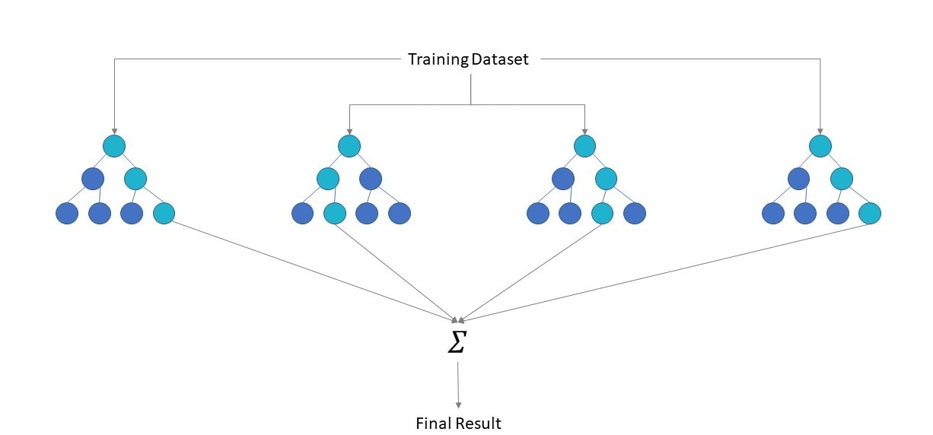
Random Forest Classification
Random Forest Classifier is an supervised machine algorithm
Random forest algorithms have three main hyperparameters, which need to be set before training. These include node size, the number of trees, and the number of features sampled. From there, the random forest classifier can be used to solve for regression or classification problems.
The random forest algorithm is made up of a collection of decision trees, and each tree in the ensemble is comprised of a data sample drawn from a training set with replacement, called the bootstrap sample.

Slide 6
Technologies: Visual Studios
Programming Language: Python
Library: Streamlit(web)
Pandas
Altair
PIL
Sklearn
Project GitHub link:
https://github.com/mvvr/-HEART-FAILURE-CLINICAL-RECORDS-PREDICTION-

Slide 7
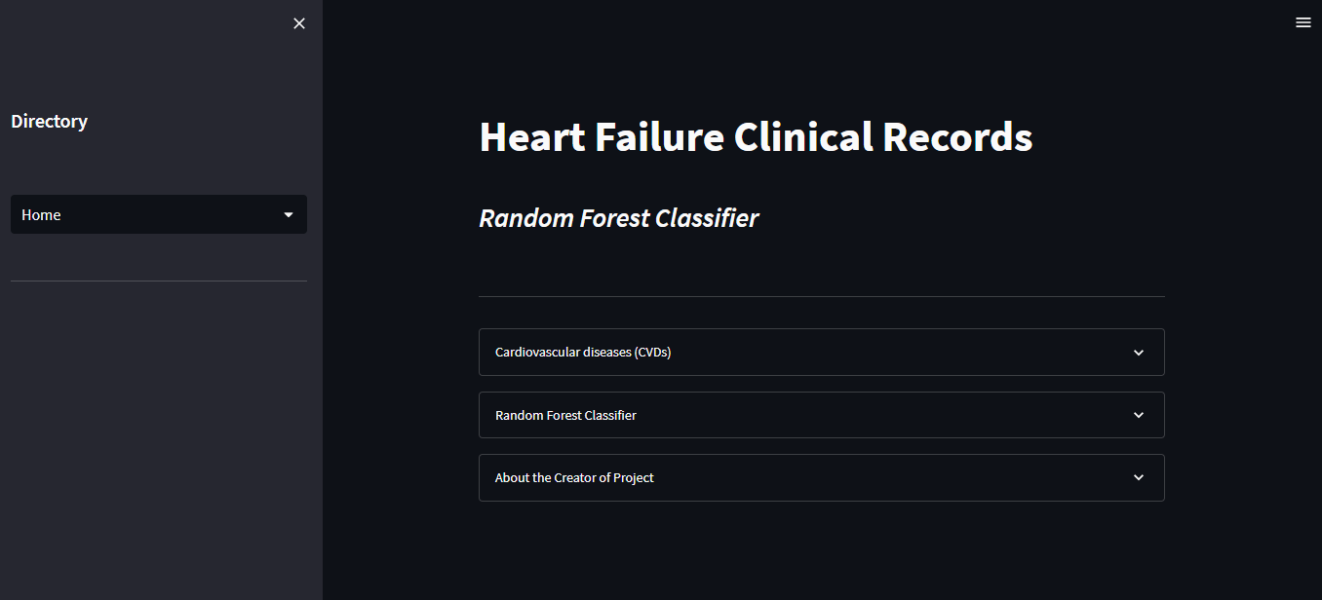
Streamlit run app.py
Home

Slide 8
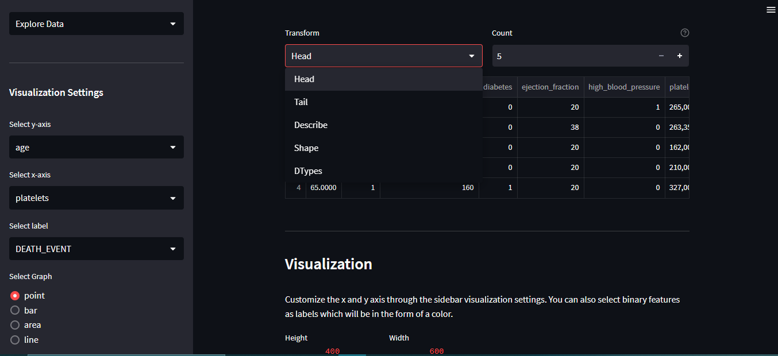
Exploring DataSet

Slide 9
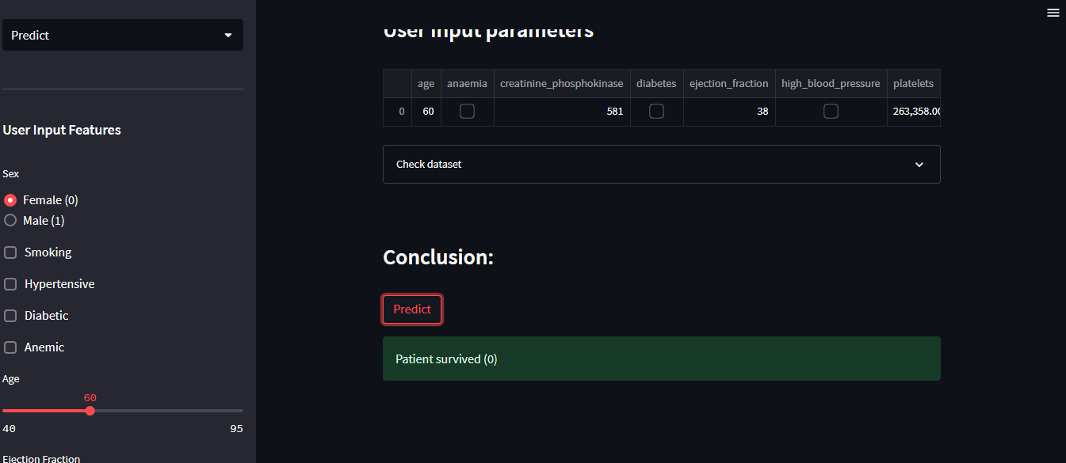
Prediction

Slide 10
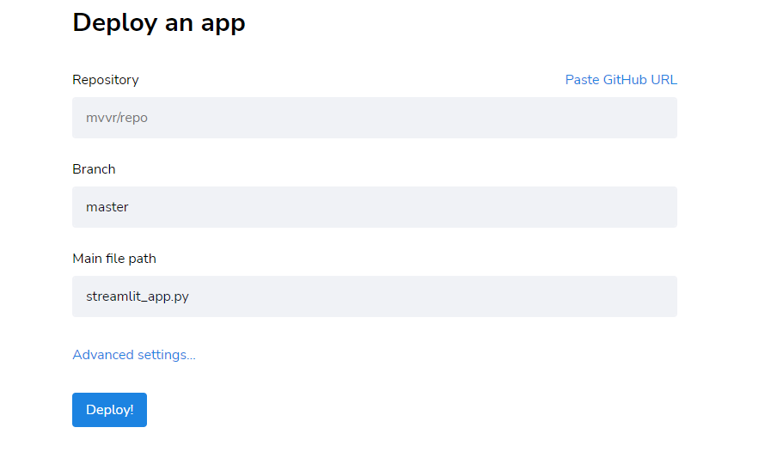
Future Scope
Deploy the app in https://share.streamlit.io/deploy

