Slide 1
Logging
Rsyslog
tcp
(sudo|do su)
logrotate
SSL
k1599_rsyslog_client
Nord
k1599_rsyslog_server
Sued

Slide 2
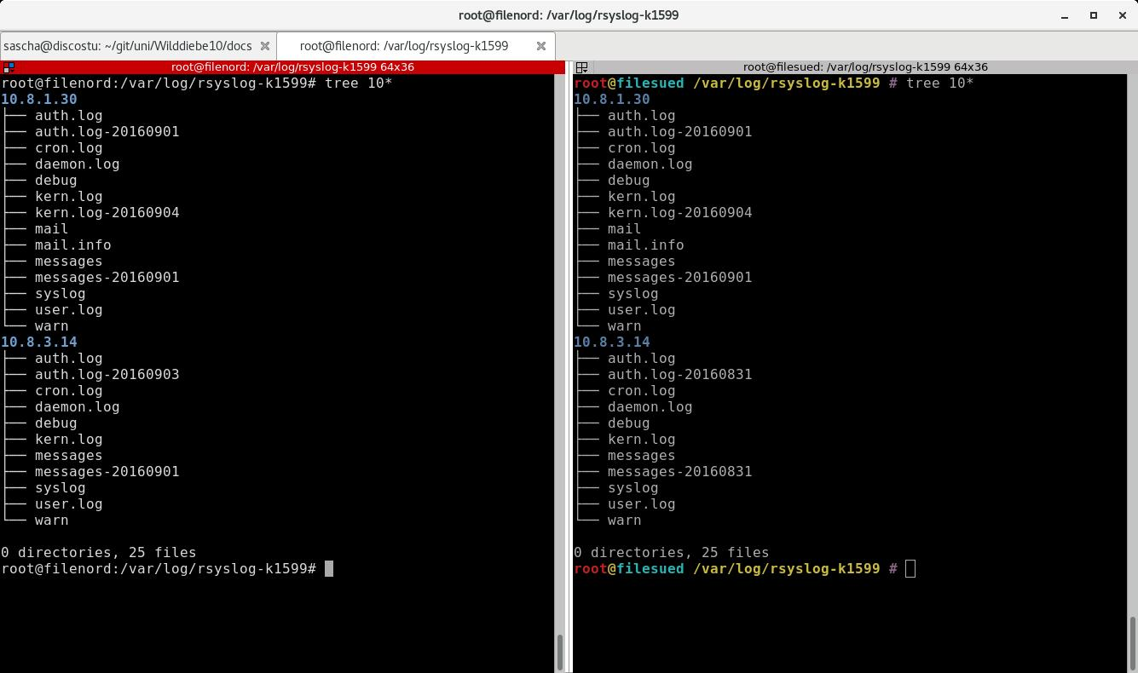
Rsyslog

Slide 3
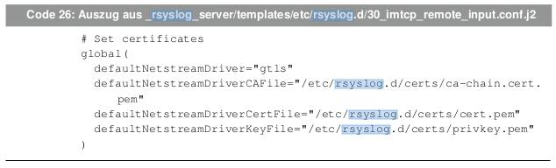
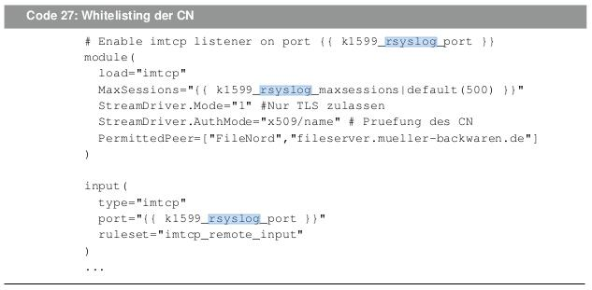
Rsyslog - Server

Slide 4
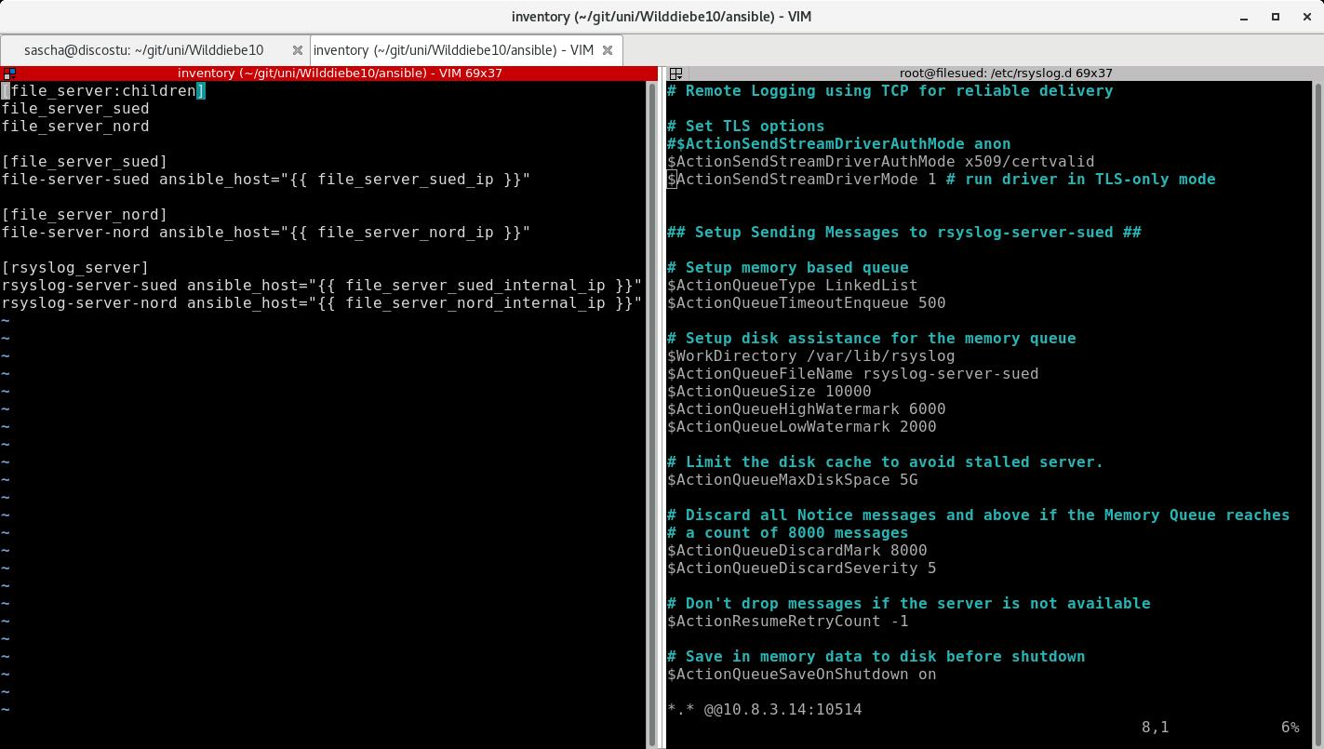
Rsyslog - Client

