Slide 1
AGRICULTURAL PLANNING & FOOD DEMAND
Yue Cui, Tao Hu, Susanne Pyda, Alina Sienkiewicz, Longyu Wang, Tingbing Yao
GROUP DECISIVE

Slide 2

1 | BACKGROUND

Slide 3

Food Insecurity in Developing Nations
Food security – historically referred to access to food supplies to meet caloric requirements and avoid famine
Agricultural policies therefore focus on staple grain self-sufficiency in order to meet nutritional demand
Staple grain-self-sufficiency was a major part of resolving food insecurity problems after the 2008 food price crisis.

Slide 4
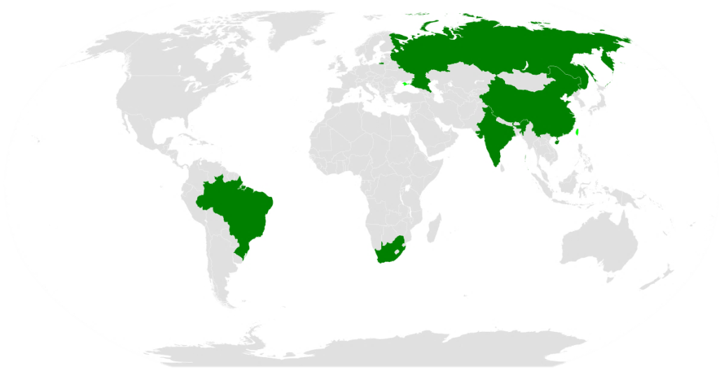
Problem Background
Focus on BRICS: Brazil, Russia, India, and China, South Africa
Rapidly evolving economies and middle class - significant diet transitions
Main crop categories discussed in this case include: meat, cereal and vegetables

Slide 5
Problem Motivation
Governments aim to balance and optimize the supply and demand equilibrium – there is incentive to forecast and respond
Inefficiencies in this system can result not only in direct financial losses but in health issues for the population

Slide 6
Problem Background
Problem
Hypothesis
Current agricultural policies in BRICS countries favor the production of staple grains and do not address malnutrition or growing diet diversification
There is a significant discrepancy between agricultural production and dynamic consumer demand, caused by agricultural policy in BRICS countries
Our model will be applied to China as a sample solution

Slide 7
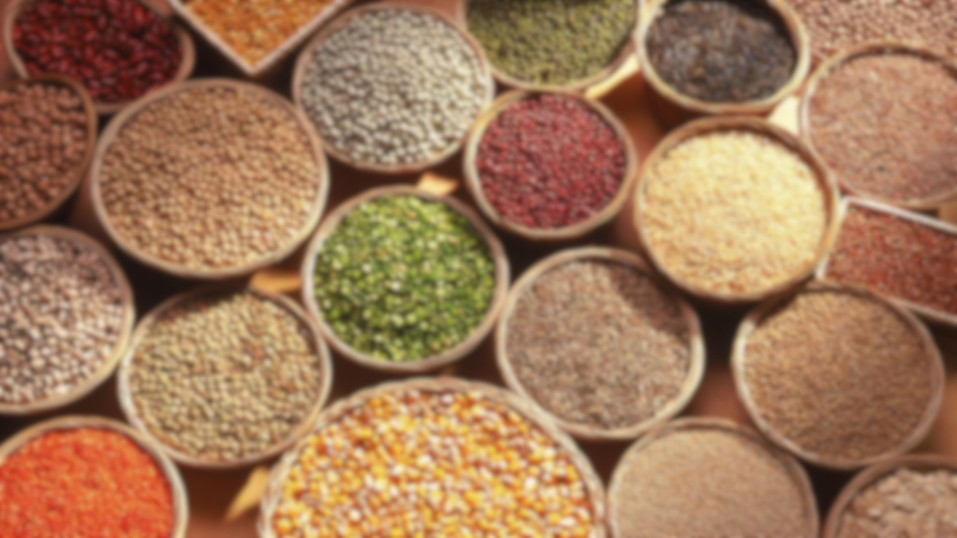
2 | METHODOLOGY

Slide 8
Methodology
1. | Sample Selection
2. | Regression Analysis
3. | Two-Stage Stochastic Modelling and Resource Optimization
4. | Result Integration

Slide 9
1. Sample Selection and Comparison
Used data from 5 developing and 5 developed countries to identify differences in trends
Found that the gap between supply and demand for all food groups analyzed is greater in developing countries

Slide 10
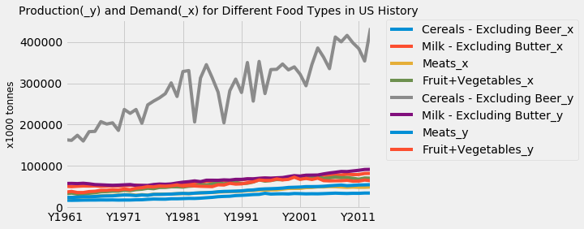
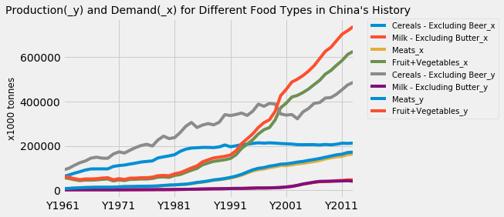
USA
China

Slide 11
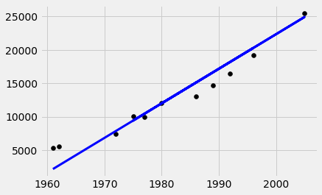
2. Regression Analysis
Feature space transformation used to fit data to a linear model to predict food demand
Linear model used creates low, middle and high demand scenarios for future demand of cereals in China
*For details on the methodology, please refer to section 3.1 and 3.2 in the supporting document

Slide 12
3. Stochastic Modelling and Resource Optimization
Using demand predicted in data analysis section - a stochastic model can be used to obtain recommended supply – accounting for uncertainty in predicted demand
Supply quantity is the unknown and the cost of supply as the resource in classic stochastic modeling
Decision(variables) is designed to be the actual supply quantity of each type of agricultural product and then a second-stage set of resources decisions is designed to be the predicted demand based on linear regression

Slide 13
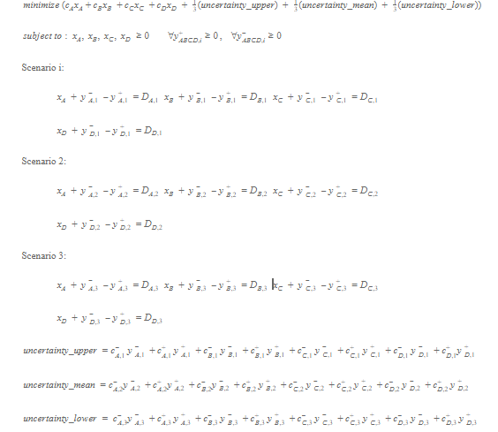
Stochastic Programming Model
*For details on the methodology, please refer to section 3.3 and 3.4 in the supporting document

Slide 14
3. Stochastic Modelling and Resource Optimization
Stochastic solution - hedges against uncertainty by considering all possibilities of demand
Generates a balanced production and purchasing strategy across agricultural types

Slide 15
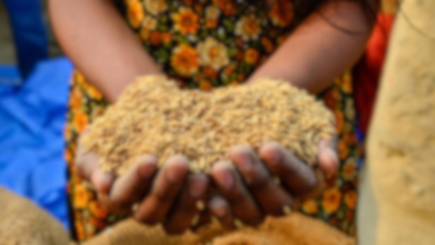
3 | RESULTS

Slide 16
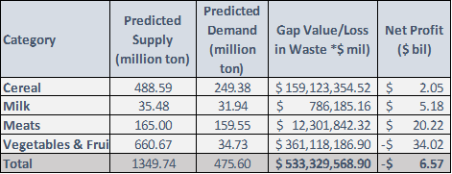
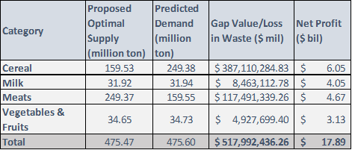
Results
Supply and Demand Predictions for China without Optimization
Supply and Demand Predictions for China with Optimization
Net profit = sales revenue – production cost
Value in food loss/Gap Value = production cost spent on overproduction + unearned net profit for underproduction

Slide 17
Results
China
Increase in Net profit | Value in food loss
Net profit increases to $17.89 billion from $-6.57 billion ($24.46 billion) | Reduction of 2.78% in food waste

Slide 18
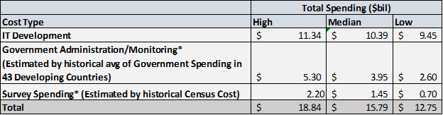
Results – Business Analysis
Large-scale technical business project which has many associated costs:
IT development
Government administration
Survey cost
Predicted costs:
Model development
User interface development
End testing
Expected cost of
$12.75-18.84 billion

Slide 19
Results
ROI and Payback Period Summary
* Please note the indicator of “high/median/low” refers to the three cost scenarios based on estimation. Therefore, the “High” cost scenario can lead to a lowest ROI of 29.85 and a highest payback period of 3.35 years.

Slide 20
Conclusion
The stochastic model developed can be used to profitably reduce inefficiencies in agricultural production and improve nutrition for members of developing countries
By implementing this model governments can improve agricultural planning/policy making with better predictions for food demand and decrease the response time to changes in dietary trends
Improvements and Future Work
Improve the accuracy of demand predictions by surveying household nutrition preference and needs
Expand stochastic model to include multiple periods
Consider more frictional factors such as inflation, consumer price index, and import and export data

Slide 21

Thank you!

Slide 22
Reference
[1] Pingali, P. Food Sec. (2015) 7: 583. https://doi.org/10.1007/s12571-015-0461-x
[2] China Statistical Database : http://www.stats.gov.cn/tjsj/pcsj/

