Slide 1
Randomly Weighted
Random Forest

Slide 2
The Problem
When humans hire people, there is a natural variance in the individuals that get hired. This is due to people’s varied opinions and preferences.
Models that are used to predict who will be hired based off a set of attributes lack this variance, leading to a lack of diversity in the people that are hired.
This is called systematicity and causes an arbitrary exclusion of applicants.
The goal of this project is to create a model that overcomes systematicity.

Slide 3
The Algorithmic Leviathan Solutions
Randomly selecting a model from a set of models at prediction time
Introducing randomness to scores at prediction time

Slide 4
Problems with the Algorithmic Leviathan Solutions
Randomly Selecting a model from a set of models at Prediction time:
You won’t be able to train enough models to have truly different results across a large number of applicants
Introducing randomness to scores at prediction time:
The decision are made randomly and are particularly different from traditional hiring processes
Overall, these solutions are far from how humans traditionally hire people.

Slide 5
General Human Hiring Processes
Group of people make up a hiring committee
Each person on this committee will likely have a different set of attributes they care about
These attributes could overlap with other members on the committee
The hiring outcome is determined by each committee member’s ‘vote’ or decision

Slide 6
Randomly Weighted Random Forest Ensemble
This model emulates the real work hiring process
Random state variable - adds variance among trees representing difference in opinions
While also combining the two proposed solutions
Different trees - set of models
Weights added to decisions - random variance added at prediction time

Slide 7
How does it work?
Create a set of trees
Each tree is trained with a different random_state() value
Each tree’s prediction is counted as a vote
A randomly generated weight is added to each vote
A list of prediction for each applicant is returned from the predict function

Slide 8
Model Evaluation
The predict function is ran five times to simulate five different hiring processes (this could also be interpreted as people on a hiring committee.)
Then ten columns (applicants) are randomly drawn
 | A1 | A2 | A3 | A4 | A5 | A6 | A7 | A8 | A9 | A10
Decision 1 | Hired | Hired | Hired | Pre-Inter | Interview | Pre-Inter | Pre-Inter | Hired | Pre-Inter | Interview
Decision 2 | Hired | Hired | Pre-Inter | Pre-Inter | Interview | Pre-Inter | Pre-Inter | Hired | Hired | Interview
Decision 3 | Hired | Hired | Pre-Inter | Pre-Inter | Interview | Pre-Inter | Pre-Inter | Hired | Pre-Inter | Interview
Decision 4 | Hired | Hired | Pre-Inter | Pre-Inter | Interview | Pre-Inter | Pre-Inter | Hired | Hired | Interview
Decision 5 | Interview | Hired | Interview | Pre-Inter | Interview | Pre-Inter | Pre-Inter | Hired | Pre-Inter | Interview

Slide 9
Initial Metrics
Borderline Applicant: Applicants that are hired by at least one hiring process
Strong Applicant: Applicants that are hired by all hiring processes
 | A1 | A2 | A3 | A4 | A5 | A6 | A7 | A8 | A9 | A10
Borderline Applicant | Yes | No | Yes | No | No | No | No | No | Yes | No
Strong Applicant | No | Yes | No | No | No | No | No | Yes | No | No

Slide 10
A More Sophisticated Metric
The previous metric was too generous when determining borderline candidates
Borderline Applicants are now defined as applicants that are hired by at least 50% of the hiring processes
 | A1 | A2 | A3 | A4 | A5 | A6 | A7 | A8 | A9 | A10
% of Hired Decisions | 80% | 100% | 20% | 0% | 0% | 0% | 0% | 100% | 40% | 0%
Borderline Applicant | Yes | No | No | No | No | No | No | No | No | No
Strong Applicant | No | Yes | No | No | No | No | No | Yes | No | No

Slide 11
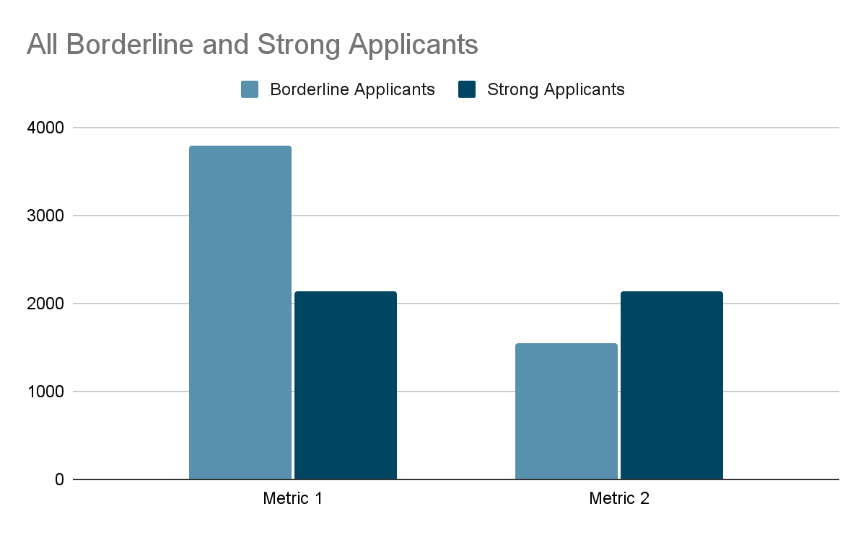
Metric Evaluation Expanded
Here are the results when the metrics are applied to all predictions
Nearly half of metric 1 borderline applicants are not counted in metric 2

Slide 12
Conclusion and Limitations
Conclusion:
Random forest ensemble models are good start to overcoming systematicity because they parallel real-world hiring processes. Ensuring variance in random forests is easy and can be done in several ways. Most significantly, the model predictions are interpreted based on human-given definitions. So clearly and adequately define strong and borderline applicants is imperative to the success of this model.
Model Limitations:
Prediction accuracy
Limited number of estimators for each tree due to convergence

Slide 13
Future Work
Further experiment with model parameters to improve accuracy
Fix misclassification (e.g., one tree classifies “hired” and the rest classify “pre-interview”)
Fix model overfitting problem
Implement cross validation
Investigate the results and how the decisions are made

Slide 14
Thank you!

