Slide 1
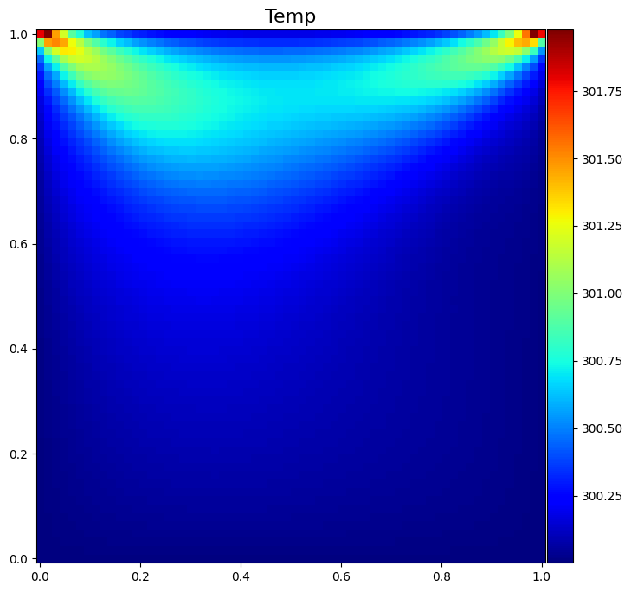
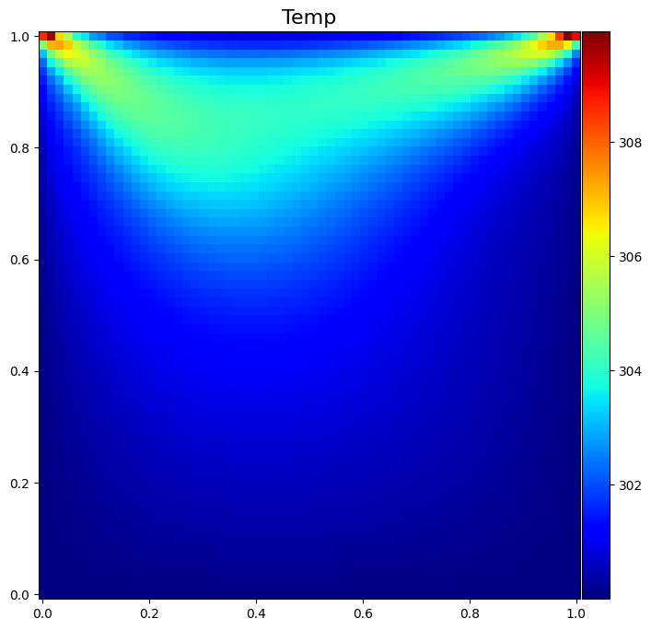
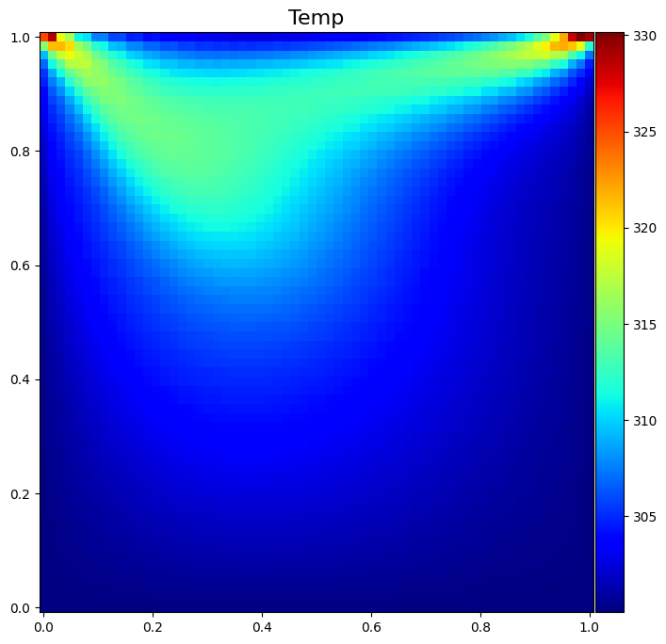
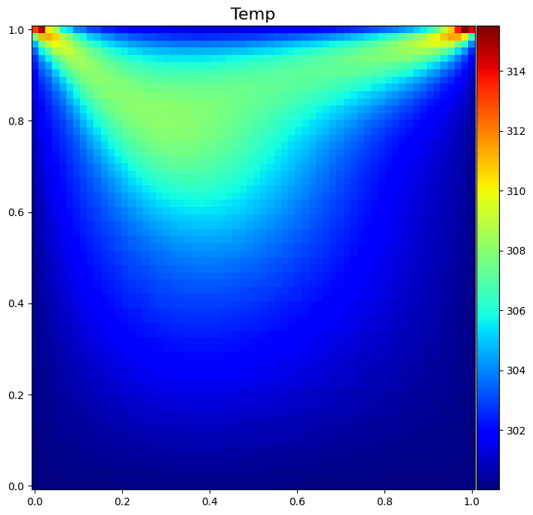
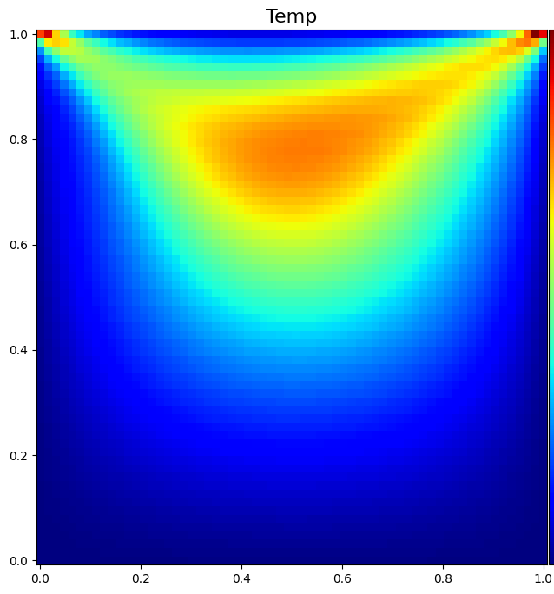
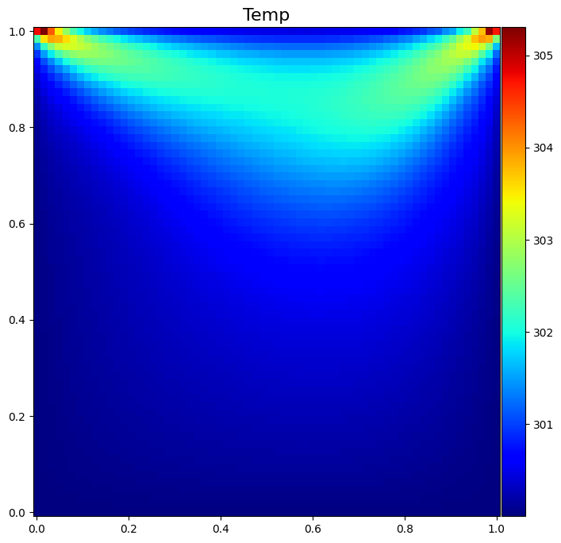
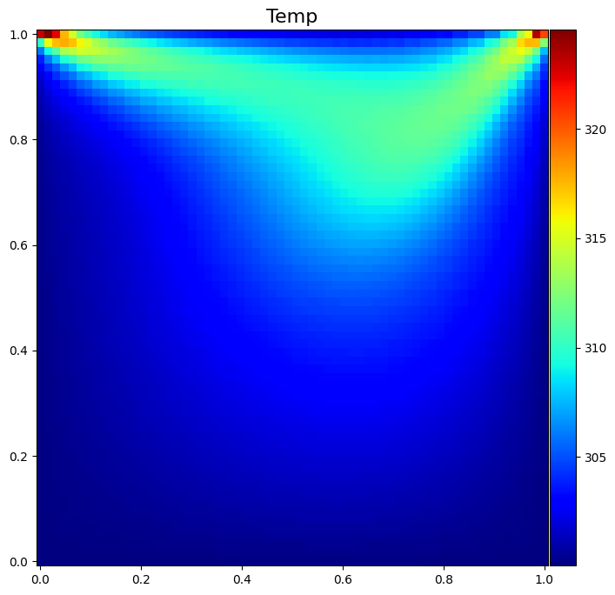
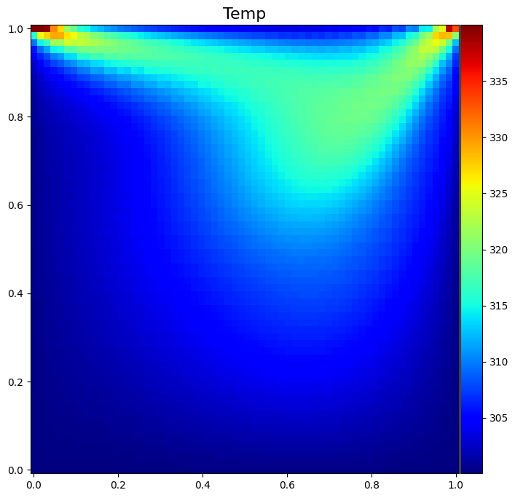
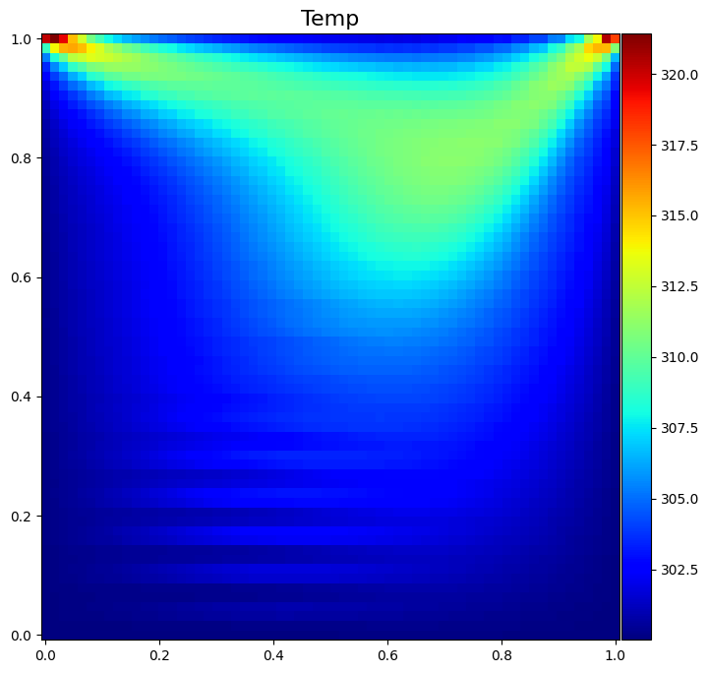
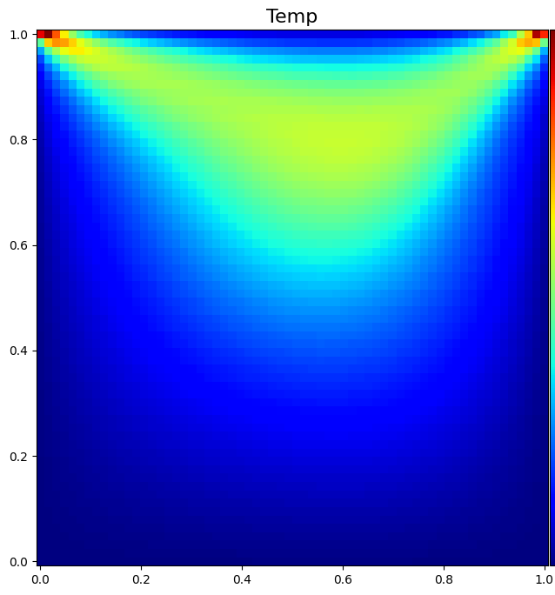




















$$ωt=1.1$$
$$ωt=1.2$$
$$ωt=1.3$$
$$ωt=1.4$$
$$ωt=1.5$$
$$u_{wall}$$
$$u_{wall}$$
$$u_{wall}$$
$$u_{wall}$$
$$u_{wall}$$
$$ωt=1.6$$
$$ωt=1.7$$
$$ωt=1.8$$
$$ωt=1.9$$
$$ωt=2.0$$
$$u_{wall}$$
$$u_{wall}$$
$$u_{wall}$$
$$u_{wall}$$
$$u_{wall}$$

Slide 2
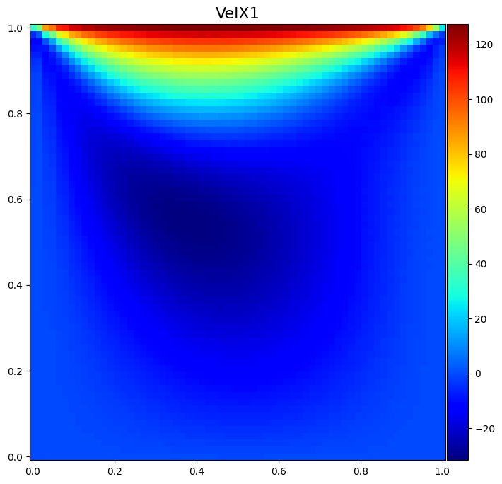
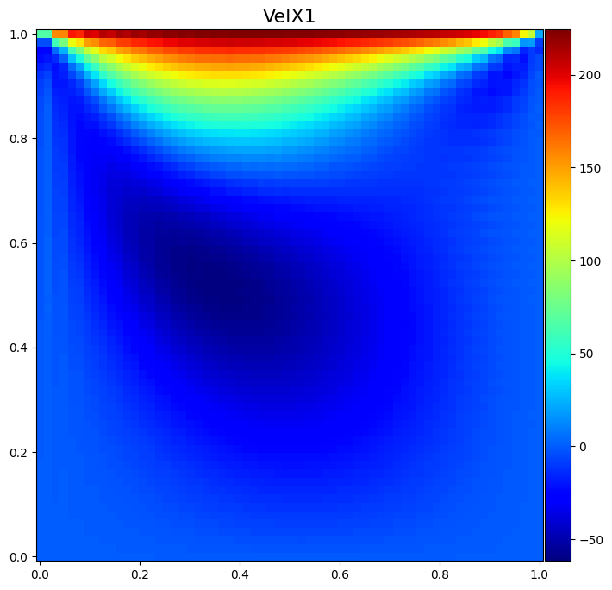
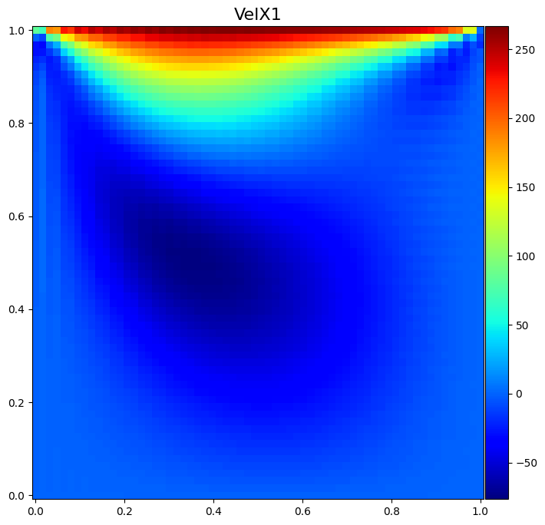


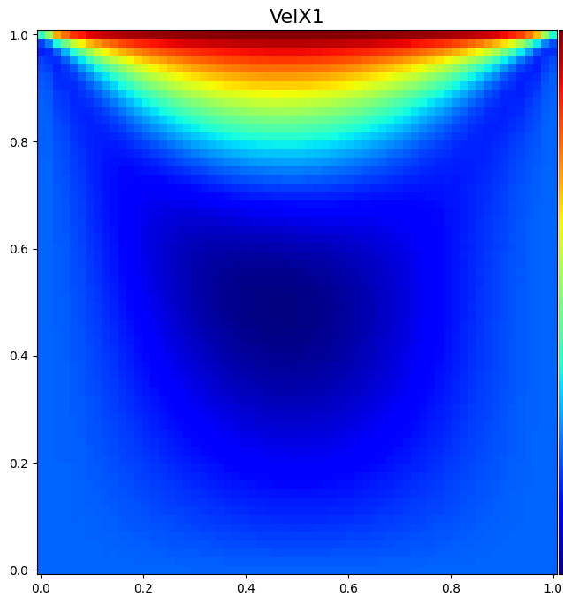
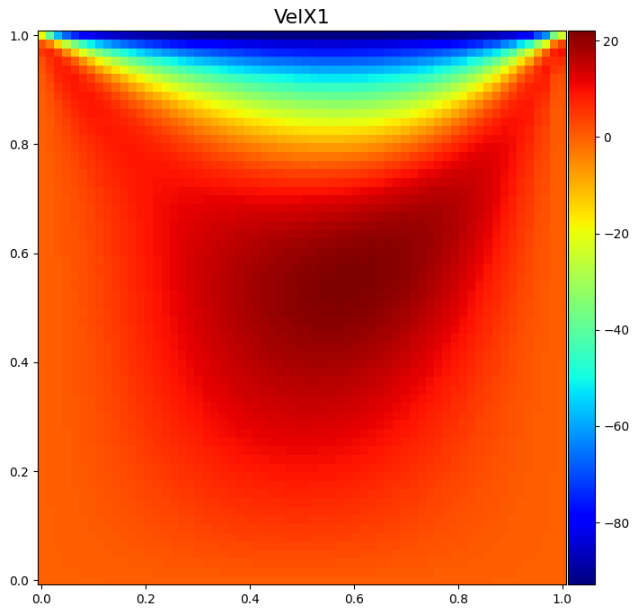
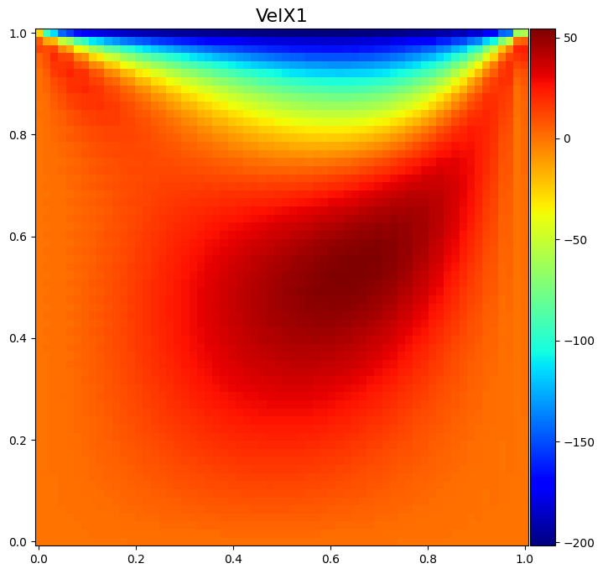
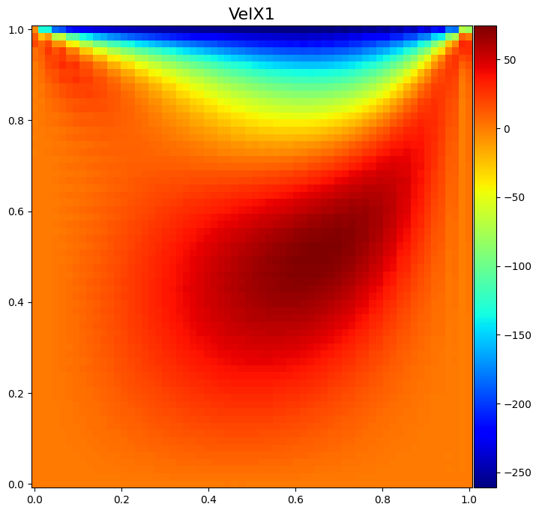

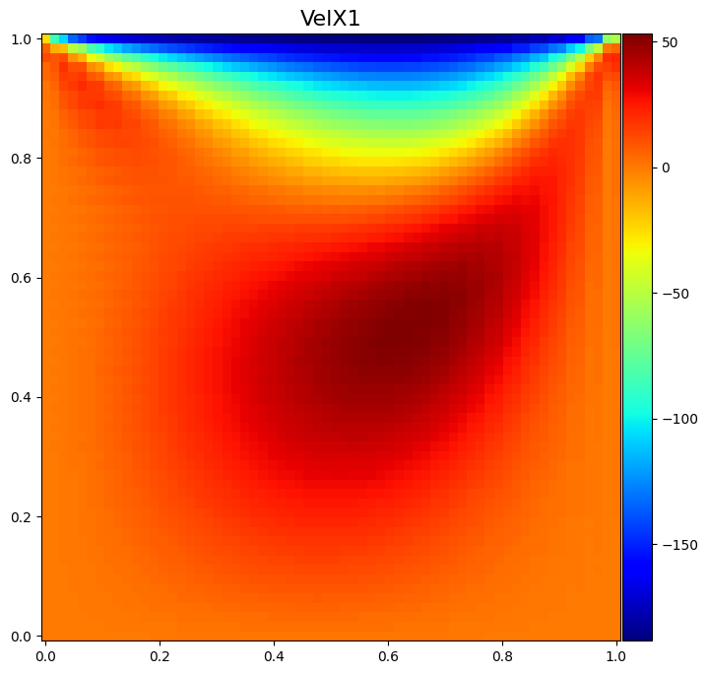
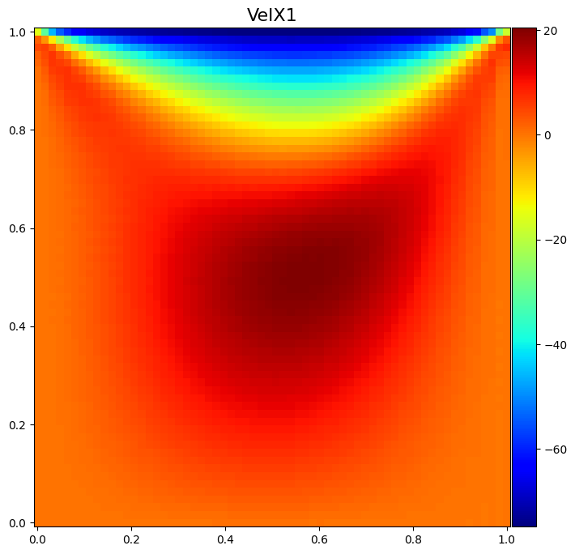
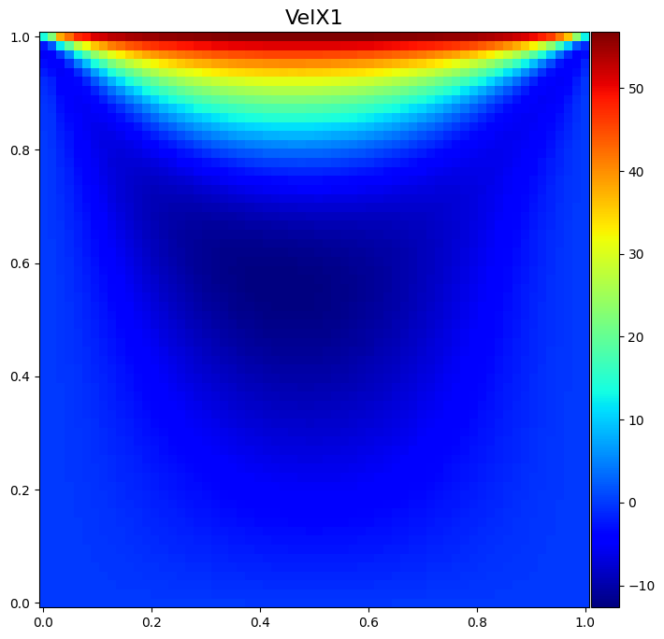

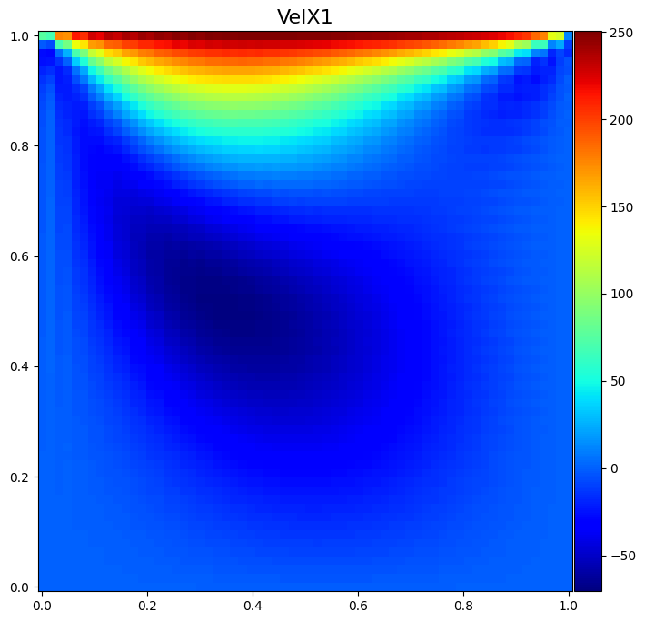

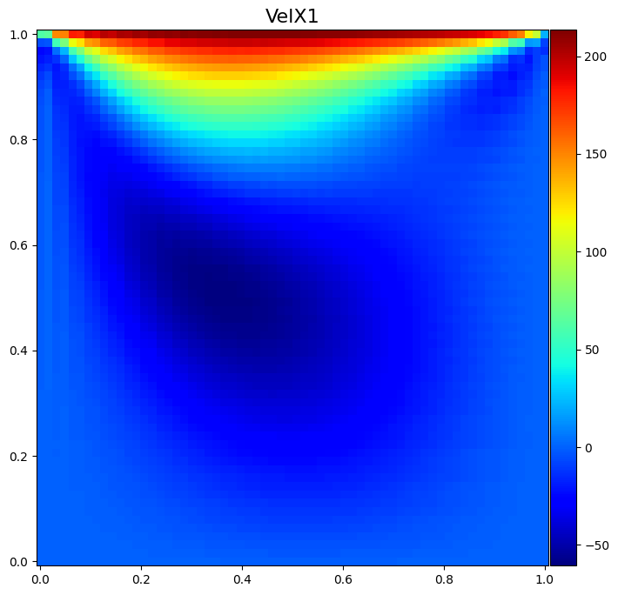





































$$ωt=0.5$$
$$ωt=0.6$$
$$ωt=0.7$$
$$ωt=0.8$$
$$ωt=0.9$$
$$ωt=1.0$$
$$u_{wall}$$
$$u_{wall}$$
$$u_{wall}$$
$$u_{wall}$$
$$u_{wall}$$
$$u_{wall}$$
$$ωt=1.0$$
$$ωt=1.1$$
$$ωt=1.2$$
$$ωt=1.3$$
$$ωt=1.4$$
$$ωt=1.5$$
$$u_{wall}$$
$$u_{wall}$$
$$u_{wall}$$
$$u_{wall}$$
$$u_{wall}$$
$$u_{wall}$$
$$ωt=1.5$$
$$ωt=1.6$$
$ωt=1.$7
$$ωt=1.8$$
$$ωt=1.9$$
$$ωt=2.0$$
$$u_{wall}$$
$$u_{wall}$$
$$u_{wall}$$
$$u_{wall}$$
$$u_{wall}$$
$$u_{wall}$$

Slide 3
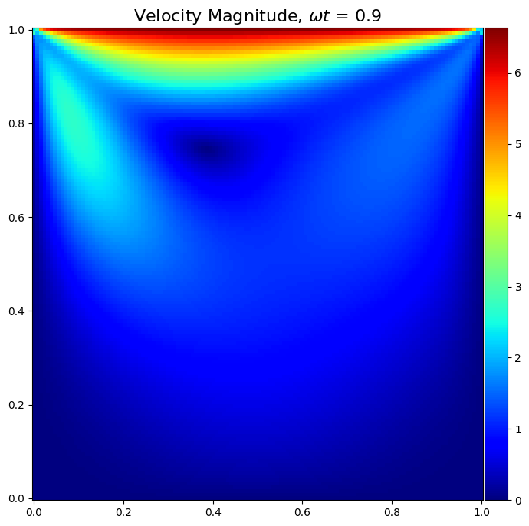
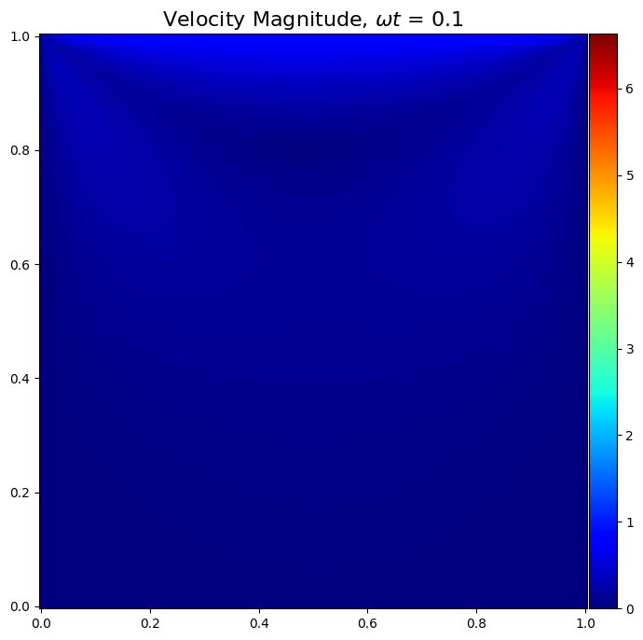
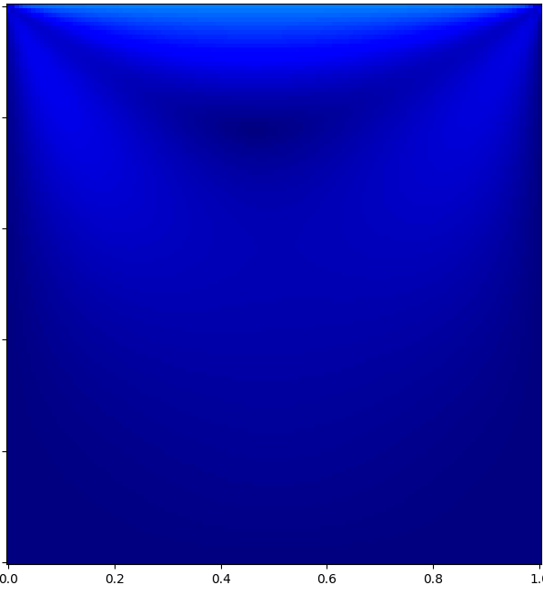
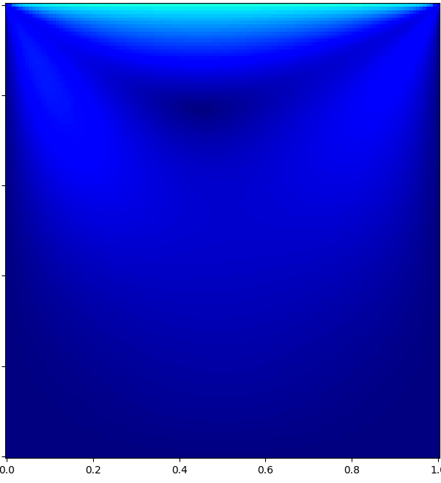
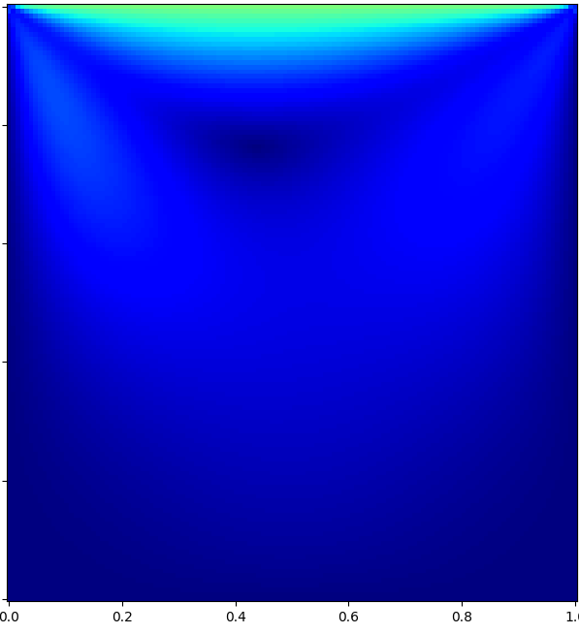
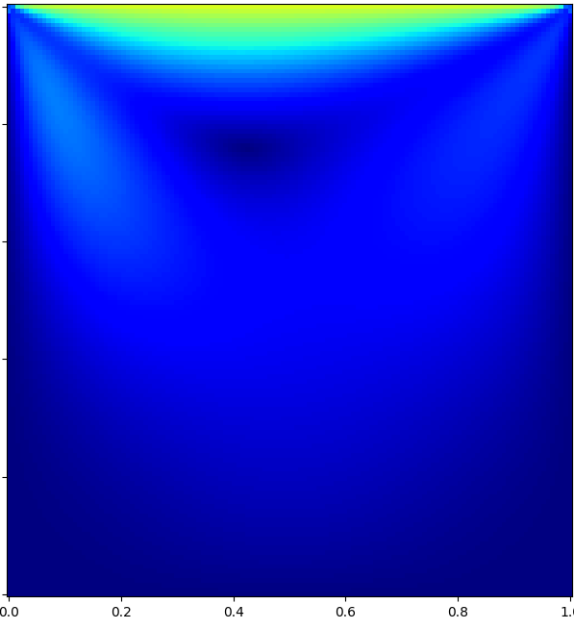
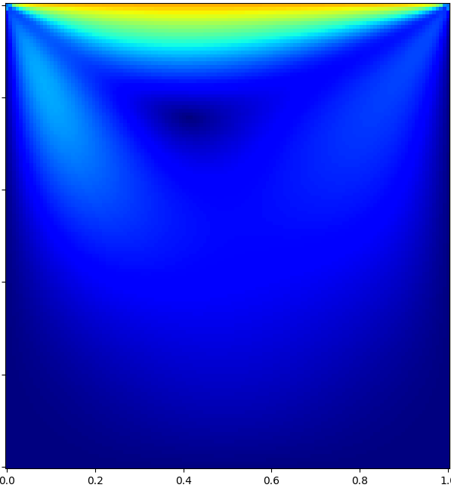
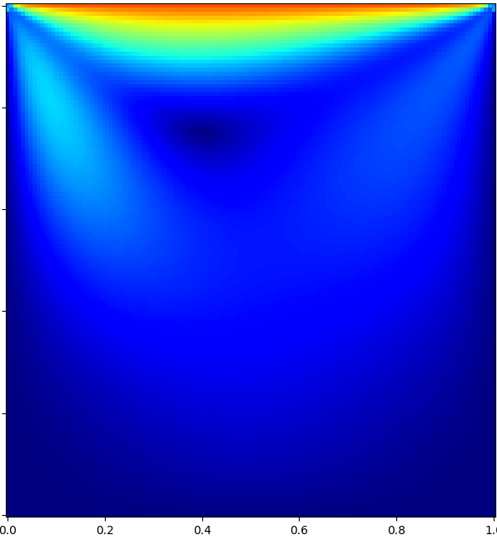
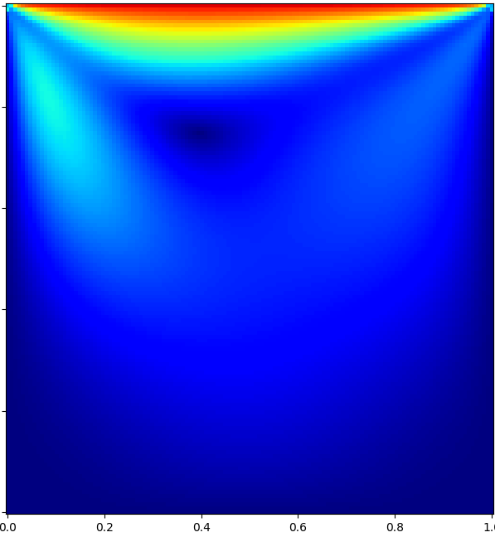

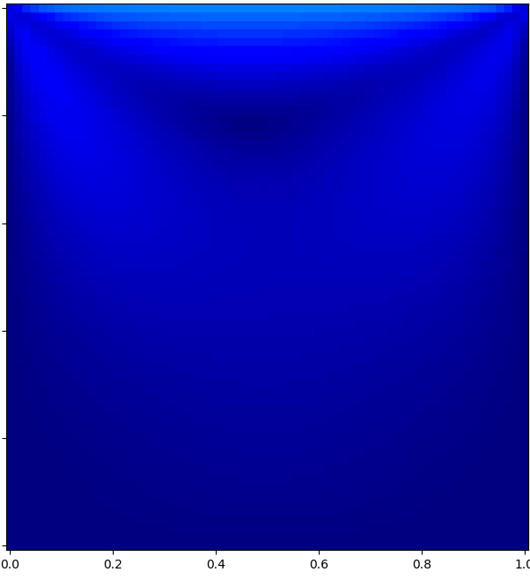
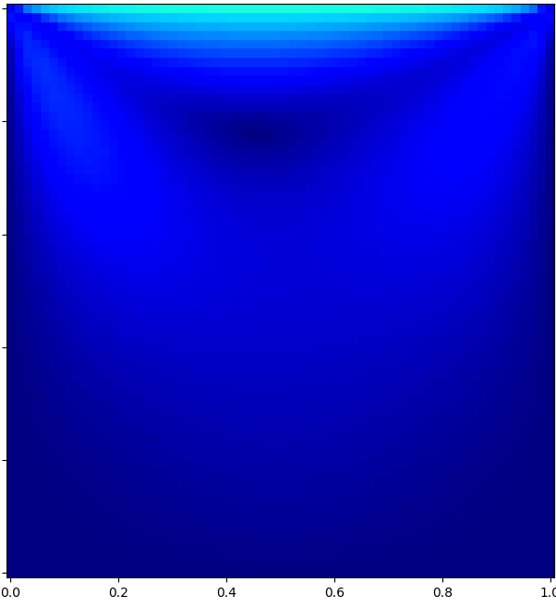
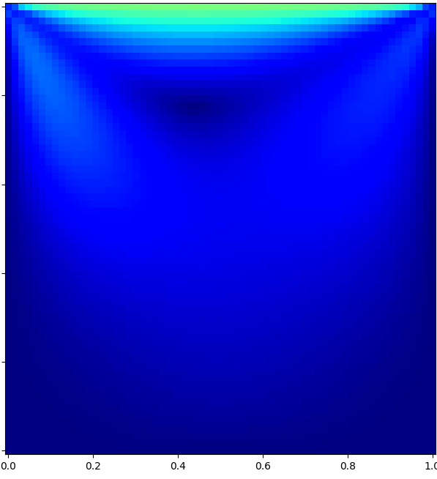
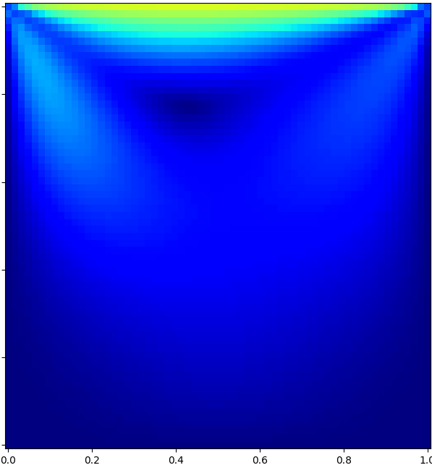
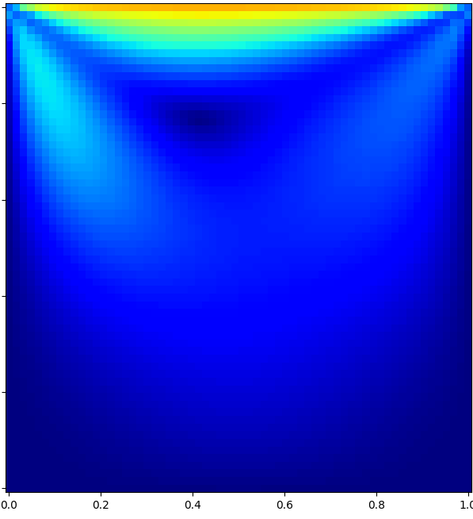
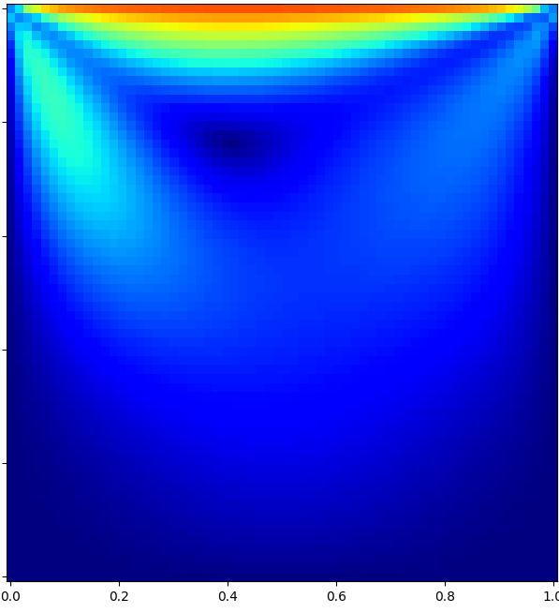
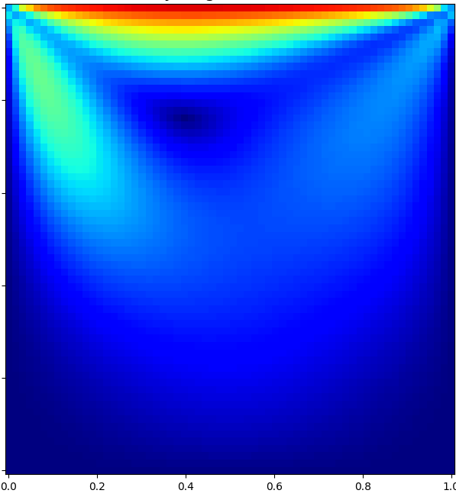
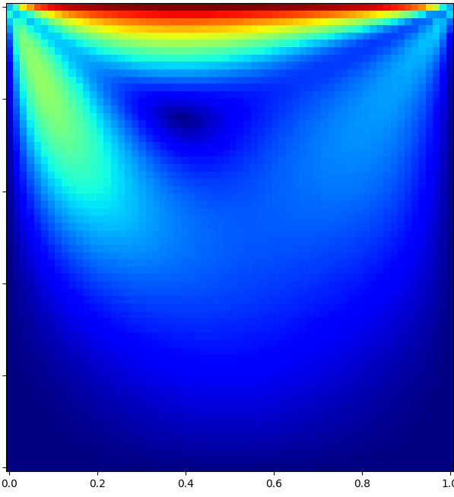
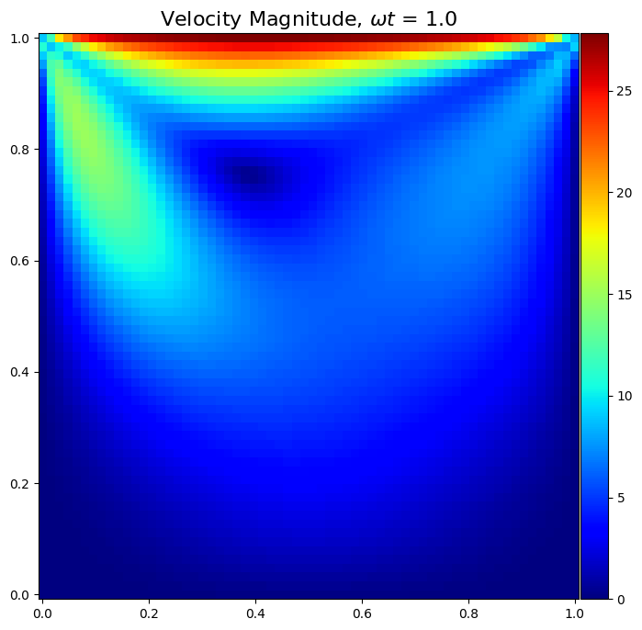
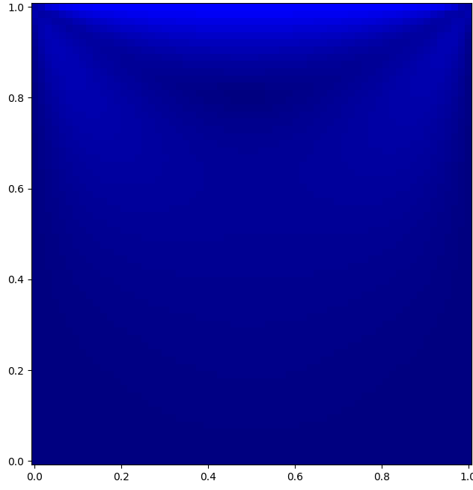
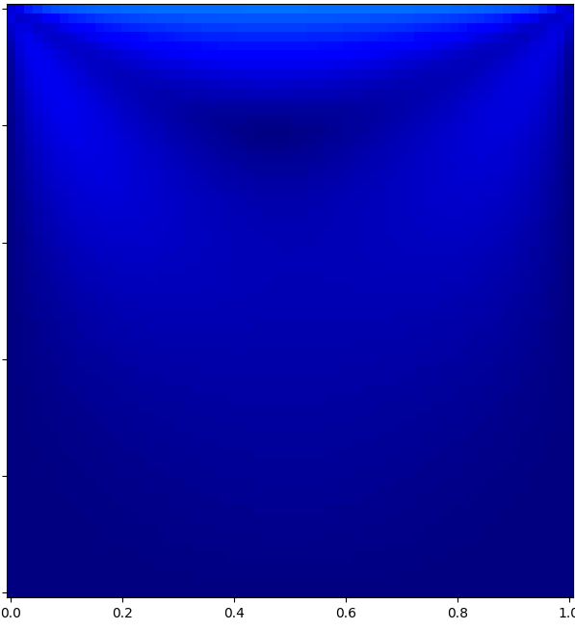
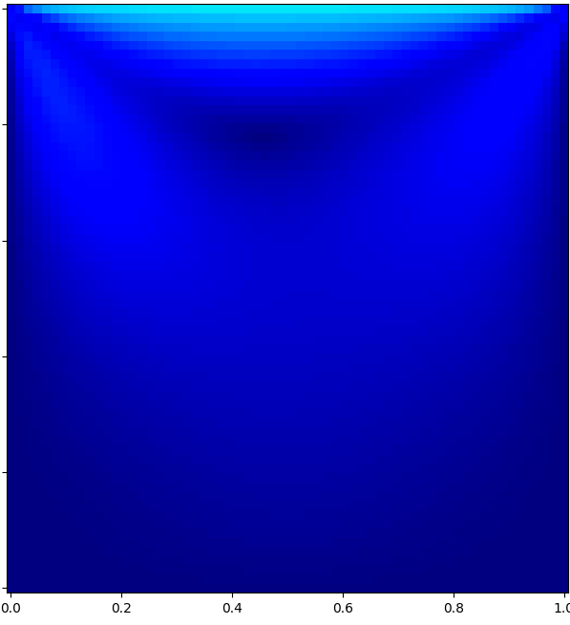
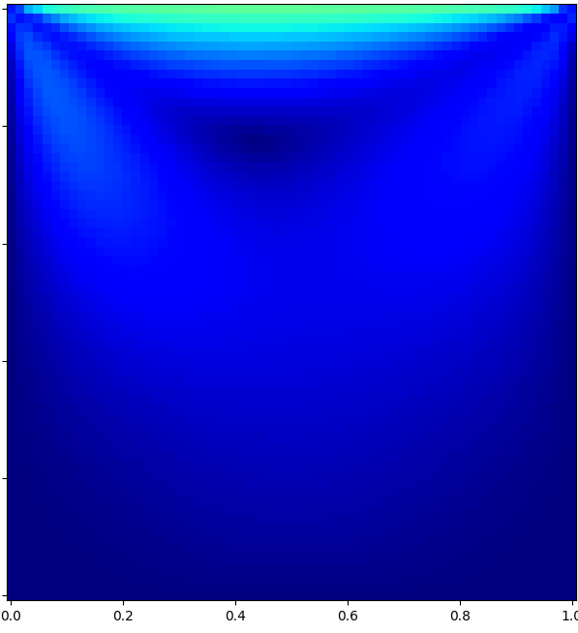
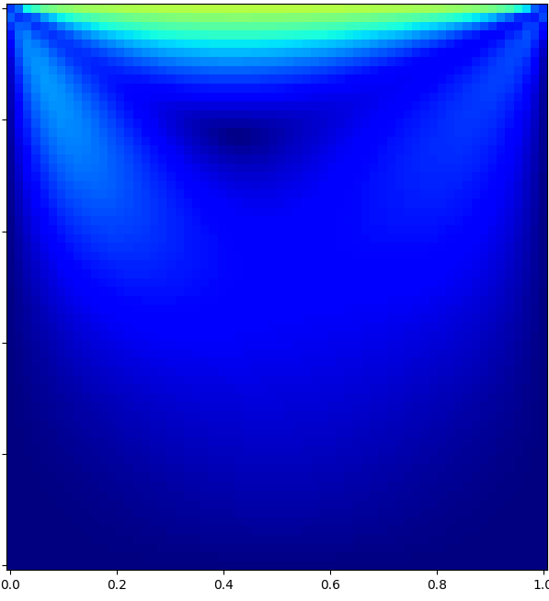
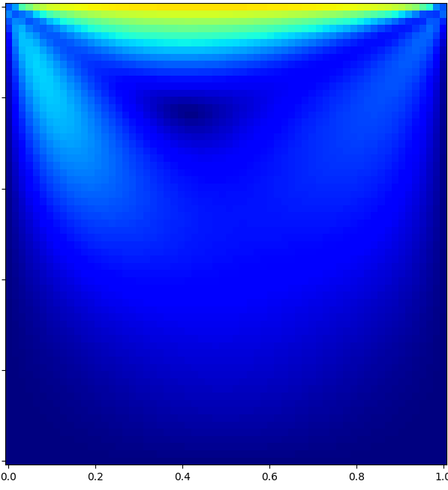
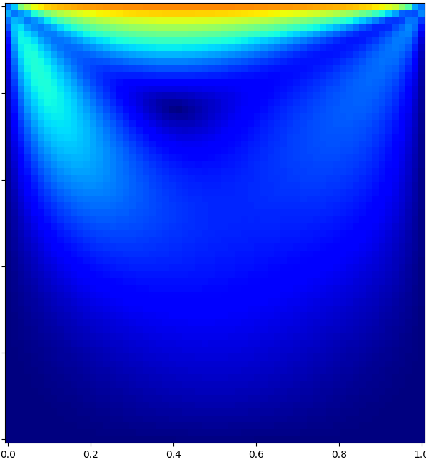
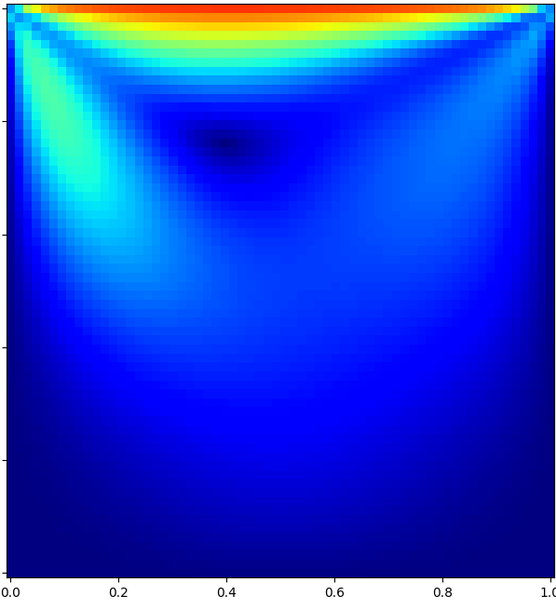
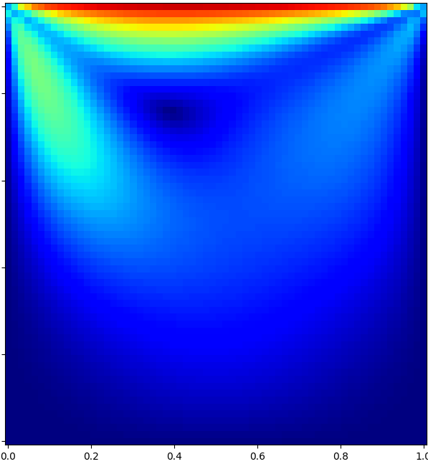

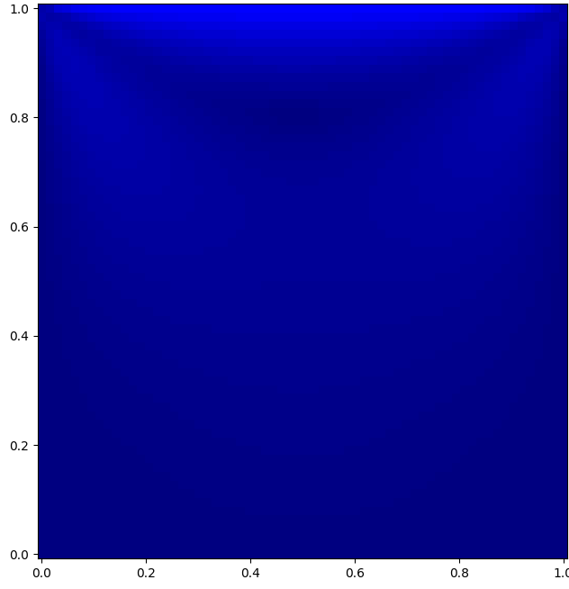
































$$ωt=0.1$$
$$ωt=0.2$$
$$ωt=0.3$$
$$ωt=0.4$$
$$ωt=0.5$$
$$ωt=0.6$$
$$ωt=0.7$$
$$ωt=0.8$$
$$ωt=0.9$$
$$ωt=1.0$$
Incompressible
0
1
2
3
4
5
6
$$Ma=0.025$$
0
1
2
3
4
5
6
$$Ma=0.1$$
0
5
10
15
20
25
$$Ma=0.5$$
0
20
40
60
80
100
120
$$Ma=0.8$$
0
25
50
75
100
125
150
175
200

Slide 4

Incompressible

