Slide 1
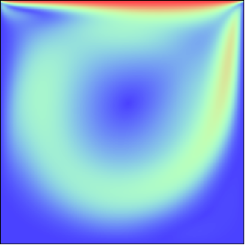


Absolute value of velocity field, $Re=1000$
$U$, lid-driven velocity
Flow
Wall

