Slide 1
DAY - 04
Spring MVC (Annotation)

Slide 2
Annotation 기반
Sprnig MVC

Slide 3
Annotation 설정을 위한 준비 (presentation-layer.xml)
<beans xmlns="http://www.springframework.org/schema/beans"
xmlns:xsi="http://www.w3.org/2001/XMLSchema-instance"
xmlns:context="http://www.springframework.org/schema/context"
xsi:schemaLocation="http://www.springframework.org/schema/beans
http://www.springframework.org/schema/beans/spring-beans.xsd
http://www.springframework.org/schema/context
http://www.springframework.org/schema/context/spring-context-4.2.xsd">
<context:component-scan base-package="com.springbook.view“/>
</beans>

Slide 4
@Controller Annotation
@Controller가 붙은 클래스를 메모리에 생성하고 Controller 객체로 인식하도록 한다.
Controller를 POJO(Plain Old Java Object) 스타일로 코딩할 수 있다.
@Controller
public class InsertBoardController {
}

Slide 5
@RequestMapping
클라이언트의 요청 path에 대해 실행될 메소드를 매핑한다.
@Controller
public class InsertBoardController {
@RequestMapping(value="/insertBoard.do")
public void insertBoard(HttpServletRequest request) {
}
}

Slide 6
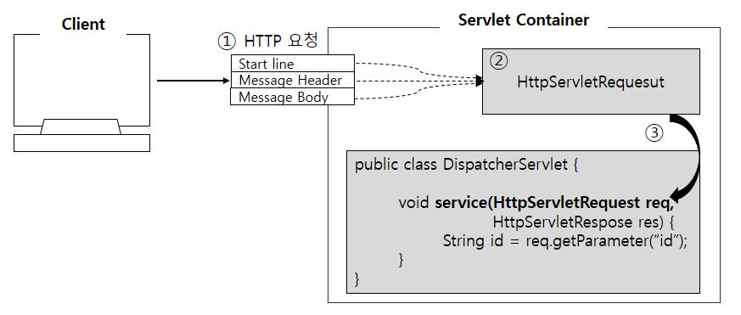
사용자 입력 값 자동 셋팅 원리

Slide 7
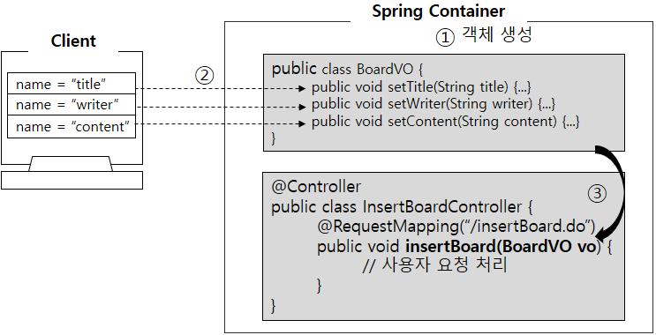
Command 객체 사용하기

Slide 8
요청 방식에 따른 @RequestMapping 사용
@Controller
public class LoginController {
@RequestMapping(value="/login.do", method=RequestMethod.GET)
public String loginView(UserVO vo) {
vo.setId("test");
vo.setPassword("test123");
return "login.jsp";
}
@RequestMapping(value="/login.do", method=RequestMethod.POST)
public String login(UserVO vo, UserDAO userDAO) {
if(userDAO.getUser(vo) != null) return "getBoardList.do";
else return "login.jsp";
}
}

Slide 9
JSP에서 Command 객체 사용하기
<table border="1" cellpadding="0" cellspacing="0">
<tr>
<td bgcolor="orange">아이디</td>
<td><input type="text" name="id" value="${userVO.id }"/></td>
</tr>
<tr>
<td bgcolor="orange">비밀번호</td>
<td><input type="password" name="password"
value="${userVO.password }"/></td>
</tr>
<tr>
<td colspan="2"><input type="submit" value="로그인"/></td>
</tr>
</table>

Slide 10
@ModelAttribute 사용
Controller | @RequestMapping(value="/login.do", method=RequestMethod.GET) public String loginView(@ModelAttribute("user") UserVO vo) { vo.setId("test"); vo.setPassword("test123"); return "login.jsp"; }
JSP | <tr> <td bgcolor="orange">아이디</td> <td><input type="text" name="id" value="${user.id }"/></td> </tr> <tr> <td bgcolor="orange">비밀번호</td> <td><input type="password" name="password" value="${user.password }"/></td> </tr>

Slide 11
Servlet API 사용
Servlet 에서 제공하는 HttpServletRequest, HttpServletResponse, HttpSession, Locale 등 다양한 객체를 매개 변수로 받을 수 있다.
@RequestMapping(value="/login.do", method=RequestMethod.POST)
public String login(UserVO vo, UserDAO userDAO, HttpSession session) {
UserVO user = userDAO.getUser(vo);
if(user != null) {
session.setAttribute("userName", user.getName());
return "getBoardList.do";
}
else return "login.jsp";
}

Slide 12
Controller 메소드 리턴 타입
리턴타입 | 소스 비교
ModelAndView | public ModelAndView login(UserVO vo, UserDAO userDAO, ModelAndView mav) { if(userDAO.getUser(vo) != null) mav.setViewName("getBoardList.jsp"); else mav.setViewName("login.jsp"); return mav; }
String | public String login(UserVO vo, UserDAO userDAO) { if(userDAO.getUser(vo) != null) return "getBoardList.jsp"; else return "login.jsp"; }

Slide 13
@RequestParam 사용하기
@Controller
public class BoardController {
@RequestMapping("/getBoardList.do")
public String getBoardList(
@RequestParam(value="searchCondition", defaultValue="TITLE",
required=false) String condition,
@RequestParam(value="searchKeyword", defaultValue="",
required=false) String keyword) {
System.out.println("검색 조건 : " + condition);
System.out.println("검색 단어 : " + keyword);
return "getBoardList.jsp";
}
}

Slide 14
@ModelAttribute 사용하기 (1)
@ModelAttribute("conditionMap")
public Map<String, String> searchConditionMap() {
Map<String, String> conditionMap = new HashMap<String, String>();
conditionMap.put("제목", "TITLE");
conditionMap.put("내용", "CONTENT");
return conditionMap;
}
@RequestMapping("/getBoardList.do")
public String getBoardList(BoardVO vo, BoardDAO, boardDAO, Model model) {
// Model 정보 저장
model.addAttribute("boardList", boardDAO.getBoardList(vo));
return "getBoardList.jsp";
}

Slide 15
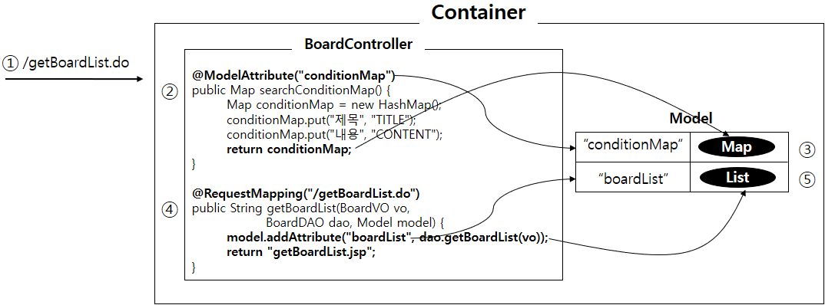
@ModelAttribute 사용하기 (2)

Slide 16
@ModelAttribute 사용하기 (3)
<table border="1" cellpadding="0" cellspacing="0" width="700">
<tr>
<td align="right">
<select name="searchCondition">
<c:forEach items="${conditionMap}" var="option">
<option value="${option.value}">${option.key}
</c:forEach>
</select>
<input name="searchKeyword" type="text"/>
<input type="submit" value="검색"/>
</td>
</tr>
</table>

Slide 17
@SessionAttribute 사용하기 (null 업데이트 방지)
@Controller
@SessionAttributes("board")
public class BoardController {
@RequestMapping("/updateBoard.do")
public String updateBoard(@ModelAttribute("board") BoardVO vo) {
System.out.println("BoardVO 상세 정보 : " + vo.toString());
boardDAO.updateBoard(vo);
return "getBoardList.do";
}
@RequestMapping("/getBoard.do")
public String getBoard(BoardVO vo, Model model) {
model.addAttribute("board", boardDAO.getBoard(vo));
return "getBoard.jsp";
}
}

Slide 18
Layer 통합하기
( Presentation-Layer, Business-Layer )

Slide 19
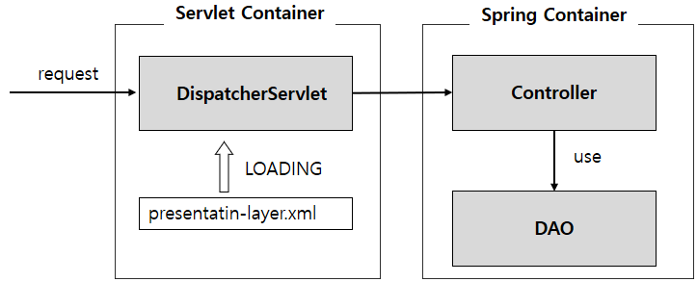
Layer 통합

Slide 20
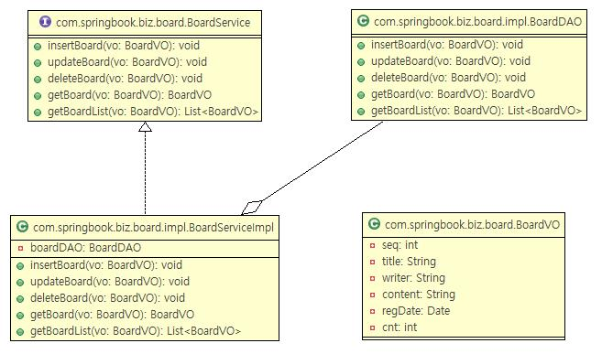
Business Component 구조

Slide 21
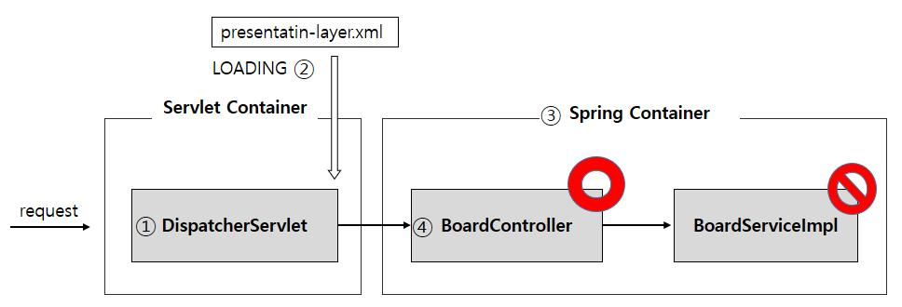
Autowired 실패 원인

Slide 22
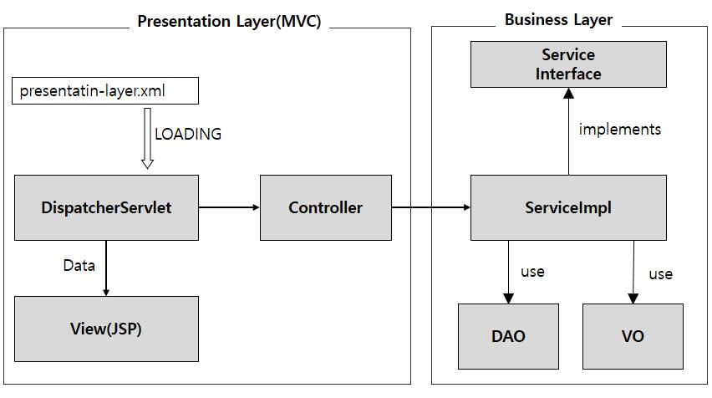
Layer 연결

Slide 23
ContextLoaderListener 등록 ( web.xml )
<context-param>
<param-name>contextConfigLocation</param-name>
<param-value>
classpath:applicationContext.xml
</param-value>
</context-param>
<listener>
<listener-class>
org.springframework.web.context.ContextLoaderListener
</listener-class>
</listener>

Slide 24
presentatin-layer.xml
LOADING
LOADING
①
Servlet Container
③
Spring Container
②
Spring Container(ROOT)
web.xml
DispatcherServlet
Controller
ServiceImpl
ContextLoaderListener
use
DAO
LOADING
applicationContext.xml

Slide 25
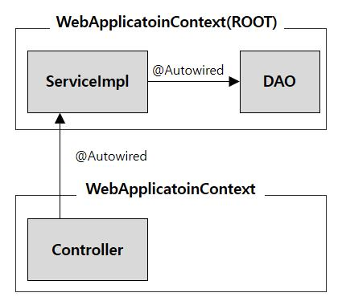
Container의 관계

Slide 26
File Upload

Slide 27
업로드 화면 만들기 (insertBoard.jsp)
<form action="insertBoard.do" method="post" enctype="multipart/form-data">
<table border="1" cellpadding="0" cellspacing="0">
<tr>
<td bgcolor="orange" width="70">제목</td><td align="left">
<input type="text" name="title"/></td>
</tr>
<tr>
<td bgcolor="orange" width="70">업로드</td><td align="left">
<input type="file" name="uploadFile"/></td>
</tr>
<tr>
<td colspan="2" align="center">
<input type="submit" value=" 새글 등록 "/></td>
</tr>
</table>
</form>

Slide 28
VO 클래스 수정 (BoardVO.java)
import org.springframework.web.multipart.MultipartFile;
public class BoardVO {
private int seq;
private String title;
private MultipartFile uploadFile;
~생략~
public MultipartFile getUploadFile() {
return uploadFile;
}
public void setUploadFile(MultipartFile uploadFile) {
this.uploadFile = uploadFile;
}
}

Slide 29
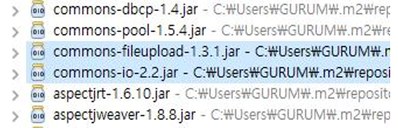
라이브러리 추가 (pom.xml)
<!-- FileUpload -->
<dependency>
<groupId>commons-fileupload</groupId>
<artifactId>commons-fileupload</artifactId>
<version>1.3.1</version>
</dependency>

Slide 30
Spring 설정파일 수정 (presentation-layer.xml)
고정된 아이디 사용
<!-- 파일 업로드 설정 -->
<bean id="multipartResolver"
class="org.springframework.web.multipart.commons.CommonsMultipartResolver">
<property name="maxUploadSize" value="100000" />
</bean>

Slide 31
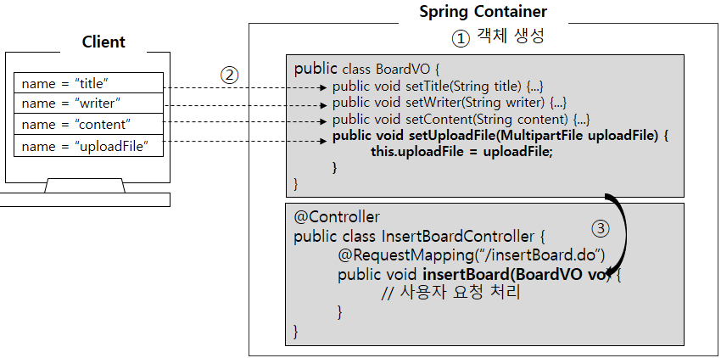
업로드 정보(MultipartFile)를 Command 객체에 할당하는 과정

Slide 32
MultipartFile 메소드
메소드 | 설 명
String getOriginalFilename() | 업로드한 파일명을 문자열로 리턴
void transferTo(File destFile) | 업로드한 파일을 destFile에 저장
boolean isEmpty() | 업로드한 파일 존재 여부 리턴(없으면 true 리턴)

Slide 33
업로드 처리 (BoardController.java)
// 글 등록
@RequestMapping("/insertBoard.do")
public String insertBoard(BoardVO vo) throws IOException {
// 파일 업로드 처리
MultipartFile uploadFile = vo.getUploadFile();
if(!uploadFile.isEmpty()) {
String fileName = uploadFile.getOriginalFilename();
uploadFile.transferTo(new File(“C:/" + fileName));
}
boardService.insertBoard(vo);
return "getBoardList.do";
}

Slide 34
Exceptioin Handle

Slide 35
Annotation 기반 (presentation-layer.xml)
<beans xmlns="http://www.springframework.org/schema/beans"
xmlns:xsi="http://www.w3.org/2001/XMLSchema-instance"
xmlns:mvc="http://www.springframework.org/schema/mvc"
xsi:schemaLocation="http://www.springframework.org/schema/mvc
http://www.springframework.org/schema/mvc/spring-mvc-4.2.xsd
http://www.springframework.org/schema/beans
http://www.springframework.org/schema/beans/spring-beans.xsd">
<context:component-scan base-package="com.springbook.view“/>
<mvc:annotation-driven/>
</beans>

Slide 36
Exception Handler 작성(CommonExcpetionHandler.java)
@ControllerAdvice("com.springbook.view")
public class CommonExceptionHandler {
@ExceptionHandler(ArithmeticException.class)
public ModelAndView handleArithmeticException(Exception e) {
ModelAndView mav = new ModelAndView();
mav.addObject("exception", e);
mav.setViewName("/common/arithmeticError.jsp");
return mav;
}
@ExceptionHandler(Exception.class)
public ModelAndView handleException(Exception e) {
ModelAndView mav = new ModelAndView();
mav.addObject("exception", e);
mav.setViewName("/common/error.jsp");
return mav;
}
}

Slide 37
Exception Handler Annotation
@ControllerAdvice("com.springbook.view")
- CommonExceptionHandler 객체를 생성하는 Annotation
- "com.springbook.view" 패키지로 시작하는 컨트롤러에서 예외 발생 시
@ExceptionHandler 어노테이션으로 지정한 메소드 실행
ArithmeticException이 발생하면 handleArithmeticException( ) 메소드 실행
handleException( ) 메소드는 기본 예외 핸들러

Slide 38
XML 기반 (presentation-layer.xml)
<bean id="exceptionResolver"
class="org.springframework.web.servlet.handler.SimpleMappingExceptionResolver">
<property name="exceptionMappings">
<props>
<prop key="java.lang.ArithmeticException">
common/arithmeticError.jsp
</prop>
<prop key="java.lang.NullPointerException">
common/nullPointerError.jsp
</prop>
</props>
</property>
<property name="defaultErrorView" value="common/error.jsp" />
</bean>

Slide 39
다국어(국제화)

Slide 40
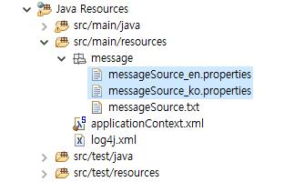
Message 파일 작성
# login.jsp
message.user.login.title=LOGIN
message.user.login.id=ID
message.user.login.password=PASSWORD
message.user.login.loginBtn=LOG-IN

Slide 41
MessageSource 등록
<!-- MessageSource 등록 -->
<bean id="messageSource"
class="org.springframework.context.support.ResourceBundleMessageSource">
<property name="basenames">
<list>
<value>message.messageSource</value>
</list>
</property>
</bean>

Slide 42
LocaleResolver 등록
LocaleResolver 종류 | 기능 설명
AcceptHeaderLocaleResolver | 브라우저에서 전송된 HTTP 요청 헤더에서 Accept-Language에 설정된 Locale로 메시지를 적용한다.
CookieLocaleResolver | Cookie에 저장된 Locale 정보를 추출하여 메시지를 적용한다.
SessionLocaleResolver | HttpSession에 저장된 Locale 정보를 추출하여 메시지를 적용한다.
FixedLocaleResolver | 웹 요청과 무관하게 특정 Locale로 고정한다.

Slide 43
Locale 변경하기
<?xml version="1.0" encoding="UTF-8"?>
<beans mvc 네임스페이스 등록>
<!-- LocaleResolver 등록 -->
<bean id="localeResolver"
class="org.springframework.web.servlet.i18n.SessionLocaleResolver">
</bean>
<!-- LocaleChangeInterceptor 등록 -->
<mvc:interceptors>
<bean class="org.springframework.web.servlet.i18n.LocaleChangeInterceptor">
<property name="paramName" value="lang"/>
</bean>
</mvc:interceptors>
</beans>

Slide 44
다국어 적용
<%@page contentType="text/html; charset=EUC-KR"%>
<%@taglib uri="http://www.springframework.org/tags" prefix="spring" %>
<html>
<head>
<meta http-equiv="Content-Type" content="text/html; charset=EUC-KR">
<title><spring:message code="Message Key"/></title>
</head>
<body>
<center>
~~~
</center>
</body>
</html>

Slide 45
JSON 변환

Slide 46
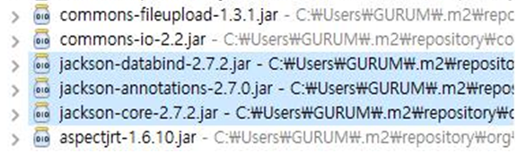
라이브러리 추가 ( pom.xml )
<!-- Jackson2 -->
<dependency>
<groupId>com.fasterxml.jackson.core</groupId>
<artifactId>jackson-databind</artifactId>
<version>2.7.2</version>
</dependency>

Slide 47
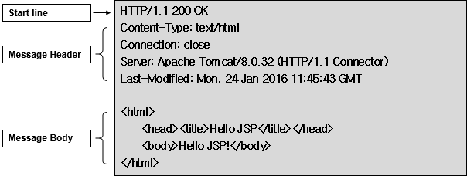
HTTP 응답 프로토콜 구조

Slide 48
MessageConverter 등록
<?xml version="1.0" encoding="UTF-8"?>
<beans xmlns="http://www.springframework.org/schema/beans"
xmlns:xsi="http://www.w3.org/2001/XMLSchema-instance"
xmlns:context="http://www.springframework.org/schema/context"
xmlns:mvc="http://www.springframework.org/schema/mvc"
xsi:schemaLocation="http://www.springframework.org/schema/mvc
http://www.springframework.org/schema/mvc/spring-mvc-4.2.xsd
http://www.springframework.org/schema/beans
http://www.springframework.org/schema/beans/spring-beans.xsd
http://www.springframework.org/schema/context
http://www.springframework.org/schema/context/spring-context-4.2.xsd">
<mvc:annotation-driven></mvc:annotation-driven>
</beans>

Slide 49
Controller 수정
@Controller
@SessionAttributes("board")
public class BoardController {
@Autowired
private BoardService boardService;
@RequestMapping("/dataTransform.do")
@ResponseBody
public List<BoardVO> dataTransform(BoardVO vo) {
vo.setSearchCondition("TITLE");
vo.setSearchKeyword("");
List<BoardVO> boardList = boardService.getBoardList(vo);
return boardList;
}
}
객체를 HTTP 응답 몸체(Body)로 변환

Slide 50
XML 변환

Slide 51
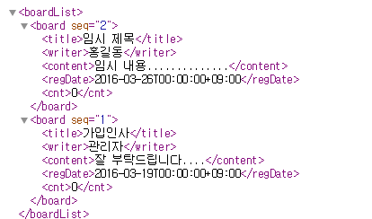
목적 XML 데이터 파일

Slide 52
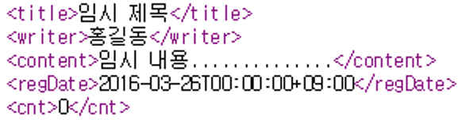
JAXB Annotation 설정
@XmlAccessorType(XmlAccessType.FIELD)
public class BoardVO {
@XmlAttribute
private int seq;
private String title;
private String writer;
private String content;
private Date regDate;
private int cnt;
@XmlTransient
private String searchCondition;
@XmlTransient
private String searchKeyword;
@XmlTransient
private MultipartFile uploadFile;
}

Slide 53
JAXB Annotation 설정
@XmlRootElement(name = "boardList")
@XmlAccessorType(XmlAccessType.FIELD)
public class BoardListVO {
@XmlElement(name = "board")
private List<BoardVO> boardList;
public List<BoardVO> getBoardList() {
return boardList;
}
public void setBoardList(List<BoardVO> boardList) {
this.boardList = boardList;
}
}

Slide 54
Controller 수정 ( BoardController.java )
@Controller
@SessionAttributes("board")
public class BoardController {
@Autowired
private BoardService boardService;
@RequestMapping("/dataTransform.do")
@ResponseBody
public BoardListVO dataTransform(BoardVO vo) {
vo.setSearchCondition("TITLE");
vo.setSearchKeyword("");
List<BoardVO> boardList = boardService.getBoardList(vo);
BoardListVO boardListVO = new BoardListVO();
boardListVO.setBoardList(boardList);
return boardListVO;
}

Slide 55
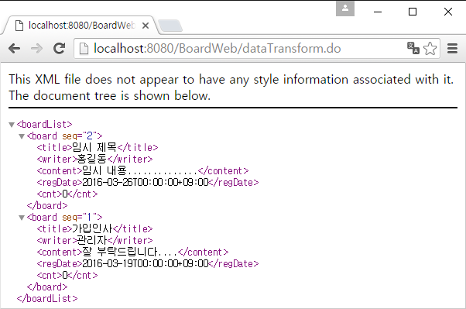
실행 결과

