Slide 1
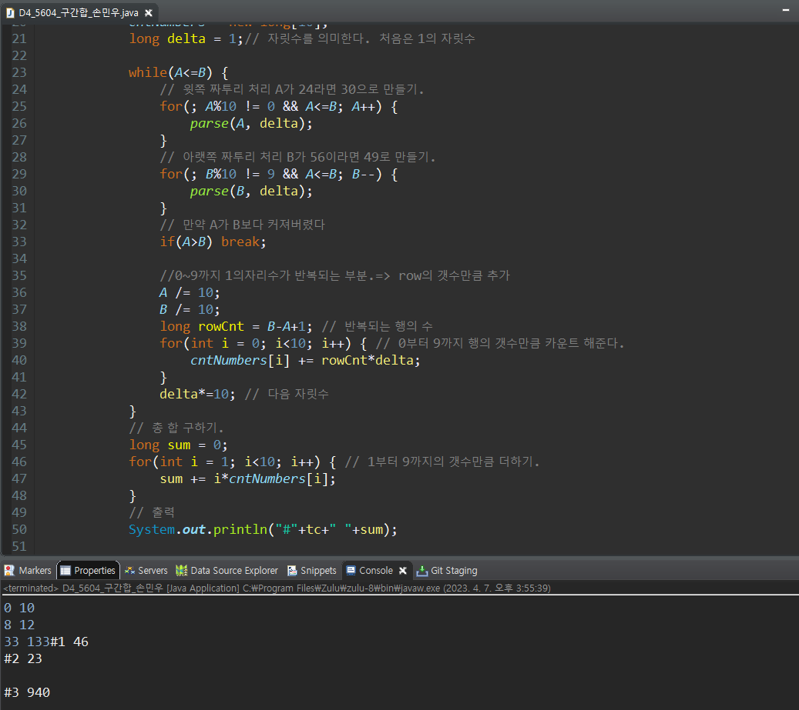
D4_5604_구간합_손민우

