Slide 1

LG SMART FRIDGE
Matthew Walcher & Caitlyn O’Driscoll

Slide 2
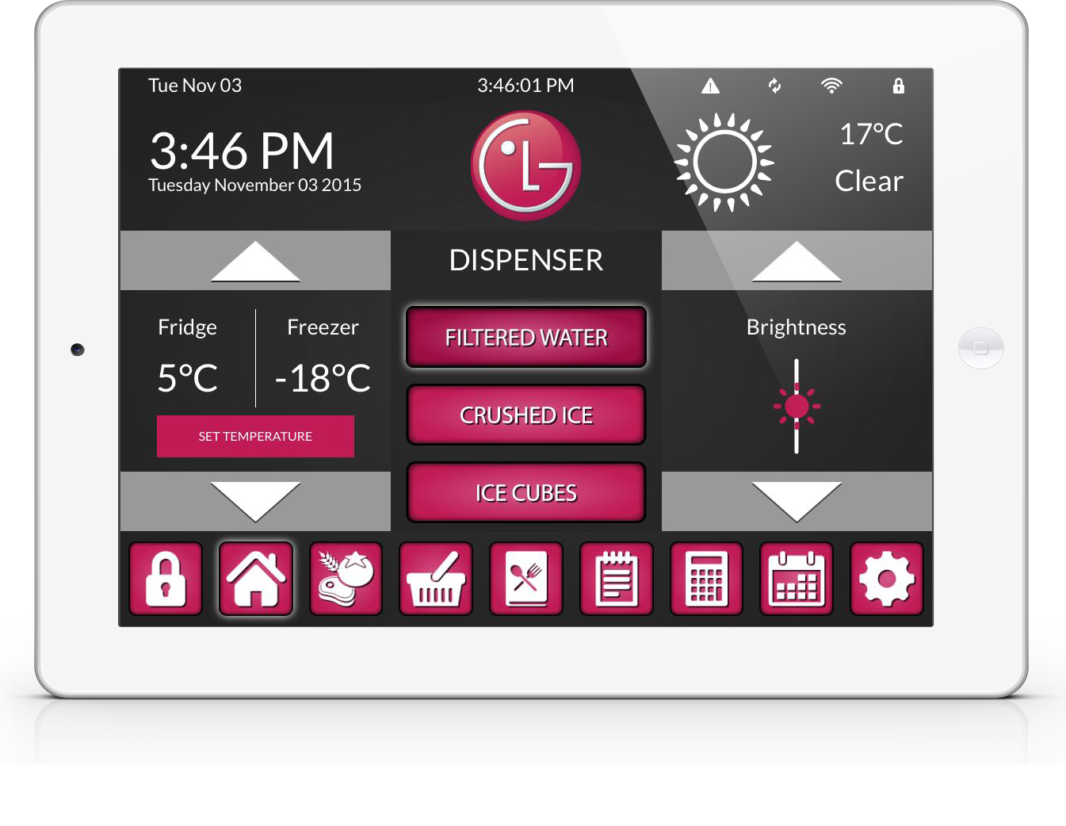
Home
Matthew Walcher & Caitlyn O’Driscoll

Slide 3
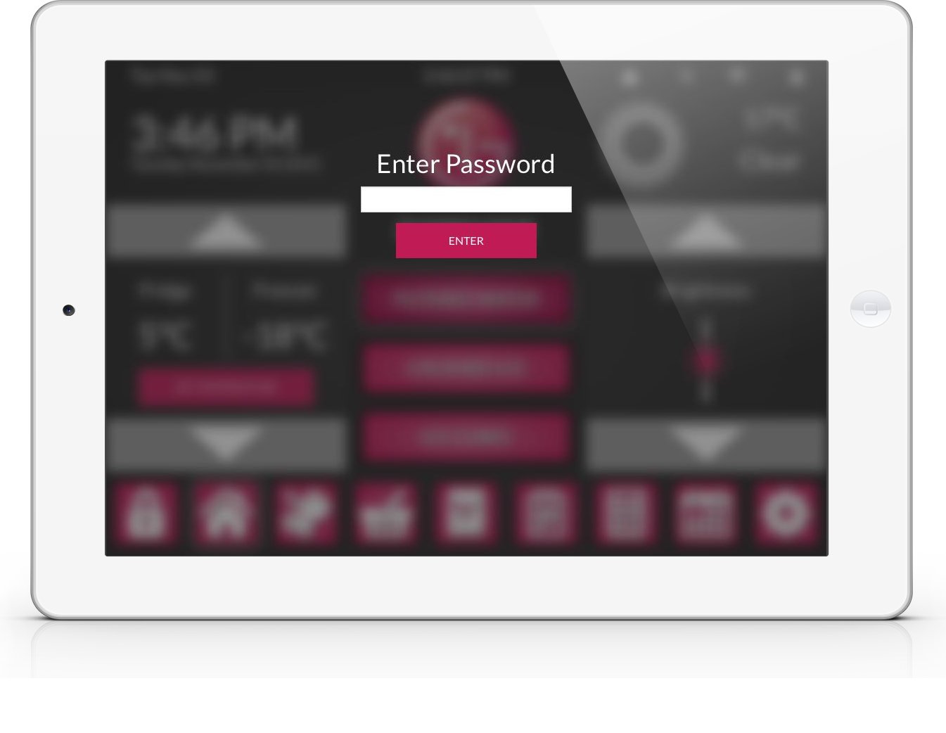
Lock
Matthew Walcher & Caitlyn O’Driscoll

Slide 4
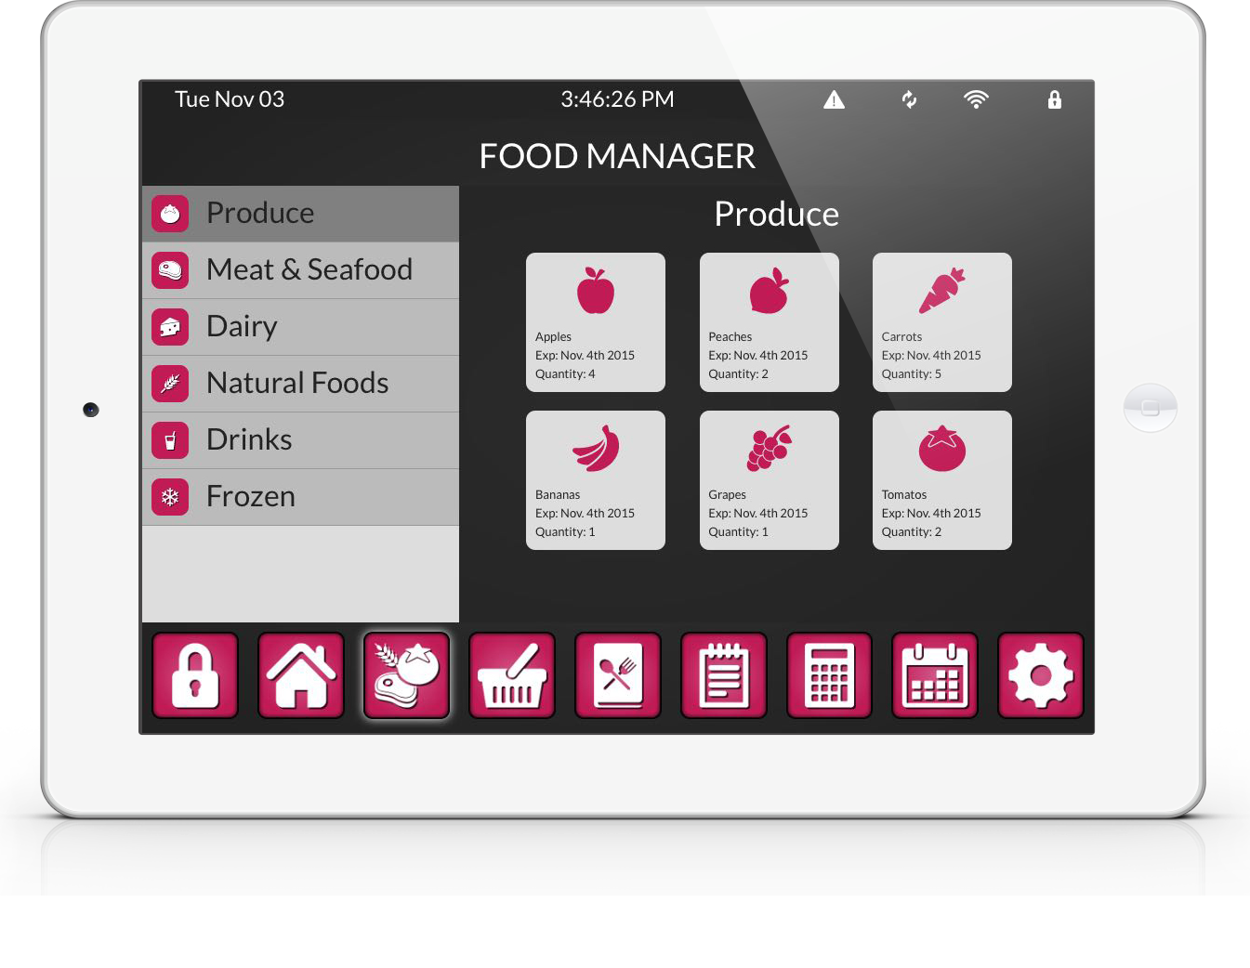
Food Manager
Matthew Walcher & Caitlyn O’Driscoll

Slide 5
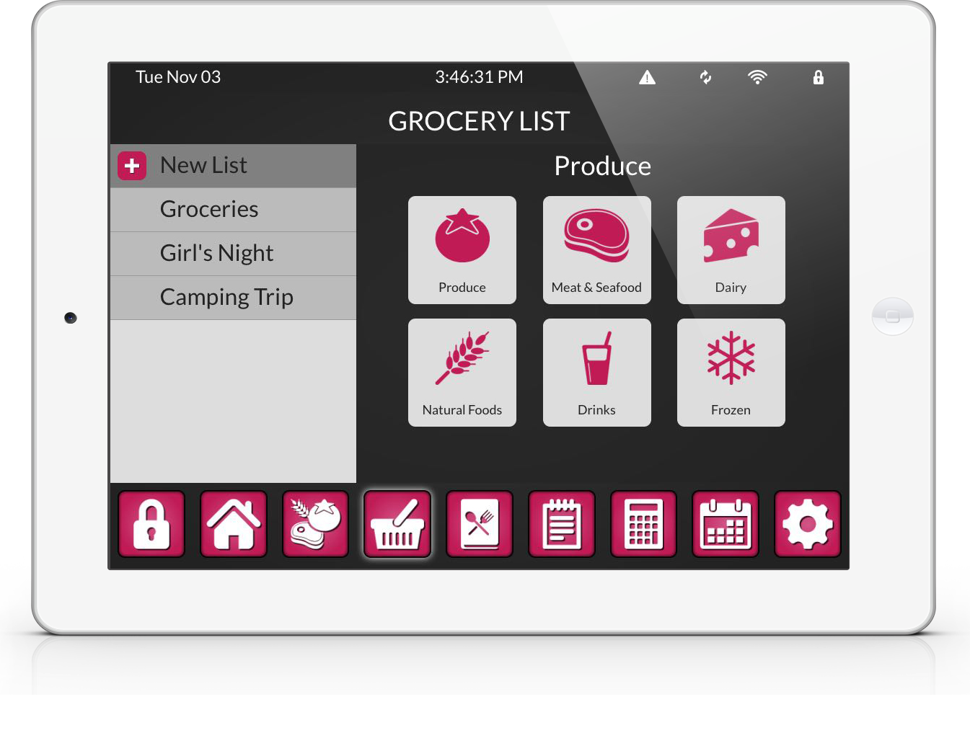
Grocery Lists
Matthew Walcher & Caitlyn O’Driscoll

Slide 6
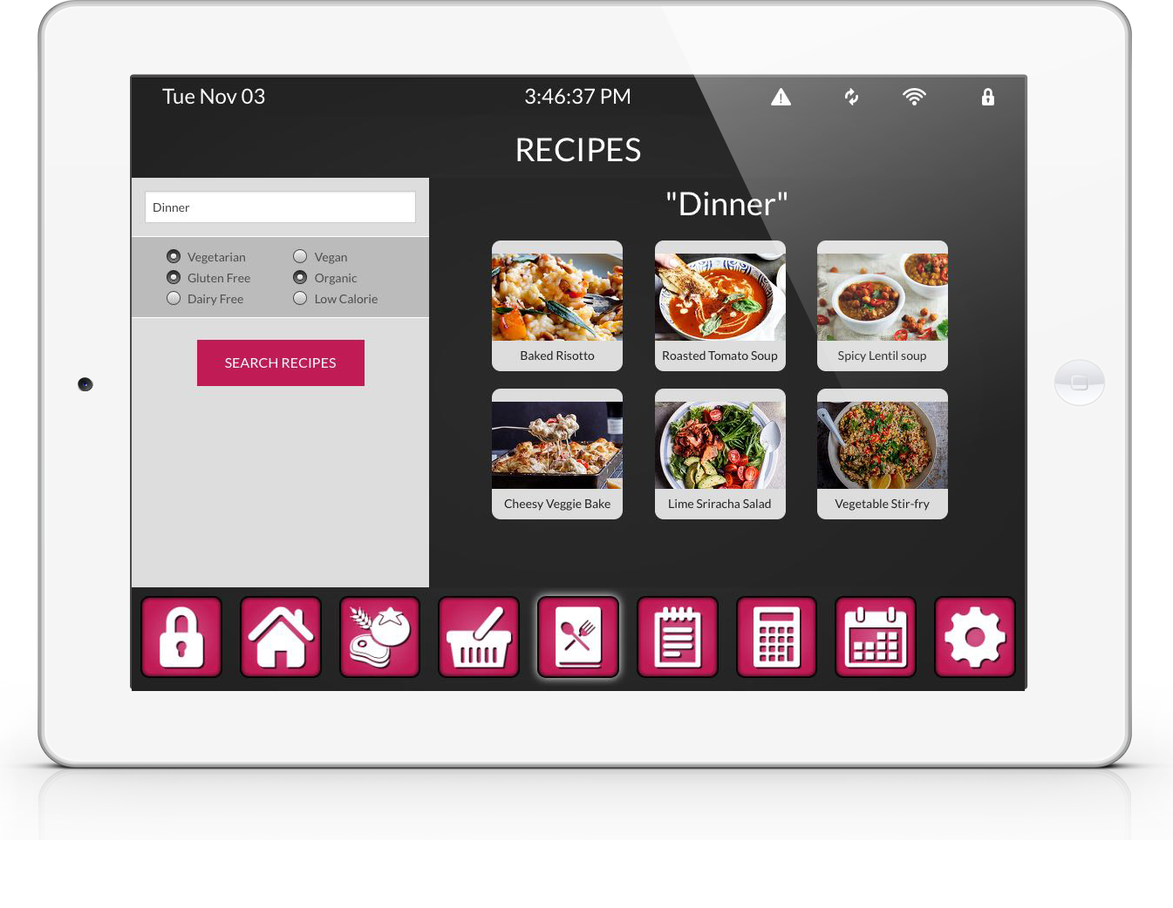
Recipes
Matthew Walcher & Caitlyn O’Driscoll

Slide 7
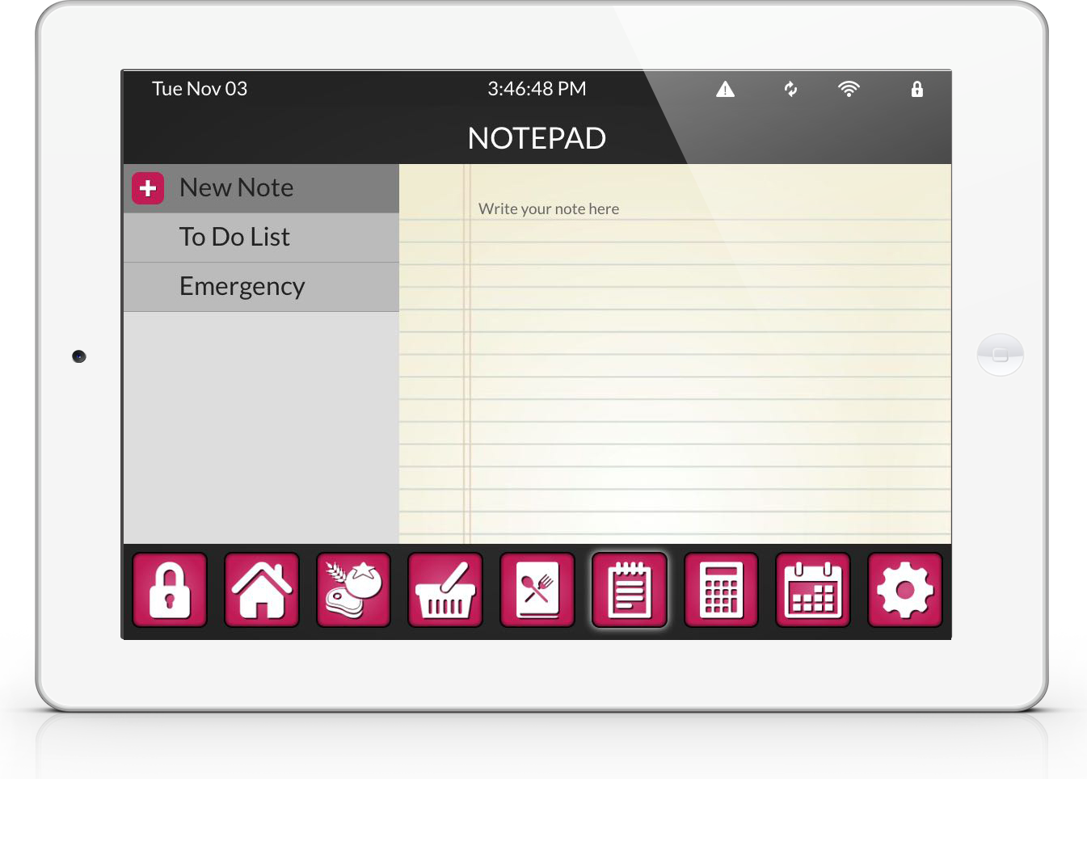
Note Pad
Matthew Walcher & Caitlyn O’Driscoll

Slide 8
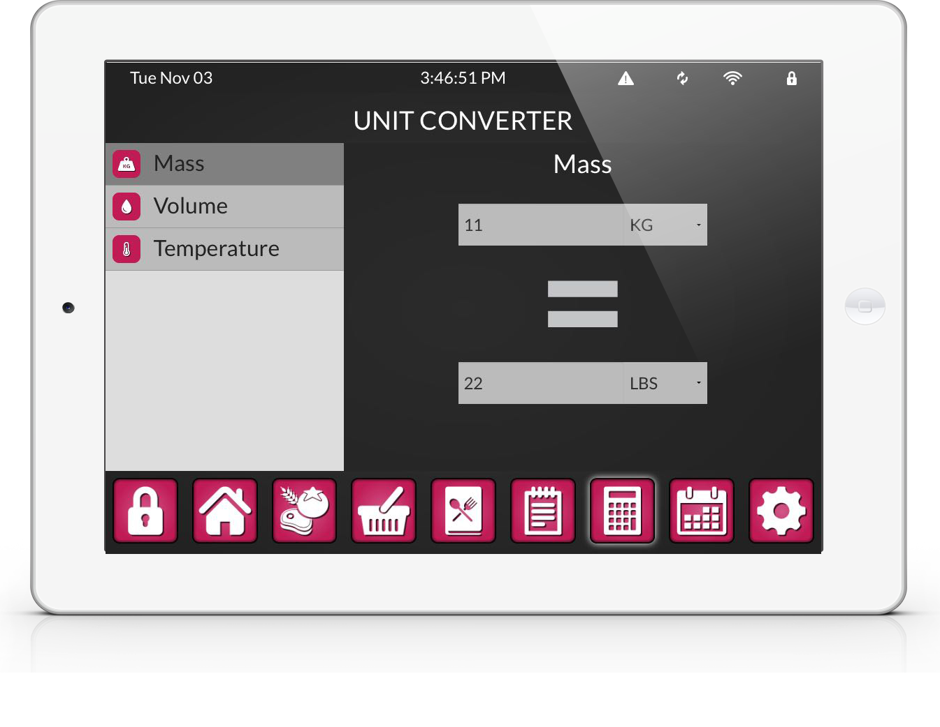
Unit Converter
Matthew Walcher & Caitlyn O’Driscoll

Slide 9
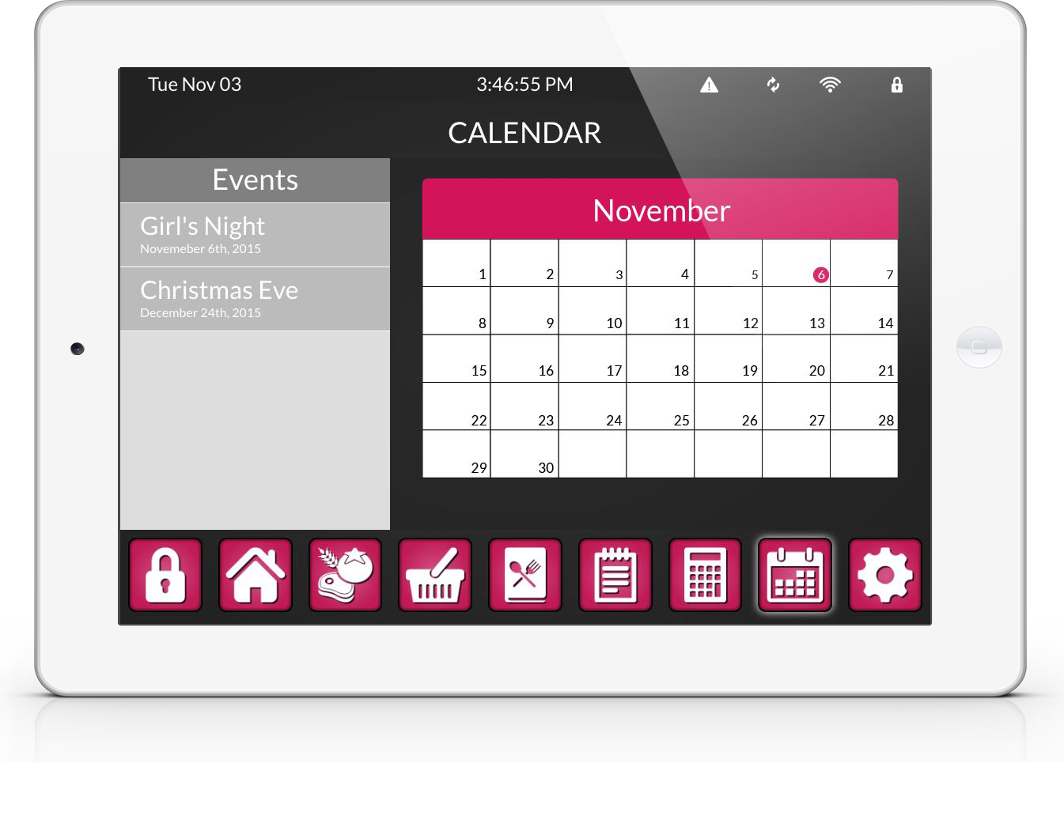
Calendar
Matthew Walcher & Caitlyn O’Driscoll

Slide 10
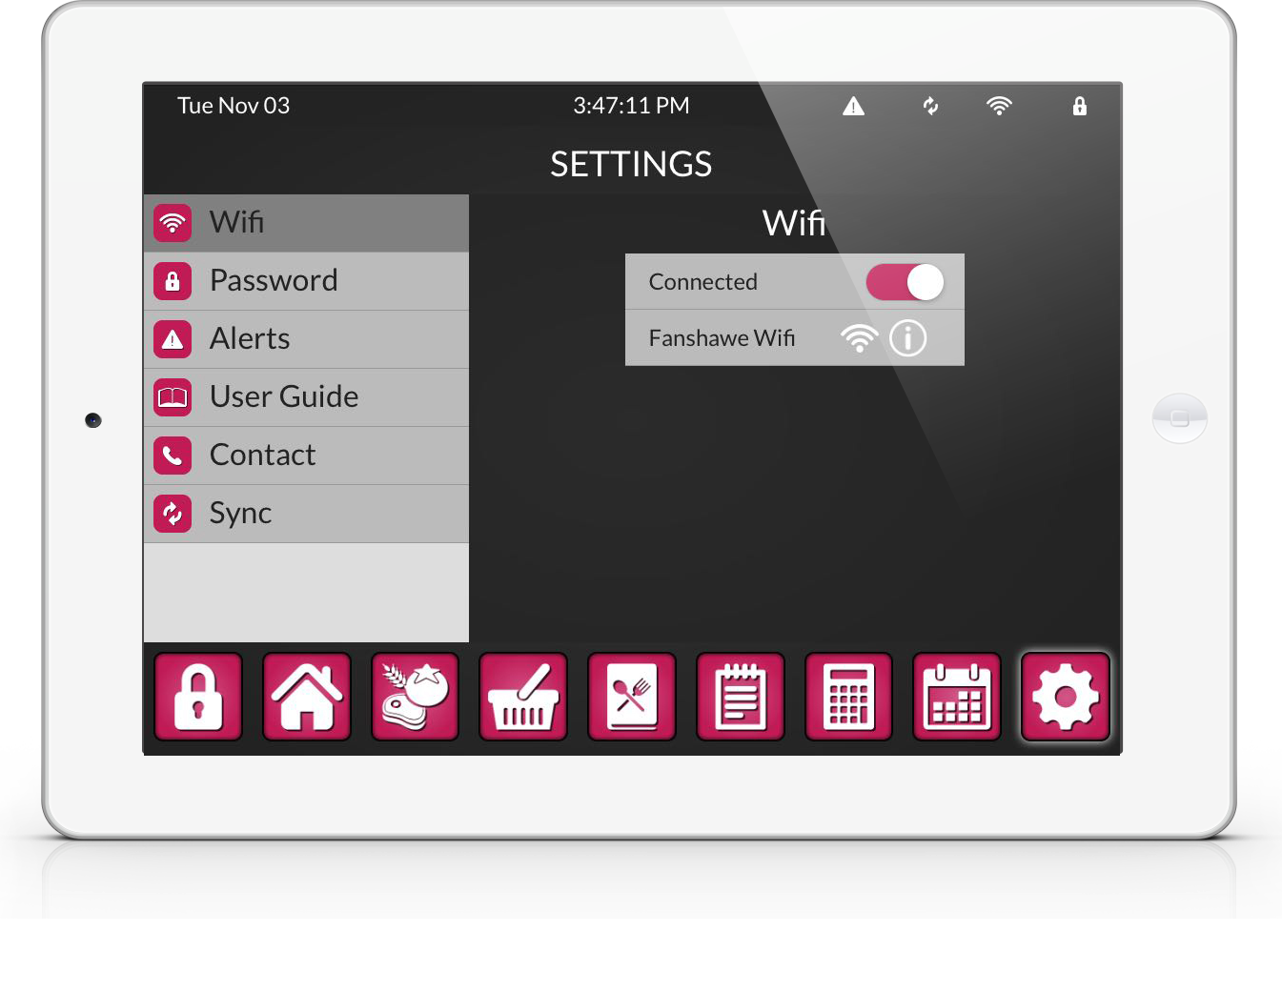
Settings
Matthew Walcher & Caitlyn O’Driscoll

