Slide 1

Keyboard Access Attacker
Requirements
  One time physical access to system
  Permenant hardware installation
Benefits
  Keylogging
  Keyboard control and injection

Slide 2
Attack Scenario
Desire access to local bank's computer network
Discretely insert device as keyboard pass-thru
Log keystrokes during the day
Come back during non-business hours
  Download keystrokes remotely
  Remote keyboard control
    Download further exploits to install on system

Slide 3
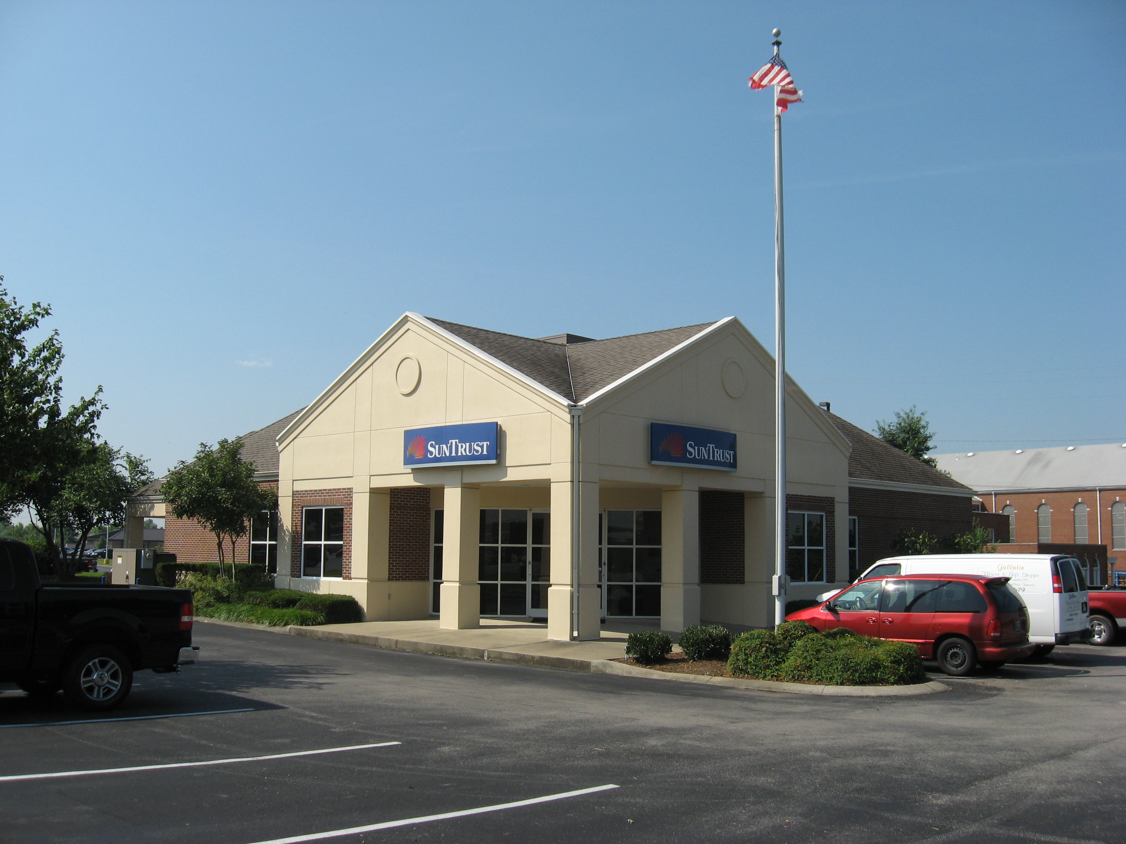
Typical Bank

Slide 4
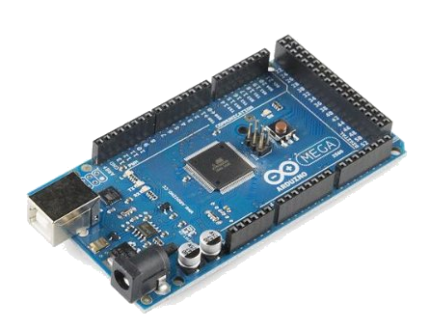
Hardware
Arduino MEGA 2560 (Arduino)
  Atmel AVR ATmega2560 16MHz 8kB RAM
  4 UARTs (I used 2 of 4)
  USB to Serial Interface
    ATmega8u2
  Flexible ”Shield” Interface
  Open source / Free development library

Slide 5
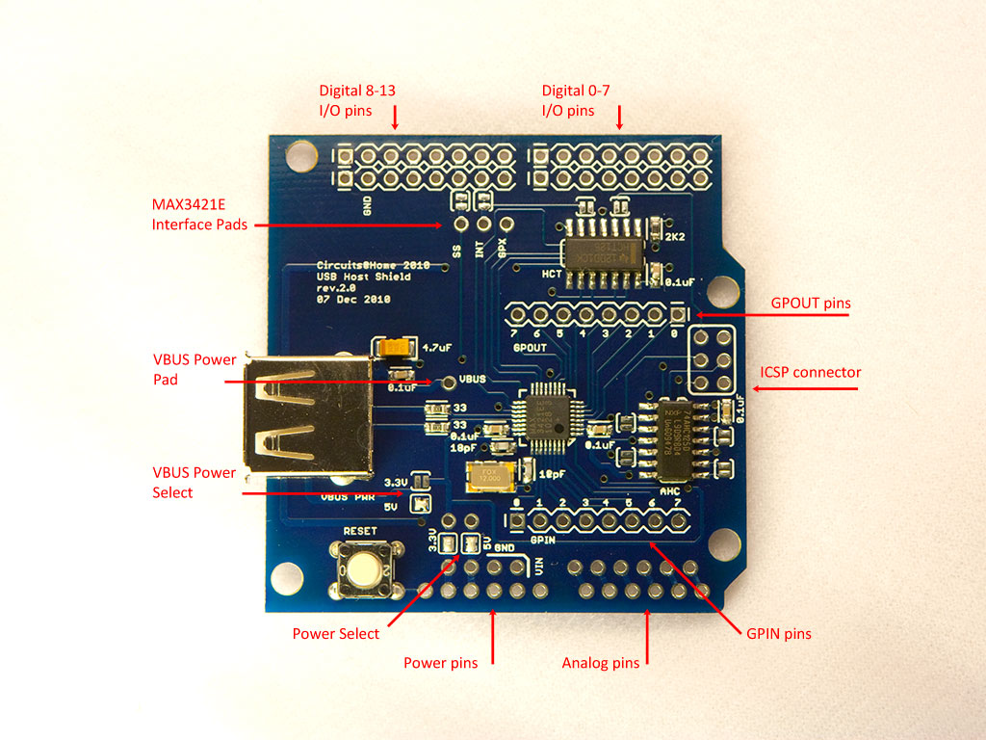
Hardware Continued
USB Host Shield 2.0 (Circuits@Home)
  Maxim MAX3421E USB host controller

Slide 6
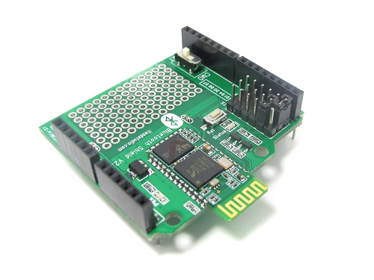
Hardware Continued
BlueTooth Shield v2.2 (itead studio)
  CSR BC417
    Embedded microprocessor
  UART to Bluetooth made simple
  CMD mode – Configure operating parameters via serial commands
  DAT mode – UART to Bluetooth bi-directional
Android Smartphone or Tablet
USB cable

Slide 7
Software
LUFA
  Open Source (MIT) USB Stack for AVR uC
    HID devices
    Serial devices
Arduino 1.0
  C++ / Processing for AVR
Host Shield Library
BlueTerm (Android Application)

Slide 8
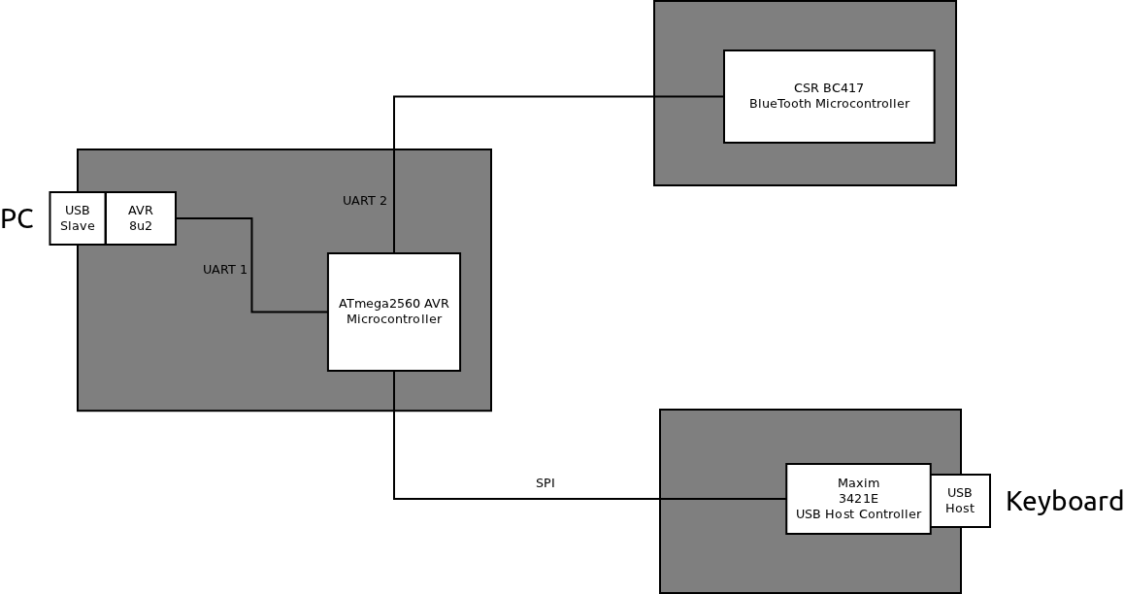
Interfaces

Slide 9
Improvements
Spoof Keyboard USB Identification
  Currently just use LUFA default configuration
Add Secure Digital (SD) Flash Storage
  Increase log capacity from 2KB to 2GB
Schedule BlueTooth radio availability
  Decrease detectability
Custom Android Exploit application
  Ready made exploit scripts
  Process key-log for passwords / usernames

Slide 10
Lessons Learned
MEGA 2560's 4 UARTs makes development easier
  Develop application on MEGA
  Deploy on UNO (1 H/W UART w/ S/W UARTs)
Revision 3 Arduino Boards
  New boards have 16u2 AVR for USB-serial converter
  Doubles program storage from 8KB to 16KB
  More room for LUFA (it barely fits with DFU on 8KB)

