Slide 1
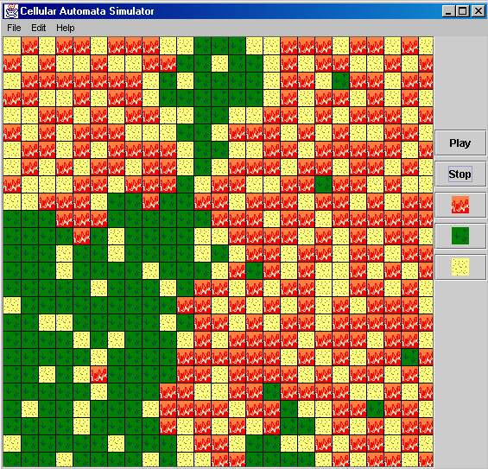
Spatial Entity Simulator
Jeffrey Miller
Michael Wales

Slide 2

Topics
Brief overview of Cellular Automata (CA) concepts
High level design of simulator
Demonstration
Lessons learned

Slide 3
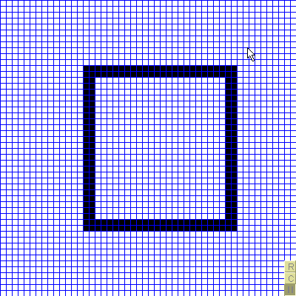
Conway’s Game of Life
A living cell will continue to live if 2 or 3 neighbors are alive
A dead cell will become alive if it has 3 living neighbors

Slide 4
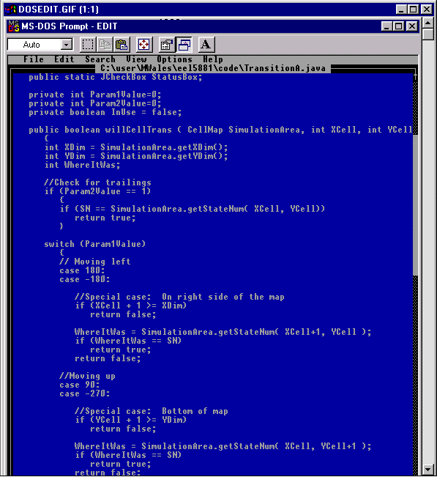
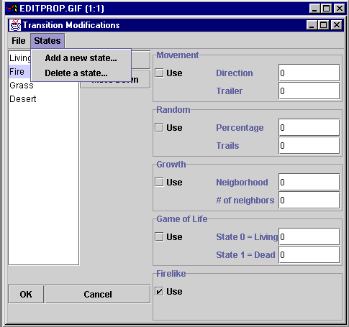
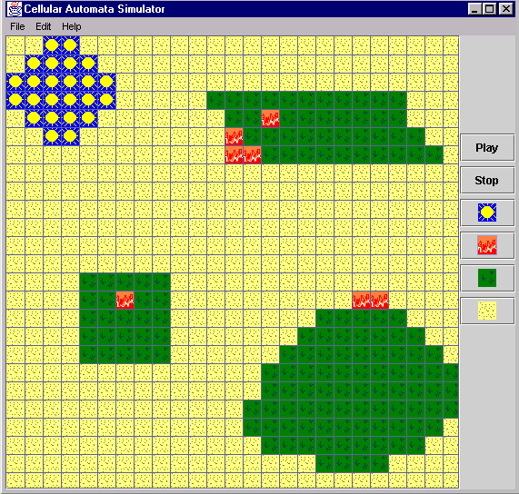
General Requirements
Create a general use simulator
  User friendly initial state editor
  Needs to be programmable
  Transition properties edited through a user-friendly GUI
  Load and save files

Slide 5
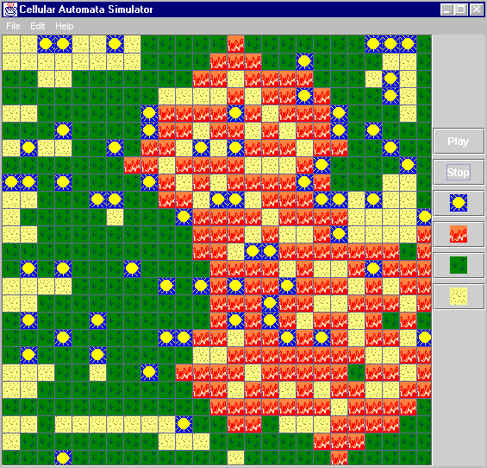
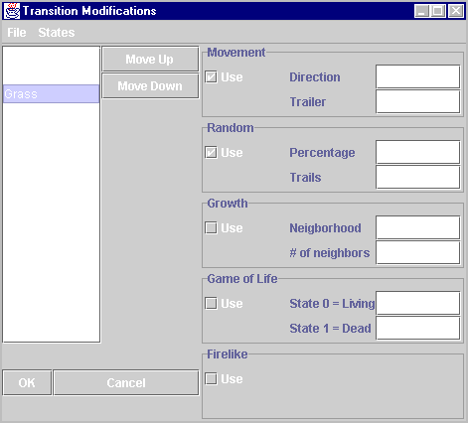
Program Design
Application divided into two main parts
  Jeff created the editor on the left
  Michael created the properties window on the right
Both parts were integrated late in the design cycle

Slide 6
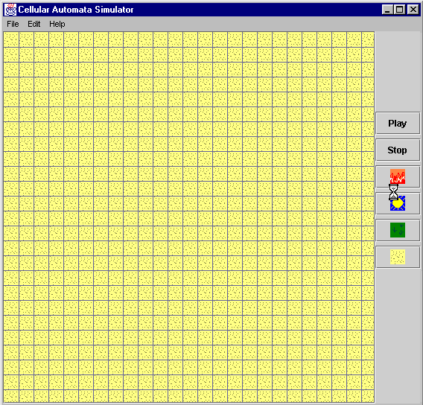
Implementing the Editing GUI
Buttons represent states
Click-able cells
  Dragging cursor selects large areas
  Clicking a cell selects
  Each cell is a class

Slide 7
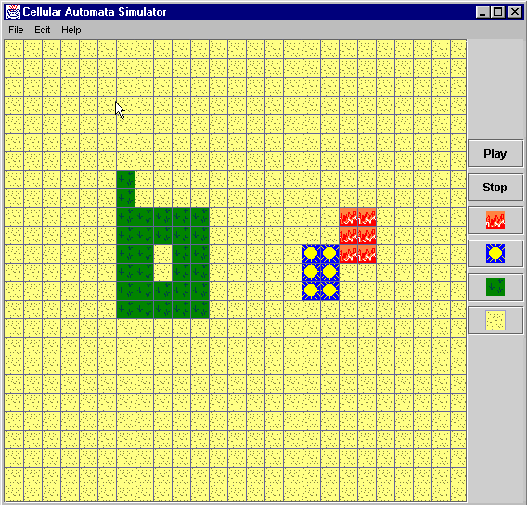
Loading and Saving Files
Serialization
Loads image file
Loads transition rules

Slide 8
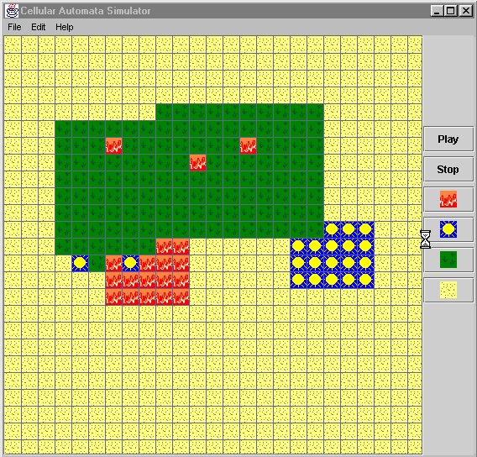
Running a Simulation
Threaded
Traverses the screen
Determines new state
Repaints grid

Slide 9
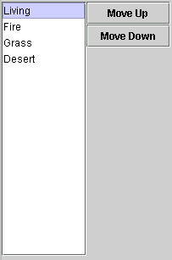
Next State Determination
What will cell (x,y) go to?
  Starts with state of least precedence
  Ask the state if it would go to cell location (x, y)
  Ask each state above it
  The state with highest precedence over-rules others

Slide 10
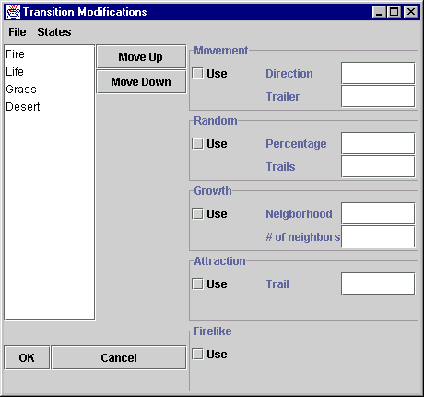
Editing Transition Rules
Each rule is programmable
Each state can have any combination of rules controlling it

Slide 11

Programmable rules
String Description = "Random";
String Param1Description = "Percentage";
String Param2Description = "Trails";
boolean willCellTrans ( CellMap Map, int X, int Y, int SN) {
if ( Param2Value == 1)
if (Map.getStateNum( X, Y) == SN)
return true;
if (RandomNum(100) >= Param1Value)
return false;
else
return true;
}

Slide 12
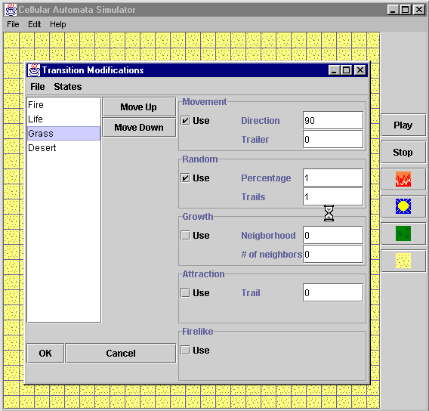
What about conflicts?
Trailer is off in Movement
Trailer is on in Random
Any rule that evaluates true will have precedence

Slide 13
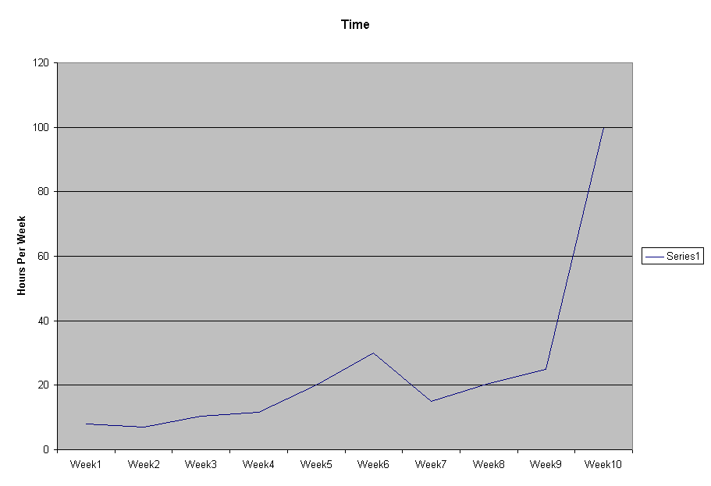
Design Issues
Under estimated complexity of the product
Learning how to use JAVA to build a GUI
Interfacing modules

Slide 14
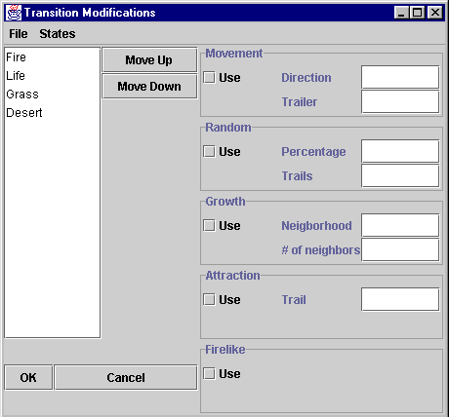
Difficulties with properties editor
Each state has a full set of transition rules
OK button will update all states
Cancel button won’t update any states
Must remember info from before and after!

Slide 15
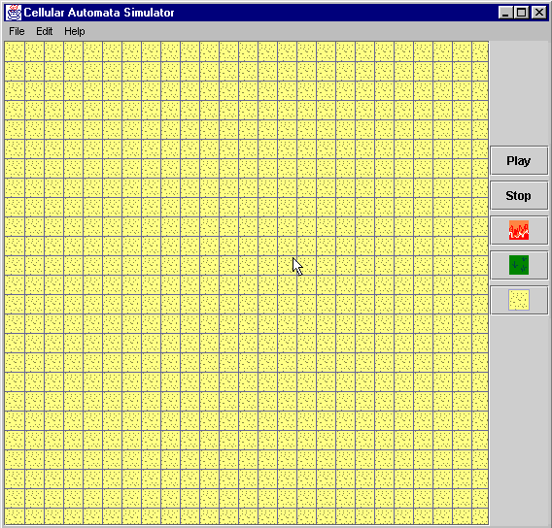
Difficulties with editor
Adding a new state
  GUI must update
  Map must contain data about the new state

Slide 16
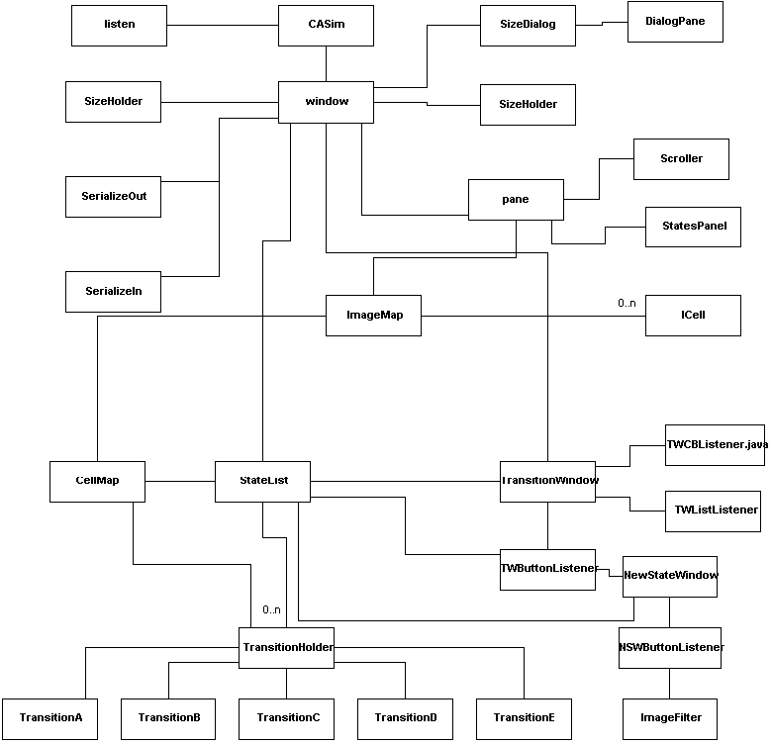
Interfacing of two GUIs
<- Editor Module
<- Properties Window

Slide 17
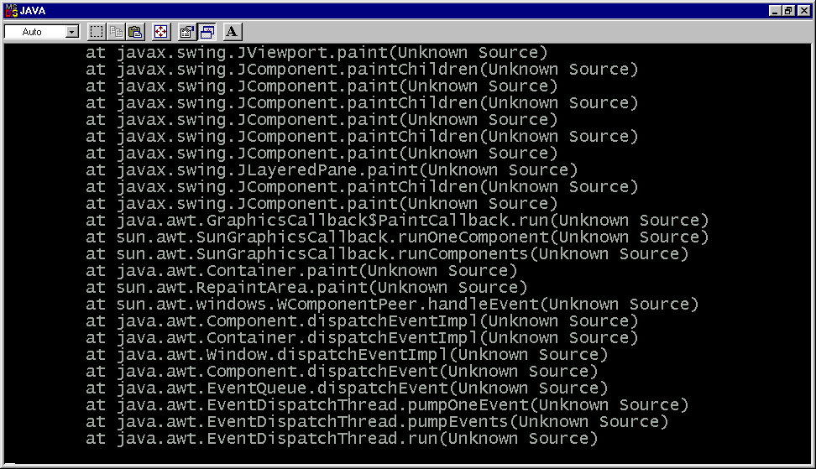
Lessons learned
Testing
  Difficult
  Time consuming

Slide 18
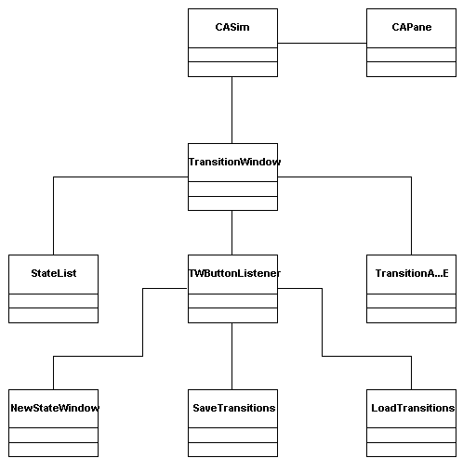
Lessons learned
High-Level and Detailed-Design should be created early
1st design = 6 classes
Final design has 28 classes

Slide 19
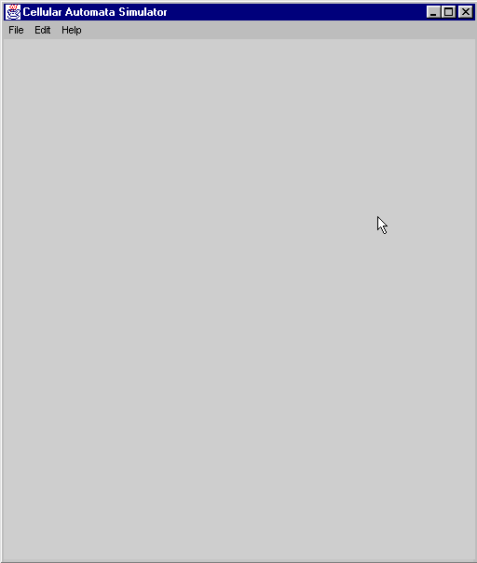
Software quality
User inputs checked
  Error dialog boxes
Try to handle all exceptions
Extensive testing

Slide 20

Conclusions
Product meets general requirements
Difficulties were resolved
Lessons learned will be applied to future projects
Software design is very time consuming

