Slide 1

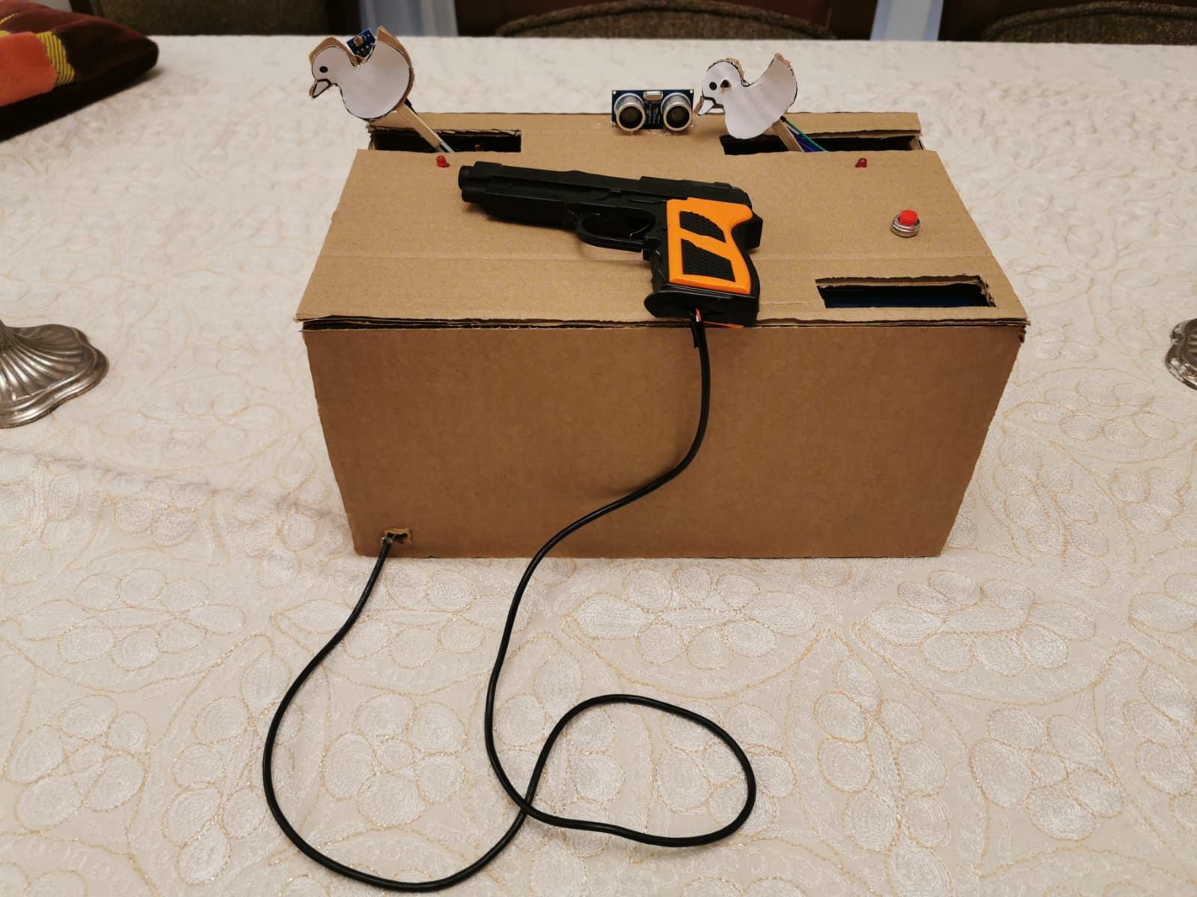
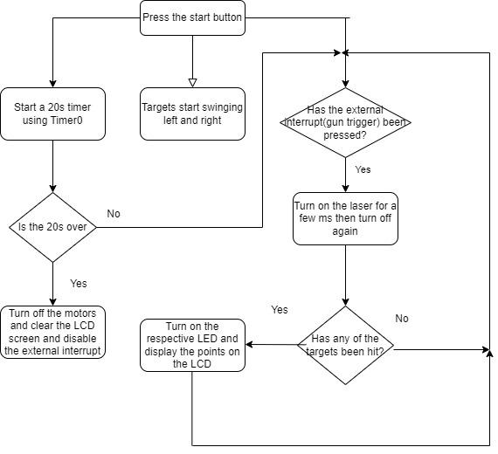
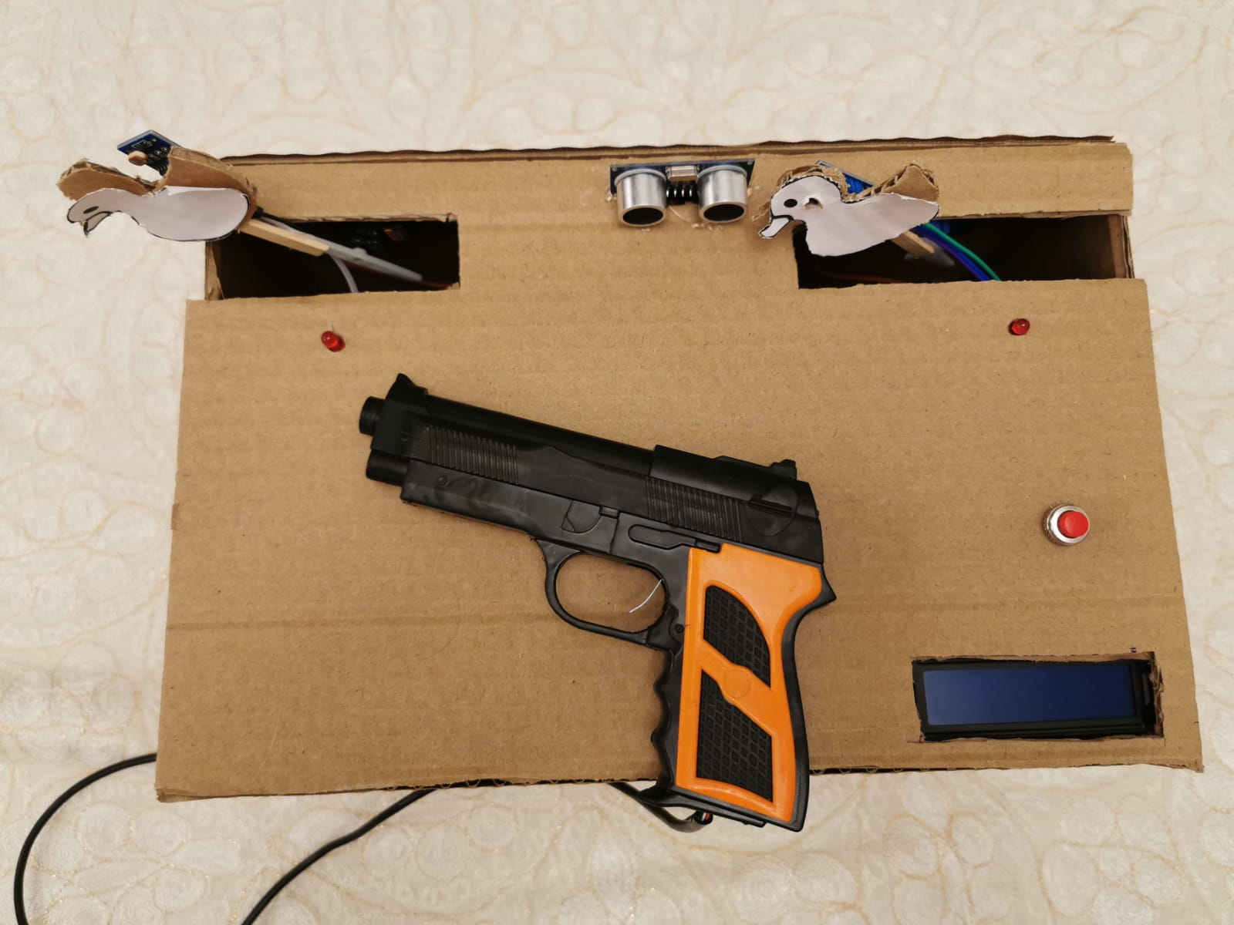
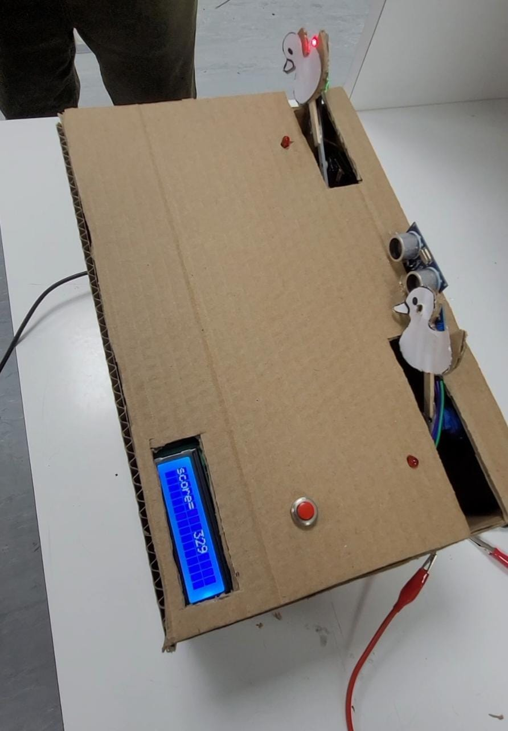
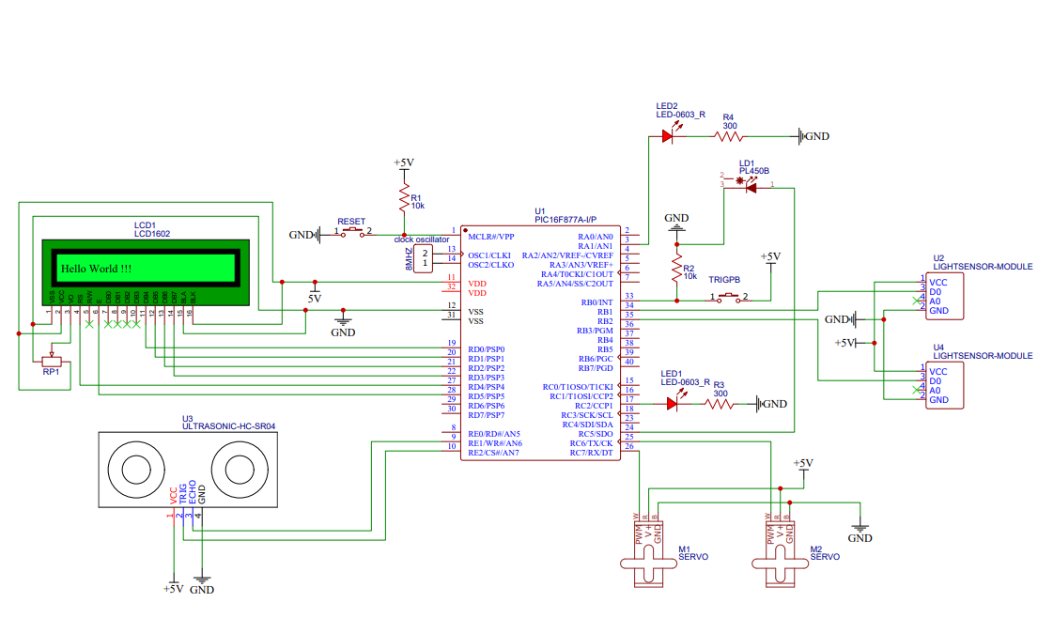


Laser Gun Game
Nabil Mazyad, Omar Abukhalaf, and Ahmad Almualla
Supervisor: Dr. Belal Sababha Embedded Systems Final Design Project, Spring 2023
King Abdullah II School of Engineering Princess Sumaya University for Technology
Introduction
This project aims to design a laser gun shooting game using one PIC16F877A microcontroller. The game has a laser emitting gun that aims at two moving targets controlled by servo motors. The main sensors and components used were two light dependent resistors and an ultrasonic sensor in addition to an LCD screen as well. The score is calculated by measuring the distance between the shooter and the target and is displayed by the LCD screen.
The designed project is a miniature-sized laser gun game.It will contain two main functions:
- A laser shooting gun that represents the player
- A target that is being aimed at for achieving points
Results
The following figures depict the final results after connecting the circuits and designing the smart city.
Design
The following flowchart provides an insight of the functionality of the main device in the smart city, which is the car.
Start
Front Figure
(b) Project shown from above
Figure 1
The game’s designed circuit is shown in Figure 2.
RB1
VDD
Ultrasonic Sensor
¹ MCLR
2
RB7 ⁴⁰
RB6 ³⁹
RB5 38
RB4 37
36
9V Battery
Voltage Regulator 9V - 5V
+5 V
3
4
Left
M1
Gnd
5
35
RB1 ³⁴
33
6
Trigger
Echo
7
8
A
877
16F
C
I
P
Vout
Gnd
9
P16F877A
32
IN1 IN2 IN3 IN4
Vin
10
+5 V
¹¹ VDD
31
H-bridge
^{Gnd 12} VSS
30
¹³ OSC1
¹⁴ OSC2
¹⁵ RC0
16
17 RC2
18
29
Oscillator
28
(c)
( c ) Active game shown with an updated score
RC0
27
RC7 ²⁶
25
24
M2
Right
12V Battery
VSS
Common Ground
19
23
RD3 ²²
RD2 ²¹
RF Receiver
+5 V
IR Left
IR Right
RD3
20
Enables 1,2
Gnd ^{RD2}
Figure 2
Conclusion
Laser tag can be played indoors or outdoors and can be enjoyed by people of all ages. It offers a fun and exciting way to engage in physical activity, while also stimulating strategic thinking and team-building skills. In this modern era of technology, laser tag is a perfect example of how innovative technologies can create new and engaging experiences for people.

