Slide 1
Computational detection and characterization of epistatic interactions in influenza A hemagglutinin protein surveillance sequences and deep mutational scanning data
Magdalene Walters¹, David McCandlish²
¹Undergraduate Research Program
²Cold Spring Harbor Laboratory

Slide 2
Outline
Biological Background
Project Motivation
Network Analysis
Visualization
NS:S ratio metric
Observed sequences that are not tolerated under high throughput mutagenesis
Discussion
Biological Background
Project Motivation
Network Analysis
Visualization
NS:S ratio metric
Observed sequences that are not tolerated under high throughput mutagenesis
Discussion

Slide 3
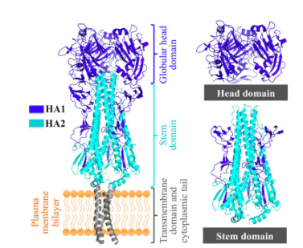
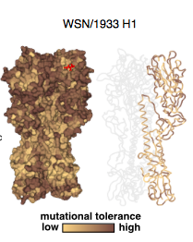
Hemagglutinin (HA) is under strong evolutionary pressure to evade detection by the human immune system
Must evade cross-immunity response of the adaptive immune system
High mutational tolerance (1 – 2 substitutions per year)
Mutations can have epistatic effects
Lu, Welsh, Swartz, 2014
Lee et. al, 2018
Biological Background
Notes:
For my project these epistatic effects
Have one mutation that is globablly stabilizing, might allow for a large amount of nonsynonymous substitutions.
Have a subsequent mutation that allows for an immune escape response
The first mutation’s effects epistatically allow for immune escape responses to be seen.
main protein involved in the immune recognition.

Slide 4
Outline
Biological Background
Project Motivation
Network Analysis
Visualization
NS:S ratio metric
Observed sequences that are not tolerated under high throughput mutagenesis
Discussion
Notes:
Have all of this data, need to make sense of it.
Try to see how it changes in time and sequence space.
Generated a sample schematic

Slide 5
Motivation
What we know:
Immune-escape and drug-resistant phenotypes often appear through a combination of several mutations that have epistatic effects on pathogen fitness.
What we have:
Incredibly dense surveillance sequence data and high throughput mutagenesis data
Both tell us in different ways which types of substitutions are tolerable
What we want to do:
Identify substitutions with possibly permissive effects
Do this through the NS:S metric
Why don’t we see what we don’t see?
Identify substitutions which aren’t viable in mutagenesis experiments but are observed regardless
Motivation

Slide 6
Outline
Biological Background
Project Motivation
Network Analysis
Visualization
NS:S ratio metric
Observed sequences that are not tolerated under high throughput mutagenesis
Discussion
Notes:
Have all of this data, need to make sense of it.
Try to see how it changes in time and sequence space.
Generated a sample schematic

Slide 7
SEQ A
A G T - G A C - C C T - G A A
Distance 1 at 4
NUCLEOTIDE LEVEL:
DISTANCE 1,
‘A 5 T’
SEQ B
A G T - G T C - C C T - G A A
Cluster size of 4
Square indicates high sampling density
Higher sampling density should show more clusters
Distance 1 at 7
Distance 1 at 7
NUCLEOTIDE LEVEL:
DISTANCE 1,
‘C 7 A’
SEQ C
A G T - G T C - A C T - G A A
NUCLEOTIDE LEVEL:
DISTANCE 1,
‘T 5 A’
Distance 1 at 4
SEQ D
A G T – G A C - A C T - G A A
Network Analysis
Notes:
First evaluated on a nucleotide level
Introduction to how substitutions are denoted as “A5T”
first show this, then need to move into slide about the clusters that we actually see.
example, one cluster, top twenty.
instead of clusters
focal sequences: sequences of high degree in the graph.

Slide 8
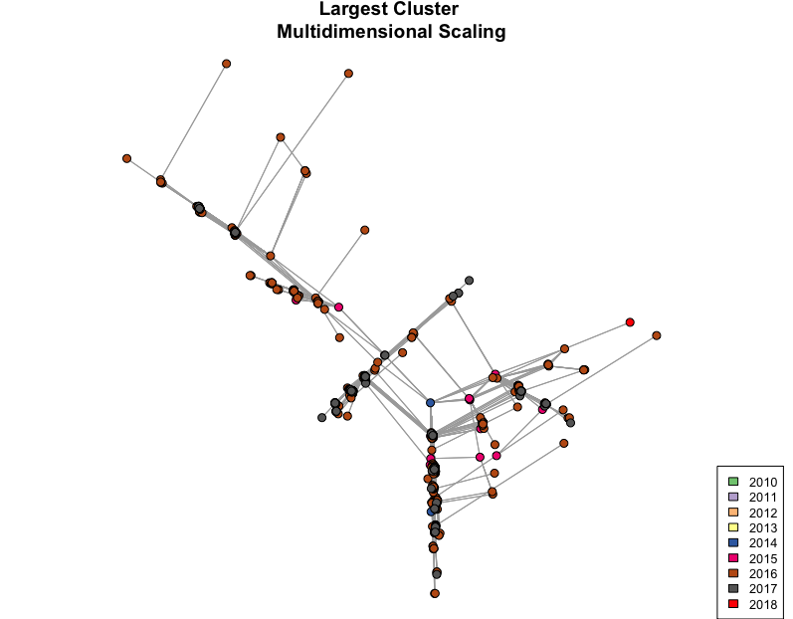
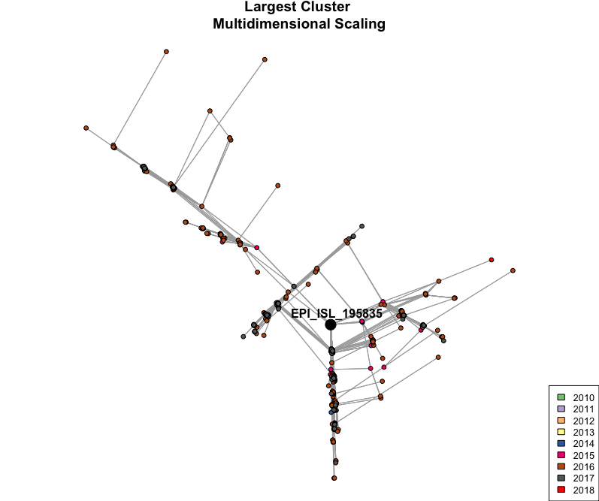
Example of the largest cluster
Contains 726 unique sequences at the nucleotide level
Dense sequence sampling space
All are examples of viable substitutions
Notes:
Maybe highlight the sequence with the most neighbors
Cloud of very closely related sequences.
Total number of single nuc neighbors and break it up into NS and S.
--neighbors include both a large number of synon neighbors and ns neighbors.
--there’s reasonable belief that these are all viable subs as they were isolated from quite sick patients in the hospital.
HEEM UH GLOOT IN IN
Consider whether I want to emphasize that the first two steps are what we expect to see in evolution (single nuc changes)
Capturing diversity at such high resolution that not only do we see the branching that we expect in a phylogeny but that we see other structures too.
Emphasize that there are 726 vertices (just semi difficult to see)
Symmetrys in dist struct cause degeneracy in representation. We can expect that tho so that’s a strength of this method.

Slide 9
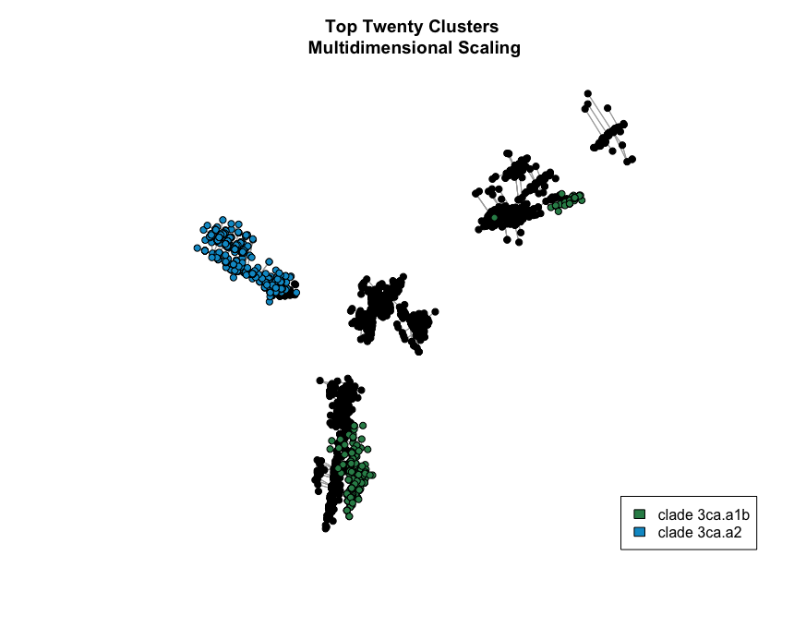
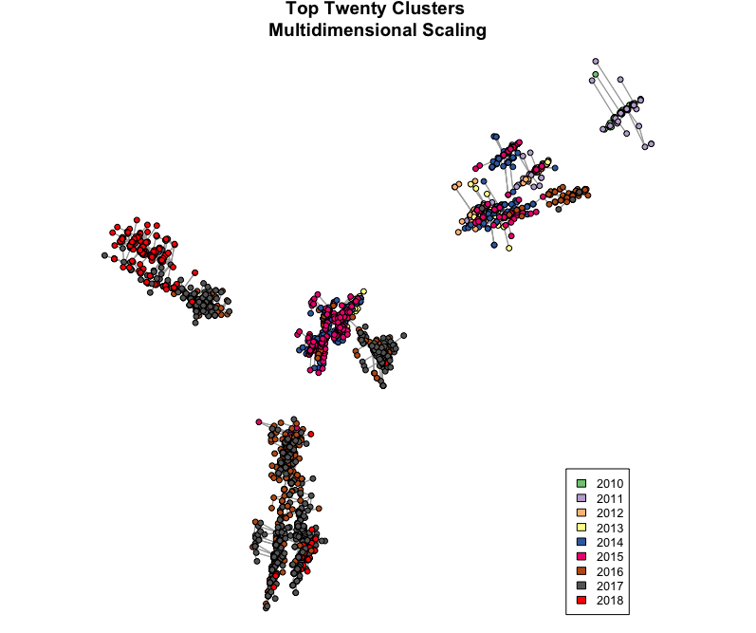
Sampling density and temporal trends in network analysis
Plotted using weighted multidimensional scaling
Indication of movement through both sequence space and time
Recent divergence represents subclades of 3c2.A:
3c2.A1b: 30% of global population
3c2.A2: 40% of global population
Network Analysis: Visualization
Notes:
Had about 20,000 unique sequences. Utilized the top twenty largest clusters to cut this down to ~5500 to make graphics easier.
wmds is like pca
cluster: individual sequence and it's neighbors
each point is either a seq with a lot of neighbors or one of those neighbors
this is clusters of clusters.
each flu season, you see a cluster of clusters
*****get rid of a lot of the white space.
*****label the individual flu clusters.
Mds in 3d would have the little blue cluster from report hovering (closer in sequence space)
--quite unusual for the flu (usually only has one dominant clade but at the time has two)

Slide 10
Outline
Biological Background
Project Motivation
Network Analysis
Visualization
NS:S ratio metric
Observed sequences that are not tolerated under high throughput mutagenesis
Discussion

Slide 11
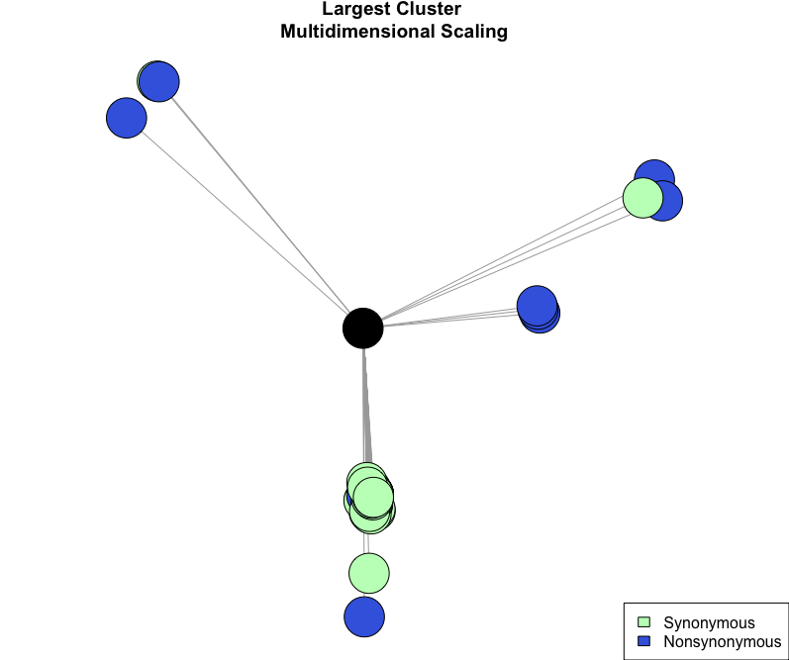
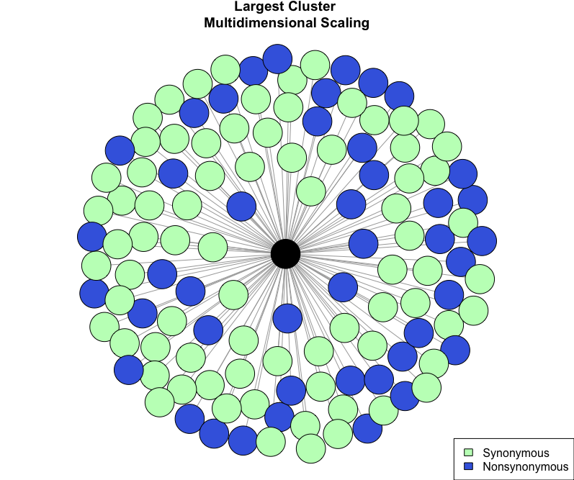
Substitution tolerance of different sequence backgrounds
Identified focal sequences
Evaluated at the amino acid level
Possible because of amino acid code redundancy
Describes the mutational tolerance of a certain sequence background
Number of nonsynonymous sequences: 44
Number of synonymous sequences: 76
NS:S ratio: 44 / 76 = 0.5789474
NS:S ratio metric
Notes:
Make sure to say that NS:S metric stands for the nonsynonymous to synonymous neighbors
Did this for the most connected sequence of each of the top twenty clusters
**maybe clarify here
# synon is proportional to the local sampling density bc we assume that they don't affect the functionality of the protein
hope to control for the fact that there is different sampling density around different clusters.

Slide 12
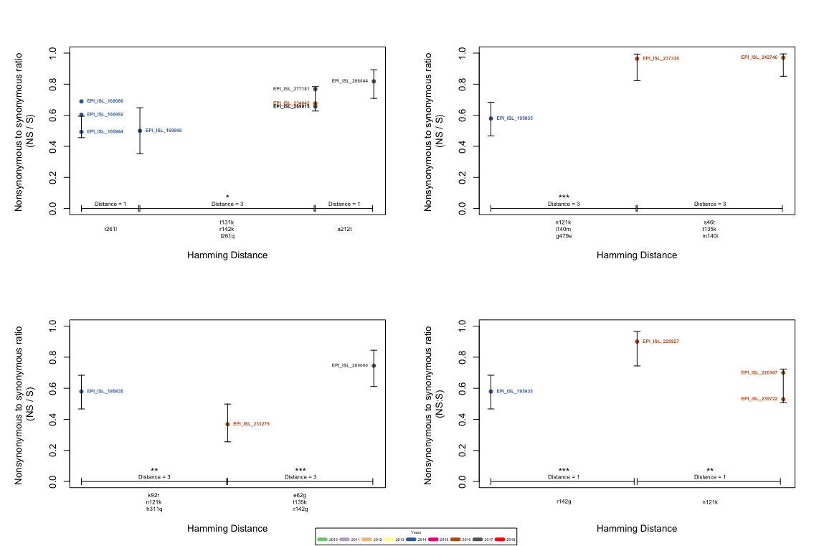
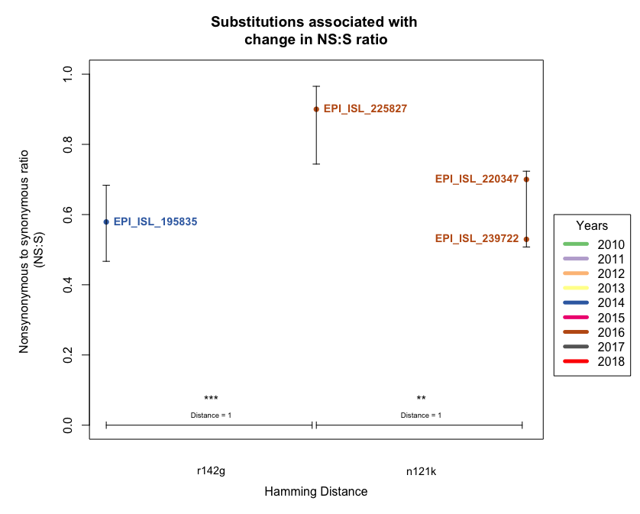
‘r142g’ and ‘n121k’ resulted in significant changes in NS:S ratio
‘r142g’ was associated with an increase in NS:S ratio from ~0.57 to 0.9 (p = 0.001545, 2-sample test for equality of proportions)
‘n121k’ was associated with a decrease in NS:S ratio from 0.9 to 0.7 (p = 0.04358, 2-sample test for equality of proportions)
These substitutions were seen repeatedly in transitions between other sequences of the top twenty clusters
Notes:
These sequences ended being highly related at the amino acid level, was able to group into some cohorts that only differed by 1 – 3 amino acids
Between 9 connections between sequences, 6 had significant differences in NS:S ratios
2/6 had significant differences associated with a single amino acid changes
This is seen in the bottom right graph which I’m going to zoom in on
Hypothesize that HA’s tolerance to substitutions fluctuates substantially on a substitution by substitution basis.

Slide 13
Outline
Biological Background
Project Motivation
Network Analysis
Visualization
NS:S ratio metric
Observed sequences that are not tolerated under high throughput mutagenesis
Discussion

Slide 14
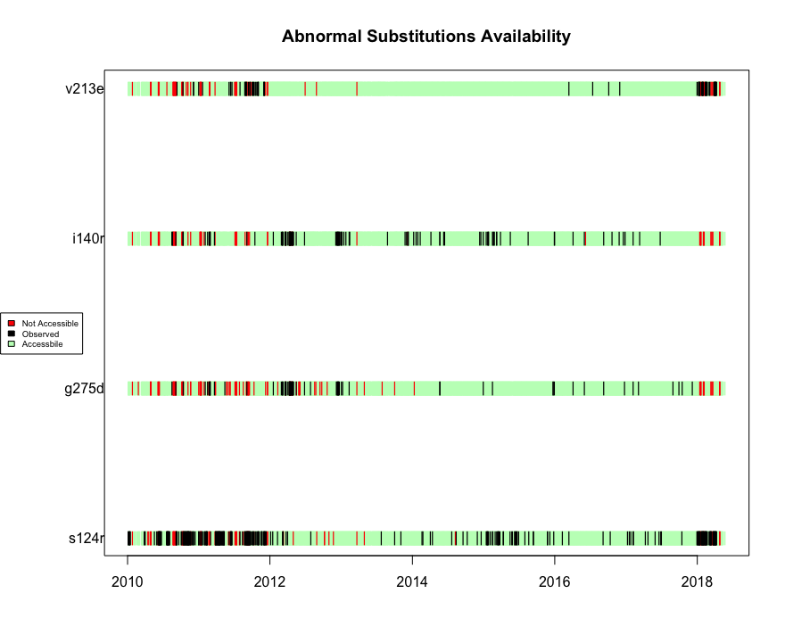
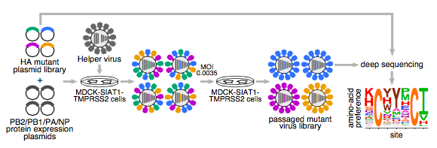

DMS data informs unexpected substitutions
CGT
CGC
CGA
CGG
AGA
AGG
Only certain mutations allow for a single nucleotide change to result in a specific substitution
Example: switching from isoleucine to arginine
ATT
ATC
ATA
Uncommon, yet recurrent, substitutions
Notes:
1.) identified all NS subs
2.) identified all substitutions which shouldn’t be permitted per DMS data (allowed in <1% of all trials)
3.) looked at availability to ensure that the times that they weren’t being seen wasn’t the result of inaccessibility via the amino acid code.
Found four mutations which exhibited patterns of observation inconsistent with assumption about sampling density.
Assumption about sampling density: more likely to see rarer substitutions at the end of the sampling period because sampling sizes are higher.
explanation of what DMS data is would be helpful. walkthrough the experiment. look at the freq of things at beginning and end to see what was tolerated. these muts usually drop out suggesting that they render the protein non-functional, but we do see some of these in nature.

Slide 15
Outline
Biological Background
Project Motivation
Network Analysis
Visualization
NS:S ratio metric
Uncommon, yet recurrent, substitutions
Discussion

Slide 16
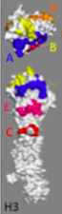
Results
Identified ‘r142g’ and ‘n121k’ as substitutions that resulted in a significant change in NS:S ratio.
Identified ‘s124r’, ‘i140r’, ‘v213e’, and ‘g275d’ as substitutions which were unexpected per DMS data, yet recurrent.
213
121, 124,
140, and 142
121 and 142
275
Discussion
Stray and Pittman, 2012
Notes:
all of them have been previously hypothesized and shown to be implicated in immune escape. known to be targets of natural selection for antigenic variants.
--find graphic that shows the different antigenic sites and then point to them and show where those positions are

Slide 17
Implications and suggestions for future work
Identified substitutions are located in positions relevant in recognition by the immune system.
‘r142g’ associated with vaccine ineffectiveness from 2014 - 2015
With increasing surveillance sequences, it should become easier to identify changes in the NS:S ratio as the result of single amino acid changes.
Examine the unexpected mutations to identify possibly permissive mutations which precede them.
Identification of permissive mutations with epistatic effects can allow for vaccine development efforts to prepare for periods of high strain diversity.
Discussion
Notes:
r142g mutation was associated with the 2014-2015 flu epidemic when the vaccine was ineffective

Slide 18
Acknowledgments
McCandlish Lab
David McCandlish
Juannan Zhou
Anna Posfai
Tong Liang
URP Staff
Notes:
put the structure picture here again.
put a lab pic on this slide.

Slide 19
Work Cited
Lee, Juhye M, et al. “Deep Mutational Scanning of Hemagglutinin Helps Predict Evolutionary Fates of Human H3N2 Influenza Variants.” BioRxiv, 10 Apr. 2018, pp. 1–16., doi:10.1101/298364.
Lu, Y., et al. “Production and Stabilization of the Trimeric Influenza Hemagglutinin Stem Domain for Potentially Broadly Protective Influenza Vaccines.” Proceedings of the National Academy of Sciences, vol. 111, no. 1, 7 Jan. 2014, pp. 125–130., doi:10.1073/pnas.1308701110.
Stray, Pittman. “Subtype and antigenic site-specific differences in biophysical influences on evolution of influenza virus hemagglutinin”. Virology Journal. Vol. 9. 2012. pp. 1-16.
Notes:
picture here of the molecule?

