Slide 1
CKEditor + reusable styles = User-friendly rich text styling
Marlene Williams
PDX DUG Meetup April 10, 2013

Slide 2
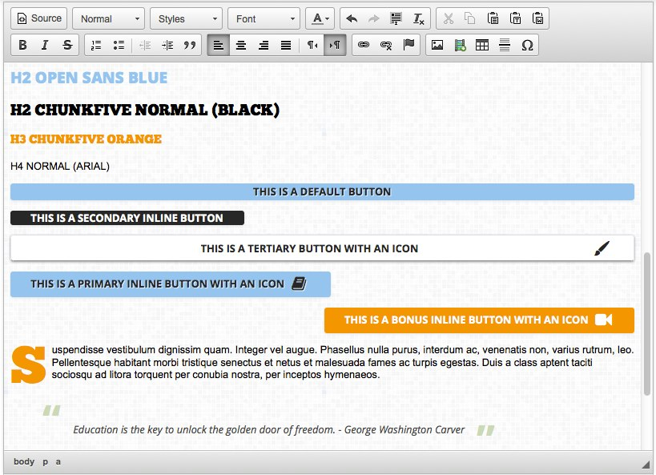

Slide 3
0) What this is not about:
Security
Semantic perfection of the editor output
3rd party CKEditor plugins/modules

Slide 4
Interpret the visual design
Create the code
Configure CKEditor

Slide 5
1) Interpret the visual design
Define reusable styles.
These are any chunks of styling that could get manually put into place, either through block/pane/menu item classes or through a WYSIWYG. E.g.:
Block styles
- Text styles
Buttons
List styles
- Icons
- Read more links

Slide 6
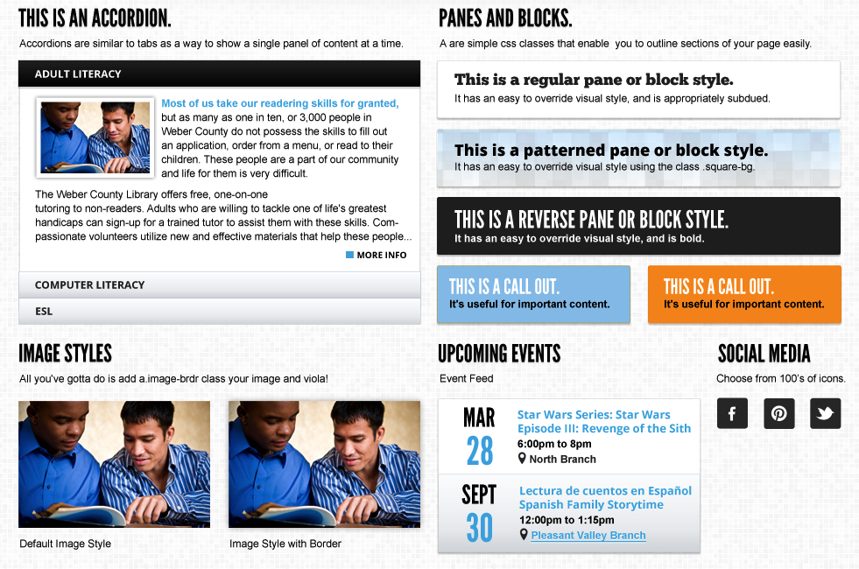

Slide 7
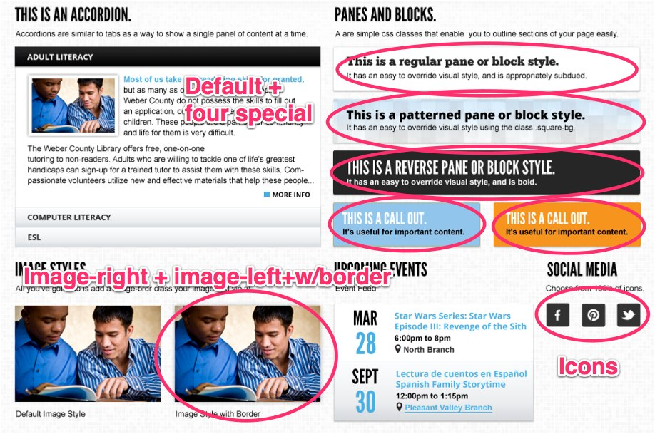

Slide 8
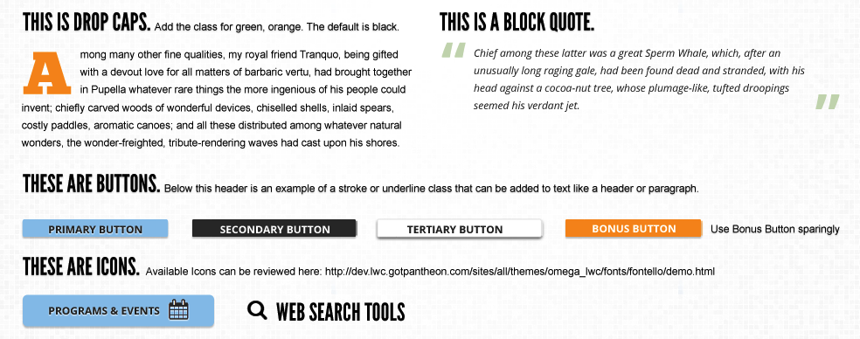

Slide 9
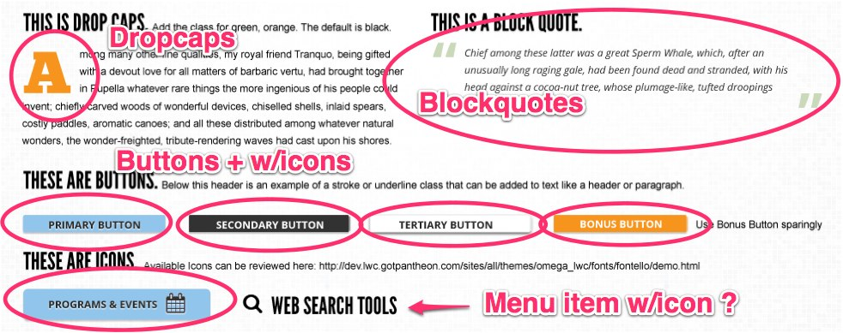

Slide 10
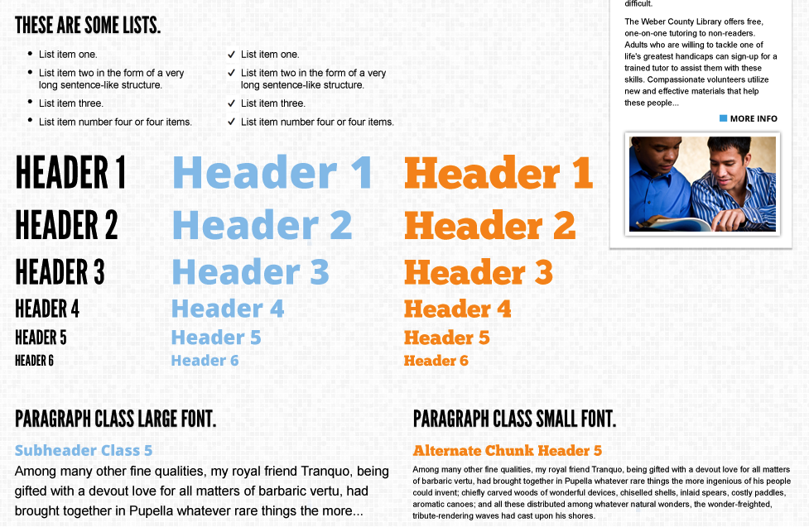

Slide 11
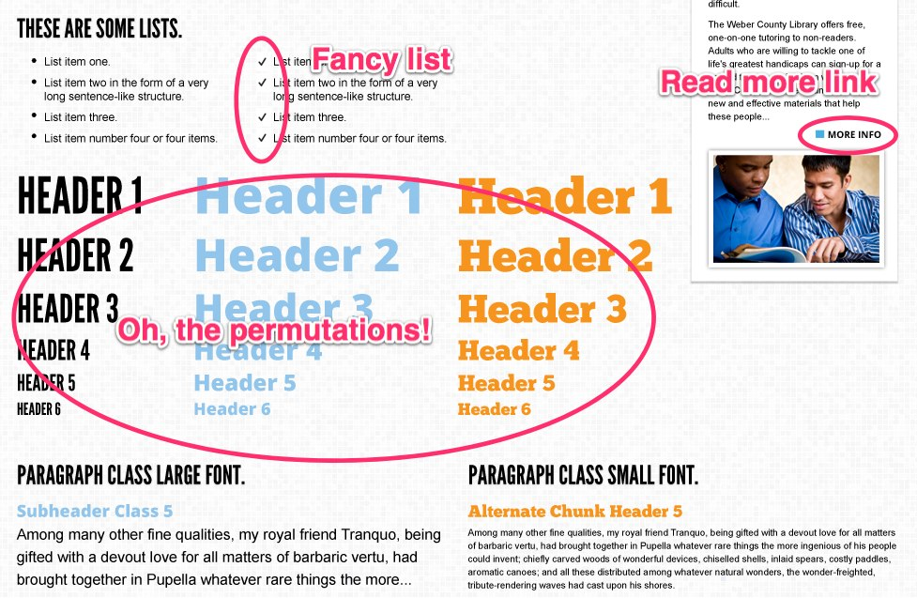

Slide 12
Look at the style tiles and/or mockups and generate a list. Talk with the designer and client if anything is unclear, or if you think there might need to be more than what is defined in the designs. Or if something is impractical.
Try to think of all the likely (or possible) ways each style could be used, then boil them down into the most simple chunks possible. If a style looks too complex and shares similar aspects with others, see if the similarities can be broken out into their own pieces, which can be included in the others. Buttons, for example.

Slide 13


Slide 14
Needed CKEditor styles:
Primary button
- Secondary button
- Tertiary button
- Bonus button
- Drop caps
- Blue callout
- Orange callout
- Decorative list
- More link
Image right
Image left
- Decorative list
Needed CKEditor fonts:
League Gothic
(default)
- Open Sans, extra bold
- ChunkFive
Needed CKEditor text colors:
- Black (default)
- Orange
- Blue

Slide 15
Needed HTML elements:
Headings 2-6
- Blockquotes
Anchor tags
Uls
- Paragraphs
Divs and spans
Markup targets for styles:
Buttons, more link: a
- Drop caps: span
- Callouts: div
- Decorative list: ul
- Images: img

Slide 16
2) Create the code
Compass/SASS helpers
Use a separate scss file for reusable styles
Use mixins + variables

Slide 17
If needed, use compass to generate a special ckeditor.scss file
For previewing content, CKEditor lets you use:
its default styles,
the current theme styles, or
a custom defined set of styles. I usually like this one since it gives me more control.
Using global styles can introduce not-fun other bugs because of the iframe, e.g. body tag styles... A separate, special ckeditor stylesheet lets you include your reusables styles and add any fixes.

Slide 18
The custom ckeditor.styles.js defines the styles in the editor.
Copy the ckeditor.styles.js file from the module into your theme's JS directory
Modify it to use your own styles
Choose your selectors carefully
Give classes instead of directly modifying styles

Slide 19
3) Configure CKEditor
Text formats
Choose which one(s) you want to use
Plugins start here, e.g. link filters, media filters, image resize
Here is a good place to incorporate security
The order of the text formats matters
CKEditor profiles
If config is going into code, you may want to create a new profile

Slide 20
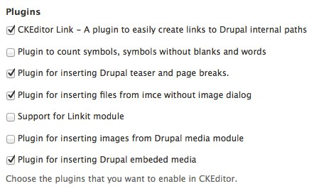
CKEditor profile configuration
Editor appearance fieldset
Plugins used: CKEditor link, Drupal teaser/page breaks, IMCE, Drupal embedded media

Slide 21
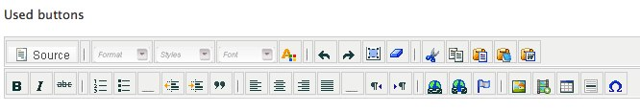
Buttons used: source, format, styles, font, font color, redo, undo, select all, clear styles, cut, copy, paste, bold, italicize, strikeout, ordered list, unordered list, indent text, unindent text, blockquote, alignment, text direction, link, unlink, anchor, IMCE image, media embed, table, hr, special character.

Slide 22

Cleanup and output fieldset
Font formats: p;div;pre;h2;h3;h4;h5;h6

Slide 23


CSS fieldset
Editor CSS: Define CSS
CSS file path: %tcss/global.css
Predefined styles: Define path to ckeditor.styles.js
Predefined styles path: %hsites/default/themes/omega_weber/js/ckeditor.styles.js

Slide 24
Advanced options fieldset
Custom JavaScript configuration:
config.font_names = 'Arial, Helvetica Neue, Helvetica, sans-serif;LeagueGothicRegular, Helvetica Neue, Helvetica, Arial, sans-serif;OpenSansExtrabold, Verdana, Helvetica, sans-serif;ChunkFiveRegular, Georgia, Palatino, Times New Roman, serif’;
config.colorButton_colors = '272727,92c5eb,f7941e';

Slide 25
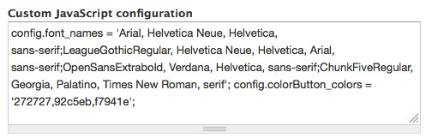

Slide 26
Epilogue: Testing & training
Clear caches
Drupal
Browser
Create a reusable styles demo page

Slide 27
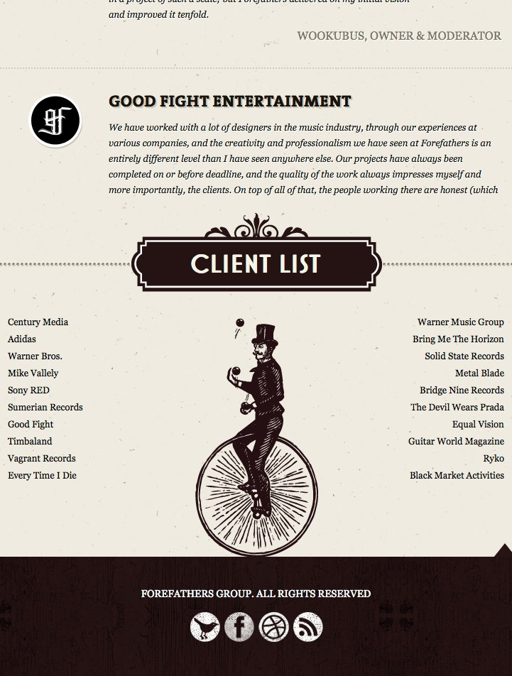

Slide 28
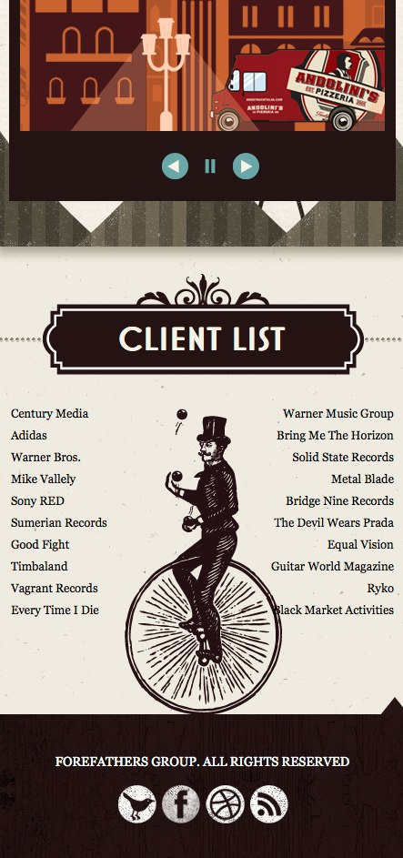

Slide 29
CKEditor + reusable styles = User-friendly rich text styling
Marlene Williams
PDX DUG Meetup April 10, 2013

