Slide 1
Method of Separation of Variables

Slide 2
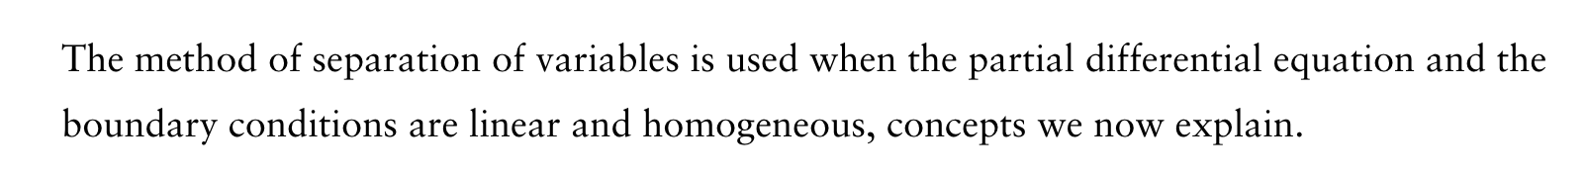

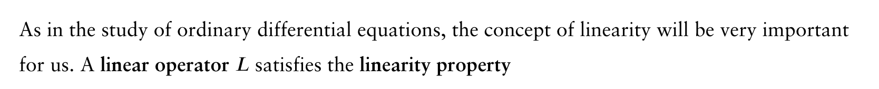

Use a technique called the method of separation of variables to solve the heat equations.

Slide 3
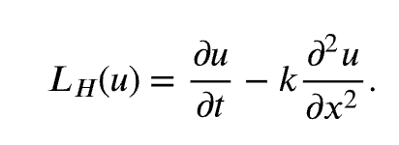
Heat operator:
Show the heat operator is a linear operator and satisfies the linearity property

Slide 4


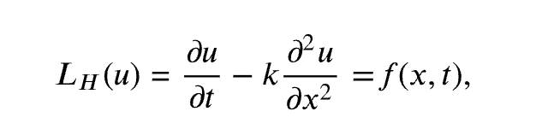
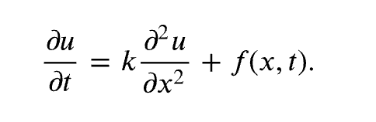

Slide 5

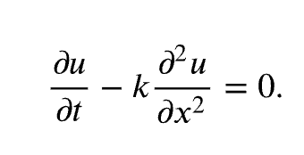

(the trivial solution)

Slide 6

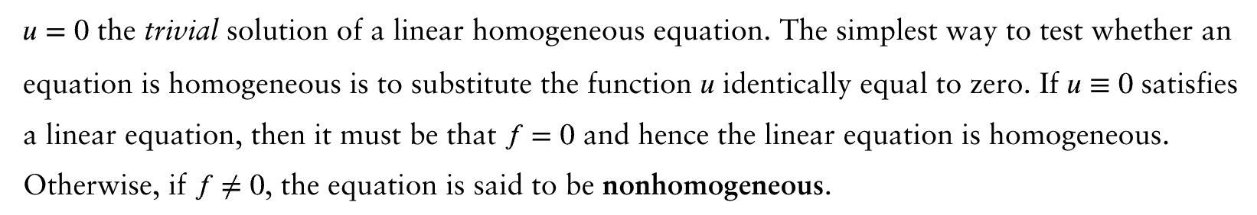
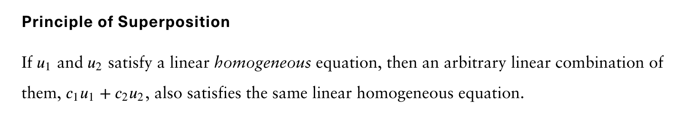


Proof:

Slide 7
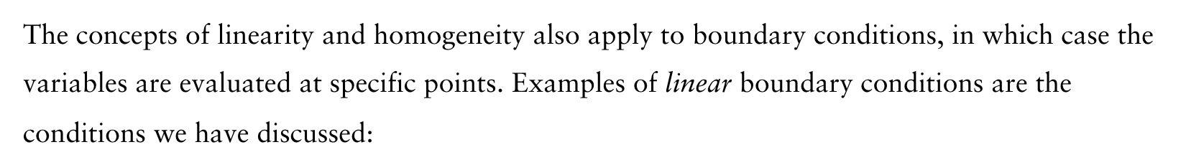
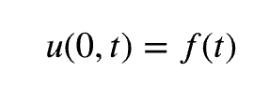
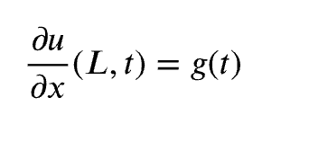
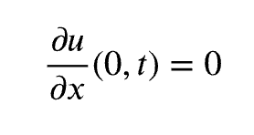
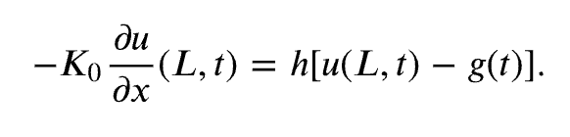
Homogeneous?

Slide 8
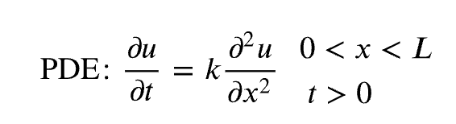
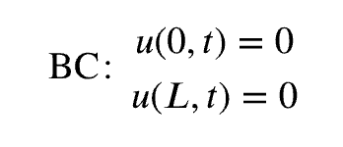
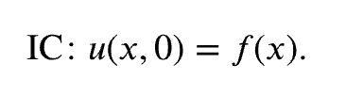
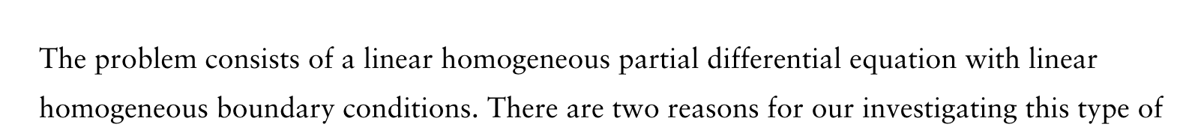

Heat Equation with Zero Temperatures At Finite Ends

Slide 9
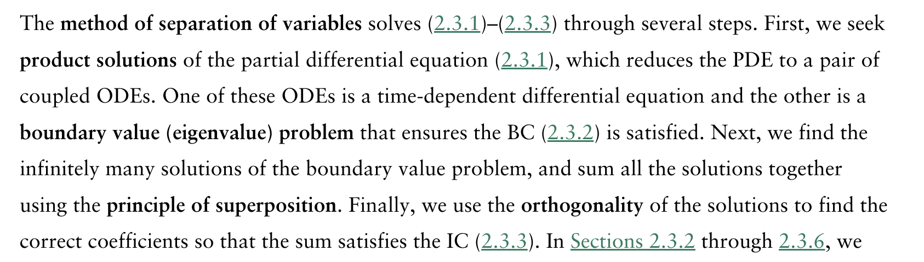


Slide 10

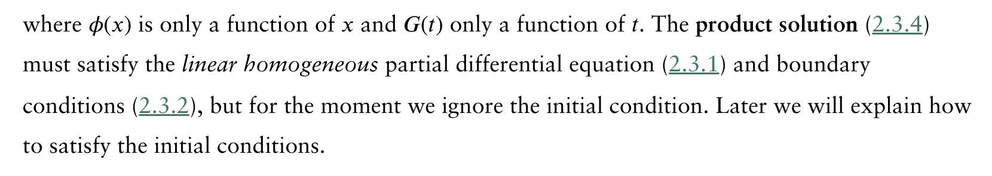

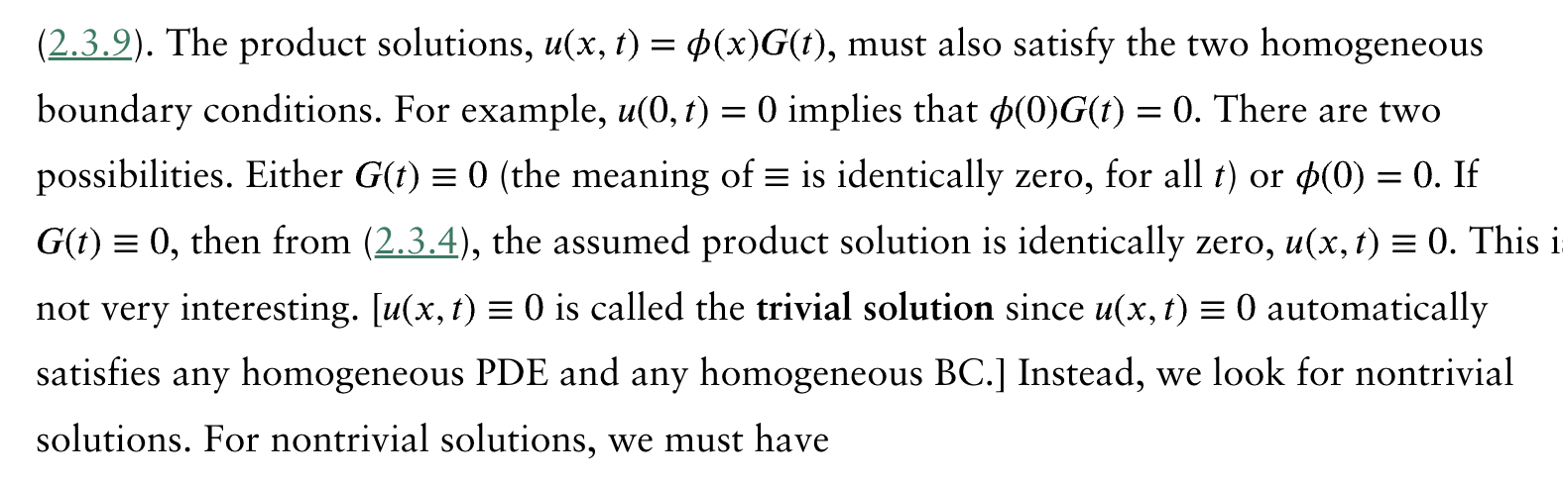

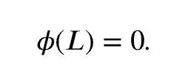

Slide 11
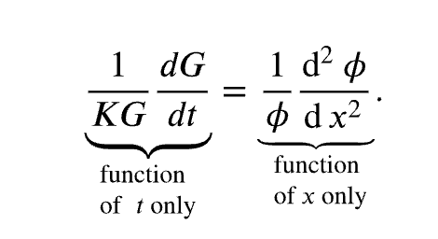
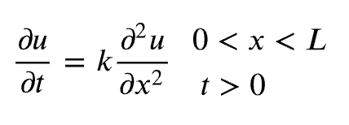

Slide 12

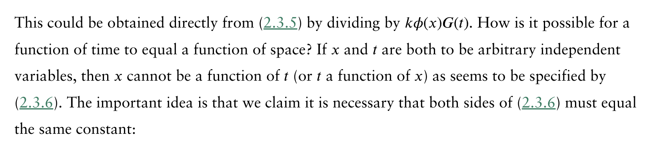
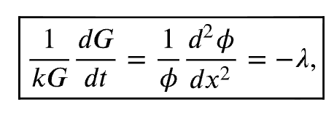

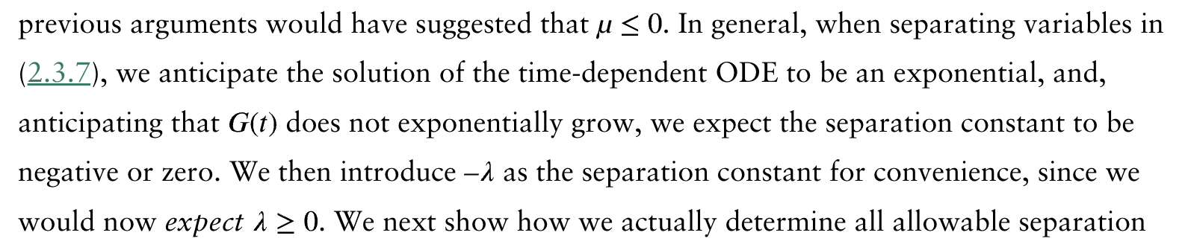
… …
… …

Slide 13
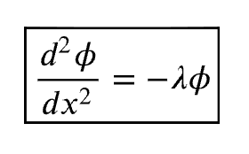
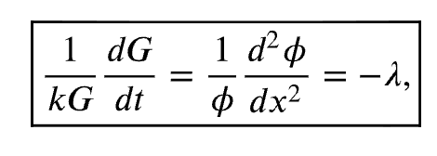
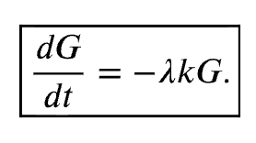
ODE
ODE

Slide 14
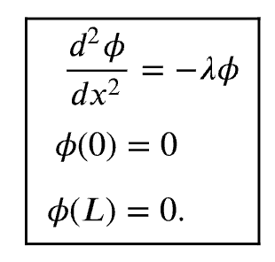

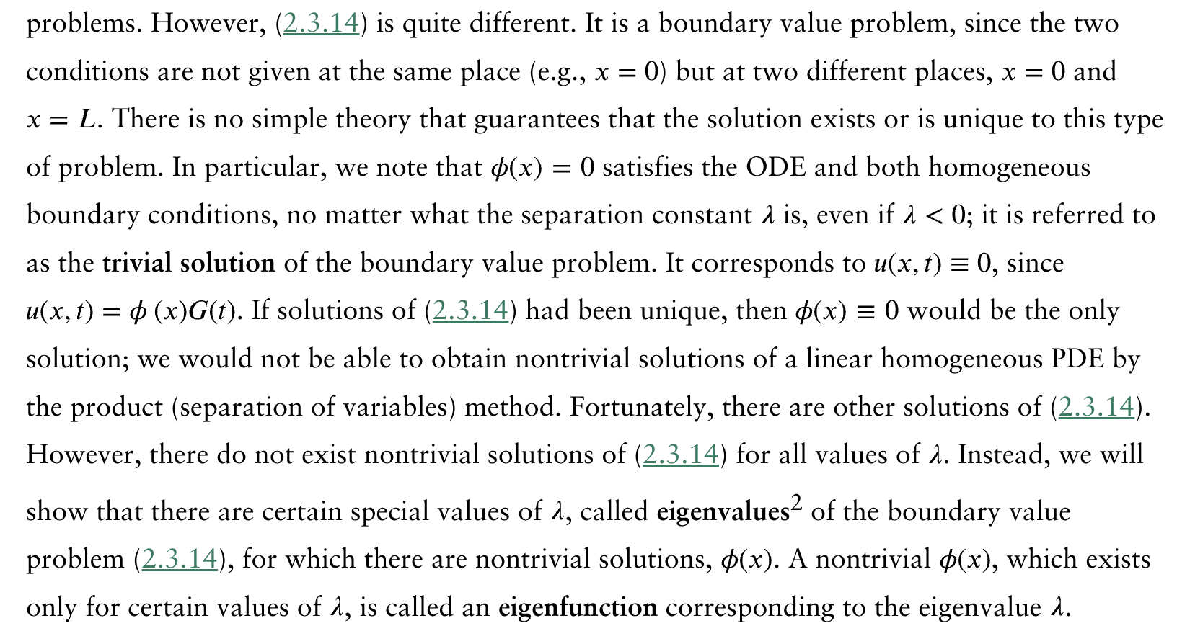
Boundary Value (Eigenvalue) Problem

Slide 15


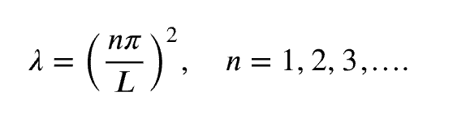

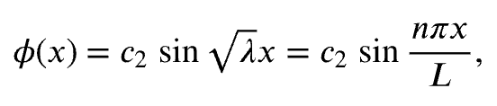
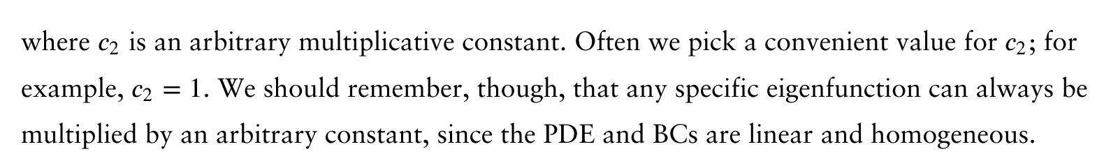
?
?

Slide 16

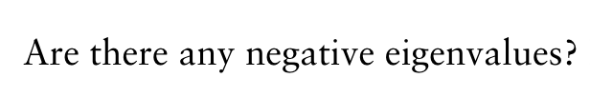


Slide 17

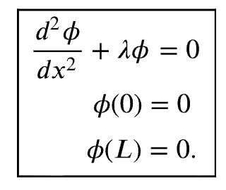
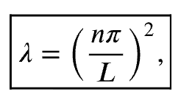
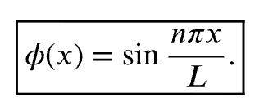

Slide 18
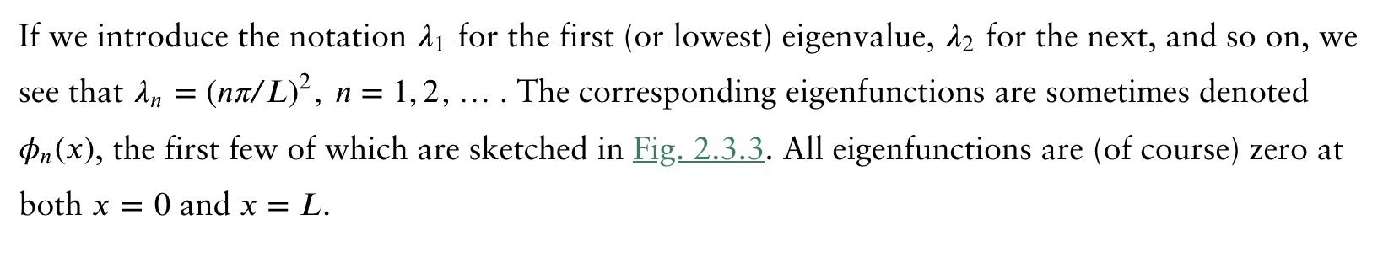
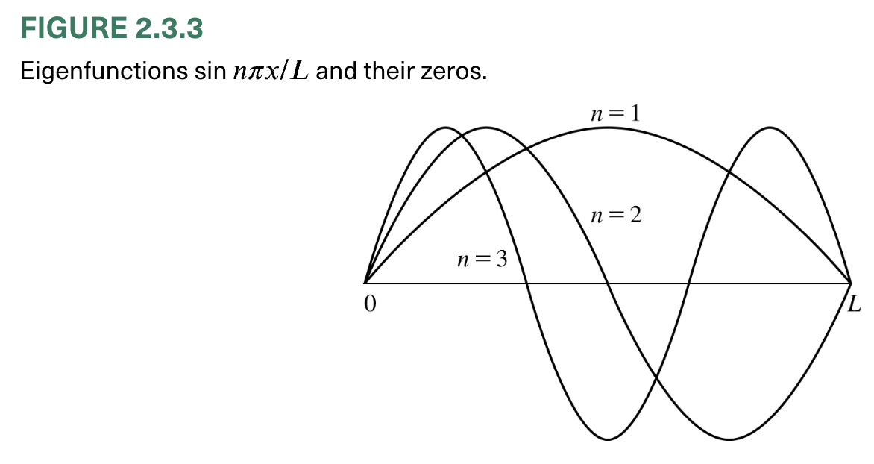

Slide 19
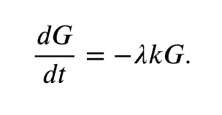

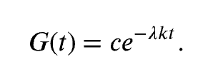
Time-Dependent Ordinary Differential Equation

Slide 20

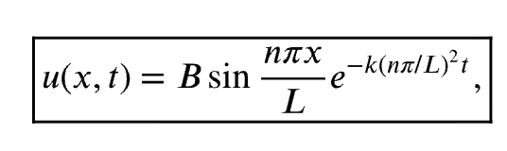


Product Solutions
Also need to consider IC!

Slide 21
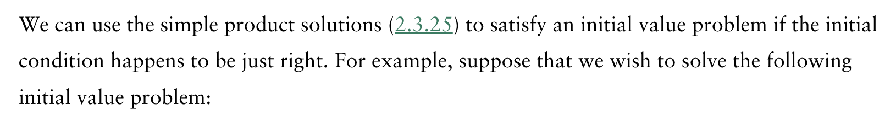
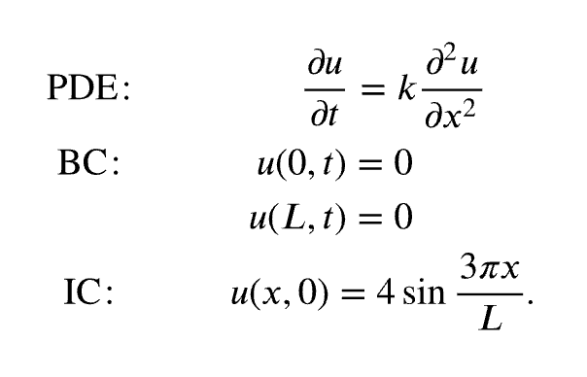
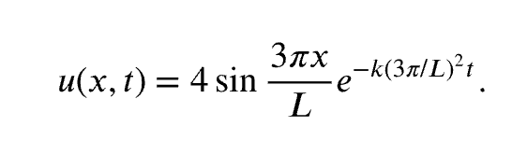


Slide 22
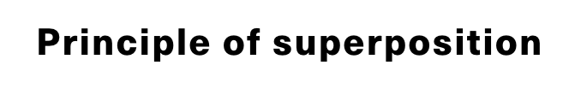
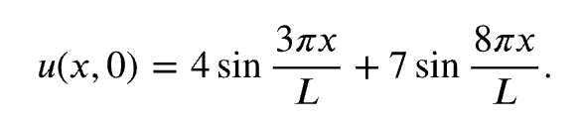
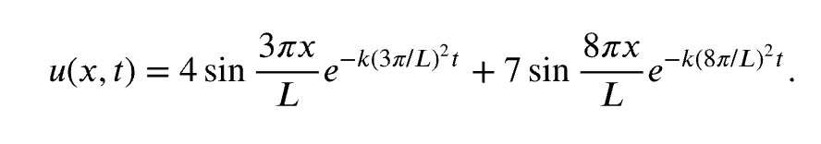
We will show that these solutions are useful in many other situations; in fact, in all situations. Consider the same PDE and BCs, but instead subject to the initial condition
More general case?

Slide 23
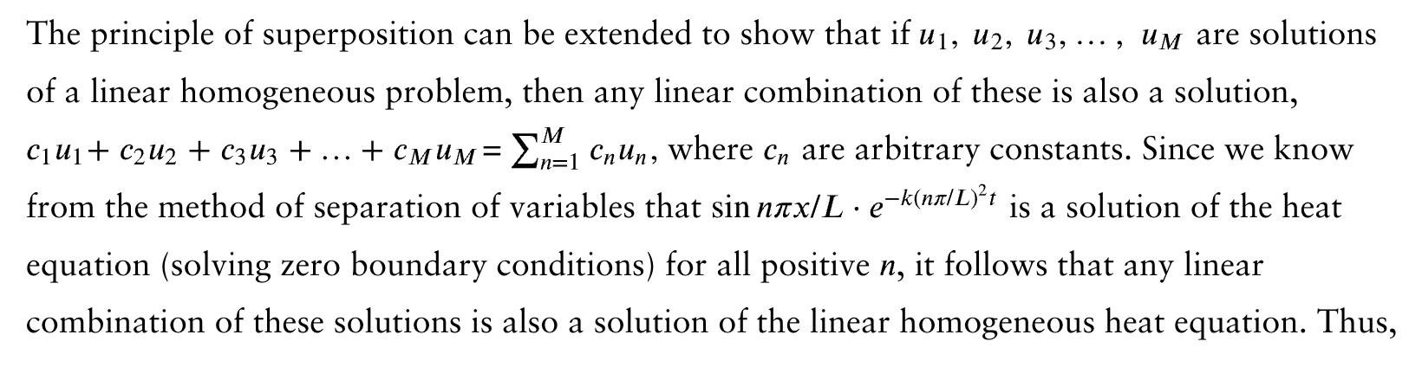




Slide 24

The theory of Fourier series states that

Slide 25





Slide 26



How do we determine the coefficients?
Note that the eigenfunctions satisfy the following integral property:
?

Slide 27



Slide 28


Slide 29




Example

Slide 30


Slide 31



Slide 32


Slide 33






Example
Eigenvalues and eigenfunctions:

Slide 34


or

Slide 35



Slide 36





Example

Slide 37


Slide 38




Heat Conduction in a Thin Insulated Circular Ring

Slide 39



Periodic boundary conditions

Slide 40





(a linear homogeneous subject to linear homogeneous BCs)
Eigenvalues and eigenfunctions:

Slide 41




?
General solution

Slide 42



Slide 43


Slide 44







Laplace’s Equation Inside a Rectangle

Slide 45



We break our problem into four problems, each having one nonhomogeneous condition. We let

Slide 46









Product solutions

Slide 47


BVP:
?
?

Slide 48



?
?

Slide 49


Slide 50




Laplace’s Equation Inside a Circular Disk
Suppose that we had a thin circular disk of radius $a$(with constant thermal properties and no sources) with the temperature prescribed on the boundary. If the temperature on the boundary is independent of time, then it is reasonable to determine the equilibrium temperature distribution.
The geometry of this problem suggests that we use polar coordinates.
On

Slide 51






?
?
For physical reasons, we will prescribe that the temperature is finite or, equivalently, bounded

Slide 52




Product solutions
BVP:
eigenvalues
eigenfunctions

Slide 53




Slide 54










Slide 55



Slide 56






Slide 57



The maximum principle is a very important tool for further analysis of partial differential equations … …

