Slide 1
1
Systems of Linear Equations

Slide 2
1.1
Introduction to Systems of Linear Equations

Slide 3
Objectives
Recognize a linear equation in n variables.
Find a parametric representation of a solution set.
Determine whether a system of linear equations is consistent or inconsistent.
Use back-substitution and Gaussian elimination to solve a system of linear equations.

Slide 4
Linear Equations in n Variables

Slide 5
Linear Equations in n Variables (1 of 1)
Definition of a Linear Equation in n Variables
A linear equation in n variables x₁, x₂, x₃, ... , x _{n} has the form
a₁x₁ + a₂x₂ + a₃x₃ + ... + a _{n}x _{n} = b.
The coefficients a₁, a₂, a₃, ... , a _{n} are real numbers, and the constant term b is a real number. The number a₁ is the leading coefficient, and x₁ is the leading variable.

Slide 6
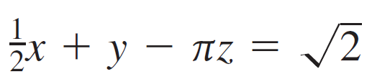


Example 1 – Linear and Nonlinear Equations
Each equation is linear.
a. 3x + 2y = 7
b.
c.
Each equation is not linear.
a. xy + z = 2
b.
c. sin x₁ + 2x₂ − 3x₃ = 0

Slide 7
Solutions and Solution Sets

Slide 8
Solutions and Solution Sets (1 of 2)
A solution of a linear equation in n variables is a sequence of n real numbers s₁, s₂, s₃, ... , s _{n} that satisfy the equation when you substitute the values
x₁ = s₁, x₂ = s₂, x₃ = s₃, ..., x _{n} = s _{n}
into the equation.

Slide 9
Solutions and Solution Sets (2 of 2)
The set of all solutions of a linear equation is its solution set.
To describe the entire solution set of a linear equation, use a parametric representation.

Slide 10


Example 3 – Parametric Representation of a Solution Set
Solve the linear equation 3x + 2y − z = 3.
Solution:
Choosing y and z to be the free variables, solve for x to obtain
3x = 3 − 2y + z

Slide 11

Example 3 – Solution
Letting y = s and z = t, you obtain the parametric representation
y = s, z = t
where s and t are any real numbers. Two particular solutions are
x = 1, y = 0, z = 0 and x = 1, y = 1, z = 2.

Slide 12
Systems of Linear Equations

Slide 13

Systems of Linear Equations (1 of 4)
A system of m linear equations in n variables is a set of m equations, each of which is linear in the same n variables:
a₁₁x₁ + a₁₂x₂ + a₁₃x₃ + ... + a_{1n}x_{n} = b₁
a₂₁x₁ + a₂₂x₂ + a₂₃x₃ + ... + a_{2n}x_{n} = b₂
a₃₁x₁ + a₃₂x₂ + a₃₃x₃ + ... + a_{3n}x_{n} = b₃
a _{m1}x₁ + a _{m2}x₂ + a _{m3}x₃ + ... + a _{m n} x _{n} = b _{m}.

Slide 14
Systems of Linear Equations (2 of 4)
A system of linear equations is also called a linear system. A solution of a linear system is a sequence of numbers s₁, s₂, s₃, ... , s _{n} that is a solution of each equation in the system.

Slide 15

Example 4 – Systems of Two Equations in Two Variables
Solve and graph each system of linear equations.
a. x + y = 3
x − y = −1
b. x + y = 3
2x + 2y = 6
c. x + y = 3
x + y = 1

Slide 16
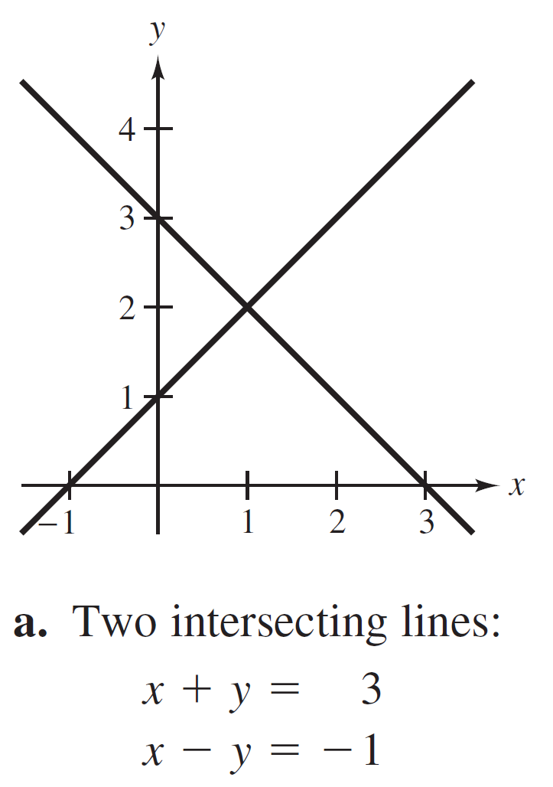
Example 4 – Solution (1 of 4)
a. This system has exactly one solution, x = 1 and y = 2. One way to obtain the solution is to add the two equations to give 2x = 2, which implies x = 1 and so y = 2.
The graph of this system is two
intersecting lines, as shown in
Figure 1.1(a).
Figure 1.1

Slide 17
Example 4 – Systems of Two Equations in Two Variables
Solve and graph each system of linear equations.
a. x + y = 3
x − y = −1
b. x + y = 3
2x + 2y = 6
c. x + y = 3
x + y = 1

Slide 18
Example 4 – Solution (2 of 4)
b. This system has infinitely many solutions because the second equation is the result of multiplying both sides of the first equation by 2.
A parametric representation of the solution set is
x = 3 − t, y = t, t is any real number.

Slide 19
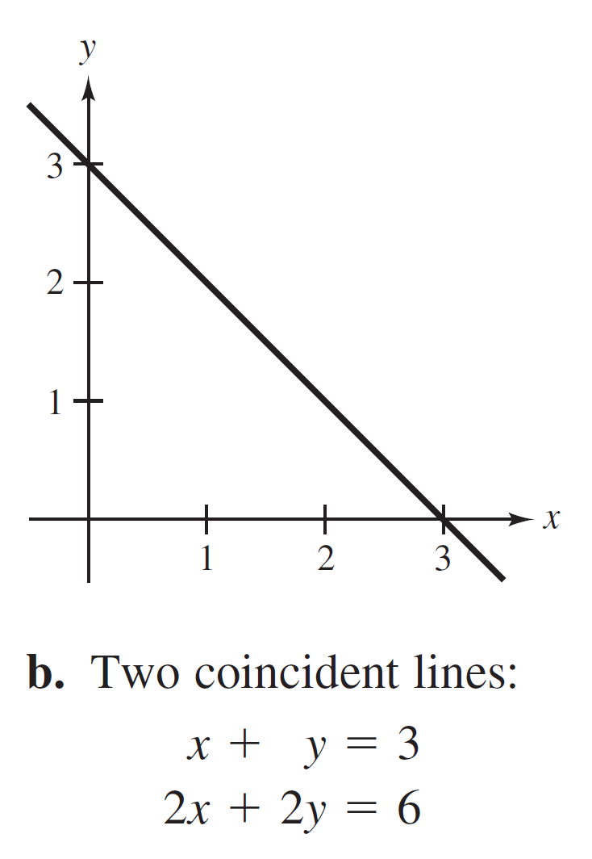
Example 4 – Solution (3 of 4)
The graph of this system is two coincident lines, as shown in Figure 1.1(b).
Figure 1.1

Slide 20
Example 4 – Systems of Two Equations in Two Variables
Solve and graph each system of linear equations.
a. x + y = 3
x − y = −1
b. x + y = 3
2x + 2y = 6
c. x + y = 3
x + y = 1

Slide 21
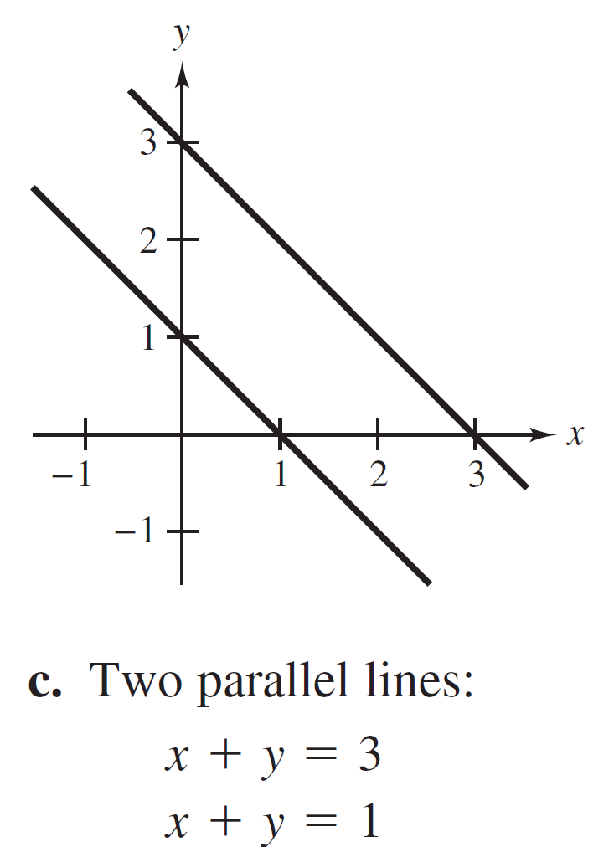
Example 4 – Solution (4 of 4)
c. This system has no solution because the sum of two numbers cannot be 3 and 1 simultaneously. The graph of this system is two parallel lines, as shown in Figure 1.1(c).
Figure 1.1

Slide 22
Systems of Linear Equations (3 of 4)
Number of Solutions of a System of Linear Equations
For a system of linear equations, precisely one of the statements below is true.
1. The system has exactly one solution (consistent system).
2. The system has infinitely many solutions (consistent system).
3. The system has no solution (inconsistent system).

Slide 23
Example 7 – Using Elimination to Rewrite a System in Row-Echelon Form
Solve the system.
x − 2y + 3z = 9
−x + 3y = −4
2x − 5y + 5z = 17

Slide 24
Example 7 – Solution (1 of 2)
Work from the upper left corner of the system, saving the x at the upper left and eliminating the other x-terms from the first column.
x − 2y + 3z = 9
y + 3z = 5
2x − 5y + 5z = 17
Adding the first equation to
the second equation produces
a new second equation.
←
x − 2y + 3z = 9
y + 3z = 5
−y − z = −1
Adding −2 times the first
equation to the third equation
produces a new third equation.
←

Slide 25

Example 7 – Solution (2 of 2)
Now that you have eliminated all but the first x from the first column, work on the second column.
x − 2y + 3z = 9
y + 3z = 5
2z = 4
Adding the second equation to
the third equation produces
a new third equation.
←
x − 2y + 3z = 9
y + 3z = 5
z = 2
Multiplying the third equation
by
produces a new third
equation.
←
The solution is x = 1, y = −1, z = 2.

Slide 26
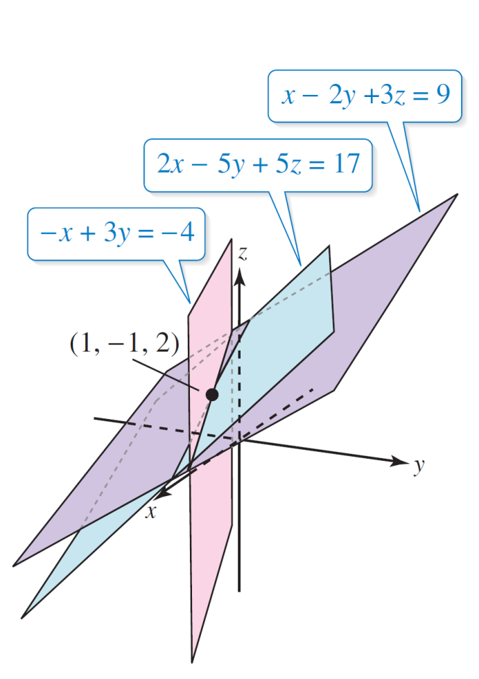
Systems of Linear Equations (4 of 4)
Each of the three equations in Example 7 represents a plane in a three-dimensional coordinate system.
The unique solution of the system is the point (x, y, z) = (1, −1, 2), so the three planes intersect at this point, as shown in Figure1.2.
Figure 1.2

