Slide 1
1
Systems of Linear Equations

Slide 2
1.2
Gaussian Elimination and Gauss-Jordan Elimination

Slide 3
Objectives
Determine the size of a matrix and write an augmented or coefficient matrix from a system of linear equations.
Use matrices and Gaussian elimination with back-substitution to solve a system of linear equations.
Use matrices and Gauss-Jordan elimination to solve a system of linear equations.
Solve a homogeneous system of linear equations.

Slide 4
Matrices

Slide 5
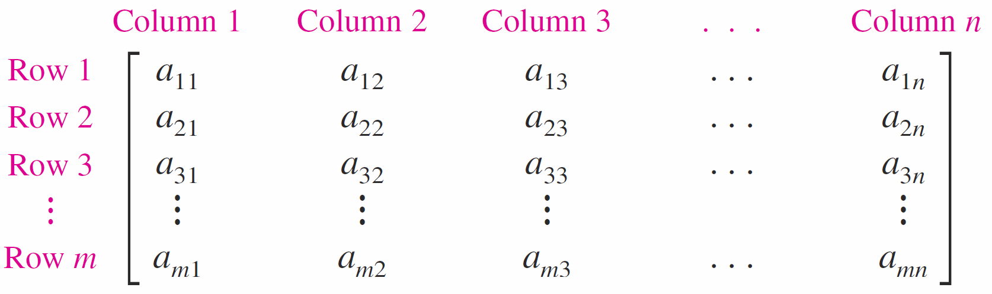
Matrices (1 of 3)
Definition of a Matrix
If m and n are positive integers, then an m × n (read “m by n”) matrix is a rectangular array
in which each entry, a _{i j}, of the matrix is a number.

Slide 6
Matrices (2 of 3)
The entry a _{i j} is located in the i th row and the j th column. The index i is called the row subscript because it identifies the row in which the entry lies, and the index j is called the column subscript because it identifies the column in which the entry lies.
A matrix with m rows and n columns is of size m × n. When m = n, the matrix is square of order n and the entries a₁₁, a₂₂, a₃₃, . . . , a _{n n} are the main diagonal entries.

Slide 7

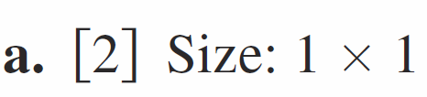
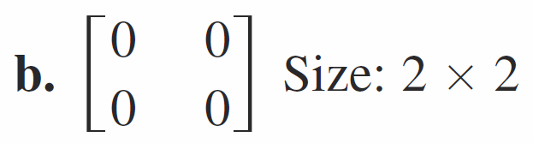
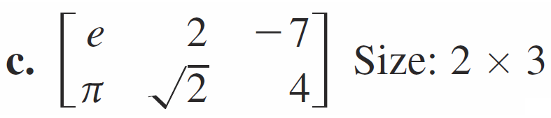
Example 1 – Sizes of Matrices
Each matrix has the indicated size.

Slide 8
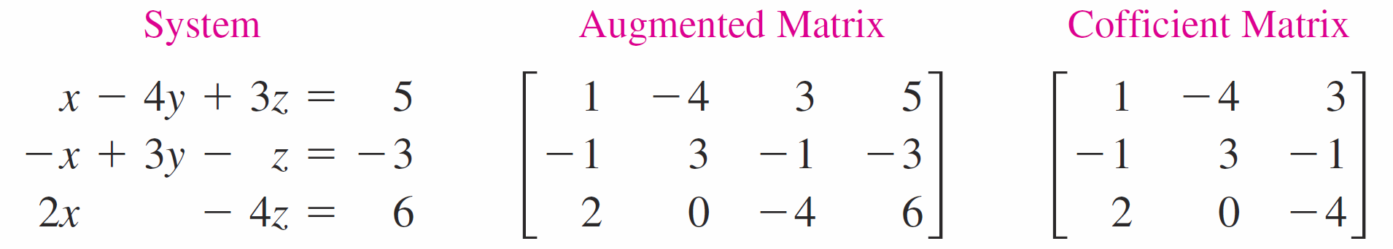
Matrices (3 of 3)
The matrix derived from the coefficients and constant terms of a system of linear equations is the augmented matrix of the system. The matrix containing only the coefficients of the system is the coefficient matrix of the system.

Slide 9
Elementary Row Operations

Slide 10
Elementary Row Operations (1 of 4)
Elementary Row Operations
1. Interchange two rows.
2. Multiply a row by a nonzero constant.
3. Add a multiple of a row to another row.

Slide 11
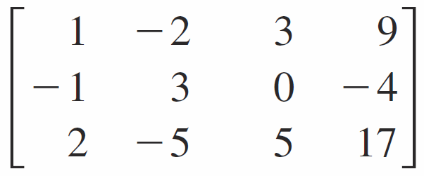
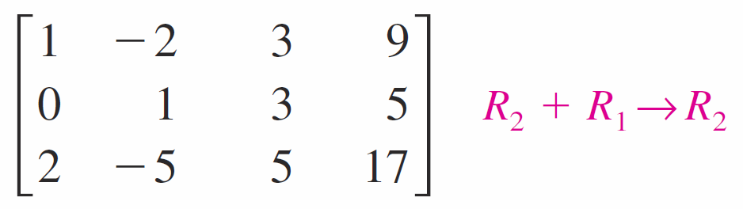
Example 3 – Using Elementary Row Operations to Solve a System (1 of 3)
Linear System
x − 2y + 3z = 9
−x + 3y = −4
2x − 5y + 5z = 17
Add the first equation to the second equation.
Associated Augmented Matrix
Add the first row to the second row to produce a new second row.
x − 2y + 3z = 9
y + 3z = 5
2x − 5y + 5z = 17
Add −2 times the first equation to the third equation.
Add −2 times the first row to the third row to produce a new third row.

Slide 12
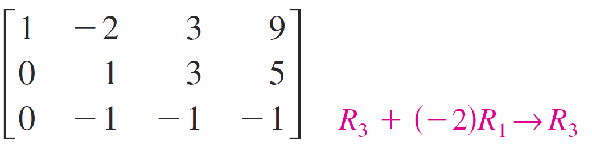
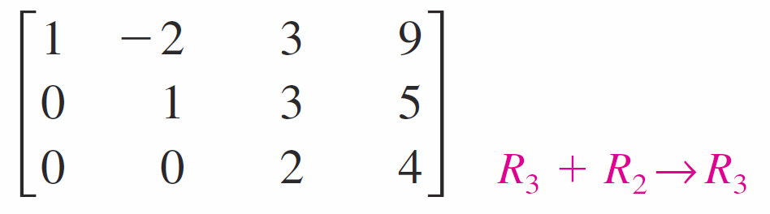


Example 3 – Using Elementary Row Operations to Solve a System (2 of 3)
x − 2y + 3z = 9
y + 3z = 5
−y − z = −1
Add the second equation to the third equation.
Add the second row to the third row to produce a new third row.
x − 2y + 3z = 9
y + 3z = 5
2z = 4
Multiply the third equation by
Multiply the third row by
to produce a new third row.

Slide 13
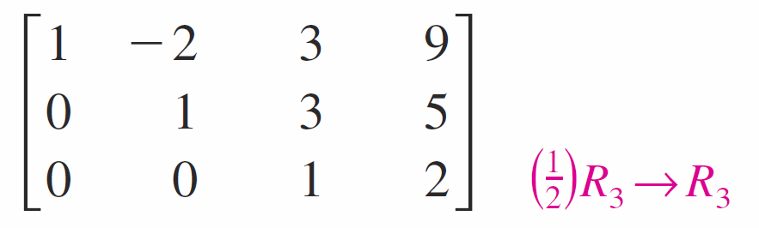
Example 3 – Using Elementary Row Operations to Solve a System (3 of 3)
x − 2y + 3z = 9
y + 3z = 5
z = 2
Use back‑substitution to find that the solution is x = 1, y = −1, and z = 2.

Slide 14
Elementary Row Operations (2 of 4)
Row-Echelon Form and Reduced Row-Echelon Form
A matrix in row-echelon form has the properties below.
1. Any rows consisting entirely of zeros occur at the bottom of the matrix.
2. For each row that does not consist entirely of zeros, the first nonzero entry is 1 (called a leading 1).
3. For two successive (nonzero) rows, the leading 1 in the higher row is farther to the left than the leading 1 in the lower row.

Slide 15
Elementary Row Operations (3 of 4)
Row-Echelon Form and Reduced Row-Echelon Form
A matrix in row-echelon form is in reduced row-echelon form when every column that has a leading 1 has zeros in every position above and below its leading 1.

Slide 16
Elementary Row Operations (4 of 4)
The procedure for using Gaussian elimination with back-substitution is summarized below.
Gaussian Elimination with Back-Substitution
1. Write the augmented matrix of the system of linear equations.
2. Use elementary row operations to rewrite the matrix in row-echelon form.
3. Write the system of linear equations corresponding to the matrix in row-echelon form, and use back-substitution to find the solution.

Slide 17
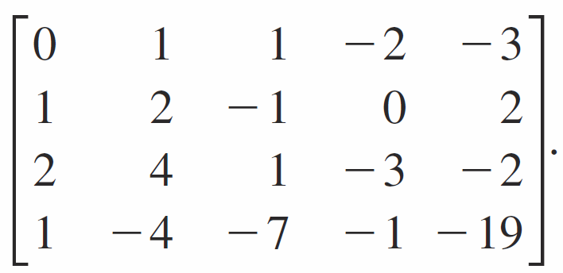
Example 5 – Gaussian Elimination with Back-Substitution
Solve the system.
x₂ + x₃ − 2x₄ = −3
x₁ + 2x₂ − x₃ = 2
2x₁ + 4x₂ + x₃ − 3x₄ = −2
x₁ − 4x₂ − 7x₃ − x₄ = −19
Solution:
The augmented matrix for this system is

Slide 18
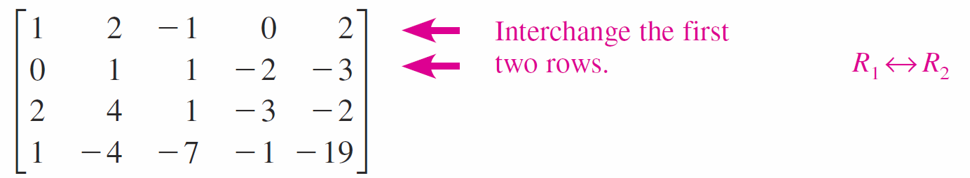
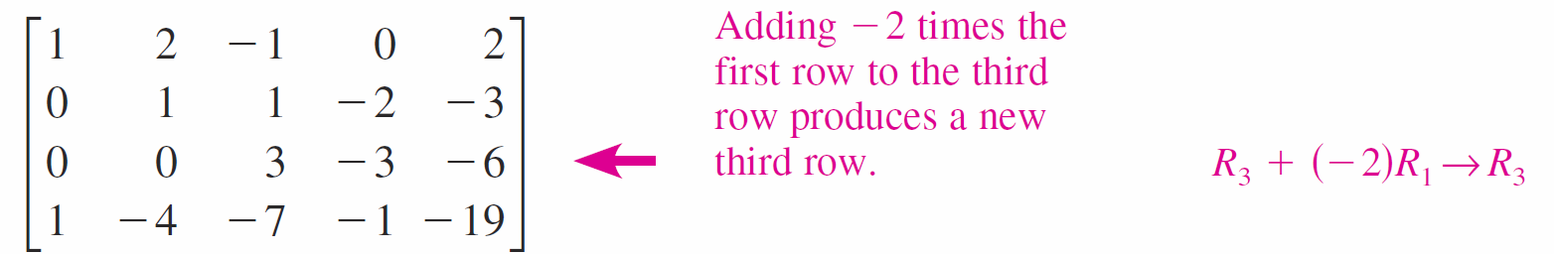
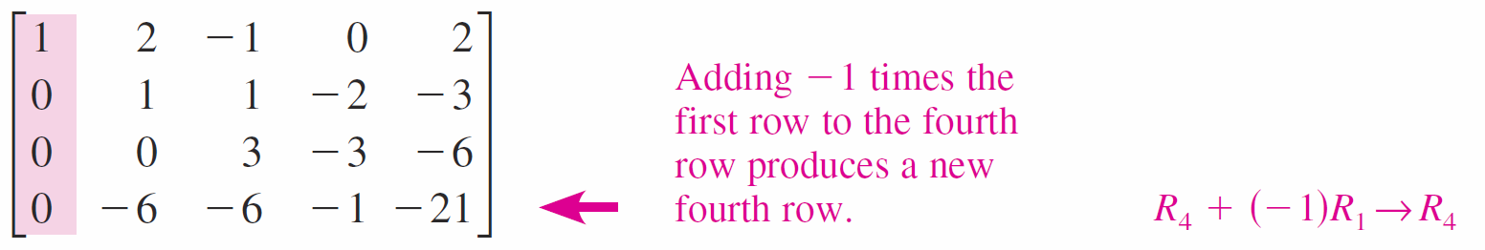
Example 5 – Solution (1 of 3)
Obtain a leading 1 in the upper left corner and zeros elsewhere in the first column.

Slide 19
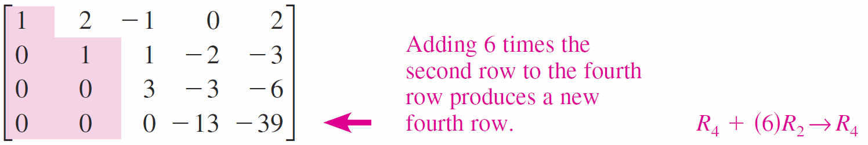


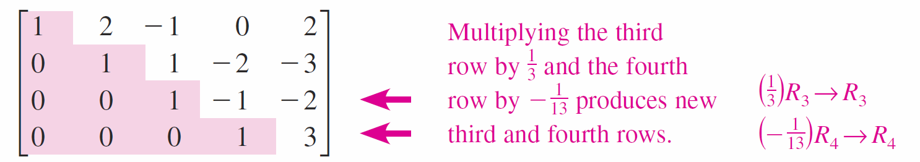
Example 5 – Solution (2 of 3)
Now that the first column is in the desired form, change the second column as shown below.
To write the third and fourth columns in proper form, multiply the third row by
and the fourth row by

Slide 20
Example 5 – Solution (3 of 3)
The matrix is now in row-echelon form, and the corresponding system is shown below.
x₁ + 2x₂ − x₃ = 2
x₂ + x₃ − 2x₄ = −3
x₃ − x₄ = −2
x₄ = 3
Use back-substitution to find that the solution is x₁ = −1, x₂ = 2, x₃ = 1, and x₄ = 3.

Slide 21
Gauss-Jordan Elimination

Slide 22
Gauss-Jordan Elimination (1 of 1)
With Gaussian elimination, you apply elementary row operations to a matrix to obtain a (row-equivalent) row-echelon form. A second method of elimination, called Gauss-Jordan elimination after Carl Friedrich Gauss and Wilhelm Jordan (1842–1899), continues the reduction process until a reduced row-echelon form is obtained.

Slide 23
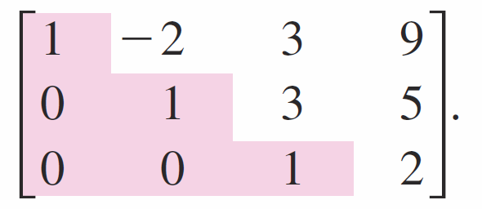
Example 7 – Gauss-Jordan Elimination
Use Gauss-Jordan elimination to solve the system.
x − 2y + 3z = 9
−x + 3y = −4
2x − 5y + 5z = 17
Solution:
You used Gaussian elimination to obtain the row-echelon form

Slide 24
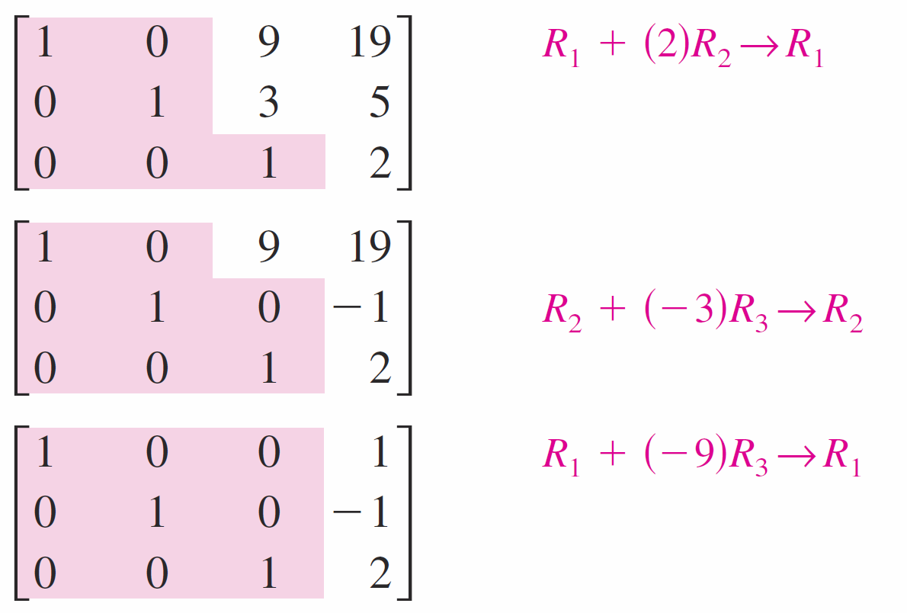
Example 7 – Solution (1 of 2)
Now, apply elementary row operations until you obtain zeros above each of the leading 1’s, as shown below.

Slide 25
Example 7 – Solution (2 of 2)
The matrix is now in reduced row-echelon form. Converting back to a system of linear equations, you have
x = 1
y = −1
z = 2.

Slide 26
Homogeneous Systems of Linear Equations

Slide 27
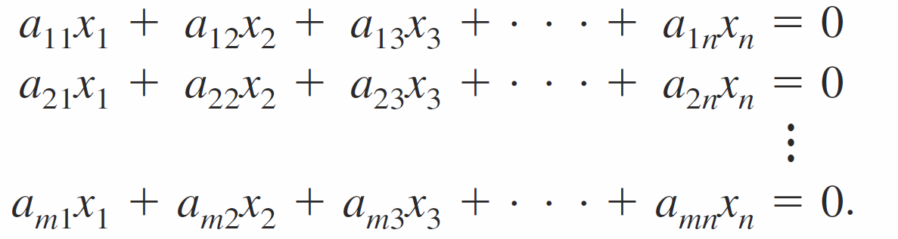
Homogeneous Systems of Linear Equations (1 of 2)
Systems of linear equations in which each of the constant terms is zero are called homogeneous. A homogeneous system of m equations in n variables has the form
A homogeneous system must have at least one solution. Specifically, if all variables in a homogeneous system have the value zero, then each of the equations is satisfied. Such a solution is trivial (or obvious).

Slide 28
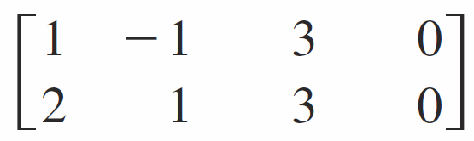
Example 9 – Solving a Homogeneous System of Linear Equations
Solve the system of linear equations.
x₁ − x₂ + 3x₃ = 0
2x₁ + x₂ + 3x₃ = 0
Solution:
Applying Gauss-Jordan elimination to the augmented matrix
yields the matrices shown below.

Slide 29
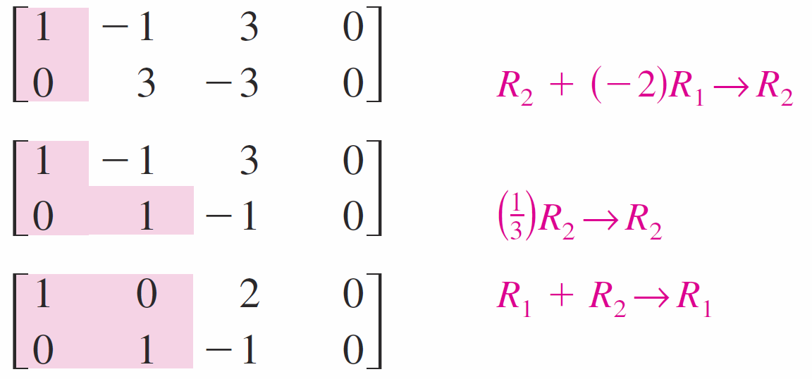
Example 9 – Solution (1 of 2)
The system of equations corresponding to this matrix is
x₁ + 2x₃ = 0
x₂ − x₃ = 0.

Slide 30
Example 9 – Solution (2 of 2)
Using the parameter t = x₃, the solution set is x₁ = −2t, x₂ = t, and x₃ = t, where t is any real number. This system has infinitely many solutions, one of which is the trivial solution (t = 0).

Slide 31
Homogeneous Systems of Linear Equations (2 of 2)
Theorem 1.1 The Number of Solutions of a Homogeneous System
Every homogeneous system of linear equations is consistent. Moreover, if the system has fewer equations than variables, then it must have infinitely many solutions.

