Slide 1
Method of Separation of Variables

Slide 2




Use a technique called the method of separation of variables to solve the heat equations.

Slide 3
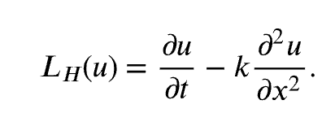
Heat operator:
Show the heat operator is a linear operator and satisfies the linearity property

Slide 4





Slide 5

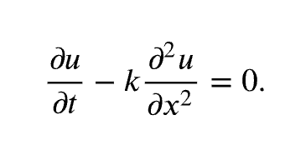

(the trivial solution)

Slide 6





Proof:

Slide 7

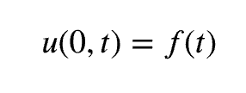
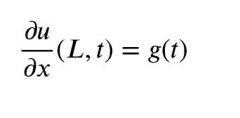
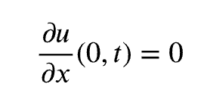

Homogeneous?

Slide 8

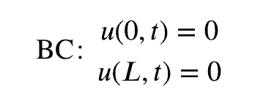



Heat Equation with Zero Temperatures At Finite Ends

Slide 9



Slide 10





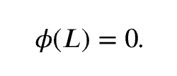

Slide 11
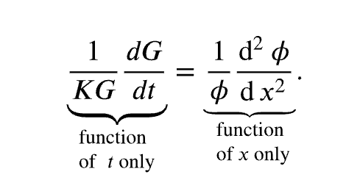
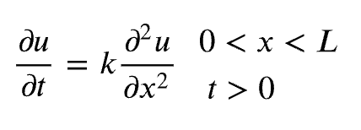

Slide 12


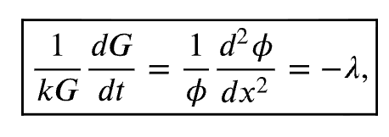


… …
… …

Slide 13
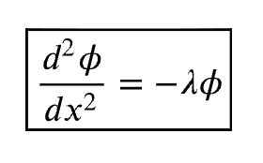
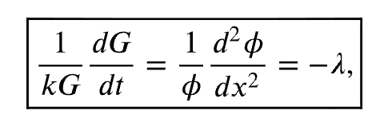
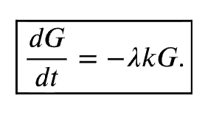
ODE
ODE

Slide 14
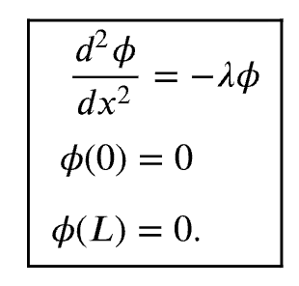

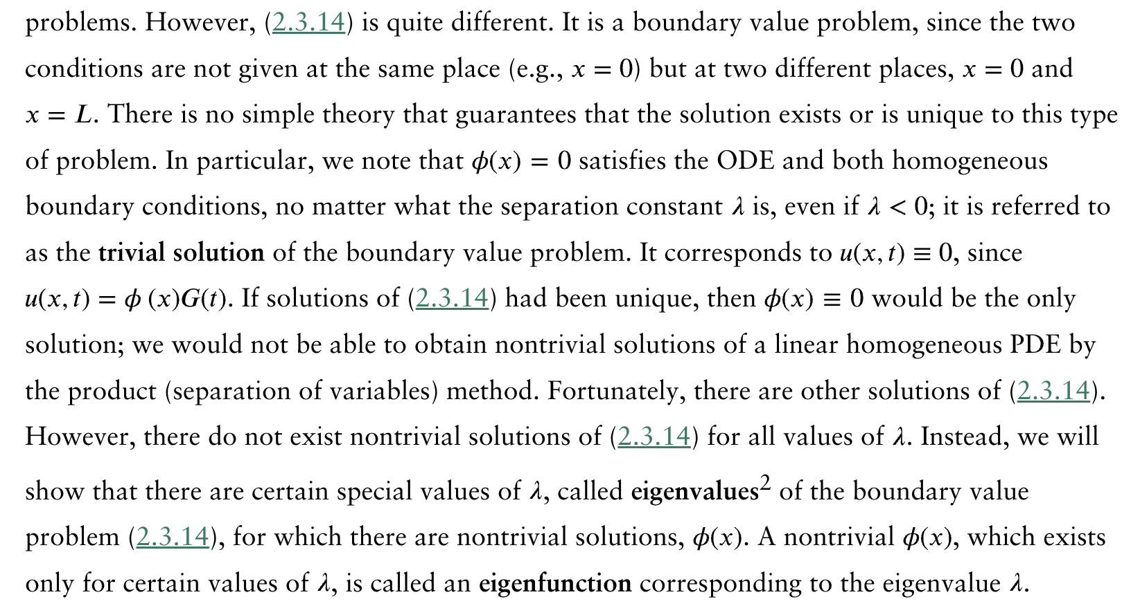
Boundary Value (Eigenvalue) Problem

Slide 15






?
?

Slide 16




Slide 17

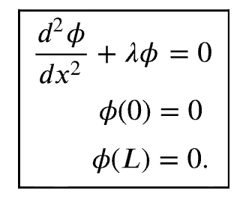
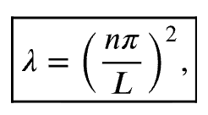
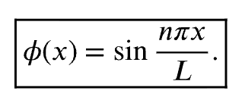

Slide 18

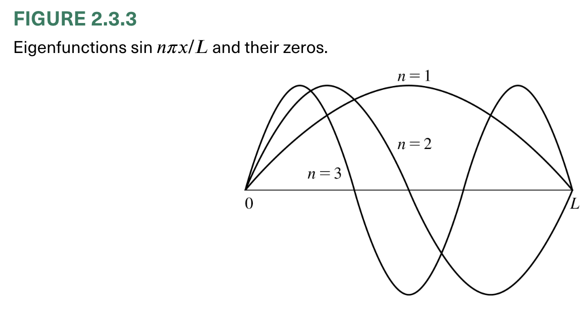

Slide 19
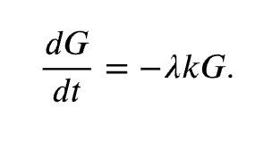

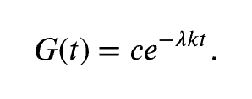
Time-Dependent Ordinary Differential Equation

Slide 20




Product Solutions
Also need to consider IC!

Slide 21

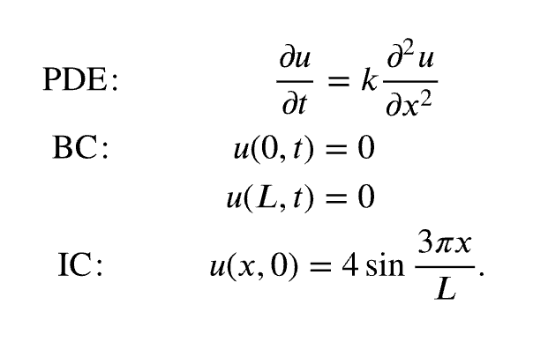



Slide 22



We will show that these solutions are useful in many other situations; in fact, in all situations. Consider the same PDE and BCs, but instead subject to the initial condition
More general case?

Slide 23





Slide 24
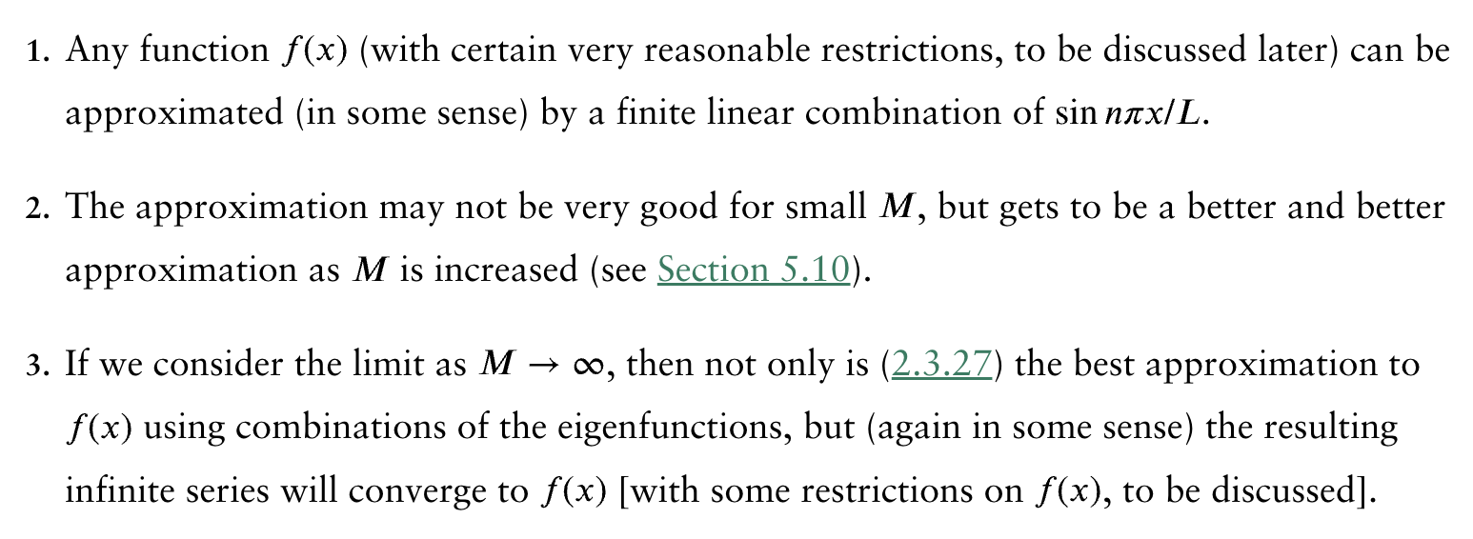
The theory of Fourier series states that

Slide 25

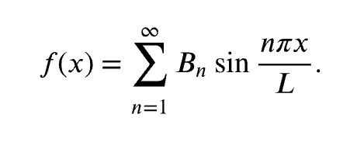

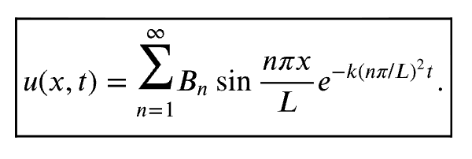

Slide 26



How do we determine the coefficients?
Note that the eigenfunctions satisfy the following integral property:
?

Slide 27

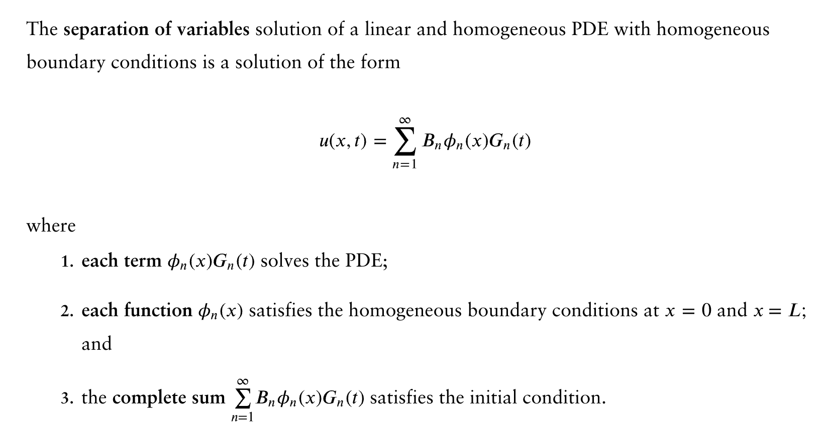

Slide 28
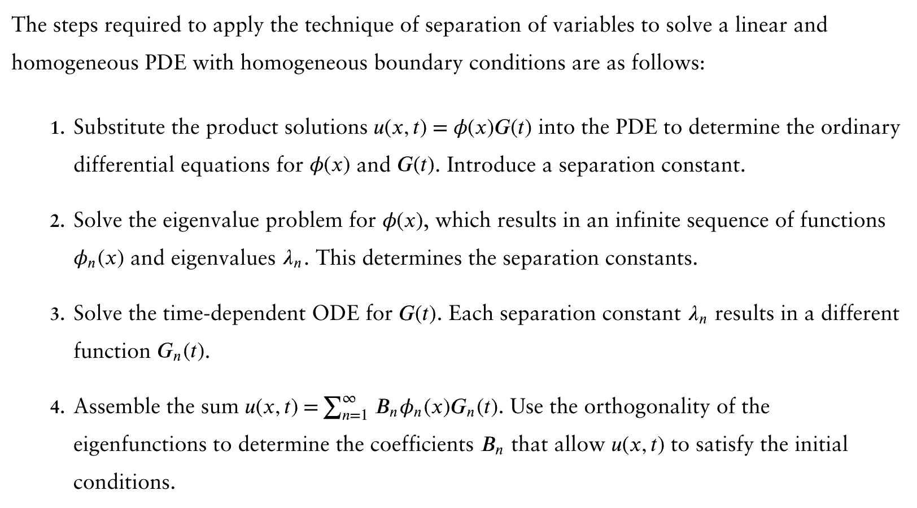

Slide 29

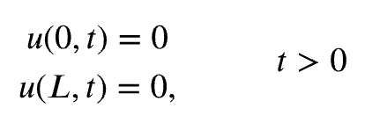


Example

Slide 30
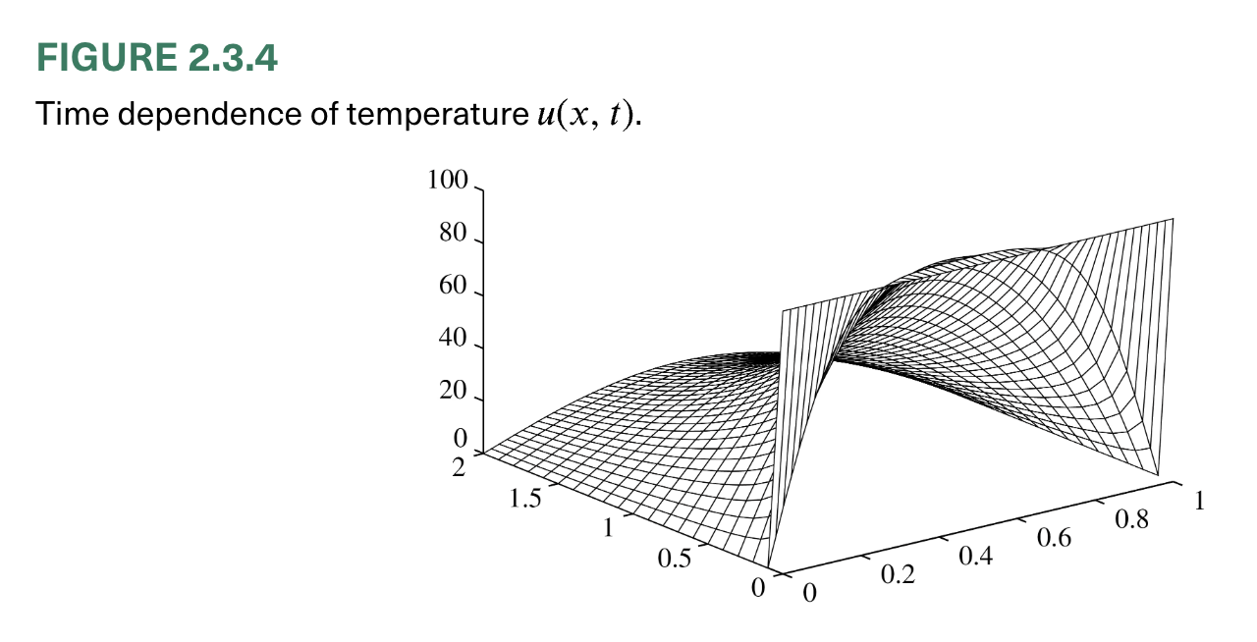

Slide 31



Slide 32
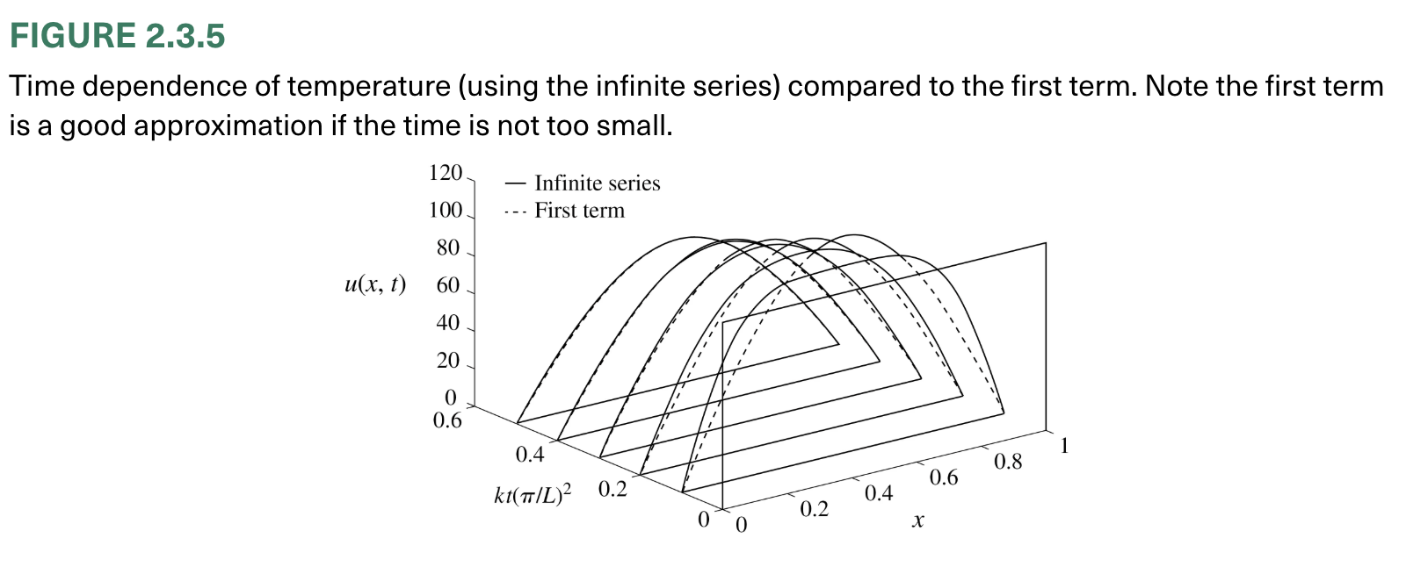

Slide 33
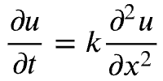





Example
Eigenvalues and eigenfunctions:

Slide 34


or

Slide 35
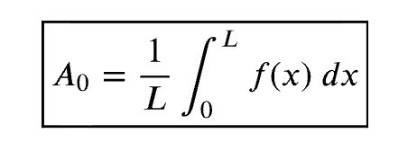


Slide 36




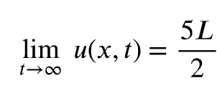
Example

Slide 37
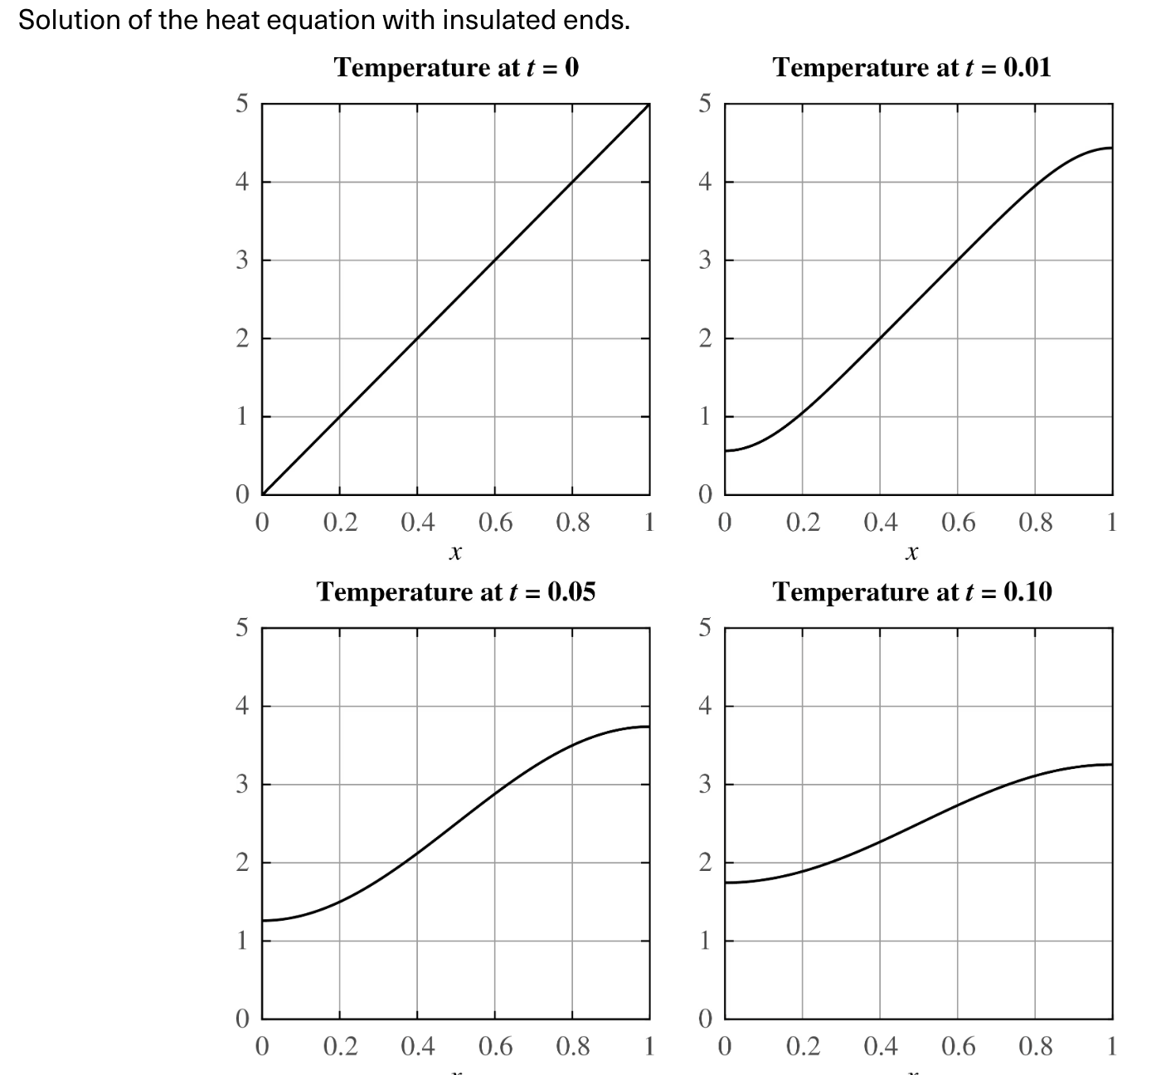

Slide 38

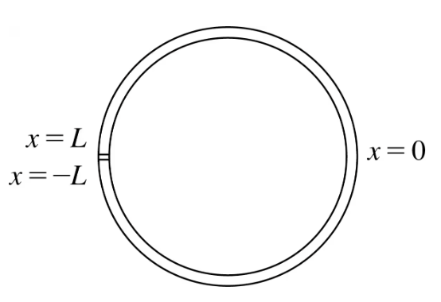


Heat Conduction in a Thin Insulated Circular Ring

Slide 39


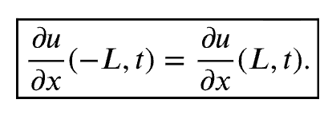
Periodic boundary conditions

Slide 40
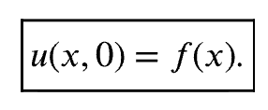
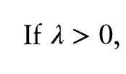
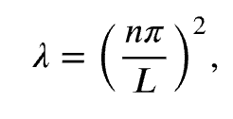


(a linear homogeneous subject to linear homogeneous BCs)
Eigenvalues and eigenfunctions:

Slide 41




?
General solution

Slide 42

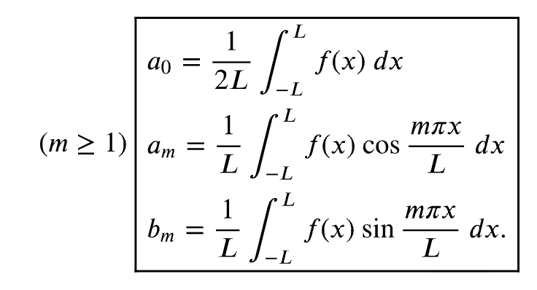

Slide 43
