Slide 1
Sturm–Liouville Eigenvalue Problems

Slide 2

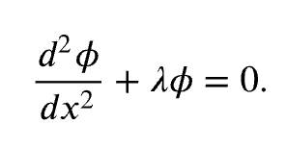


Slide 3


Slide 4


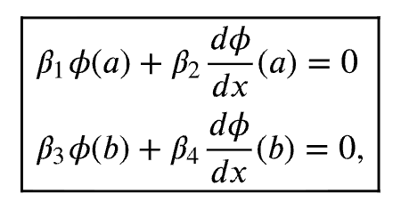


Regular Sturm–Liouville Eigenvalue Problem
A regular Sturm–Liouville eigenvalue problem consists of the Sturm–Liouville differential equation,

Slide 5


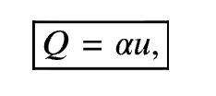


Slide 6

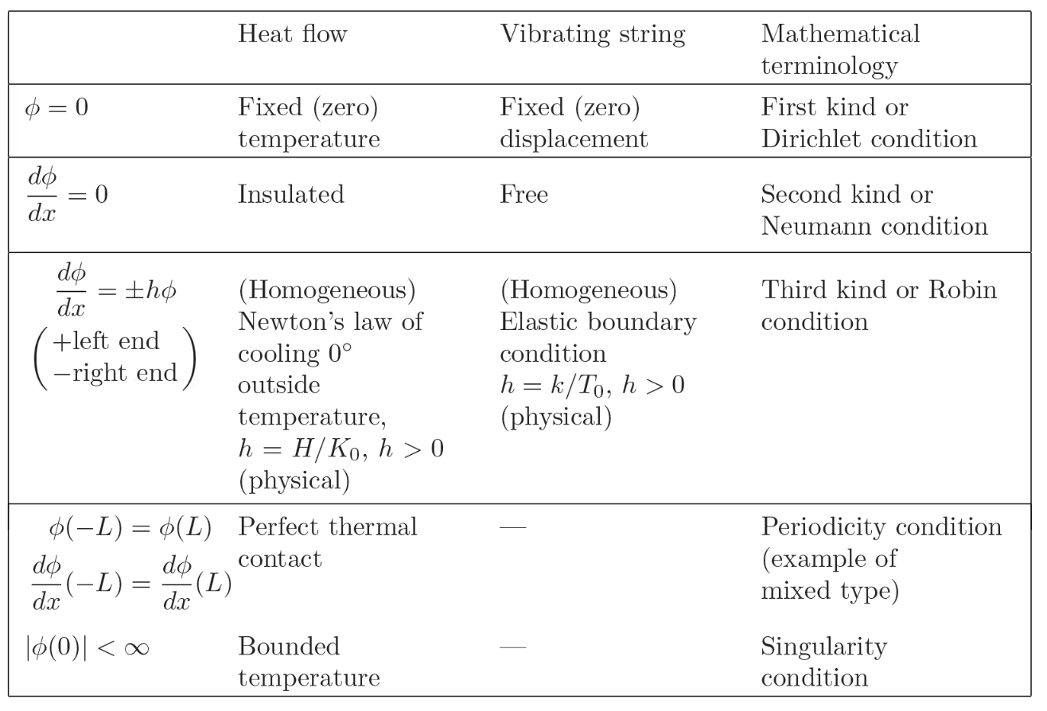


Slide 7
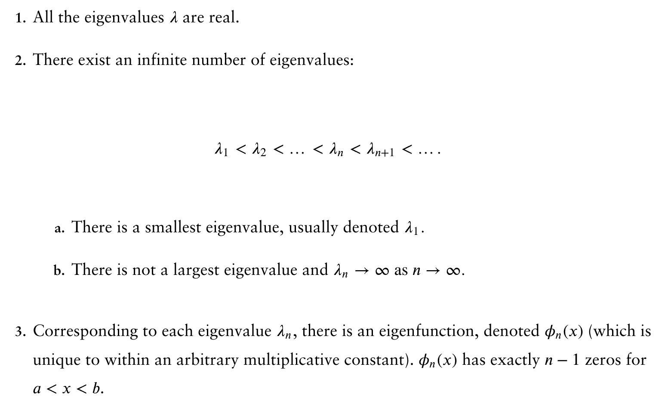
For any regular Sturm–Liouville problem, all of the following theorems are valid:

Slide 8
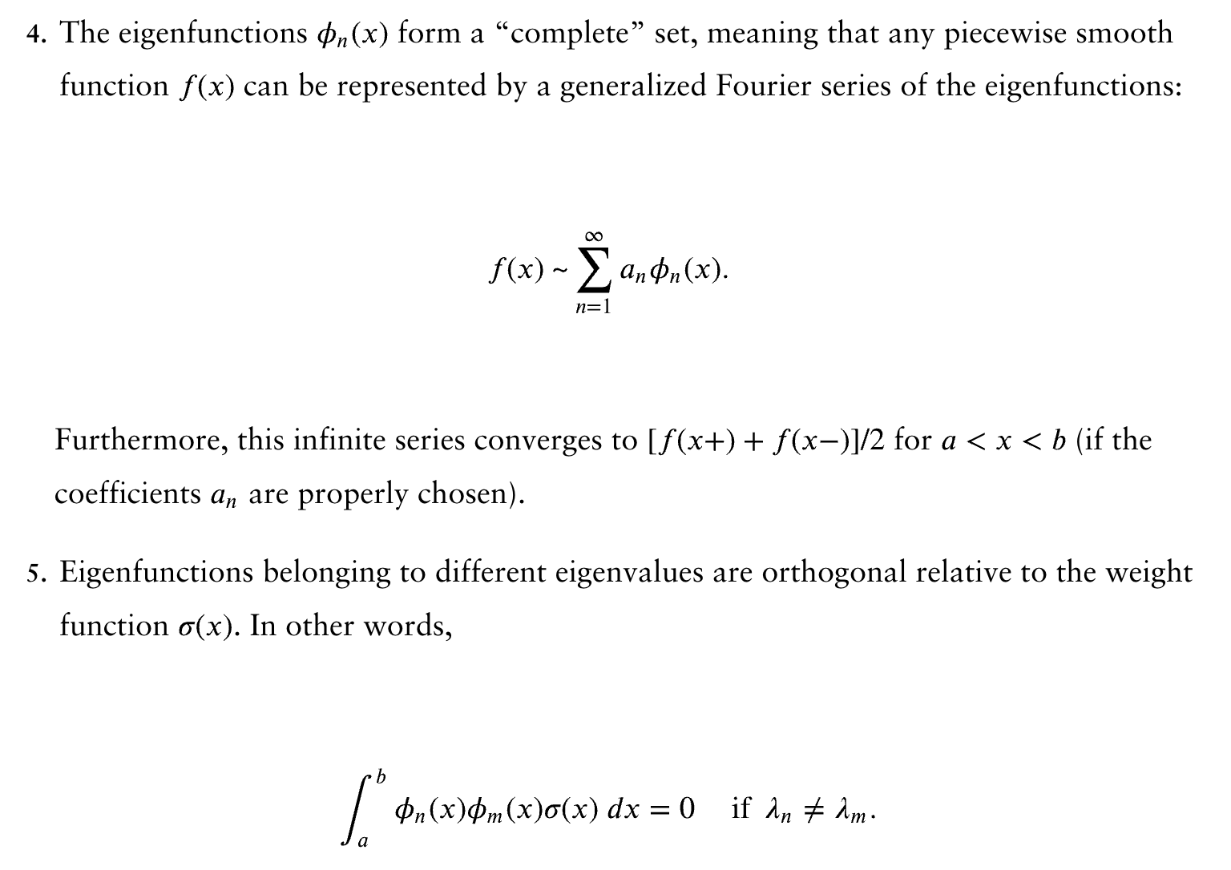
For any regular Sturm–Liouville problem, all of the following theorems are valid:

Slide 9
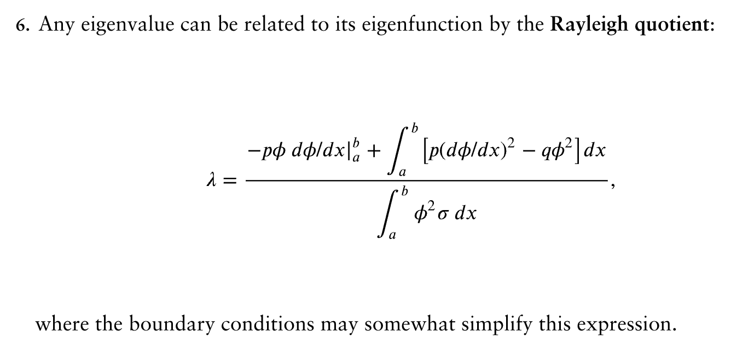
For any regular Sturm–Liouville problem, all of the following theorems are valid:

Slide 10
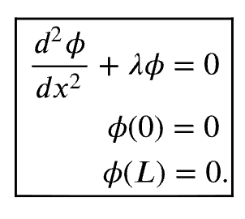

We will individually illustrate the meaning of these theorems by referring to the simplest example of a regular Sturm–Liouville problem:

Slide 11
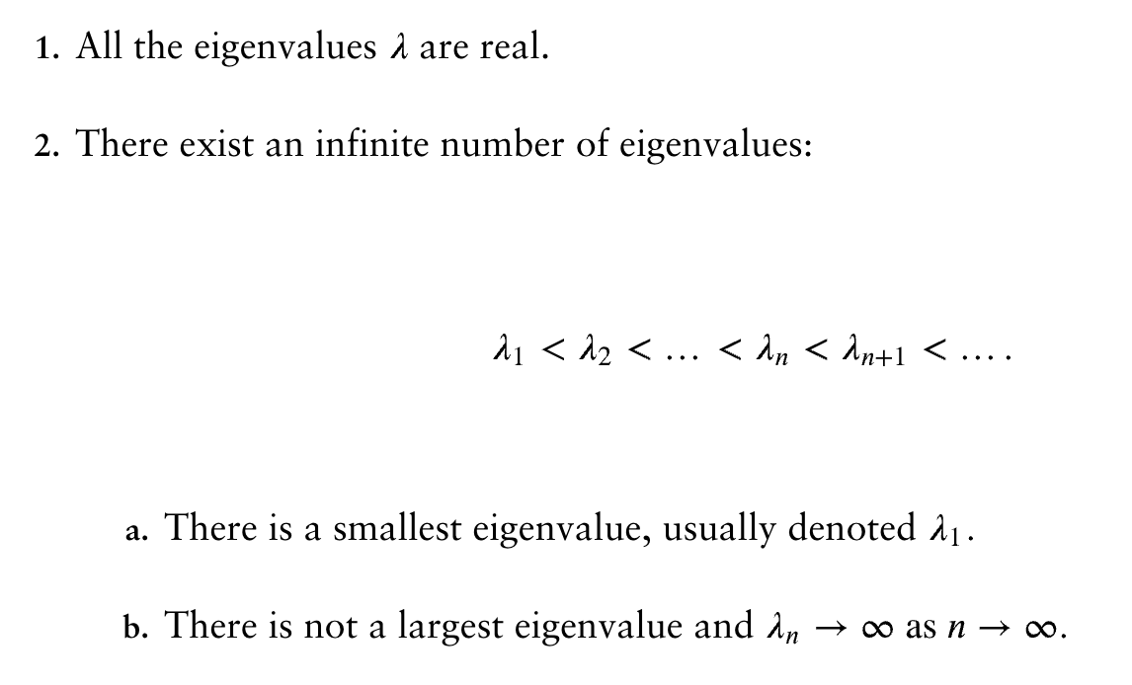

Slide 12

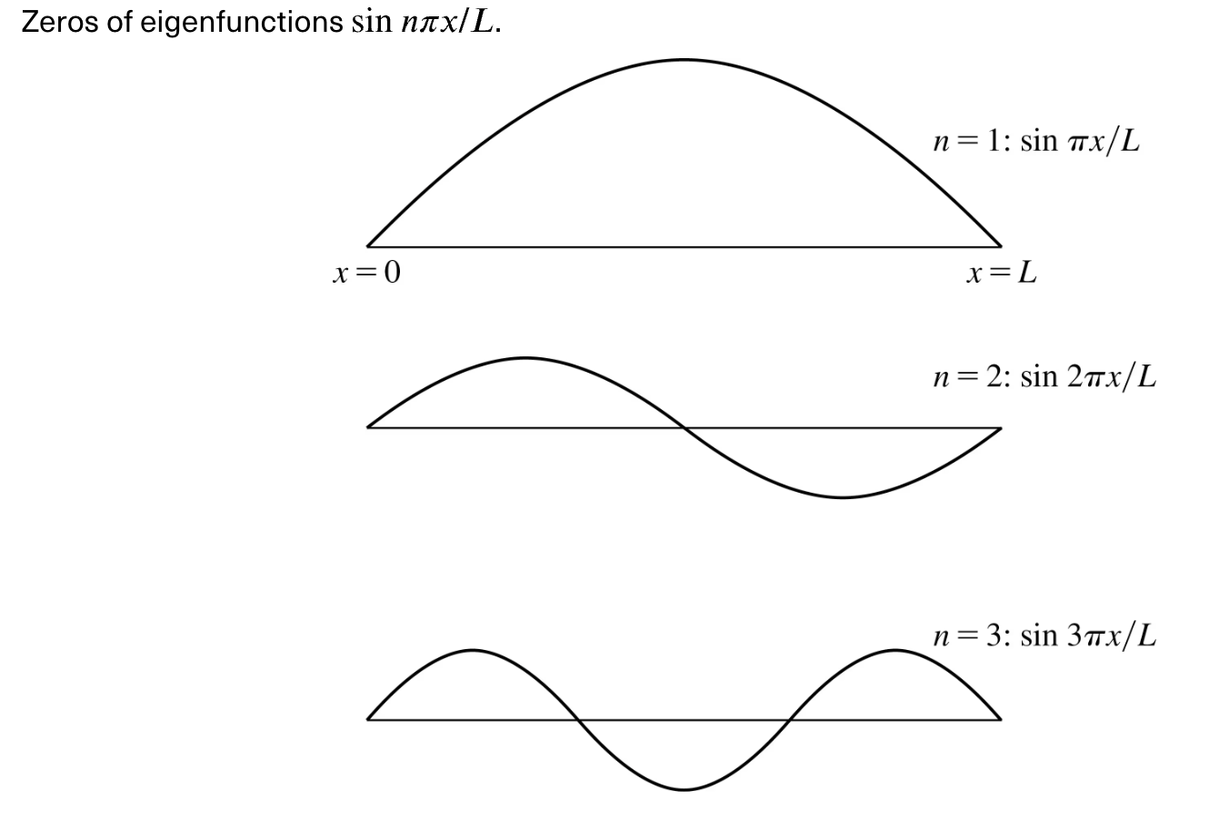

Slide 14
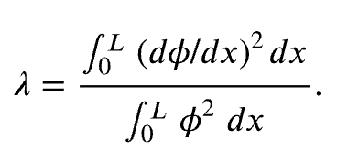



Slide 15
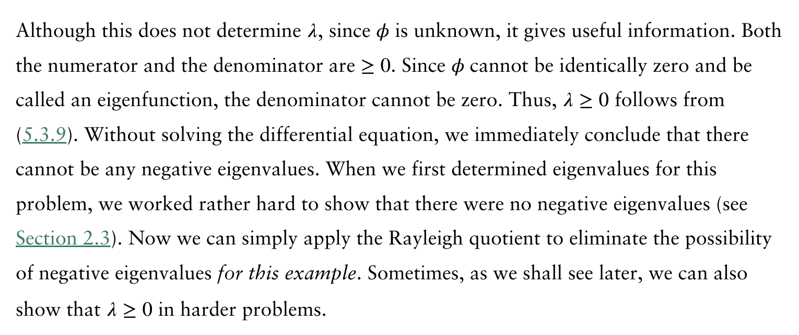

Slide 16
