Slide 1
Matrices

Slide 2


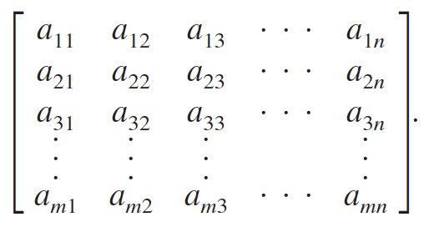
Notation
A matrix can be denoted by an uppercase letter:
A matrix can be denoted by a representative element enclosed in brackets:
A matrix can be denoted by
  a rectangular array of numbers

Slide 3
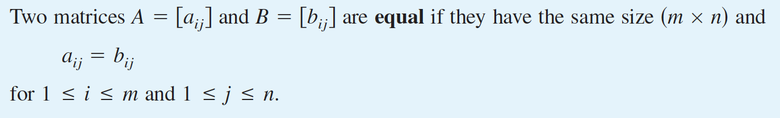

Slide 4
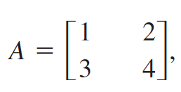
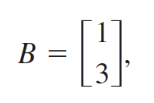

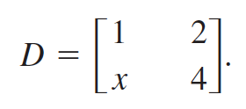
A matrix that has only one column, such as matrix B, is called a column matrix or column vector. Similarly, a matrix that has only one row, such as matrix C, is called a row matrix or row vector.
Boldface lowercase letters are often used
to designate column matrices and row matrices (vectors).

Slide 5
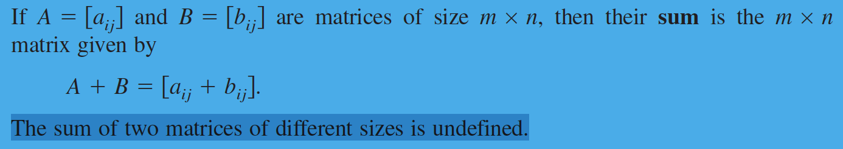
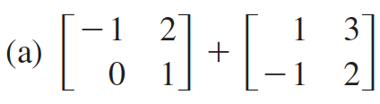
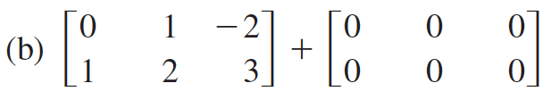
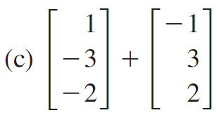
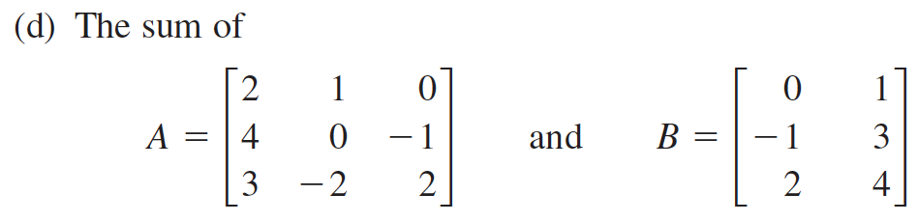
Matrix Addition

Slide 6
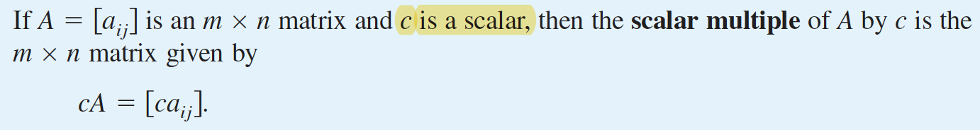
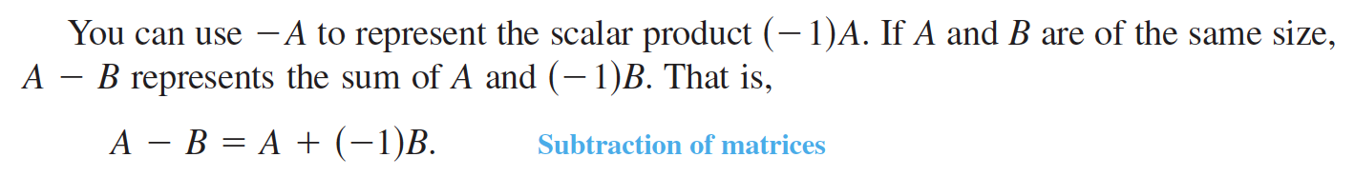
Scalar Multiplication

Slide 7
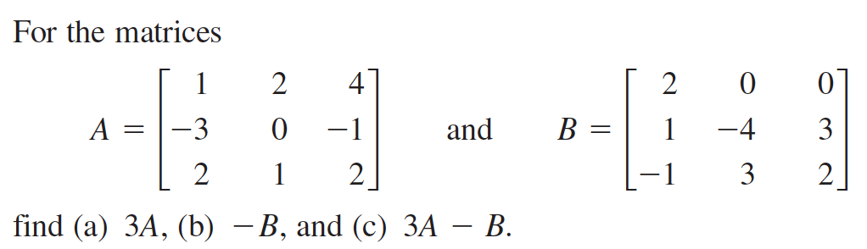

Slide 8
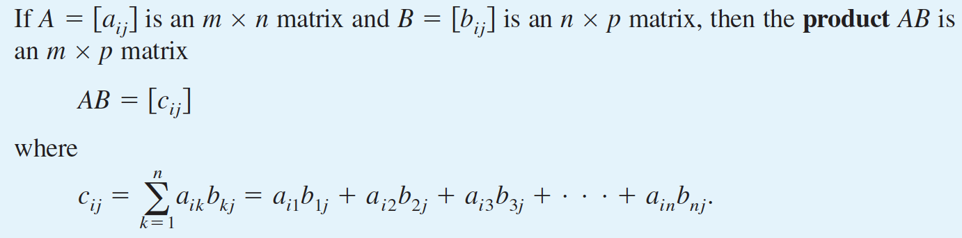
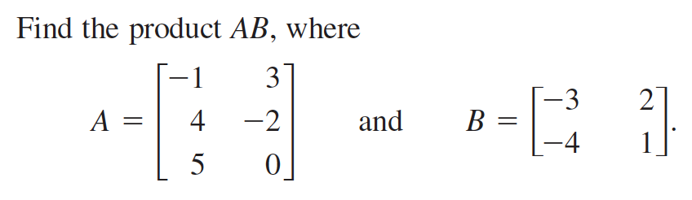
Matrix Multiplication

Slide 9
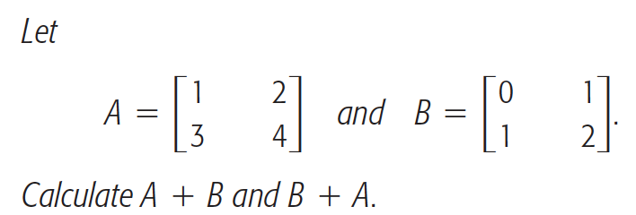

Slide 10
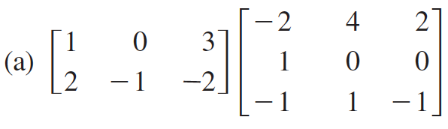
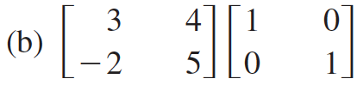
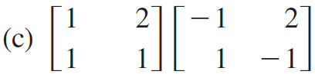
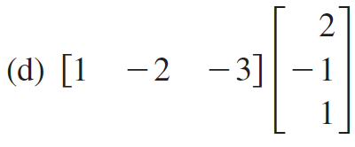
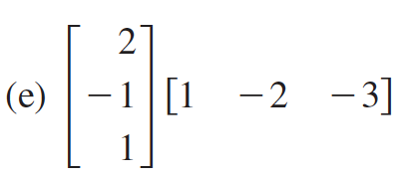

Slide 11
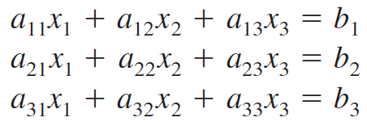

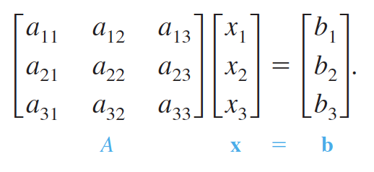



Representing a system of linear equations by matrix multiplication
The system
can be written as the matrix equation
is the coefficient matrix of the system, and are column matrices.

Slide 12
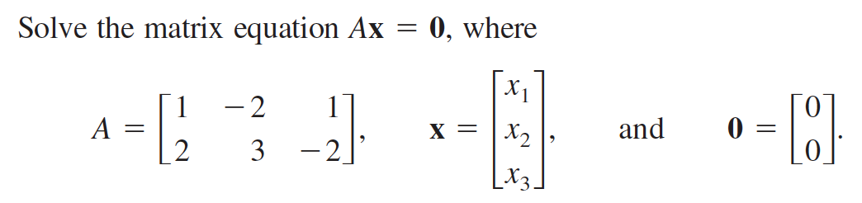

Slide 13
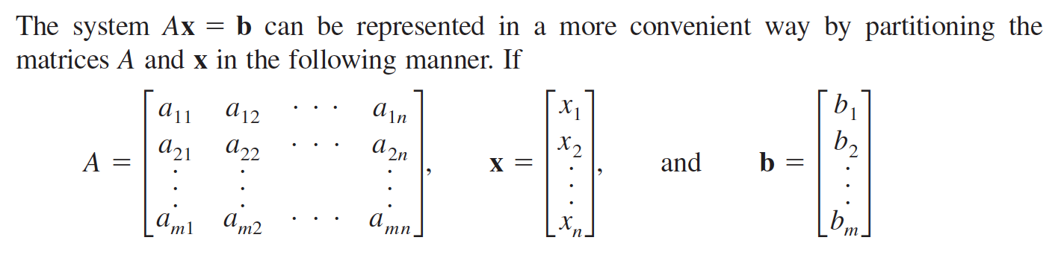

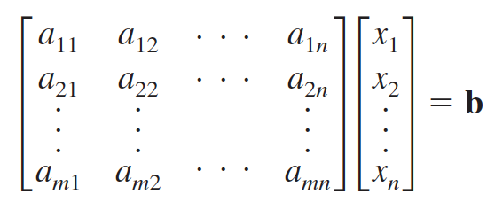
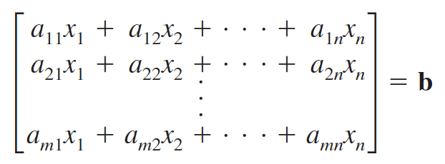
Partitioned Matrices

Slide 14
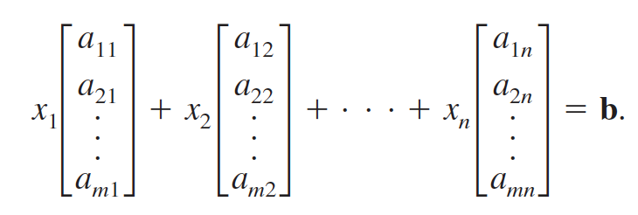
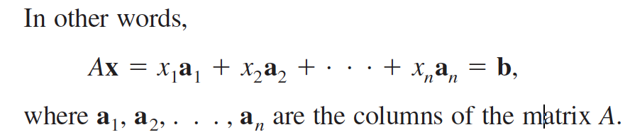

Slide 15

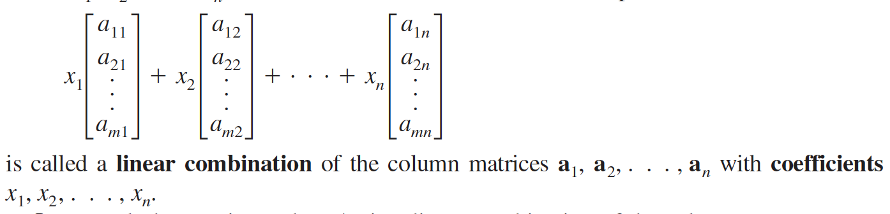

Slide 16
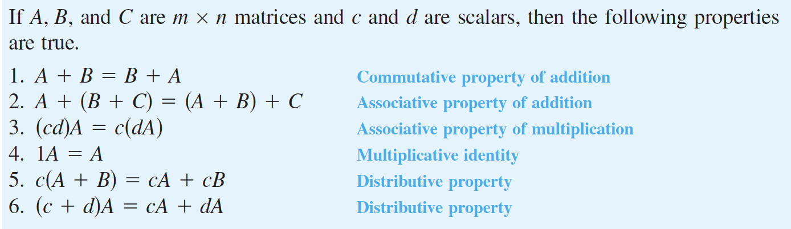

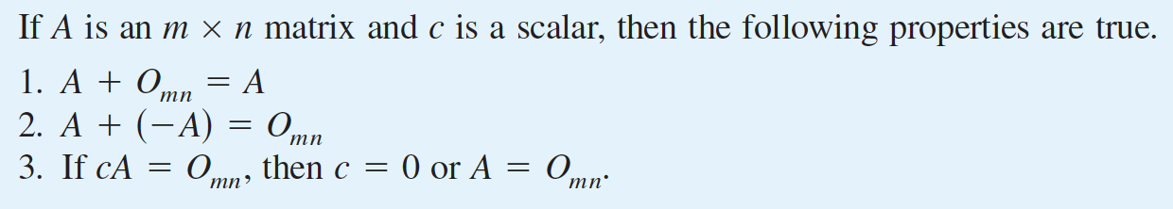
Properties of Matrix Operations

Slide 17
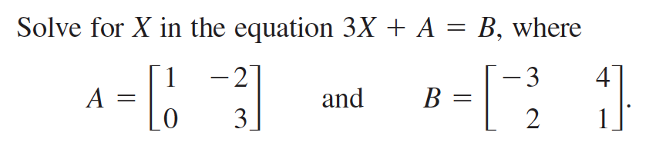

Slide 18
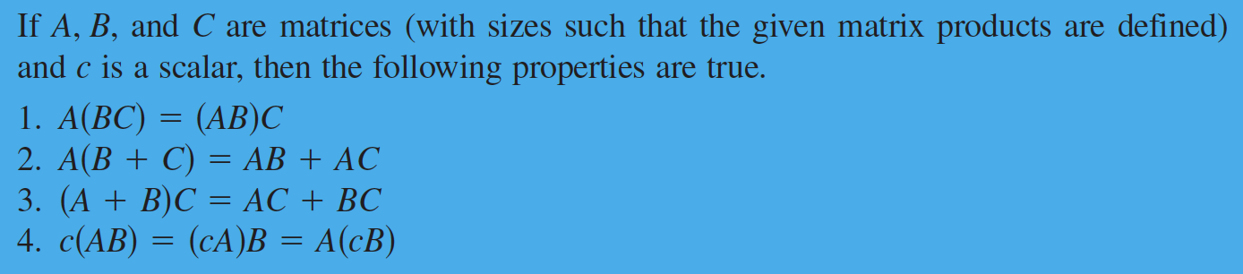

Slide 19
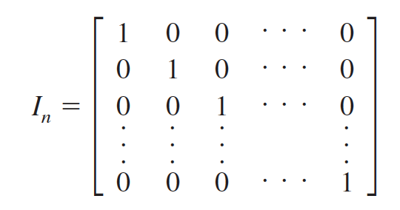
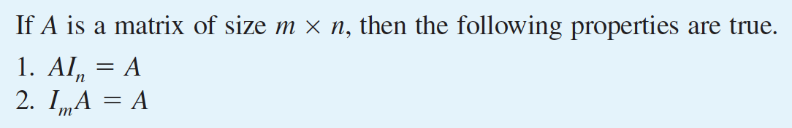
Identity Matrix

Slide 20
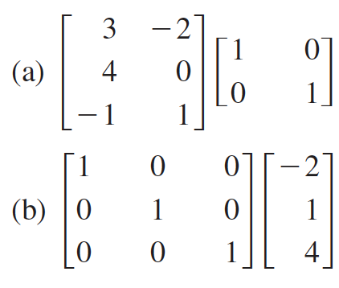

Slide 21
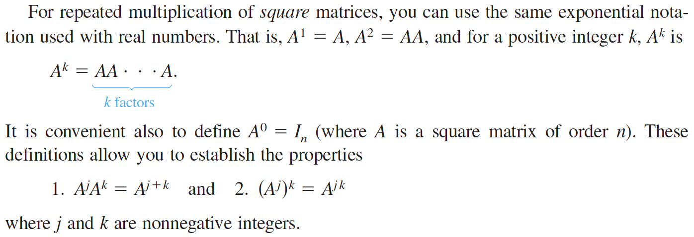

Slide 22
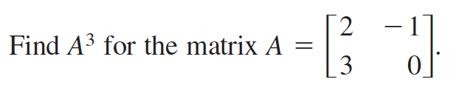

Slide 23
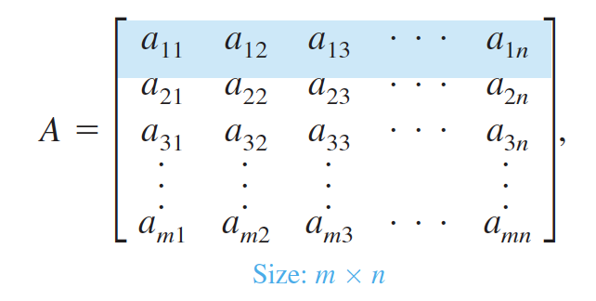
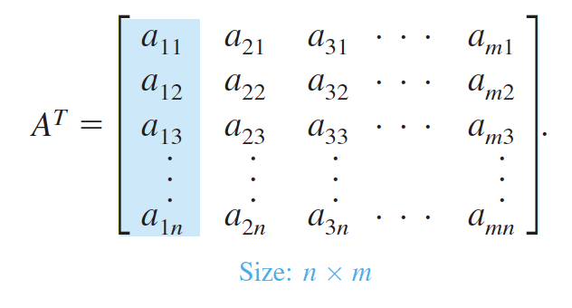
The Transpose of a Matrix
The transpose of a matrix is formed by writing its columns as rows.

Slide 24
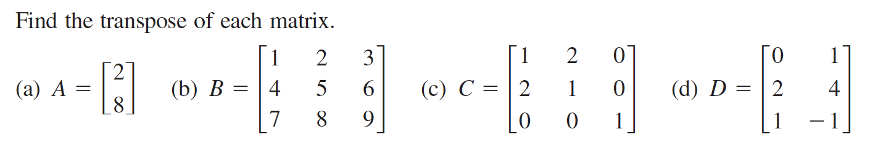

Slide 25
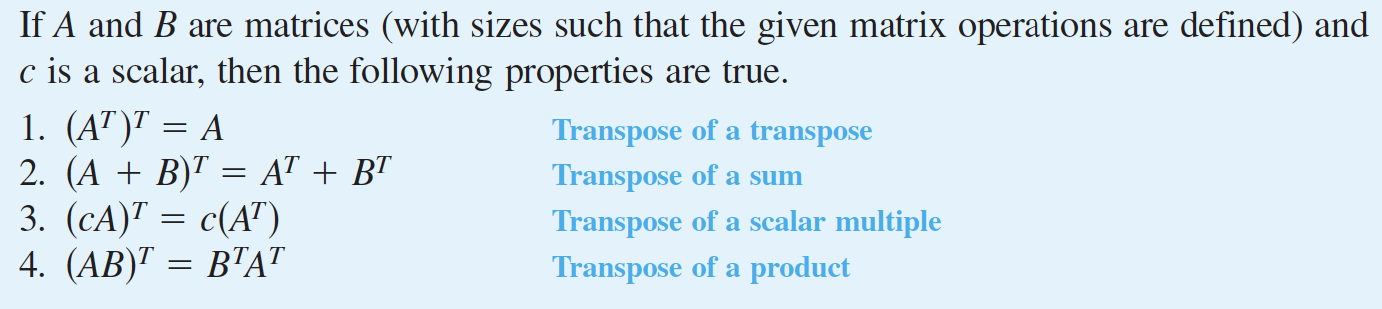

Slide 26
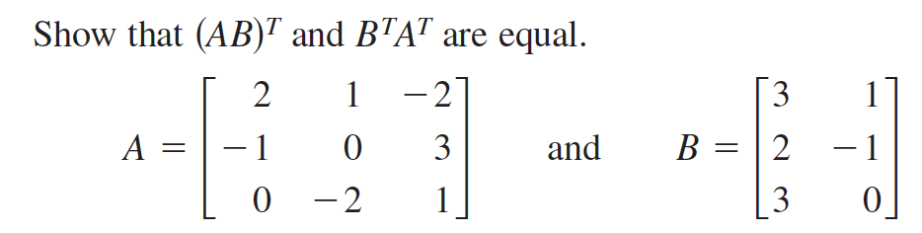

Slide 27
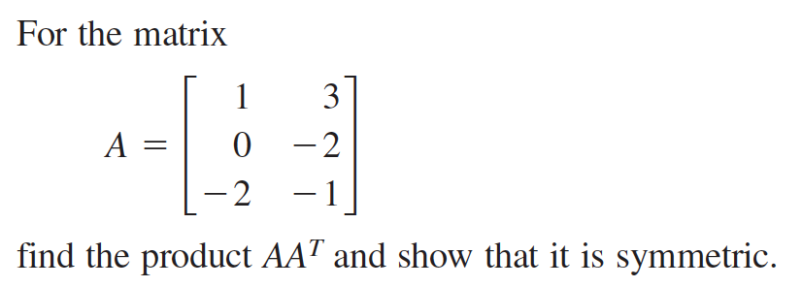

For any matrix A, the matrix given by is symmetric.

Slide 28
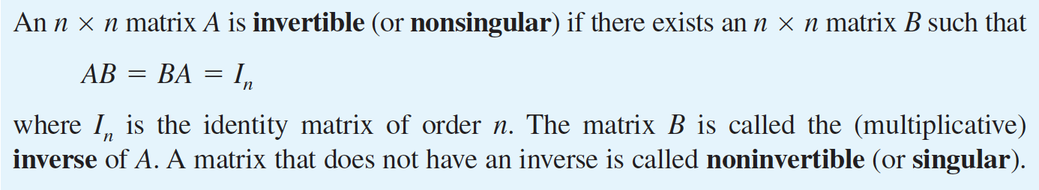
The Inverse of a Matrix
Nonsquare matrices do not have inverses.

Slide 29
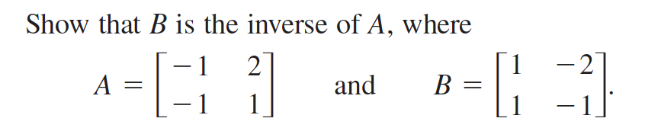
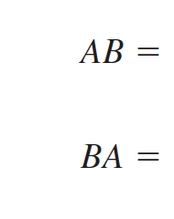
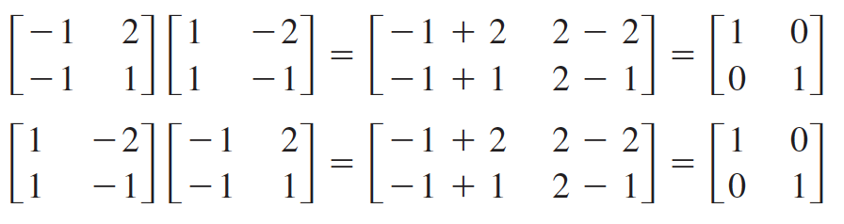

Slide 30
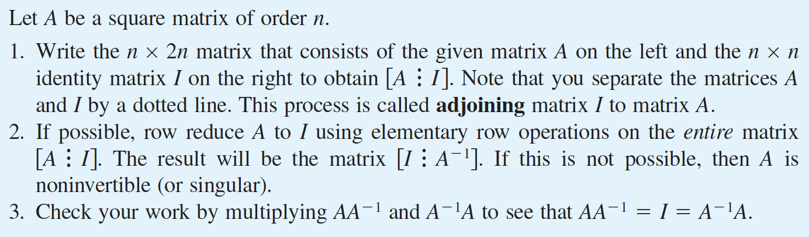
Finding the Inverse of a Matrix

Slide 31


Slide 32


Slide 33


Slide 34

Inverse for 2 x 2 matrix

Slide 35


Slide 36



Slide 37




Slide 38




Slide 39


Slide 40



Slide 41

Elementary Matrices

Slide 42


Elementary Matrices and Elementary Row Operations

Slide 43



Slide 44

The procedure demonstrated above is primarily of theoretical interest.
In other words, this procedure is not suggested as a practical method for performing Gaussian elimination.

Slide 45


Slide 46




Writing a Matrix as the Product of Elementary Matrices

Slide 47


Slide 48


The LU-Factorization

Slide 49



Slide 50




Slide 51




Slide 52


