Slide 1
The Determinant of a Matrix

Slide 2



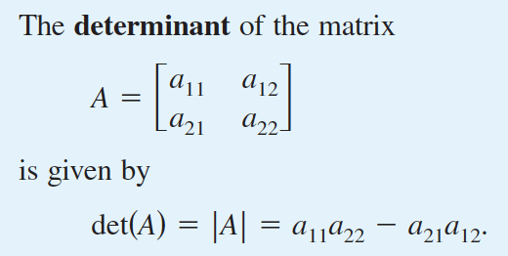
Notation: or

Slide 3


Slide 4


The determinant of a matrix of order higher than 2

Slide 5
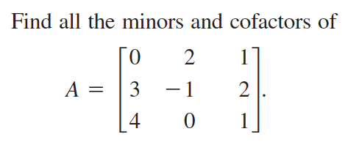
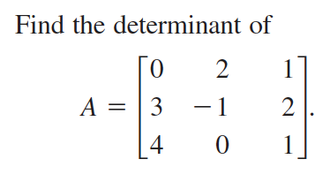



Slide 6

The row (or column) containing the most zeros is usually the best choice for expansion by cofactors.

Slide 7
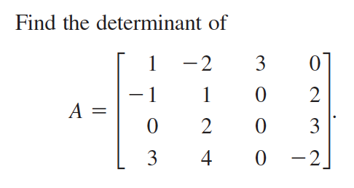

Slide 8


Slide 9

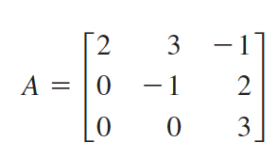

Slide 10


Slide 11

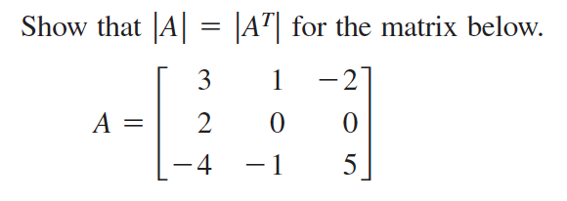

Slide 12
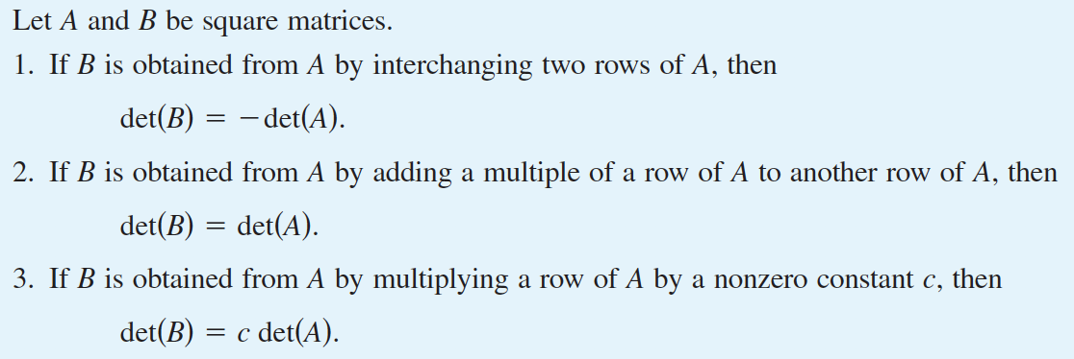

Slide 13
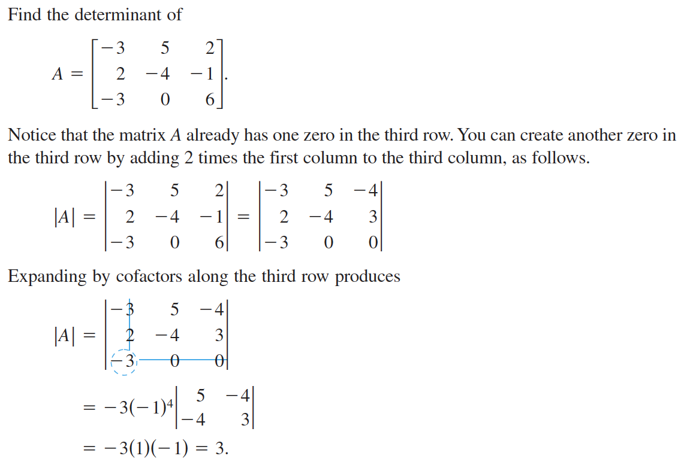

Slide 14

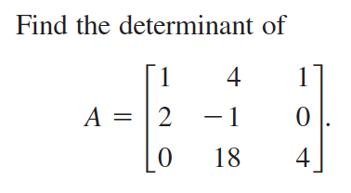

Slide 15


Slide 16



Slide 17



Slide 18
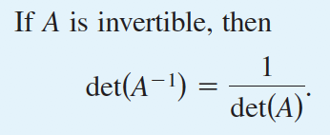

Slide 19
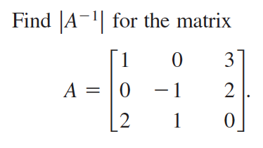

Slide 20


Slide 21


Slide 22

Eigenvalues
If A is an nxn matrix. Do there exist nx1 nonzero vectors x such that Ax is a scalar multiple of x?
The scalar is called an eigenvalue of A and is usually denoted by
The nonzero vector x is called an eigenvector of A

Slide 23


Slide 24

Find Eigenvalues and Eigenvectors
Characteristic equation of A
Eigenvalues of A roots of the characteristic equation
Once the eigenvalues are found, use Gaussian elimination to find the corresponding eigenvectors

Slide 26


Slide 27
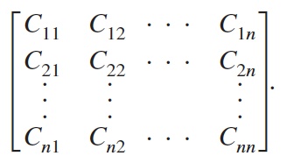
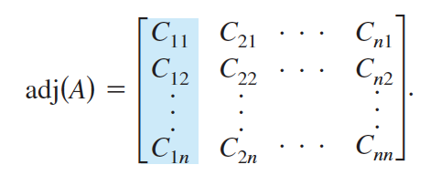
The Adjoint of a Matrix
If A is a square matrix, then the matrix of cofactors is
The transpose of this matrix is called the adjoint of A, denoted by

Slide 28
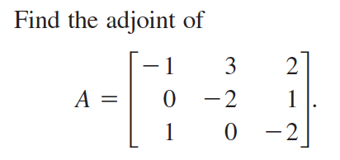

Slide 29


Slide 30
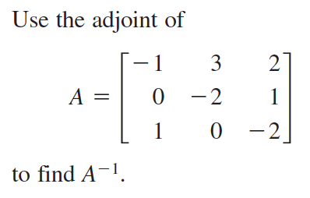

Slide 31

Cramer’s Rule
a formula that uses determinants to solve a system of n linear equations in n variables.

Slide 32


Slide 33


