Slide 1

Vector Spaces

Slide 2
In physics and engineering, a vector is characterized by two quantities (length and direction) and is represented by a directed line segment.

Slide 3

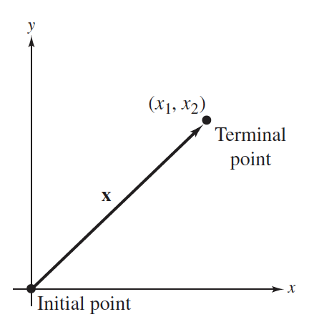

Vectors in the Plane
A vector in the plane is represented geometrically by a directed line segment whose initial point is the origin and whose terminal point is the point

Slide 4
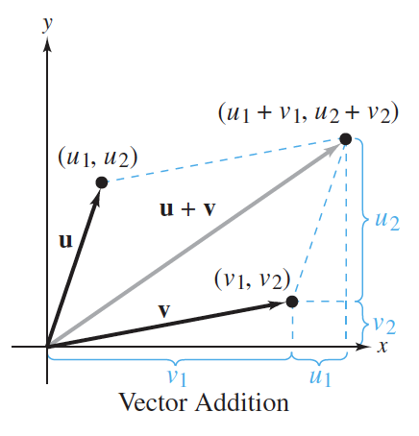

Slide 5

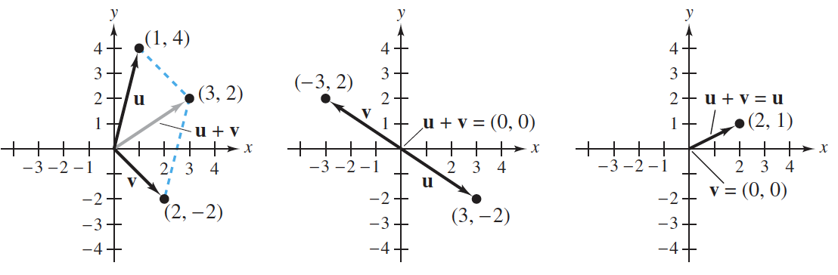

Slide 6

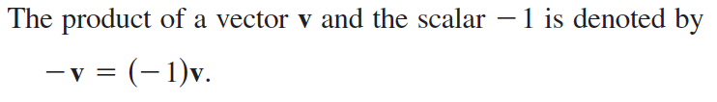



Scalar multiplication

Slide 7
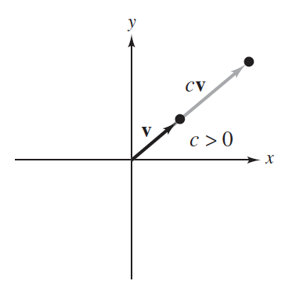
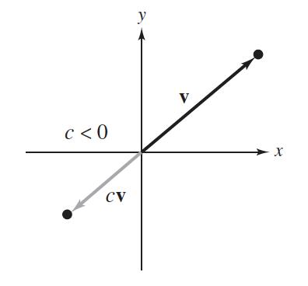

Slide 8
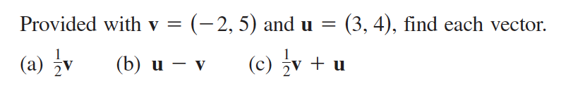

Slide 9
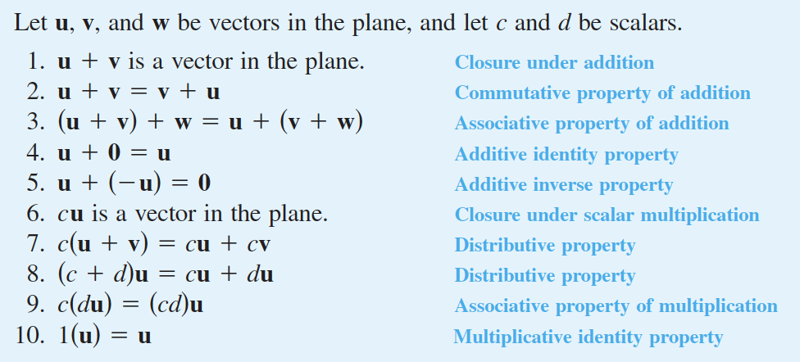

Slide 10
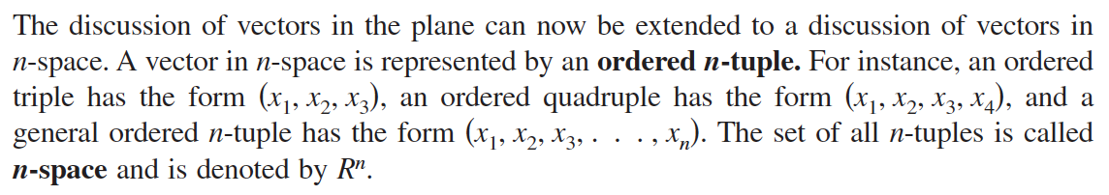

Vectors in R^{n}

Slide 11
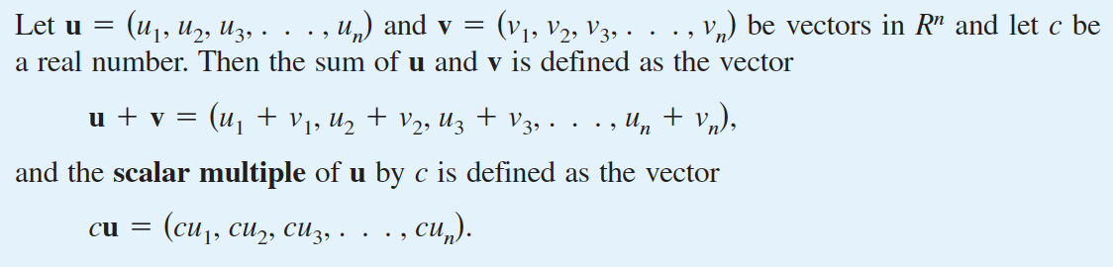
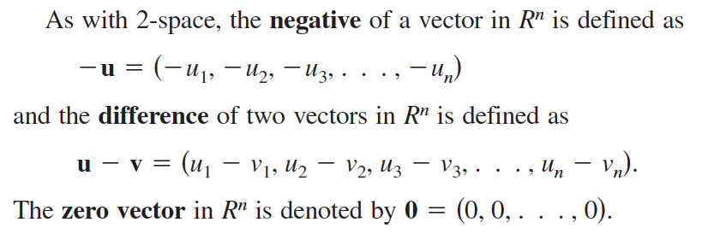

Slide 12
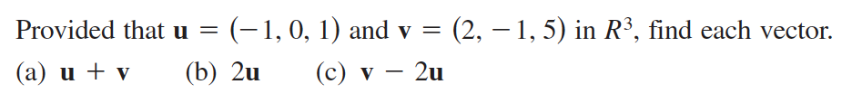

Slide 13
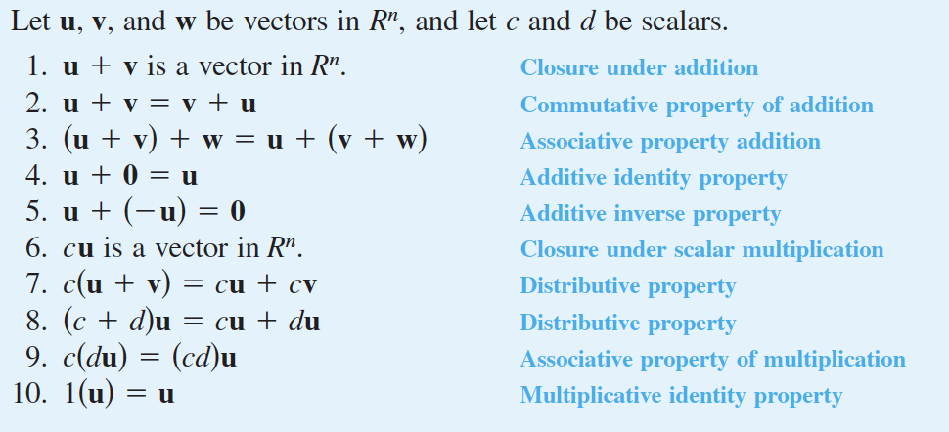

Slide 14
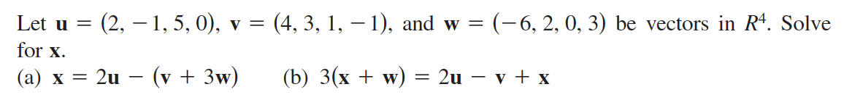

Slide 15
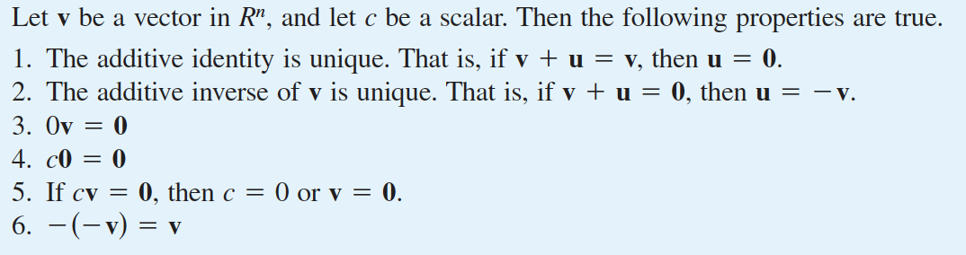

Slide 16
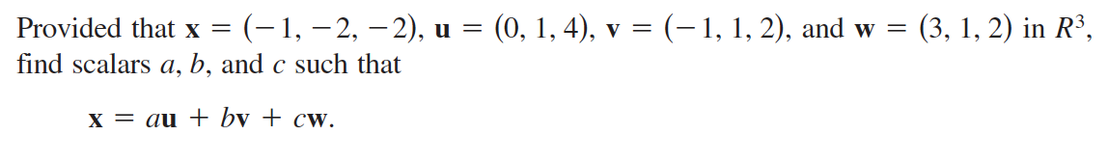

Slide 17
Vector Spaces
Recall:
Any set that satisfies these properties (or axioms) is called a vector space, and the objects in the set are called vectors.

Slide 18
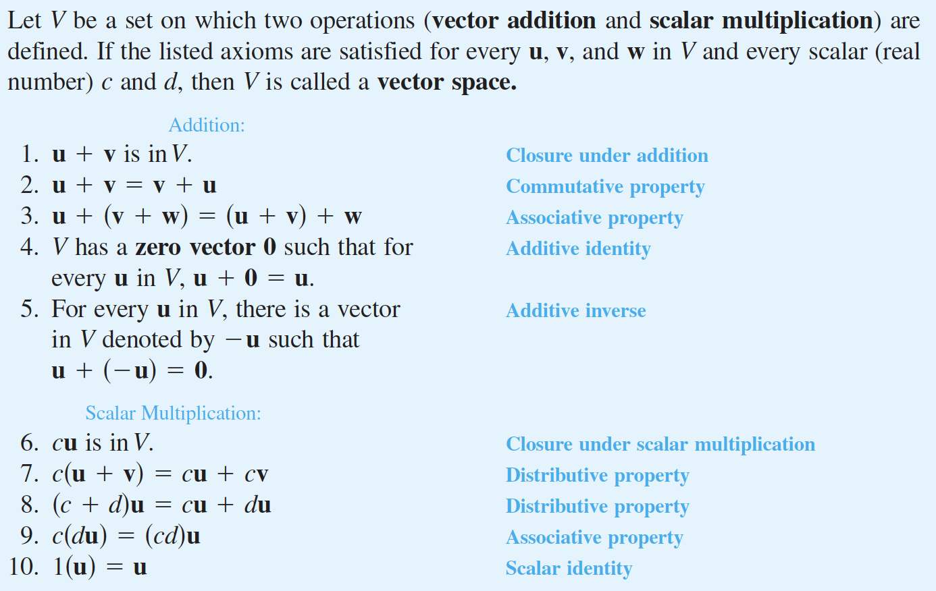

Slide 19
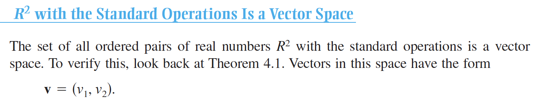

Slide 20
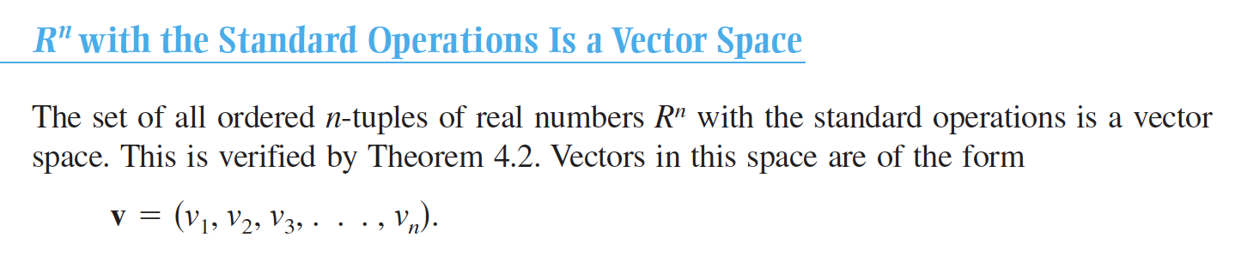

Slide 21
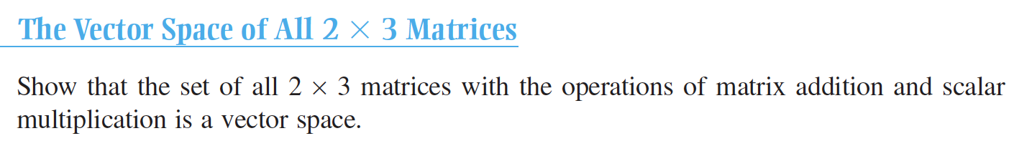

Slide 22

The Vector Space of All Polynomials of Degree 2 or Less

Slide 23
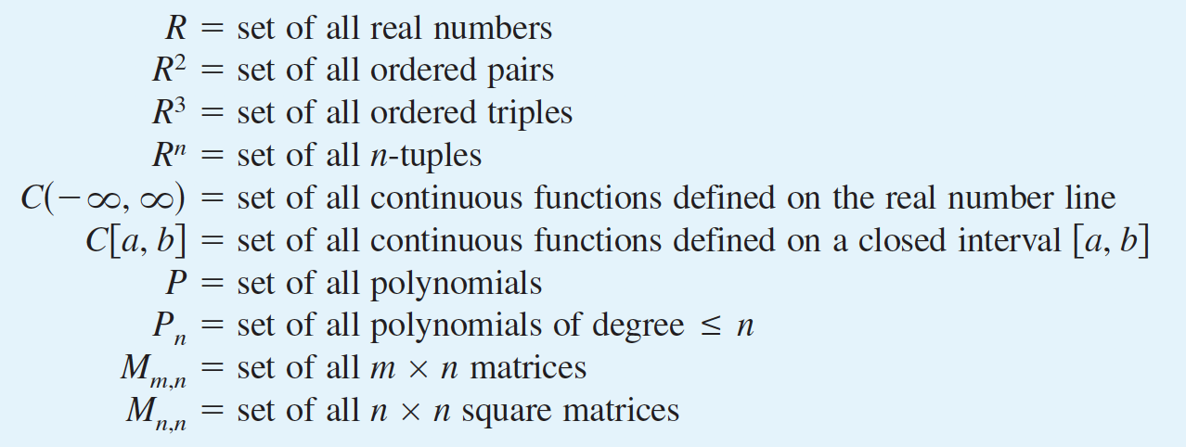
Summary of Important Vector Spaces

Slide 24
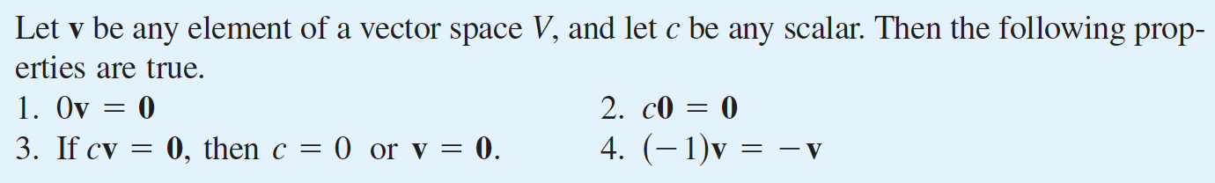

Slide 25
Counter examples
The Set of Integers Is Not a Vector Space
The Set of Second-Degree Polynomials Is Not a Vector Space

Slide 26
Subspaces of Vector Spaces
A subset of a vector space is a subspace if it is a vector space (with the same operations):

Slide 27
Example

Slide 28
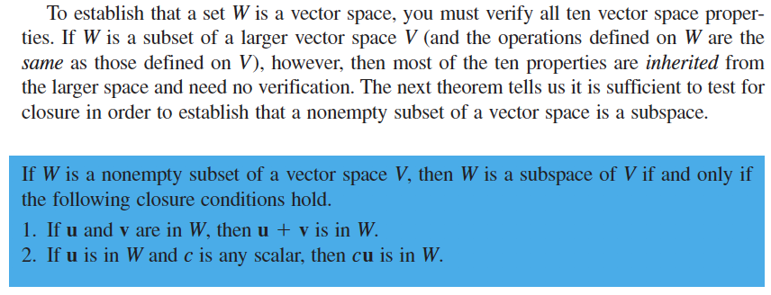

Slide 29
Example

Slide 30
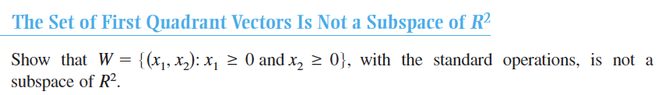
Example

Slide 31
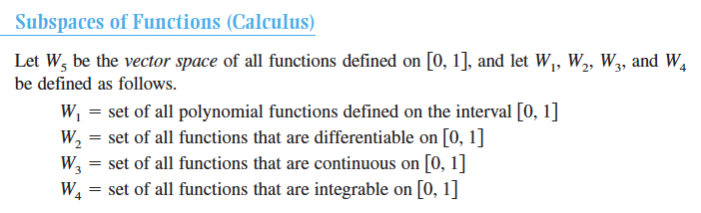
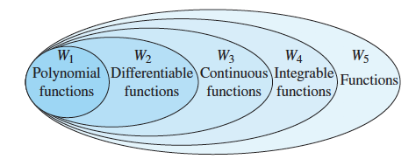
Sequences of subspaces nested within each other

Slide 32
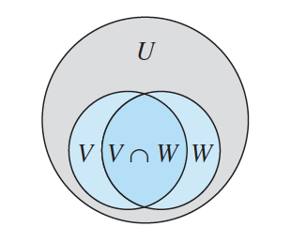

Slide 33
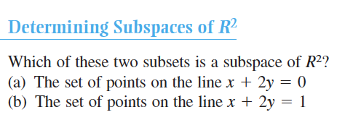

Slide 34
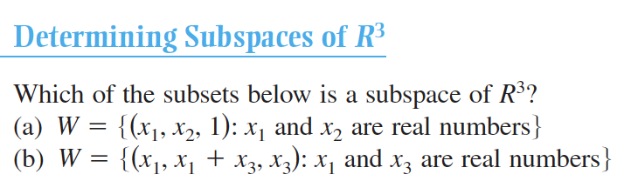

Slide 35
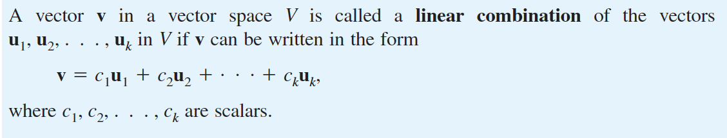
Spanning Sets and Linear Independence

Slide 36
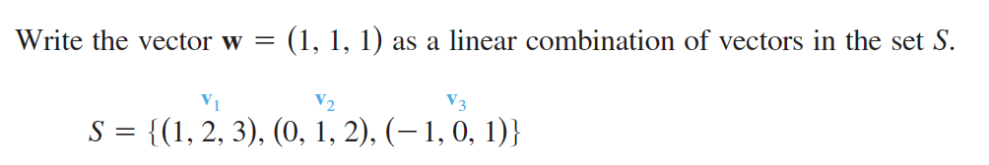

Slide 37
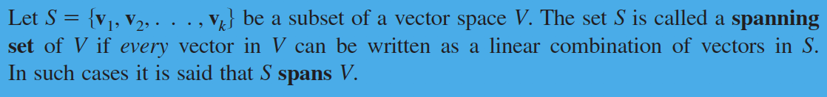
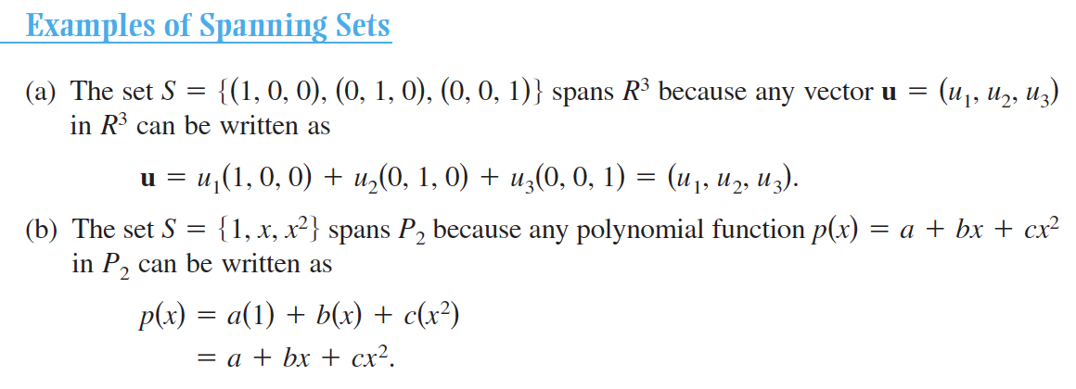

Slide 38
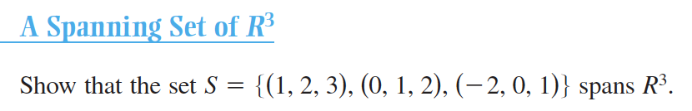
The coefficient matrix for this system has a nonzero determinant, the system has a unique solution. So, any vector in R³ can be written as a linear combination of the vectors in S, and you can conclude that the set S spans R³

Slide 39
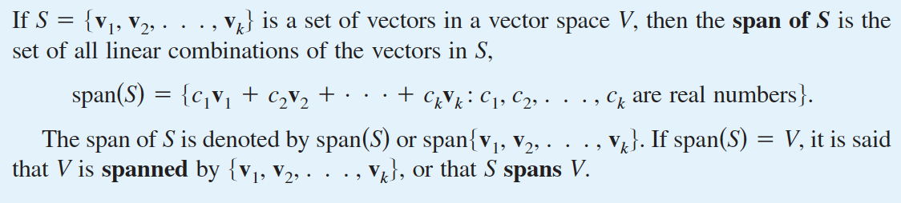
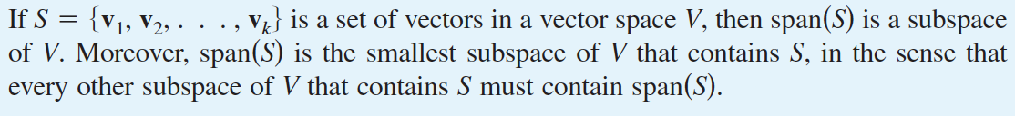

Slide 40
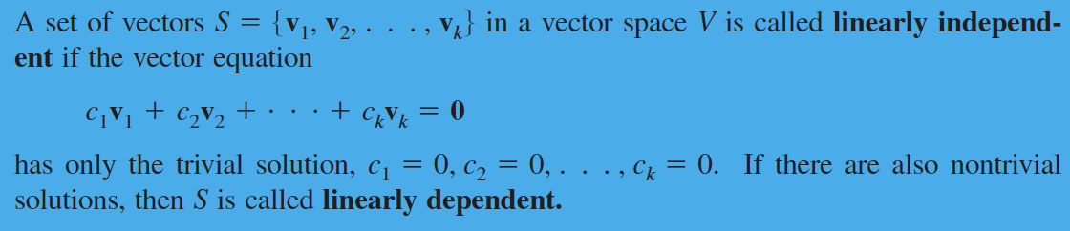

Slide 41
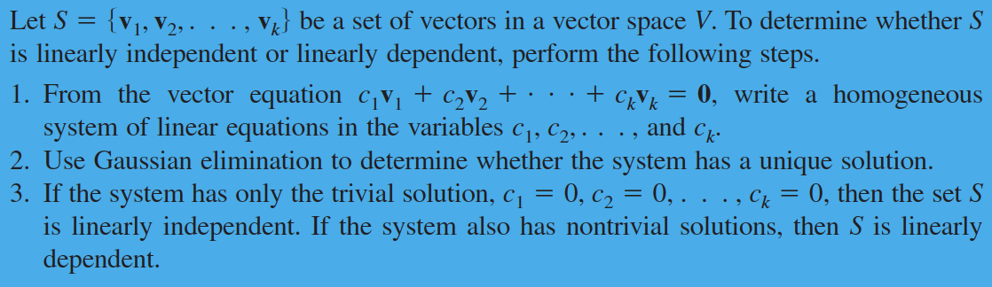
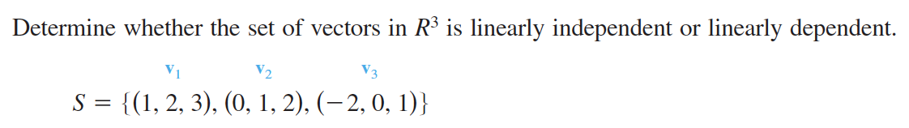

Slide 42
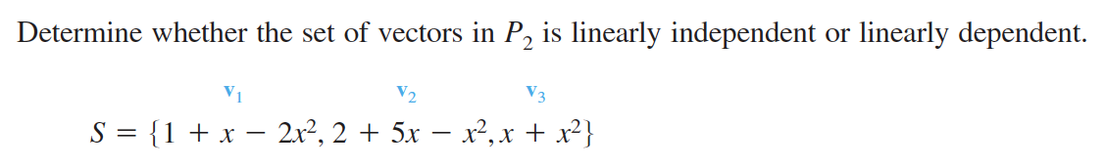

Slide 43
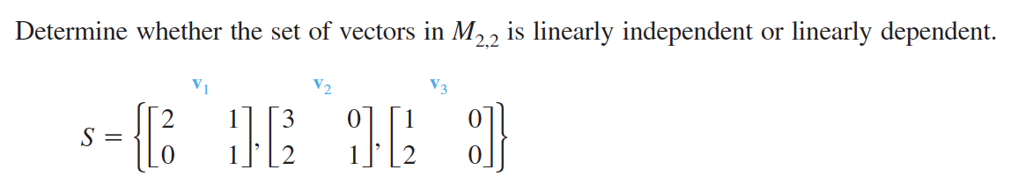

Slide 44
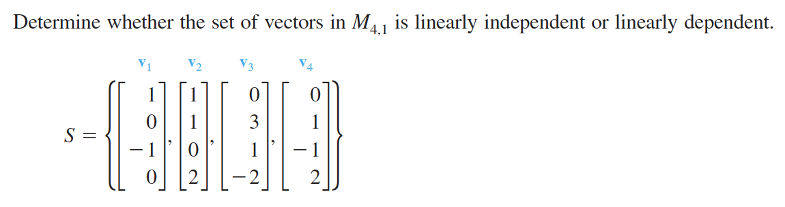

Slide 45
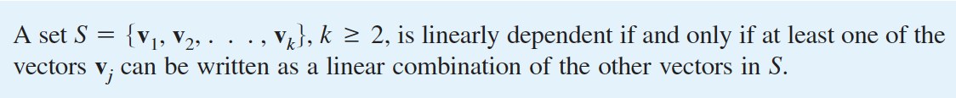
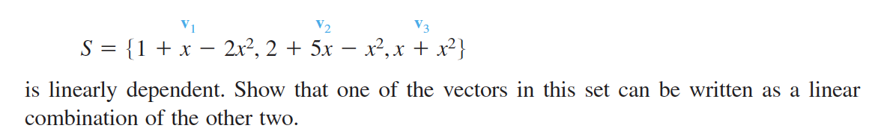

Slide 46
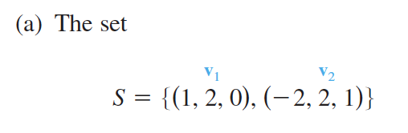
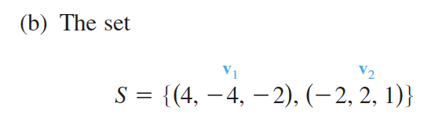
Testing for Linear Dependence of Two Vectors

Slide 47
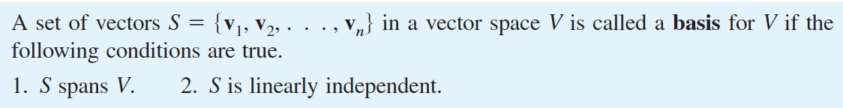
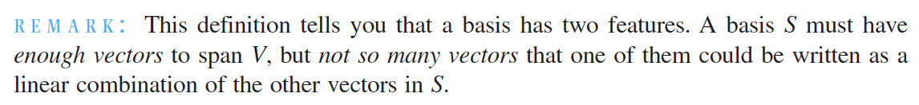
Basis and Dimension
If a vector space V has a basis consisting of a finite number of vectors, then V is finite dimensional. Otherwise, V is called infinite dimensional.

Slide 48
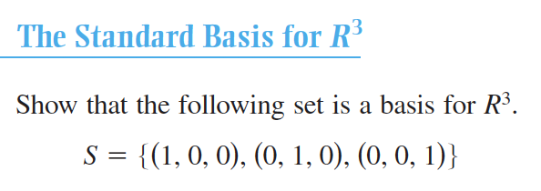

Slide 49
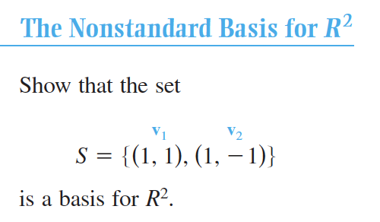

Slide 50


Slide 51



Slide 52


Slide 53


Slide 54



Slide 55


Slide 56



Slide 57



Slide 58



Slide 59


Slide 60


Slide 61


Slide 62


Slide 63


Slide 67


Slide 69


Slide 71



Slide 72


Slide 73



Slide 74



Slide 75


Slide 76


Slide 77


Slide 78

Coordinates and Change of Basis

Slide 79


Slide 80


Slide 81


Slide 82


Change of Basis in R^{n}

Slide 83


Slide 84


Slide 85


Slide 86


Slide 87



