Slide 1
Inner Product Spaces

Slide 2

Length and Dot Product in R^{n}

Slide 5



Slide 7



Slide 8



Slide 9


Slide 11



Slide 12


Slide 13



Slide 14
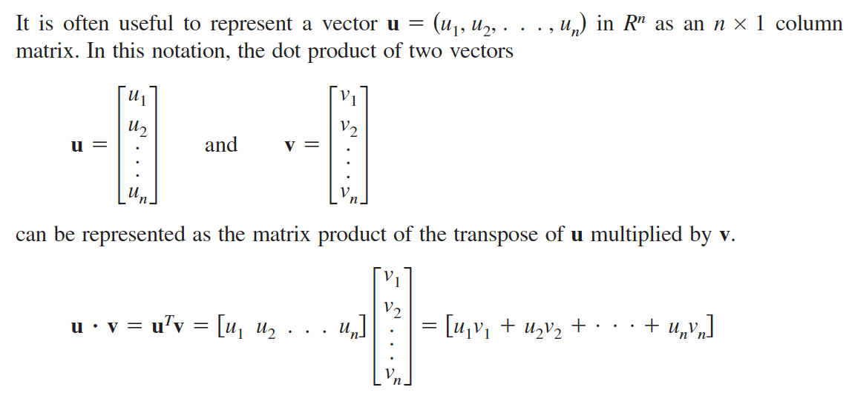
The Dot Product and Matrix Multiplication

Slide 15

Inner Product Spaces

Slide 16


Slide 17


Slide 18


Slide 19
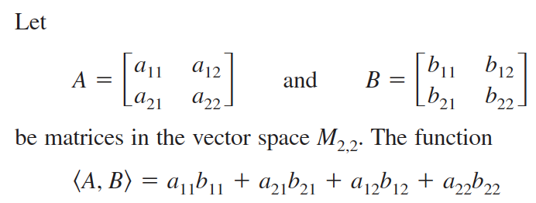


Slide 20

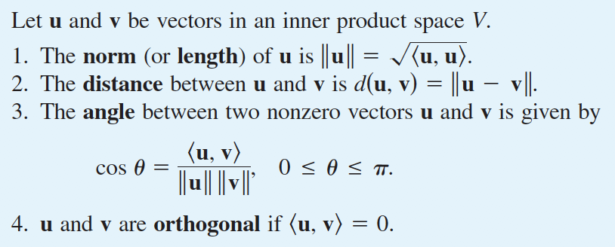

Slide 21


Slide 22


Slide 23


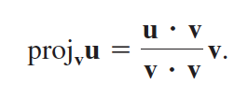
Projection in a plane
Let u and v be vectors in the plane. If v is nonzero, then u can be orthogonally projected onto v.

Slide 24


Slide 25



Slide 26

Project in an inner space

Slide 28



Slide 29


Slide 30

Gram-Schmidt Orthonormalization Process

Slide 31
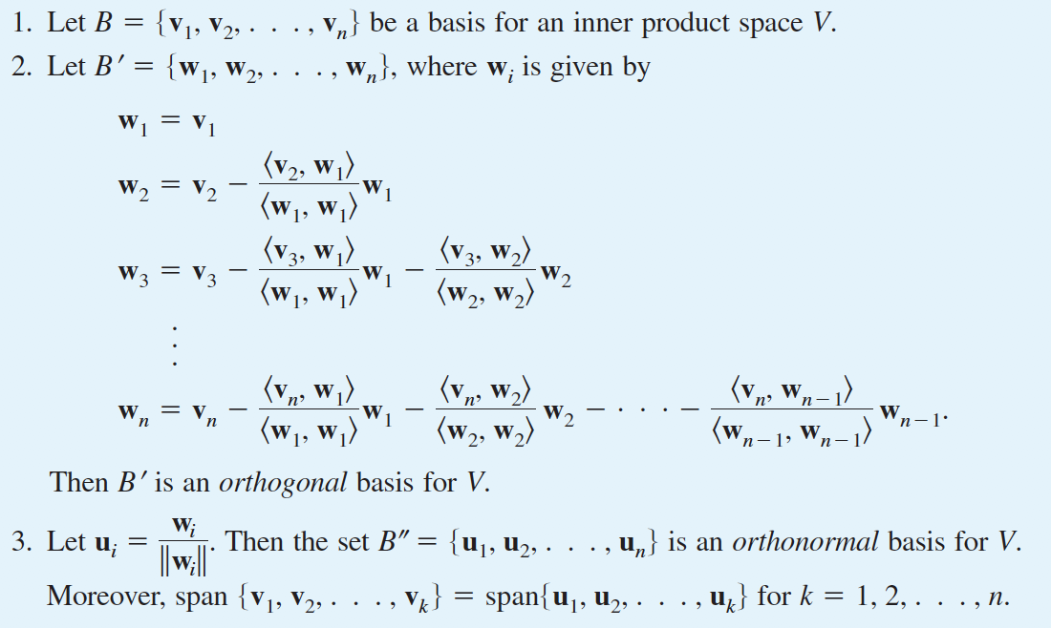
Gram-Schmidt
Orthonormalization Process

Slide 32


Slide 33


Slide 34
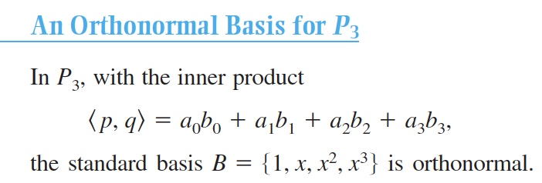

Slide 36


