Slide 1
Life cycle of a software project

Slide 2
Roles in software life cycle
Software Development Manager (SDM)
Product Manager (PM)
Project Manager (PM)
Technical Program Manager (TPM)
software development engineer (SDE)

Slide 3
Software Development Manager (SDM)
People management
Team vision and roadmap
Execution
Team culture

Slide 4
Product Manager (PM)
Researching products
Setting product vision
Developing strategic plan
Creating and maintaining product roadmap

Slide 5
Project Manager (PM)
Breaking down initiatives into tasks
Planning project timelines
Allocating project resources
Monitoring task completion

Slide 6
Technical Program Manager (TPM)
In charge of handling all delivery aspects of product
Driving programs, following progress
Providing support in case issues arise
Drive technical dependencies that have to make changes for their project(s) to launch

Slide 7
software development engineer (SDE)
System and architecture design
Coding
Testing
Operation

Slide 8
Who does what
 | Product Vision | Project Management | Implantations | Maintenance
SDM | ✔️ | ✔️
Product Manager | ✔️ | ✔️
Project Manager |  | ✔️
TPM |  | ✔️
SDE | ✔️ | ✔️ | ✔️ | ✔️

Slide 9
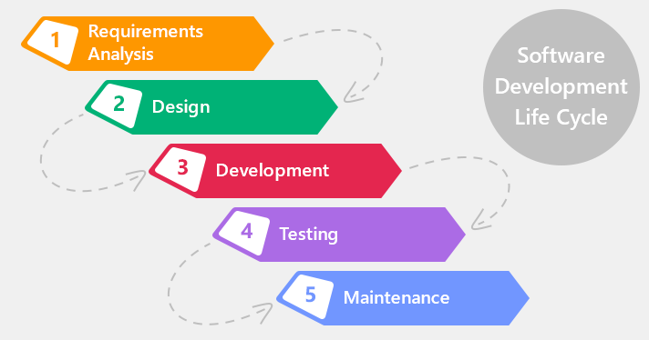
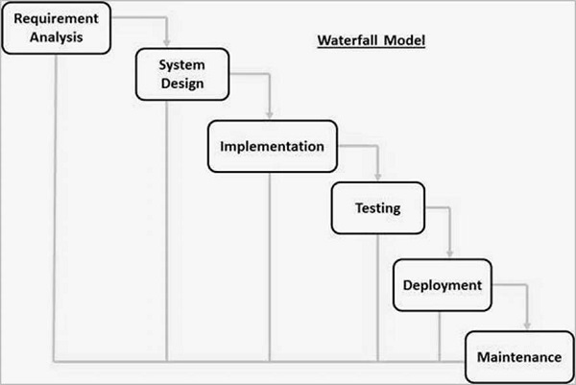
Software Life cycle

Slide 10
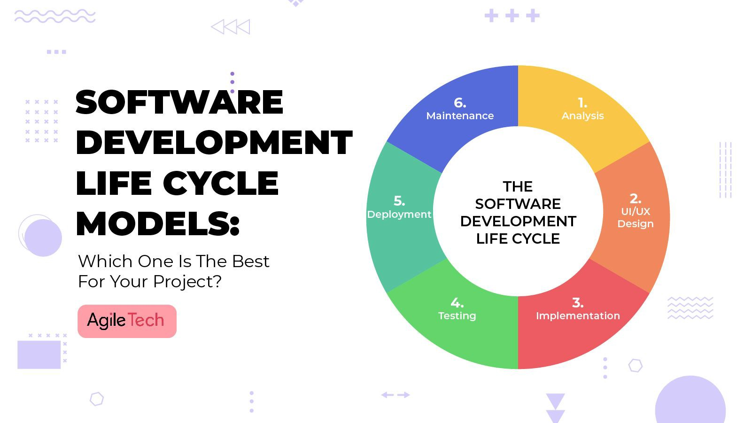
SDLC (agile)

Slide 11
Agile - Scrum
Planning — where sprint priorities are identified
Commitment — where the team reviews a list or backlog of user stories and decides how much work can be done in the sprint’s duration
Daily standup meetings — so teams can communicate updates on their development status and strategies)

Slide 12
Agile - kanban
Kanban works as a fan-in and fan-out process where the team pulls user stories from an intake board and funnels them through a staged development process until they are completed.

Slide 13
ML in Amazon – ML as a service
Variety of services support both supervised and unsupervised ML
From offline training to online training
SageMaker
Rekognition
Transcribe
Translate
Lookout
Polly

Slide 14
ML in Amazon – Use Cases
Recommendation
Forecast
Fraud detector
Others

Slide 15
ML project process
Find an use case
Find data to support the use case
Design algorithm
Label data if needed
Choose your target metrics (Precision = true positive / total predicted positive, recall = true positive / total relevant)
Train the data and predict
Adjust to meet the accuracy

Slide 16
Common ML Use cases
Regression
Classification
Time series
Computer vision
Natural Language Processing
Reinforcement learning (RL)

Slide 17
Tooling
IDE – IntelliJ, Visual Studio Code, PyCharm
Source control – Git
ML libraries: sklearn, MxNet, Tensorflow
Computing – Laptop, Cloud

Slide 18
Actions
Send me the Github email address
Choose an agile method
Set goals for the next meeting.

