Slide 1
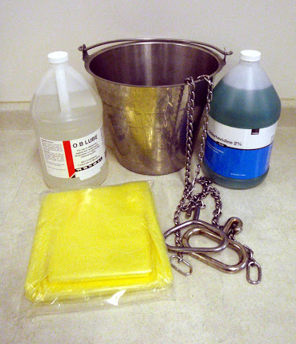
Theme 6: Calving, Young Stock Management
USE OF EQUIPMENT AROUND CALVING (Level 1)
Topic | Training & information Content
6.1 | Selection of bulls, use of sexed semen, feeding management of dry cows
6.1.1 | The calving process
6.1.2 | Use of equipment around calving
6.1.3 | Care of cow and calf after calving
6.1.4 | Colostrum management
6.2 | Milk (replacer) feeding schedule
6.3 | From birth to weaning
6.4 | Disease and health management
6.5 | Handling of calves after difficult birth
6.6 | Young stock rearing info and Key Performance Indicators

Slide 2
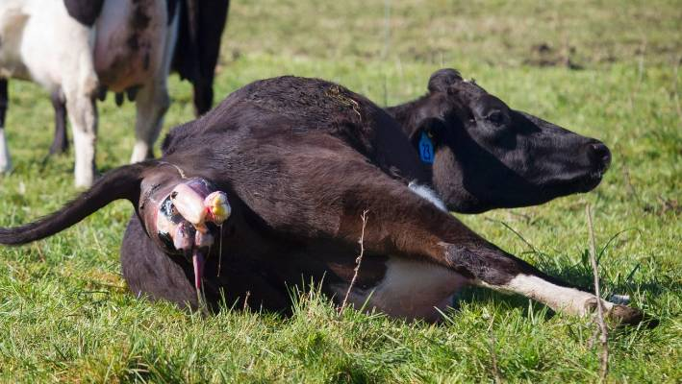
1. You will learn about (learning objectives):
How to prepare a cow for a hygienic calving procedure
How to use/implement all the necessities for a smooth hygienic calving process
Hygienic measures before, during and after birth process

Slide 3
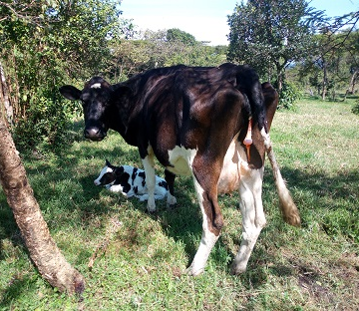
2. Background
Calving is the most important and most sensitive moment in a cow’s life
(Too) many calves die because of a lack of prevention measures around birth
Farms lose most cows (either die) because of calving issues, mostly because farmers make wrong or no decisions
Many things can go wrong, which may effect calf’s health and cow’s health and performance. As such, putting more emphasis on hygiene and care will have a direct effect on calf and cow performance

Slide 4


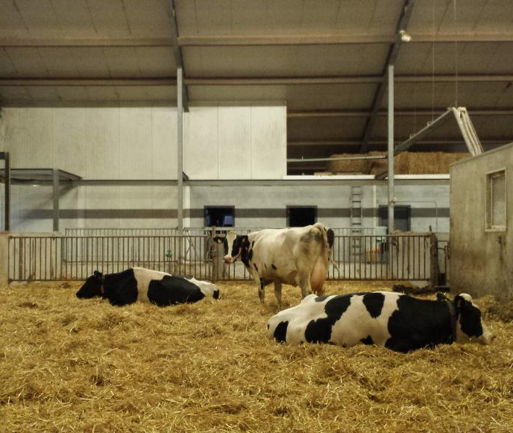
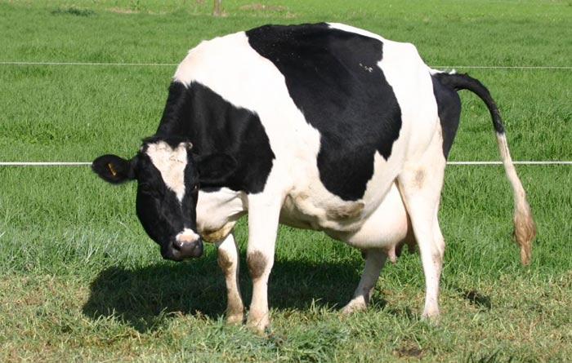
3. Calving: Hygienic Calving pen
Successful calving all starts with a good preparation. This means;
separate the cow from the herd when close to calving
take the cow to a spacious, clean calving shed
1

Slide 5
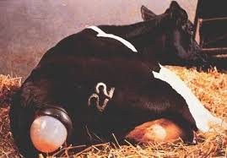

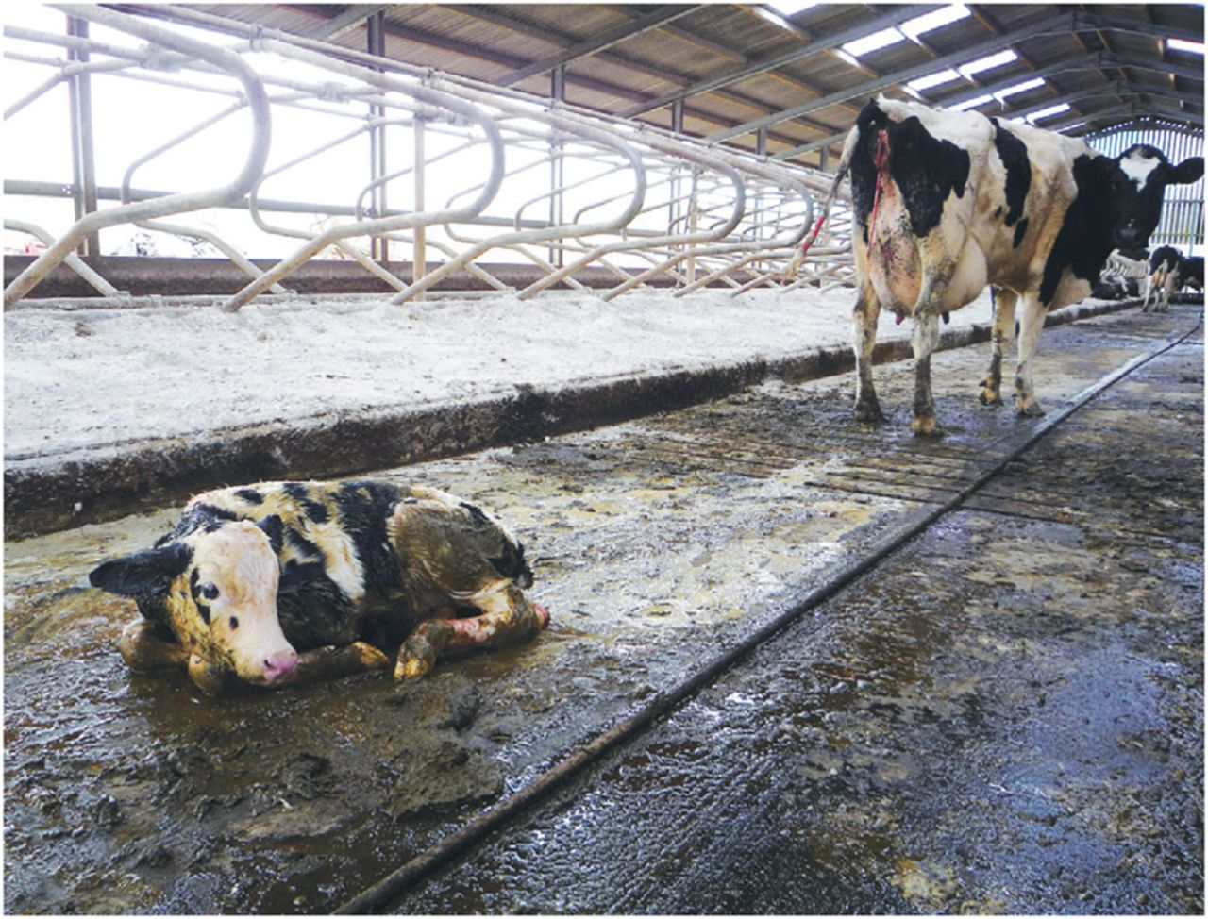

3.1 Calving: Hygienic Calving pen cont’d…
How it should be:
Unexpected:
1

Slide 6
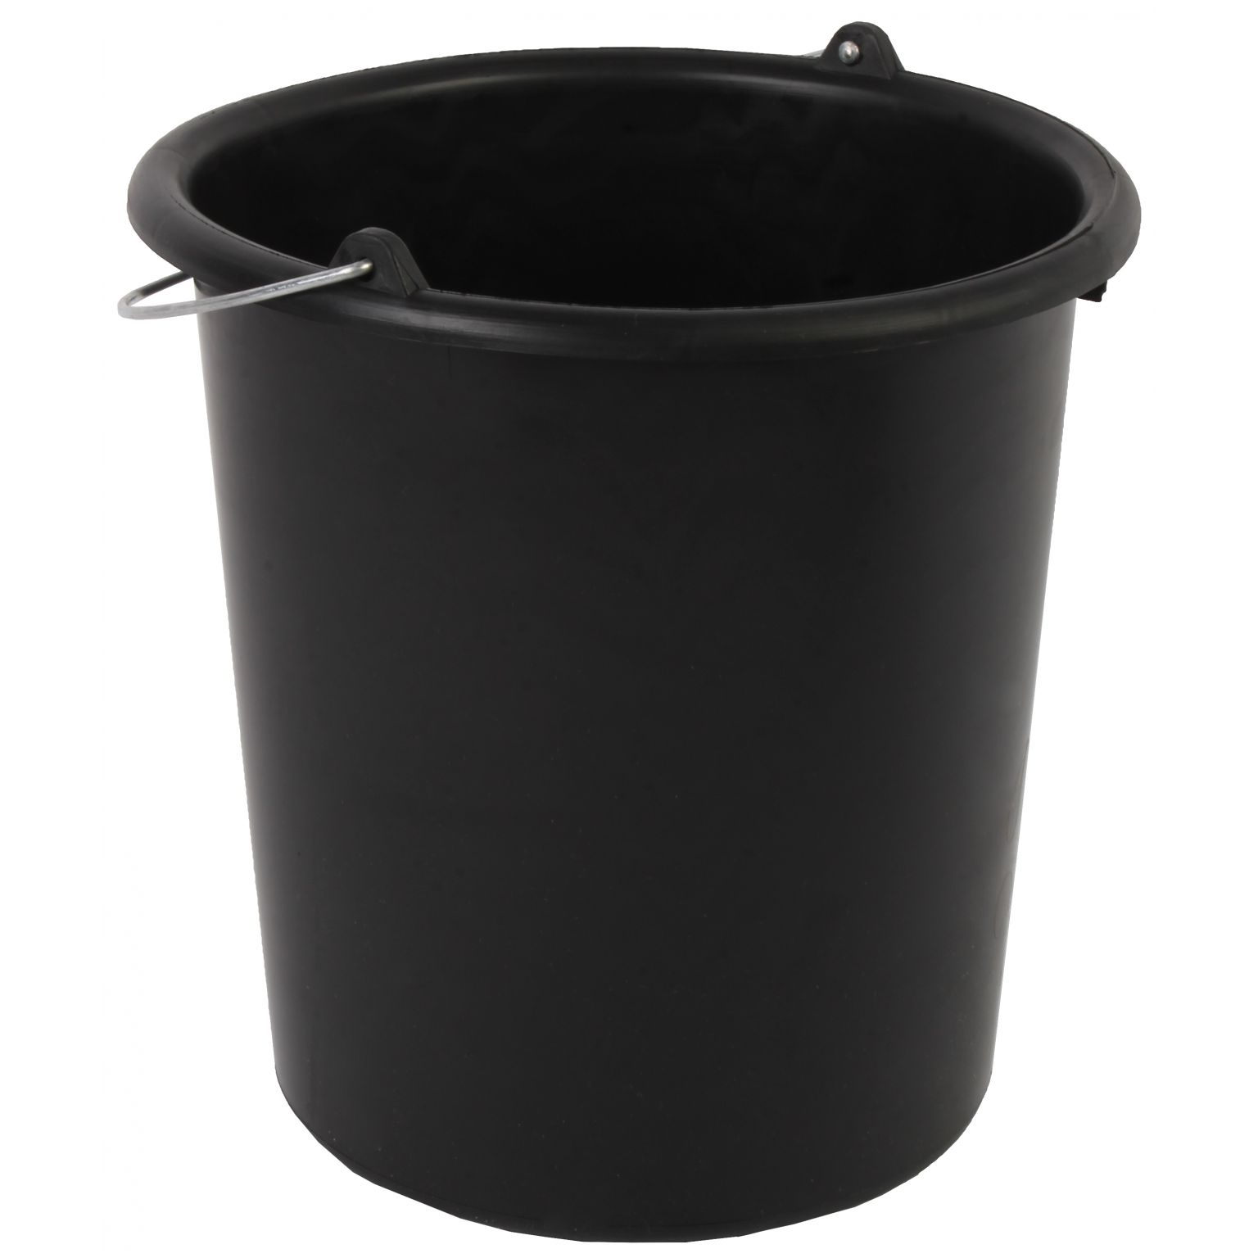

4. Water and disinfectant soap
As soon as the cow starts showing signs of calving, it is time to make sure that water and disinfectant soap is available
2
H2O

Slide 7
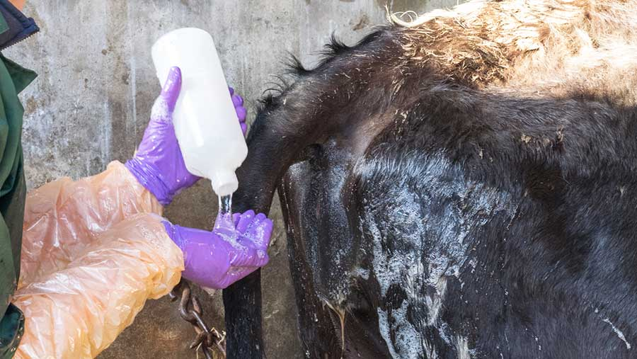
4.1 Disinfecting the vulva area
Washing and disinfecting areas around the cow’s vulva, tail and rump
2

Slide 8
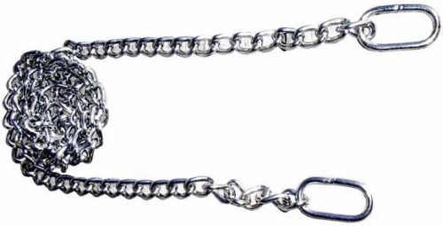
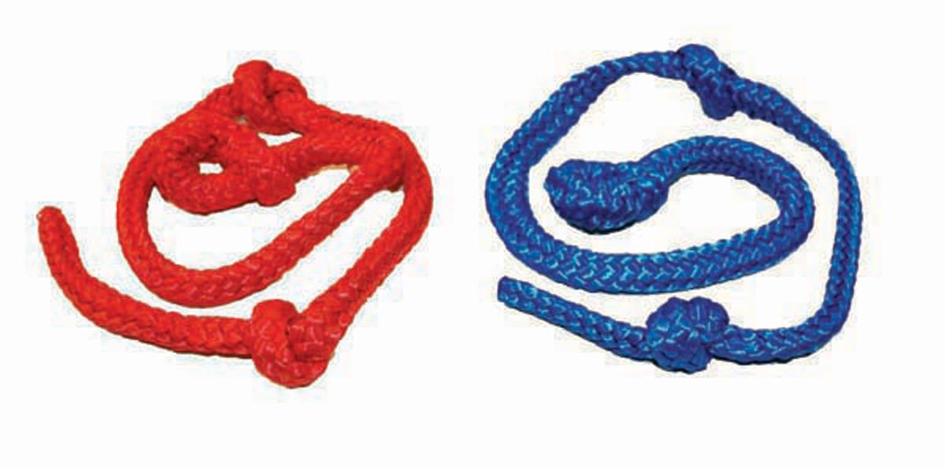
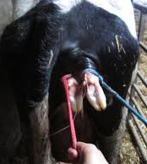
5. Special pulling chains/ropes
Disinfected, special pulling chains or ropes must be around during calving
3

Slide 9
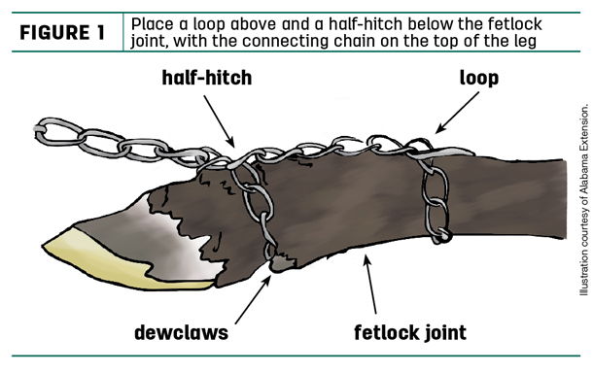
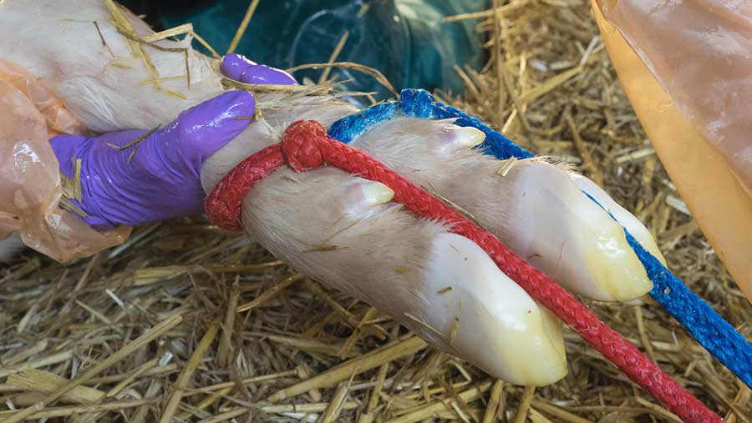
5.1 Special pulling chains/ropes cont’d…
Tip: This is how to tie and pull the strings in case assistance is needed
3

Slide 10
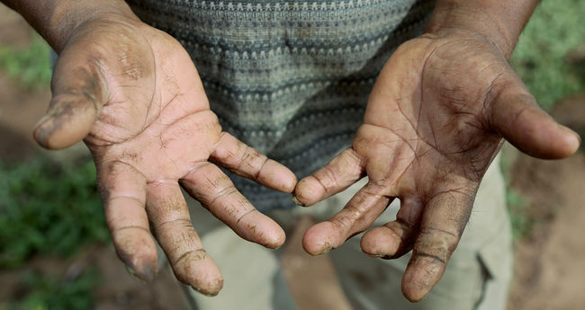
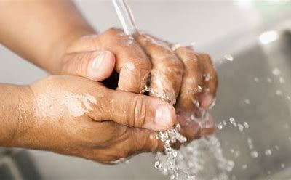
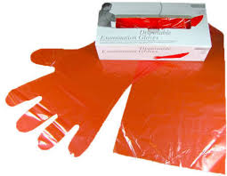
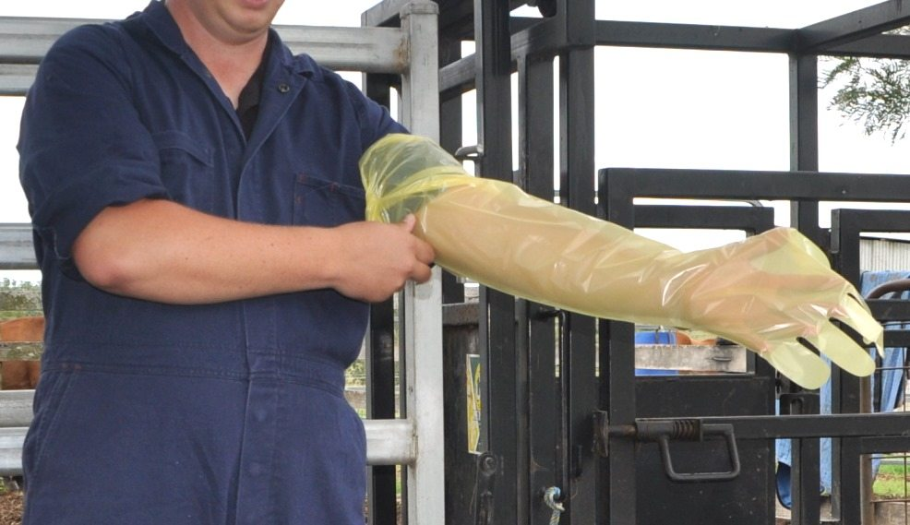
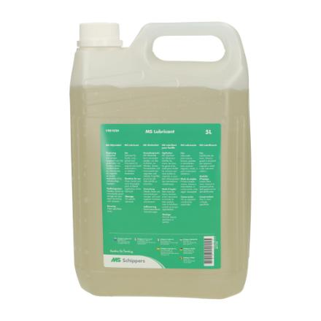
6. Clean hands and nails
Washing hands and cutting nails before you start rectal research is a must
4

Slide 11
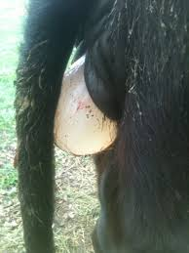

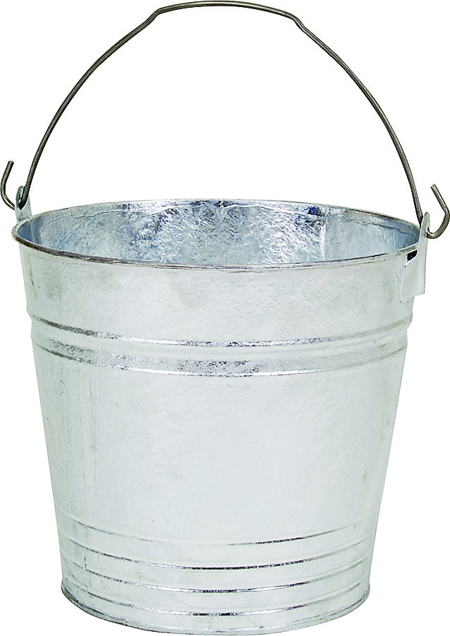
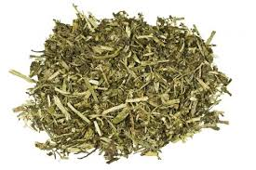
7. Stimulating feed intake using amniotic fluids
To stimulate feed intake immediately after calving, the amniotic fluids will help to increase the feed intake.
Amniotic fluids
5
Cow feed

Slide 12
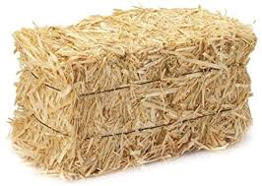
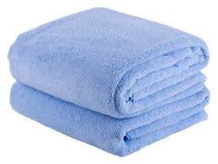
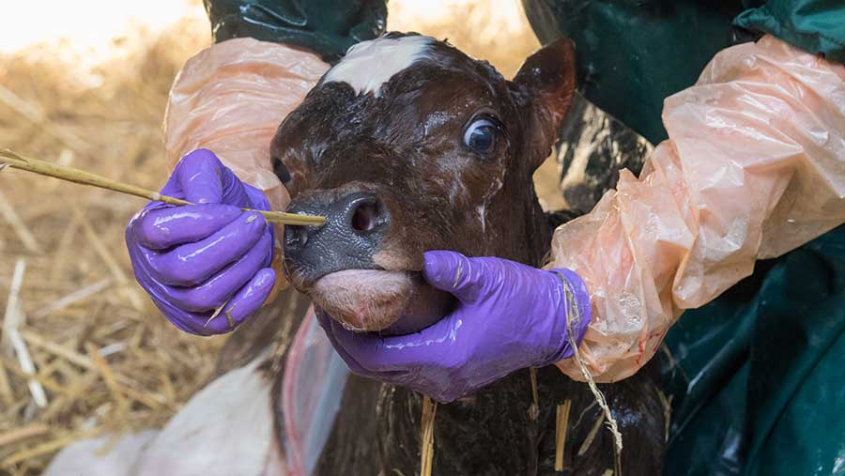
8. First aid incase of weak respiration
Clean cold water must be ready incase of weak respiration; cold water can act as a shock effect
Straw is beneficial for nose tickling, causing the calf to cough
Towels are used to dry the calf
H2O
6
Nose tickling causes the calf to cough

Slide 13
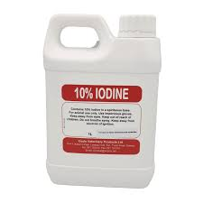
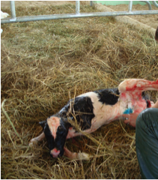
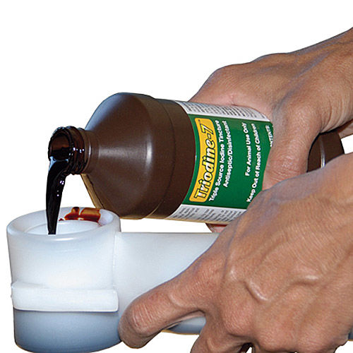
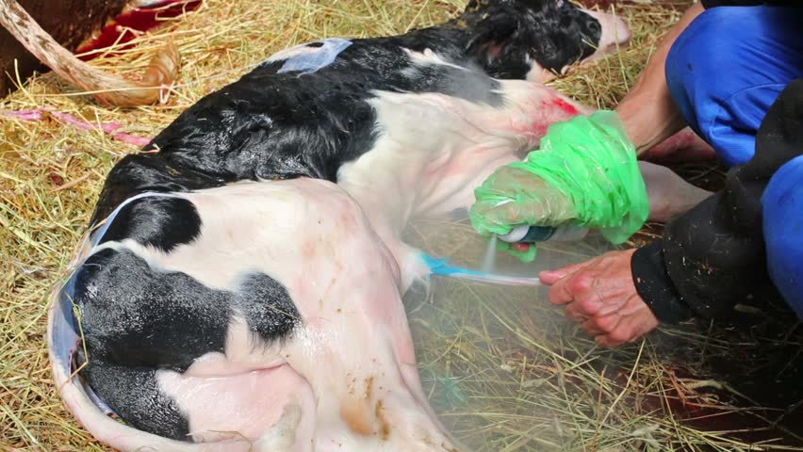
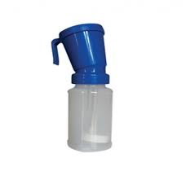
9. Umbilical/Navel cord disinfection
Umbilical cord as soon as the calf is born
Repeat this disinfection 2-3 times during the first 24 hours
7

Slide 14
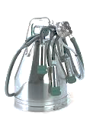
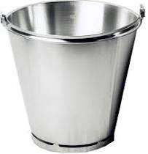
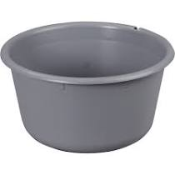
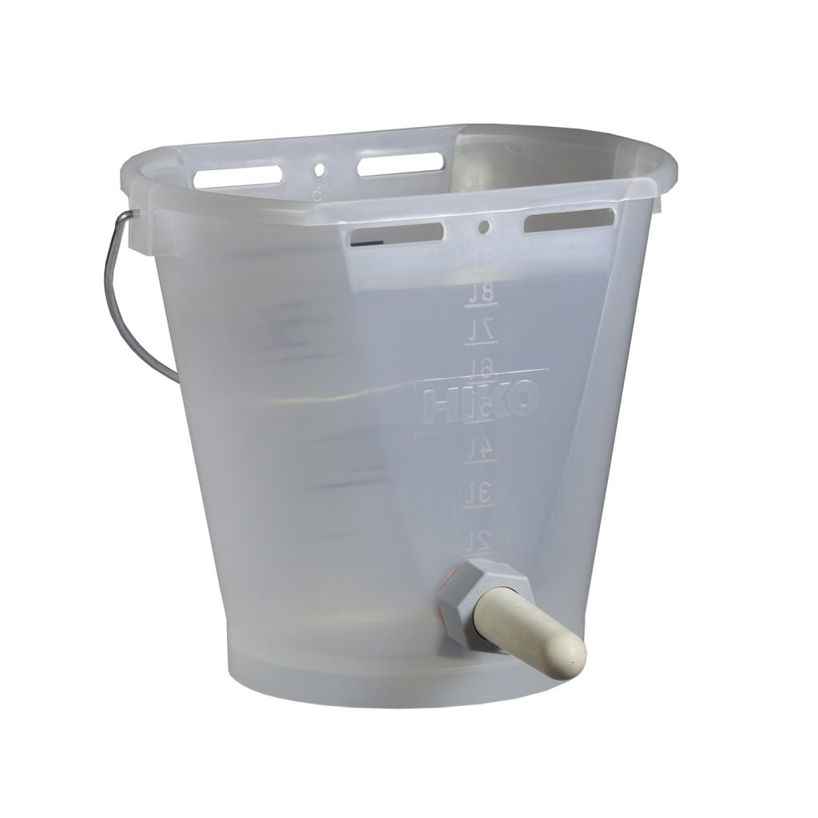
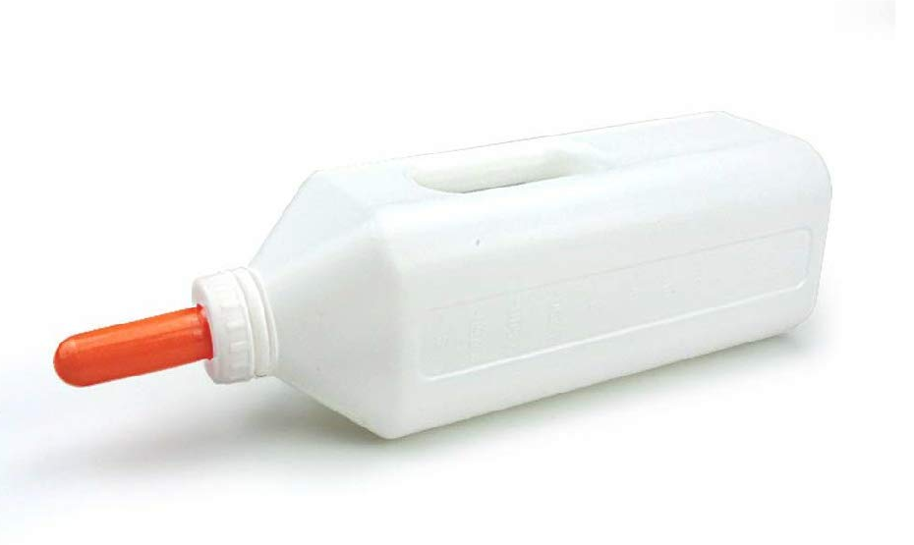
10. Preparations and demands for Milking and Feeding
First milking is done to harvest colostrum for feeding the calf
8

Slide 15
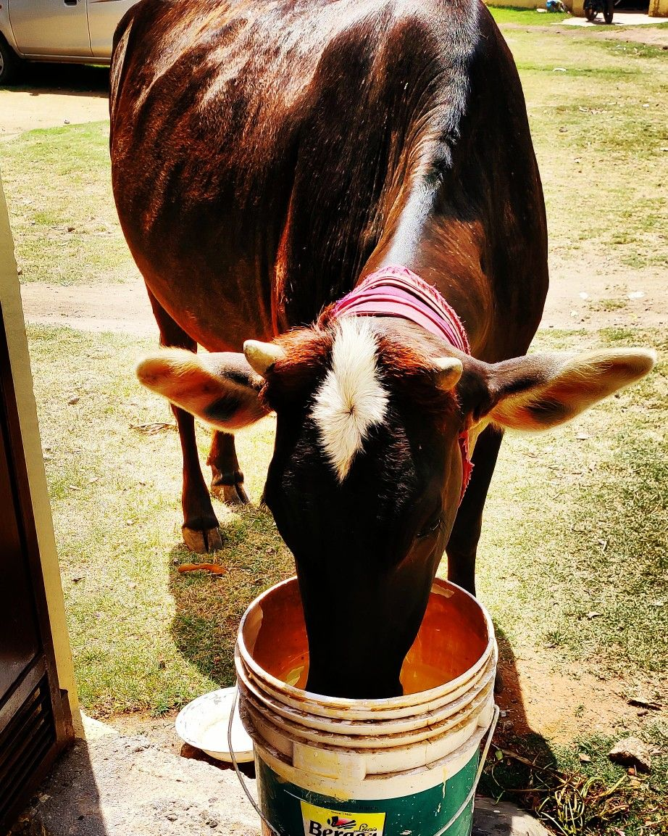
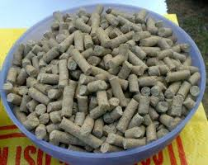
9
11. Disease prevention: Water and feed
Offer the cow lukewarm water followed by high quality feed after she calves down
H2O
38° Celsius
(100.4 ° Fahrenheit)

Slide 16
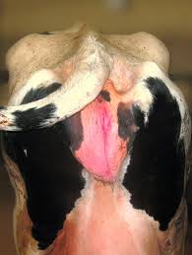
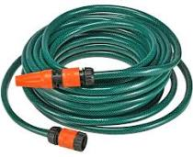
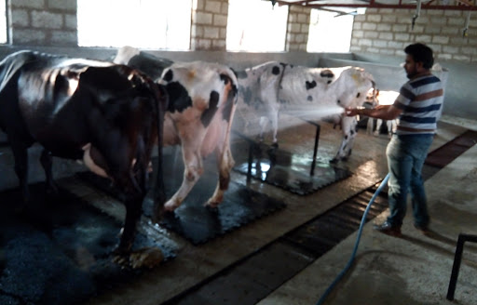
12. Cooling the cow’s vulva (in case of dystocia/heavy parturition)
Sometimes the cow’s vulva becomes slightly (or sometimes severely) swollen after assisted calving. Cooling the cow’s vulva by spraying cold water.
10
- END -

