Slide 1



IAHR TRAINING COURSES SERIES
Artificial Intelligence Tools for Transient Flow Analyses
Graph Neural Network
for passive transient source localization
by
Dr. M. Waqar
Lecturer, HKMU
Contact: mwaqar@hkmu.edu.hk

Slide 2

https://github.com/mwaqar-ust/GNN_pipe_burst

Slide 3


Problem Formulation
$${\vec{h}}_{data}$$
10
1
2
Pressure
7
3
Legends:
Pipelines
Tank
Nodes
Consumers
Transient source
Transient waves
Sensing
9
6
8
4
5
Time

Slide 4

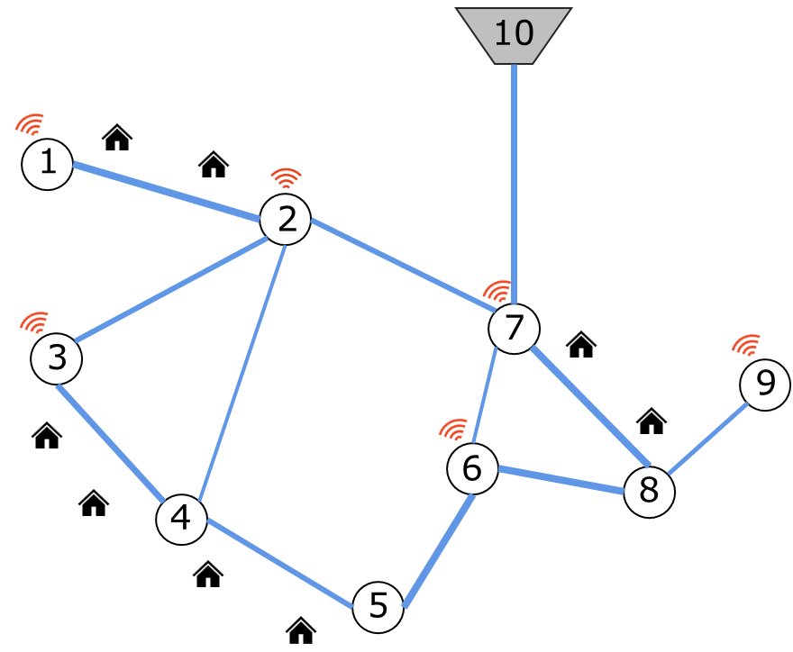

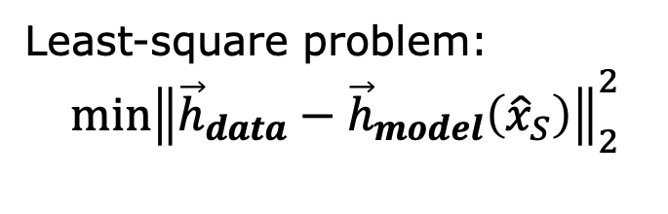
Conventional Approach
$${\vec{h}}_{data}$$
$${\vec{h}}_{model}$$
Least-square problem:
$${\min\left\|{\vec{h}}_{data}−{\vec{h}}_{model}\left({\hat{x}}_{S}\right)\right\|}_{2}^{2}$$
Transient Modeling
Pressure
Iterations
Non-convex
Highly ill-posed
Computationally expensive
Sensitive to modeling errors
﻿Misiunas et al., 2005
﻿Bohorquez et al., 2021
Pan et al., 2022
Waqar et al., 2025
Time

Slide 5
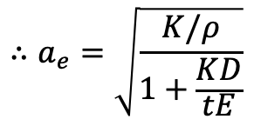
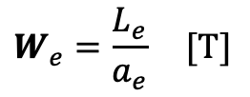

Alternative Approach (graph-theory)
$$G\left(Nodes,Edges,Weights\right)$$
$$W_{e}=\frac{L_{e}}{a_{e}} [T]$$
$$∴a_{e}=\sqrt{\frac{K/ρ}{1+\frac{KD}{tE}}}$$
Lightweight surrogate to determine the shortest travel time path between any two points on the graph (Dijkstra's algorithm)
Real-network
Graph-based replica

Slide 6
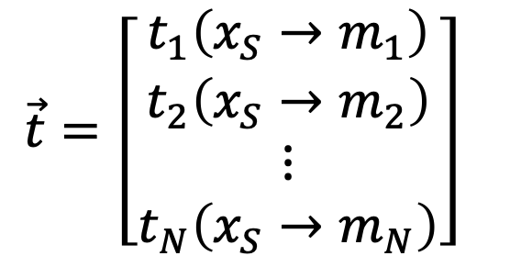
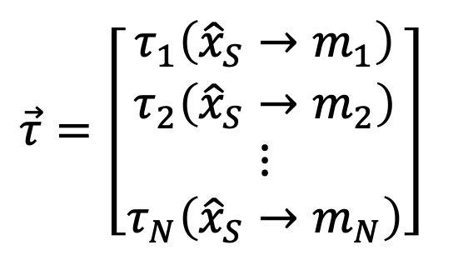
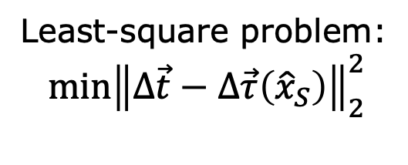
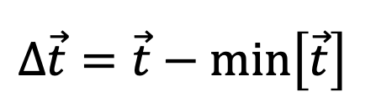

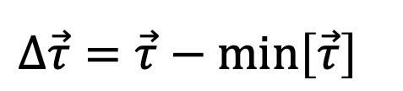
Alternative Approach (graph-theory)
$${\vec{h}}_{data}$$
$$\vec{τ}=\left[\begin{matrix}τ_{1}\left({\hat{x}}_{S}→m_{1}\right) \\ τ_{2}\left({\hat{x}}_{S}→m_{2}\right) \\ \begin{matrix}⋮ \\ τ_{N}\left({\hat{x}}_{S}→m_{N}\right)\end{matrix}\end{matrix}\right]\begin{matrix}\end{matrix}$$
$$\vec{t}=\left[\begin{matrix}t_{1}\left(x_{S}→m_{1}\right) \\ t_{2}\left(x_{S}→m_{2}\right) \\ \begin{matrix}⋮ \\ t_{N}\left(x_{S}→m_{N}\right)\end{matrix}\end{matrix}\right]\begin{matrix}\end{matrix}$$
$$G\left(N,E,W\right)$$
Pressure
$$Δ\vec{t}=\vec{t}−\min\left[\vec{t}\right]\begin{matrix}\end{matrix}$$
$$Δ\vec{τ}=\vec{τ}−\min\left[\vec{τ}\right]\begin{matrix}\end{matrix}$$
Least-square problem:
$${\min\left\|Δ\vec{t}−Δ\vec{τ}\left({\hat{x}}_{S}\right)\right\|}_{2}^{2}$$
Iterations
Lightweight (fast)
Less sensitive to modeling errors
Non-convex
Sensitive to time picks
﻿Srirangarajan et al., 2013
﻿Hampson et al., 2014
﻿Jara-Arriagada et al., 2024
Time

Slide 7
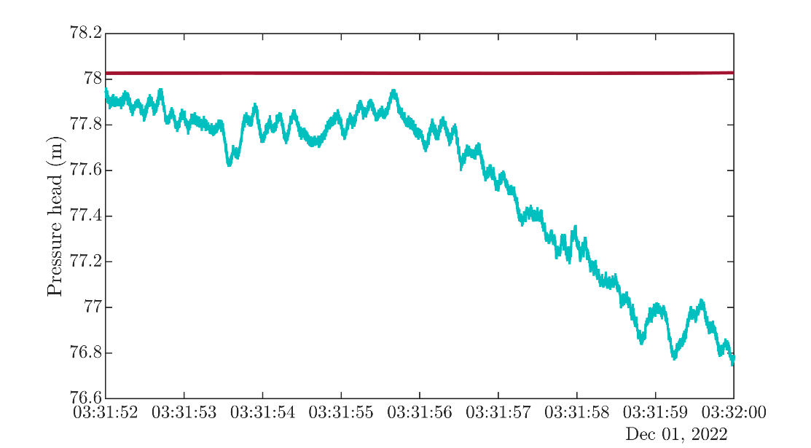


Problem Statement
$$⇒Δx=a_{e}×Δt=1000 ×0.3=300 m$$
Time pick-up errors translate into spatial errors
Error compounds for multiple sensors
$$Δt=0.3 s$$

Slide 8
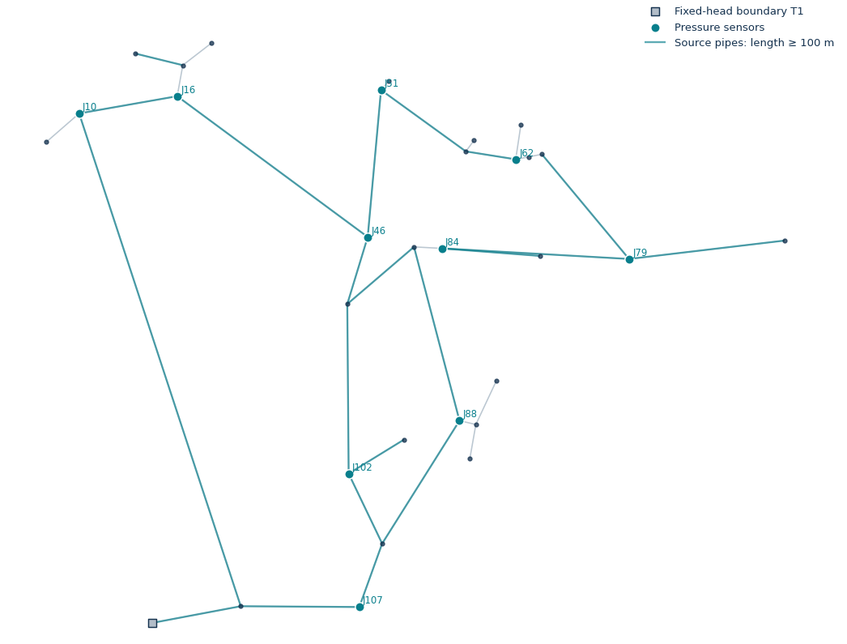
For a given burst location (training)
Graph reference = 10 features
Node-2-sensors

Slide 9
For a given burst location (training)
Observed timings = 10 features
Burst-2-Sensors

