Slide 1
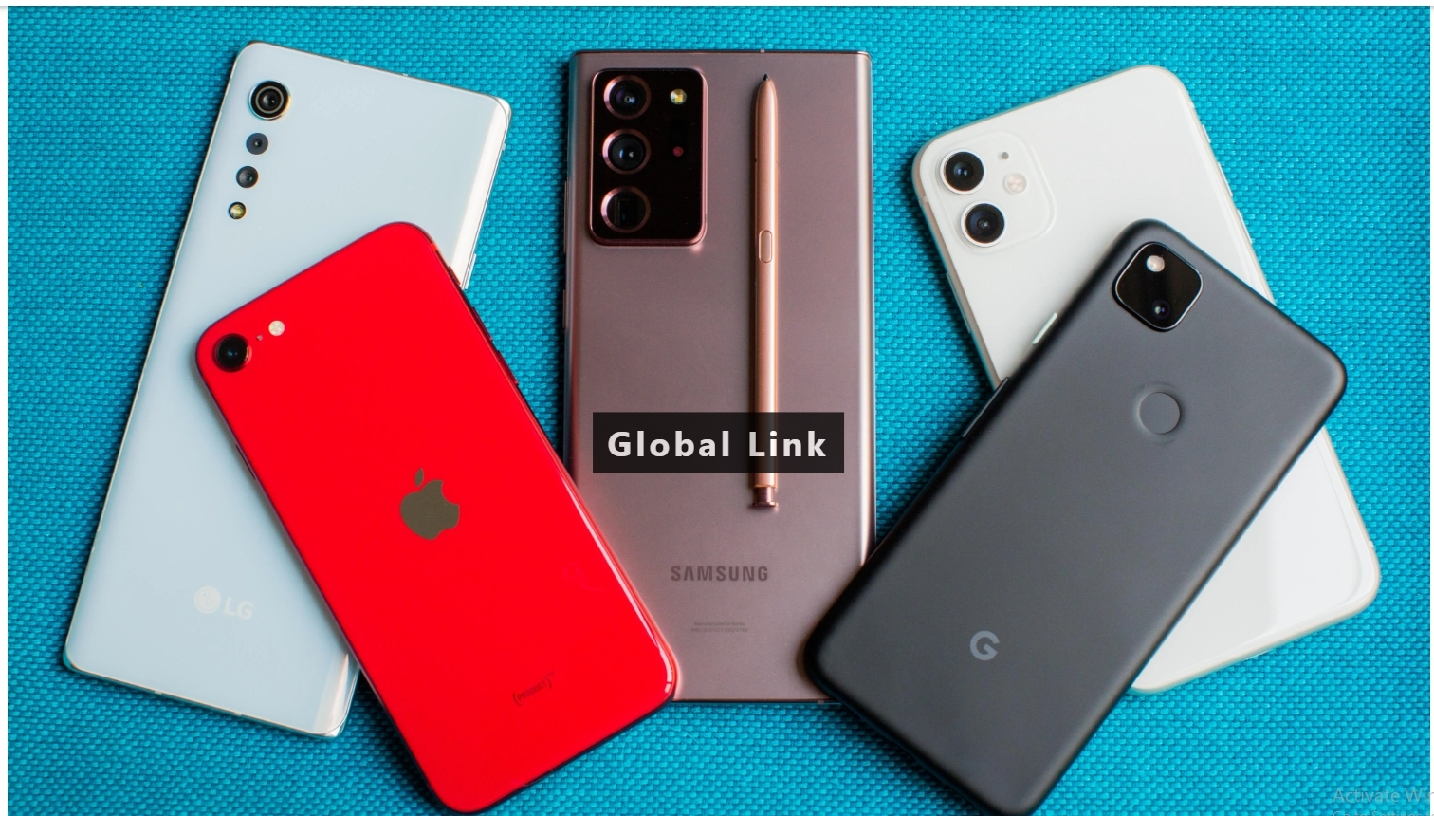

Slide 2


Slide 3

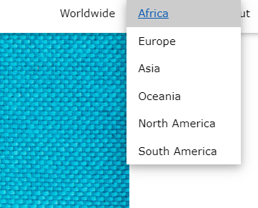
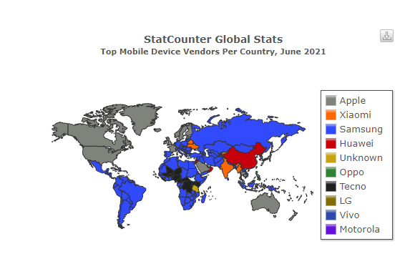
Motivation
importance of smartphone in the world
Dataset: We used Smartphone Processors Ranking & Scores from
Kaggle and Vendor Mobile Market Share

Slide 4
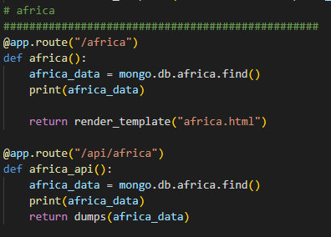
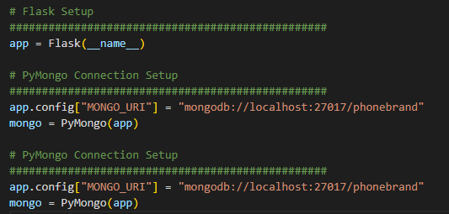
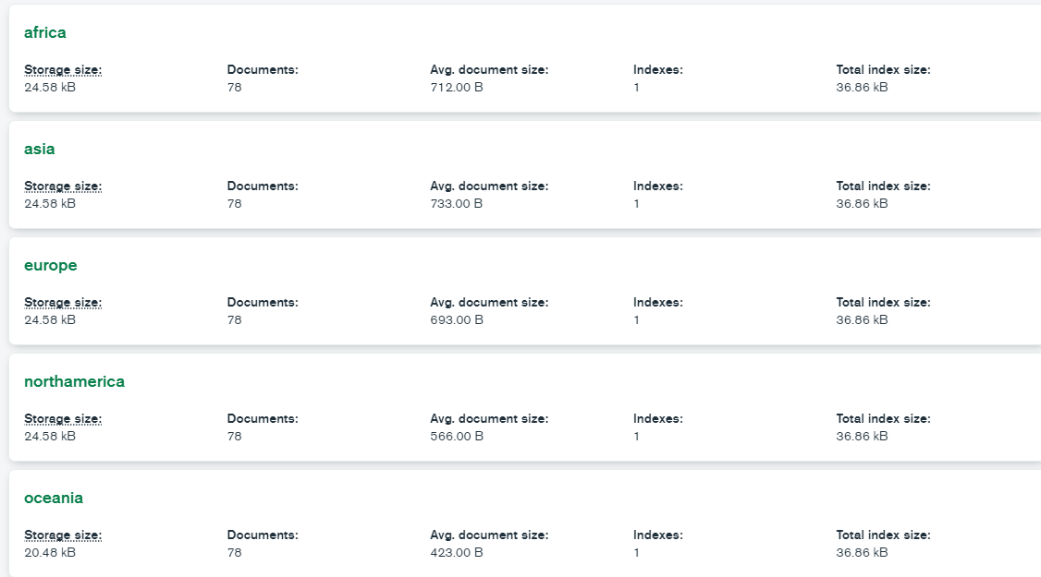
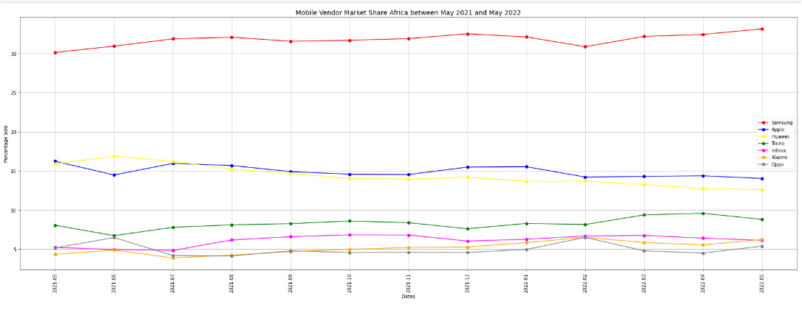
Extract, Transform, Load

Slide 5
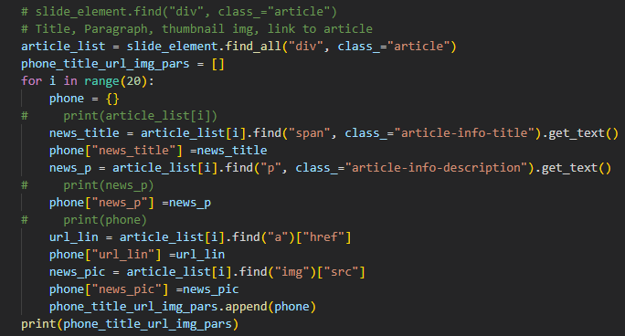
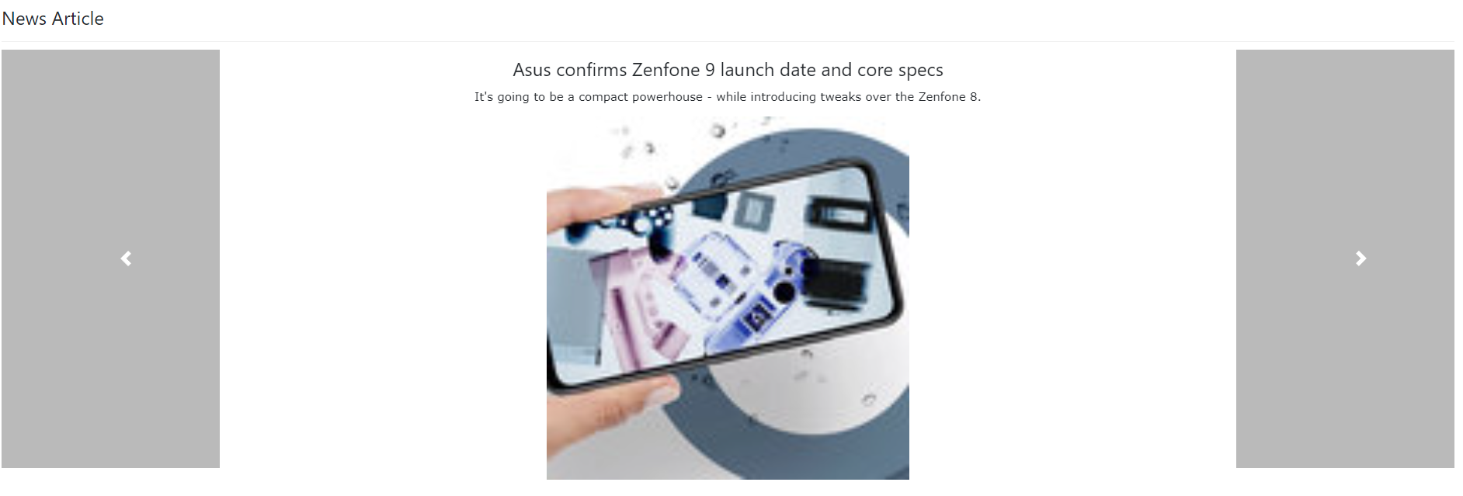
Scrape and Carousel

Slide 6
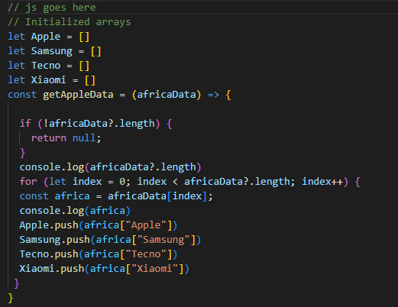

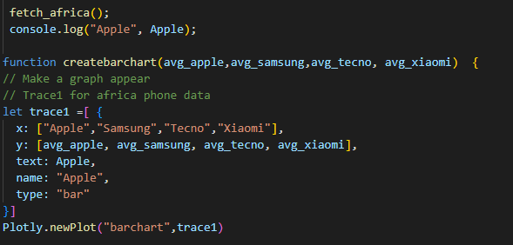
PLotly

Slide 7


Slide 8
struggles
Code creation
Site Creation
Application

Slide 9
What we learned
Carousel

Slide 10
Future
What we would like to add with further development and time

