Slide 1
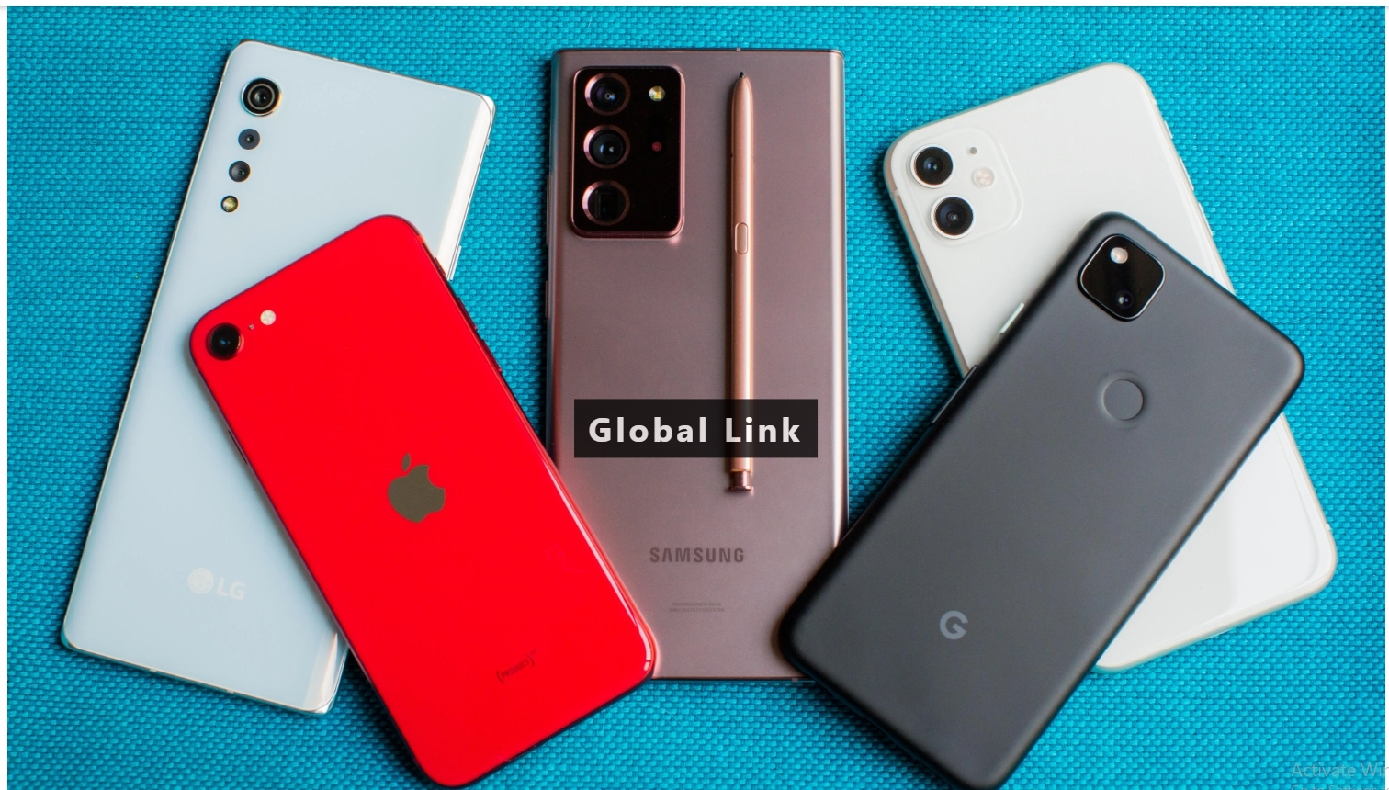

Slide 2
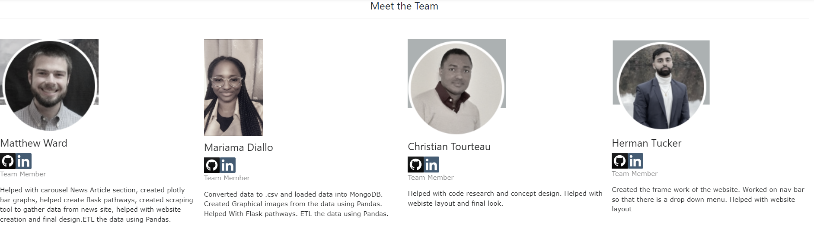

Slide 3

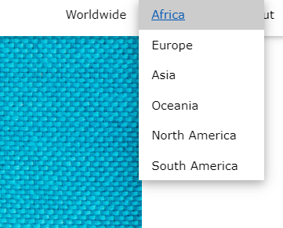
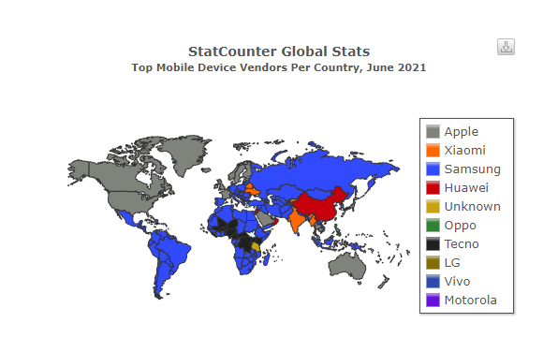
Motivation
importance of smartphone in the world
Dataset: We used Smartphone Processors Ranking & Scores from
visualize and analyze the most popular phone brands used by continent
Data : Kaggle and Vendor Mobile Market Share
Tools: Jupyter Notebook, MongoDB, HTML, Javascript

Slide 4
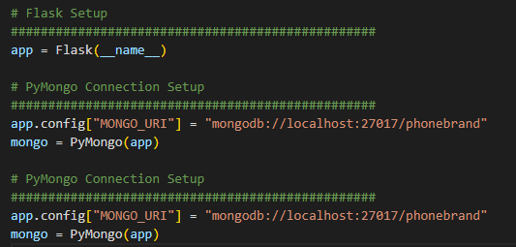
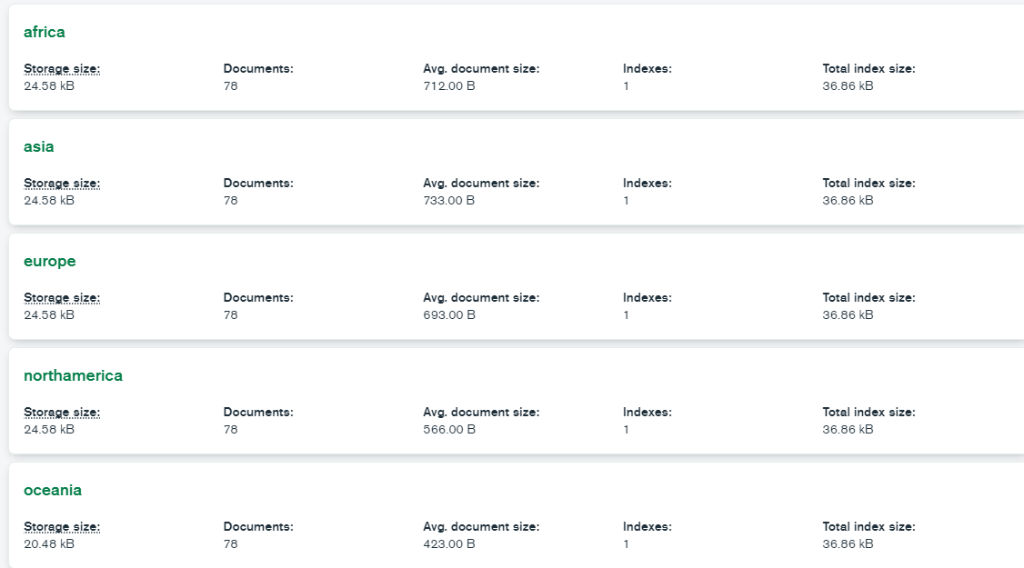
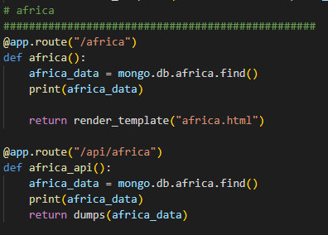
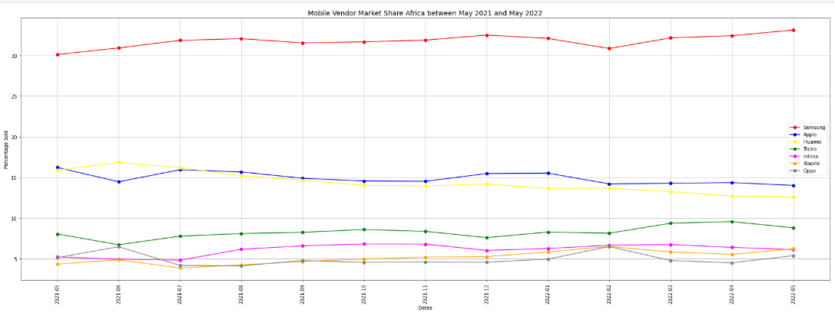
Extract, Transform, Load

Slide 5
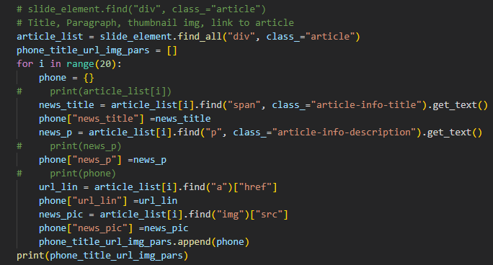
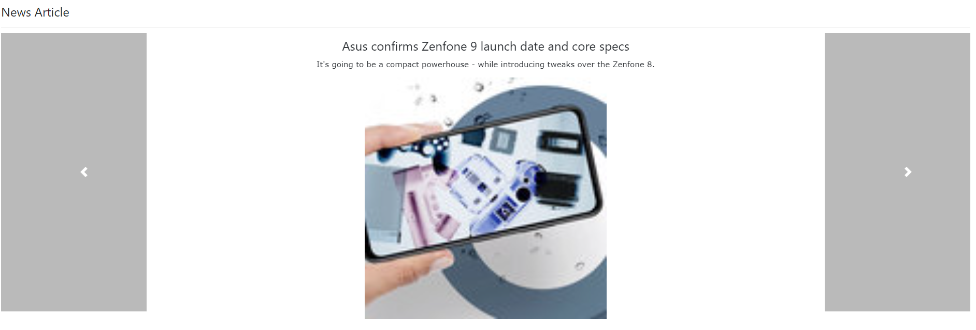
Scrape and Carousel

Slide 6
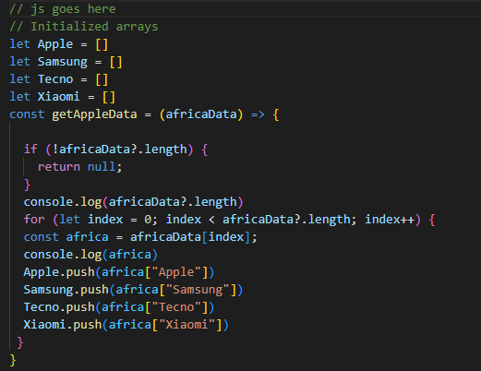

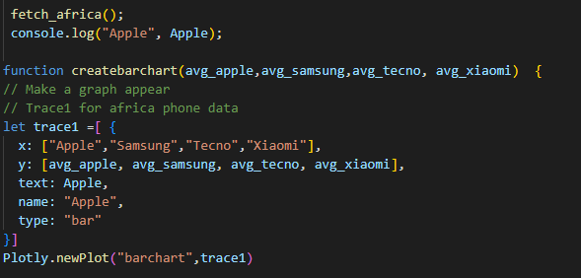
PLotly

Slide 7
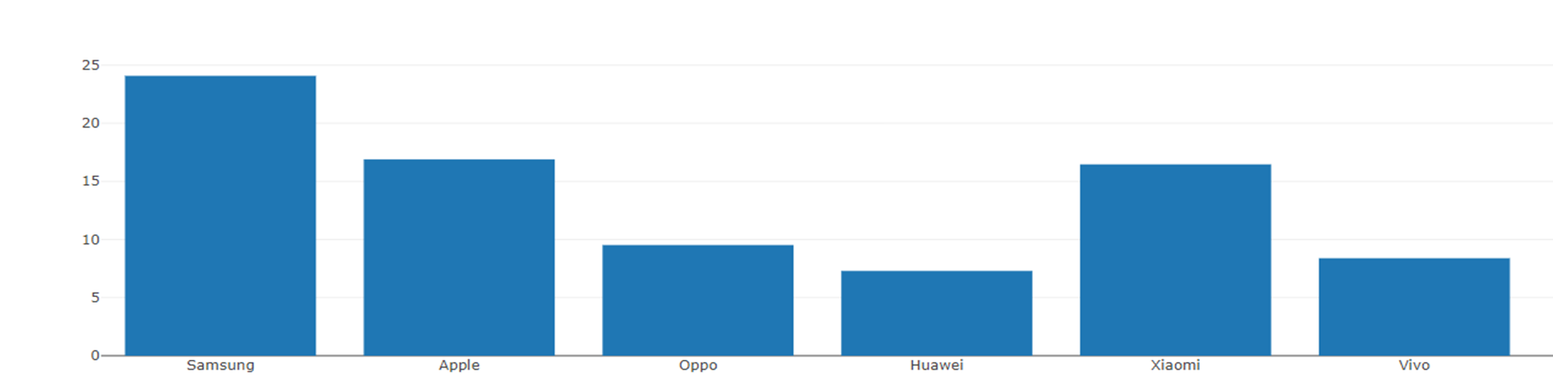

Slide 8
struggles
Code creation
Site Creation
Application

Slide 9
What we learned
Carousel
The most used phone brand globally

Slide 10
Future
What we would like to add with further development and time
Heat map
Analyze different computer brands

Slide 11
Thank you!

