Slide 1


Project 1
The Cutlery Group

Slide 2
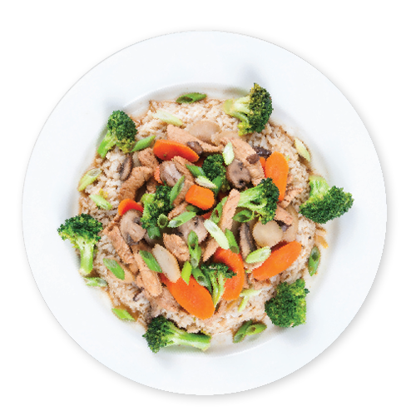
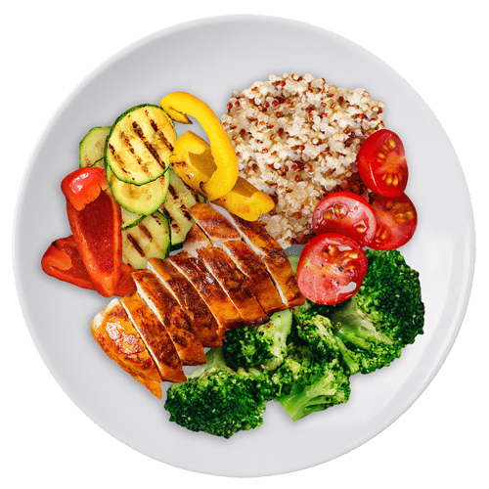
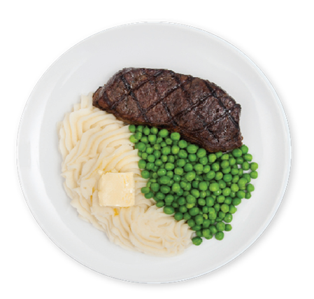
Agenda
Introduction Project and Team
Data Cleaning
Presentation of Data
Summary

Slide 3
Introduction
The Cutlery Group conducted analysis to determine whether various factors impacted restaurant reviews. This analysis was conducted utilizing Google API for restaurant data and US city population data.
Team Member | Role
Sanjay Dabra | Code Build and Visualization
Jeffrey Frazier | Code Research and PowerPoint Creation
Matthew Ward | Code Build and Visualization

Slide 4
Questions to be answered:
Does pricing influence ratings?
Does pricing influence the number of reviews?
Does population influence rating?
Does population affect the number of reviews?

Slide 5


Data Cleaning

Slide 6
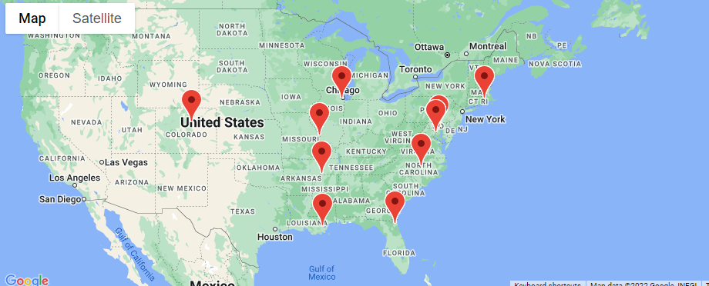
Cities
Pulled city populations and location from World Population Review (worldpopulationreview.com)
Removed all cities with population < 1MM
Randomly chose 10 cities

Slide 7
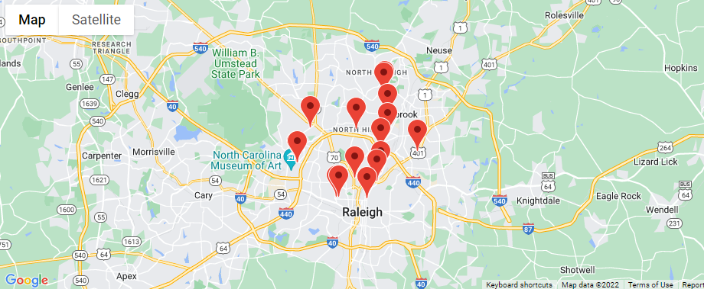
Restaurants
Used Google API to locate and pull data for restaurants within 5 KM based on coordinates from World Population Review
Removed restaurants with a Rating <4.0
Removed restaurants that had less than <250 Reviews

Slide 8
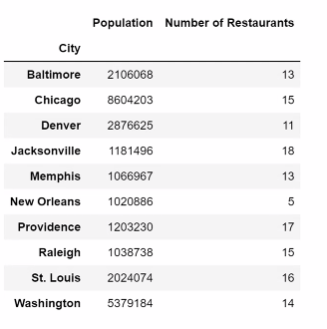
Number of Restaurants for Each City

Slide 9
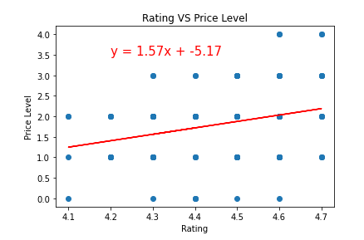
Does price level influence ratings?
R-Square Value is: 0.28
Weak Positive Correlation
Interpretation: As customers spend more money, they perceive the quality to be higher

Slide 10
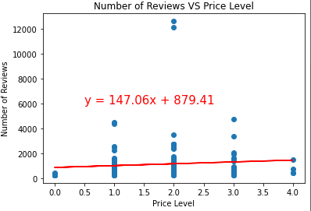
Does pricing influence the number of ratings?
R-Square Value is: -0.21
Weak Negative Correlation
Interpretation: As Price Levels increases, the number of reviews decrease, which would contribute to Mid Price Restaurants tend to have a higher Number of Reviews.

Slide 11
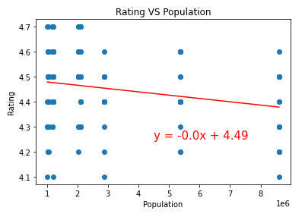
Does Population affect the rating?
R-Square Value is: -0.20
Very Weak Negative
Correlation
Interpretation: As population increases, Ratings decrease. Larger populations tend to be more diverse, which would give a wider range of ratings.

Slide 12
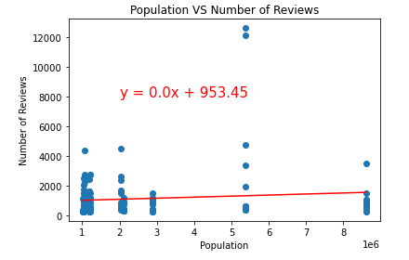
Does Population affect the number of reviews?
R-Square Value is: 0.11
No Correlation
Our initial assumption was higher population would result in a higher number of reviews.
However, the data does not reflect this assumption.

Slide 13
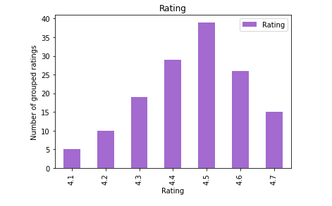
Rating Distribution
Notes:
Most given review was 4.5, data was truly random and well distibuted

Slide 14
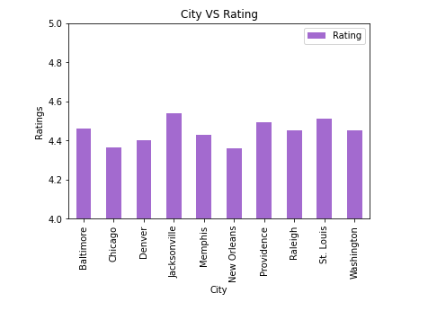

Slide 15
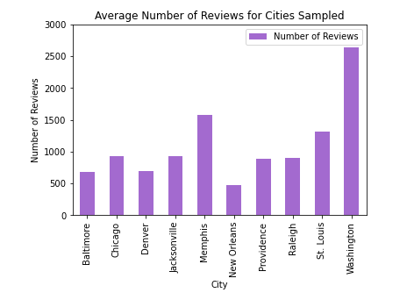

Slide 16
Summary
Weak Correlations
Price level and customer rating R-Square Value is: 0.28
Price level and the number of ratings R-Square Value is: -0.21
Population size and rating? R-Square Value is: -0.21
No Correlations
Population size and people submitting reviews? R-Square Value is: 0.1

Slide 17

Biases
When someone spends more money, they do perceive that as better quality
Our data size is small so potential outliers in the data could have more of an impact
Our data is more heavily East Coast, and the West Coast may have different trends of reviewing
Cities might have tourist centers that are further from the 5 km radius of the coordinates used
Google API only allows for the first 20 searches. There are ways using a token to increase this search which would allow for a larger sampling of restaurants.

Slide 18


Thank You

