Slide 1

#report_region Media Analysis #fiscal_period

Slide 2



Methodology
Research Background and Objectives
Procter & Gamble aims to better understand narrative trends and contextualize performance across news and social media channels.
Quarterly reports will evaluate Procter & Gamble performance against key market competitors and analyze media trends and key topics.
Language & Location Content is inclusive of local market languages and can be viewed in Brandwatch Consumer Resource under:
Project: P&G Global
Dashboard: [BW] P&G EU
Location Filter: #report_countries
Data Collection The report leveraged keyword segmentation to identify P&G and competitor focused coverage across market media sources.
Content was segmented in Brandwatch Consumer Research using automated keywords by competitors.
Sources
Data was collected from Online News, X (Twitter), Reddit, Instagram, Facebook, Forums, Blogs, YouTube, Broadcast, and other social sites.
Time Frame
Content was evaluated for #fiscal_period (#start_end_month)

Slide 3
Executive Summary:
Executive summary highlight #1 to go here…
…
…
…
1.
Executive summary highlight #2 to go here…
…
…
…
2.
Executive summary highlight #3 to go here…
…
…
…
3.
Executive summary highlight #4 to go here…
…
…
…
4.

Slide 4
#fiscal_period: Overall Market Performance*
Region | Social Media Mentions | Social Media Reach | Social Media Earned Engagements | Traditional Media Mentions | Traditional Media Reach | Sentiment
Belgium | #bgSMvol | #bgSMrch | #bgSMeng | #bgTMvol | #bgTMrch | #bgP | #bgNu | #bgNe
France | #frSMvol | #frSMrch | #frSMeng | #frTMvol | #frTMrch | #frP | #frNu | #frNe
Germany | #geSMvol | #geSMrch | #geSMeng | #geTMvol | #geTMrch | #geP | #geNu | #geNe
Greece | #grSMvol | #grSMrch | #grSMeng | #grTMvol | #grTMrch | #grP | #grNu | #grNe
Israel | #isSMvol | #isSMrch | #isSMeng | #isTMvol | #isTMrch | #isP | #isNu | #isNe
Italy | #itSMvol | #itSMrch | #itSMeng | #itTMvol | #itTMrch | #itP | #itNu | #itNe
Netherlands | #neSMvol | #neSMrch | #neSMeng | #neTMvol | #neTMrch | #neP | #neNu | #neNe
Poland | #poSMvol | #poSMrch | #poSMeng | #poTMvol | #poTMrch | #poP | #poNu | #poNe
Romania | #roSMvol | #roSMrch | #roSMeng | #roTMvol | #roTMrch | #roP | #roNu | #roNe
Russia | #ruSMvol | #ruSMrch | #ruSMeng | #ruTMvol | #ruTMrch | #ruP | #ruNu | #ruNe
Spain | #spSMvol | #spSMrch | #spSMeng | #spTMvol | #spTMrch | #spP | #spNu | #spNe
Switzerland | #swSMvol | #swSMrch | #swSMeng | #swTMvol | #swTMrch | #swP | #swNu | #swNe
Türkiye | #tuSMvol | #tuSMrch | #tuSMeng | #tuTMvol | #tuTMrch | #tuP | #tuNu | #tuNe
Ukraine | #urSMvol | #urSMrch | #urSMeng | #urTMvol | #urTMrch | #urP | #urNu | #urNe
United Kingdom | #ukSMvol | #ukSMrch | #ukSMeng | #ukTMvol | #ukTMrch | #ukP | #ukNu | #ukNe
Overall Europe | #euSMvol | #euSMrch | #euSMeng | #euTMvol | #euTMrch | #euP | #euNu | #euNe
WORK IN PROGRESS
*Comparisons are to the previous period.
Notes:
Definitions & Methodology
Traditional Media
Includes: Online News, Print, Blogs, and Broadcast
Social Media
Includes: X (formerly Twitter), Forums, and Tumblr
Earned Engagements (Social Media)
Calculated as the sum of:
Reposts
Likes
Replies
All metrics are based on organic (unpaid) interactions on X.
Reach
X: Reposts (retweets), replies, followers of reposters (retweeters), followers of author
Others (blogs, forums, news etc.): Average site visitors, average engagement, monthly visitors
Comparisons
All metrics are compared to the previous reporting period to identify the percent changes in volume, reach, and engagement.

Slide 5

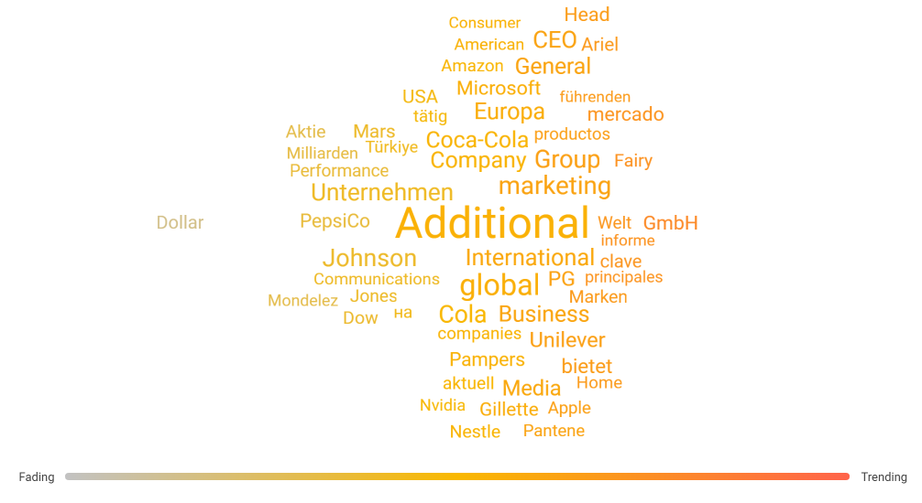
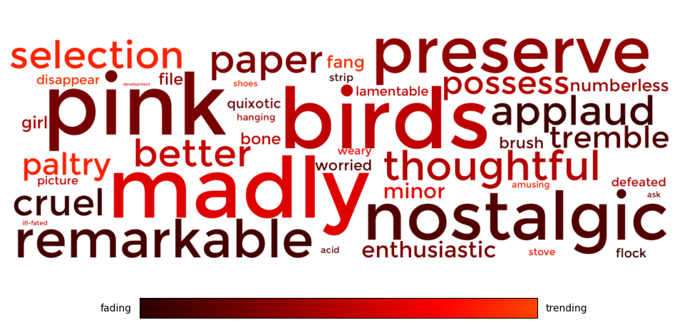
#fiscal_period: P&G Corporate Overall Europe KPIs
Sentiment Over Time
Top Channels by Volume
Trending Topics
Total Mention Volume
#pg_vol
#pgVol_vs_prev
P&G Sentiment
Competitor SOV
Key Insights
Key insight #1... … … …
Key insight #2... … … …
Key insight #3... … … …
#ch1p
#ch1v
#ch2p
#ch2v
#ch3p
#ch3v
#ch4p
#ch4v
#ch1_label
#ch2_label
#ch3_label
#ch4_label
Key Stories & Posts
Headline | Outlet | Topics
#1 Top Story Headline | #1 Top Story Outlet | Key topics for top story #1
#4 Top Story Headline | #2 Top Story Outlet​ | Key topics for top story #2
#3 Top Story Headline | #3 Top Story Outlet | Key topics for top story #3

Slide 6
#fiscal_period: P&G Corporate Overall Europe Sentiment Trends
Summary analysis of P&G sentiment trends to be populated here…
Date: Topic
Description… … … …

Slide 7
#fiscal_period: Top Competitor Highlights
#brand1_name
#brand1_vol
#brand1_vs_prev
Brand 2 analysis to be written here…
…
…
…
…
…
…
#brand2_name
#brand2_vol
#brand2_vs_prev
Brand 2 analysis to be written here…
…
…
…
…
…
…
#brand3_name
#brand3_vol
#brand3_vs_prev
Brand 3 analysis to be written here…
…
…
…
…
…
…
#brand4_name
#brand4_vol
#brand4_vs_prev
Brand 4 analysis to be written here…
…
…
…
…
…
…
SOV by Volume
Sentiment

Slide 8
Get in touch
Questions?
PGTeam@Cision.com

