Slide 1
Rethinking rest practices
An introduction to GraphQL with AWS AppSync

Slide 2


























Swag Bags
Platinum Sponsors
Lanyards
Party
Gold Sponsors
Notebooks
Media

Slide 3
hello, my name is mat warger
Decade of software experience
Finance, marketing, insurance, sports industries
Startups and Enterprise
Full-stack, diverse background
Currently @KeyholeSoftware in Kansas City
Twitter/Medium/Github @mwarger

Slide 4
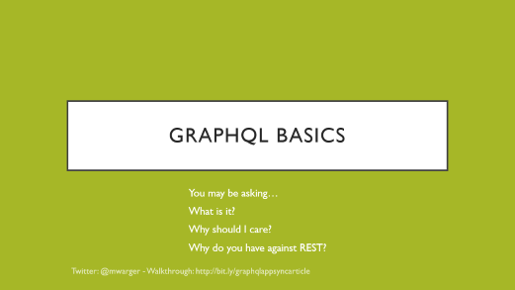

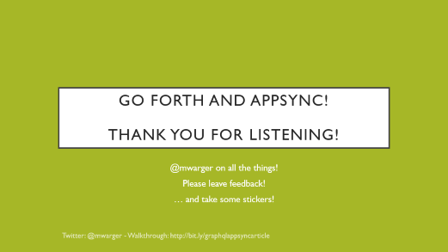
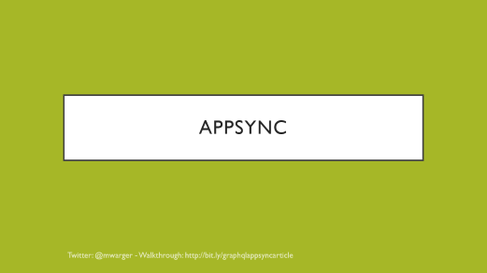
A Better way to think about data

Slide 5
The REST is History

Slide 6
Implementation concerns
Principles
Versions
Object Shape / Contract
Data Concerns
Documentation
Notes:
How strictly should you adhere to the principles of REST? How do you decide which ones count?
How should you handle versioning? Should you bother?
How do you want to structure your objects? What is the shape of the data that works best for the clients of your API?
Are you sending the appropriate data to your users? Are you sending them information they don’t need?
Concerning related or hierarchical data, are they able to efficiently query for what they need from nested structures?
Are users able to easily figure out what API endpoints are available and how they should be used?

Slide 7
questions
How strictly should you adhere to the principles of REST? How do you decide which ones count?
How should you handle versioning? Should you bother?
How do you want to structure your objects? What is the shape of the data that works best for the clients of your API?

Slide 8
More questions
Are you sending the appropriate data to your users? Are you sending them information they don’t need?
Concerning relational or hierarchical data, are they able to efficiently query for what they need from nested structures?
Are users able to easily figure out what API endpoints are available and how they should be used?

Slide 9
fetching lists with rest is verbose and/or tedious and/or mysterious

Slide 10
BEST Practices?

Slide 11
Yes!

Slide 12
But…

Slide 13
Commonly tolerated situations

Slide 14
Nested data example
GET /api/v1/games
GET /api/v1/games/2
GET /api/v1/games/2/reviews
…
GET /api/v1/games/2/reviews/3/comments

Slide 15
Another Nested data example
GET /api/v1/games
GET /api/v1/games/2
… {reviews: [123, 456, …]}
GET /api/v1/reviews/123
GET /api/v1/reviews/456
…

Slide 16
…more realistic examples
GET /api/v1/games
GET /api/v1/games/2?includes=reviews
GET /api/v1/gamesAndReviews
GET /api/v1/gamesAndReviewsWithDetails
… ☹
OR
GET /api/getGamesAndStuff
POST /api/getGamesAndReviewsAndComments

Slide 17
Updates
POST /api/v1/games
PUT /api/games/2
PATCH /api/v1/game/34
… ☹
DELETE /api/v1/game/9
POST /api/v1/onSale

Slide 18
Either Ambiguity OR dogma are inherent in rest, by nature

Slide 19
Conventions vs flexibility

Slide 20
Sending and receiving data can be fun and intuitive

Slide 21
Graphql basics
You may be asking…
What is it?
Why should I care?
Why do you have against REST?

Slide 22
Specification and tooling
GraphQL is…
A specification allowing data requests to have enforced structure
Tooling for intuitive and foolproof contracts
A query language for your API

Slide 23
Key concepts
Robust Type System
Resolvers
Queries
Mutations

Slide 24
Robust Type system
scalars
types
String
Int
Float
Boolean
ID
type Game {
title: String!
description: String
rating: Int!
}

Slide 25
Building with types
type Game {
title: String!
description: String
rating: Int @deprecated
reviews: [Review!]
}
type Review {
rating: Int!
# The name of the reviewer
author: String }
Features of the type system include:
Comments
Deprecation
Enumeration types
Interfaces
Variables

Slide 26
resolvers
Query/Mutate data
using a service
using a database
by calling a [legacy] RESTful API

Slide 27
QuerieS
Queries are how you retrieve data, turning this…
allGames { title description rating }
…into this
allGames: [{ title: “Rocket League”, description: “Soccer with cars”, rating: 10 }, { title: “Tomb Raider”, description: “Raiding tombs”, rating: 9 },
…
]

Slide 28
mutations
Mutations are how you interact with data, turning this…
createGame ( title: String!, description: String, rating: Int! ) { title description rating }
…into this
{ title: “Super Mario”, description: “Stomping Goombas”, rating: 8 }

Slide 29
appsync

Slide 30
Types enable tooling
Type System
Enums
Interfaces
Unions
Input types
Custom Scalars
Tooling
Introspection
Code Generation
Hosted Services
Database Generation
Conventions & Safe Assumptions

Slide 31
Go forth and appsync! Thank you for listening!
@mwarger on all the things!
Please leave feedback!
… and take some stickers!

