Slide 1

Introduction to Mesh Routing
Mobile Ad-hoc
Part 1

Slide 2
This Talk
What is a Mesh Network?
  It’s messy ;-)
What is Routing?
  Mobile, ad-hoc
A minimal mesh protocol
A bit of Terminology
  Proactive / Reactive Routing
  Distance Vector / Link State Routing

Slide 3
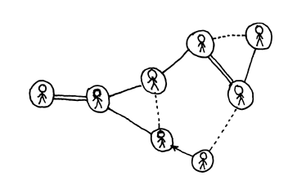
What is Routing?
Get a packet forward towards a destination
Imagine you get a packet for Mrs. Z
  You do not know Mrs. Z
  What do you do?
    Scream?
    Ask a Friend?
    Search?
  Same problem for computers networks!
    <picture of two people that exchange packets>

Slide 4
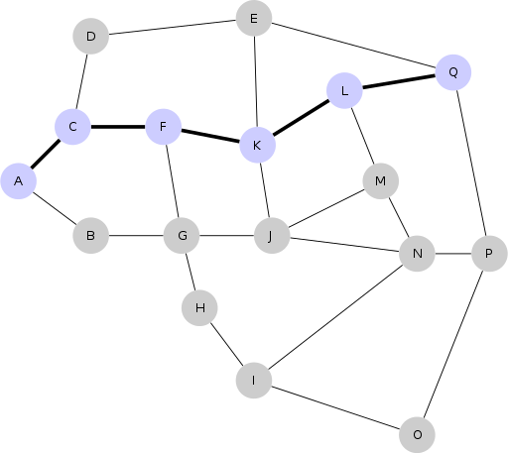
What is a Mesh Network?
(IP) Network of Computers (nodes)
arbitrary topology
  Loops!
Restricted topology
  Line
  Lattice
  Tree
  ...

Slide 5
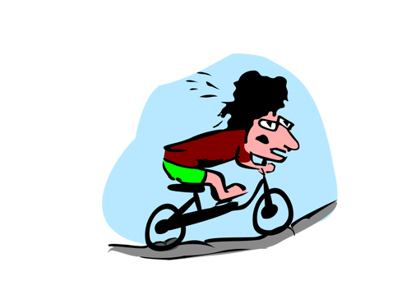
Mobile Ad-Hoc
With WiFi networks
  Signal range
  No cables – Freedom of movement!
  => Mobile
Devices can be turned on/off
  Clean slate
  => Ad-hoc

Slide 6
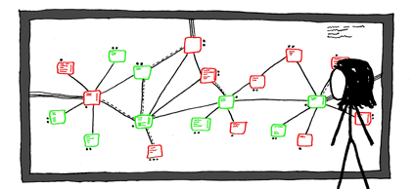
The Big Picture
Routing
  Static
    Plan on a whiteboard and configure each node
  Dynamic
    Discovery and fallback
The IP Network
  Switches work with shouting
  Static subnet trees
  Internet: subnets + sharing + fallbacks
Source: https://xkcd.com

Slide 7
The MANET Task
Imagine
  You are a node that wakes up
  No knowledge of the surrounding
  Other nodes are in the same situation
  You have a unique name (e.g. MAC address)
  You get a packet for somebody
What to do?
  Discover neighbors
  Forward packet -> which neighbor

Slide 8

Naiive Approach
Flooding all data
Pro
  No discovery needed
  Always best route found
Cons:
  No discovery
  Horribly inefficient
  Loops…..
Source: The Internet

Slide 9
Discovery By Flooding
Hello Packets
  Usually propagated throw the whole network
    (e.g. batman-adv: OGM, OLSR: HNA)
  Send in intervals
    Depends on the expected mobility / on/off rate

Slide 10

Better Flooding
Only flood unseen packets
  Resource intensive
  => use sender id and sequence number
    sender id could be MAC
    sequence number goes up
Ok, flooding is quite efficient
  What does every node see?
  What to do with it?

Slide 11
Collect data
Hello Packet
  Origin Address: A
    What nodes are there
  Sender Address: B
    Neighbors
  Sequence Number: X
    Have you heard this before
  Hop Count: N
    Good link, better link

Slide 12
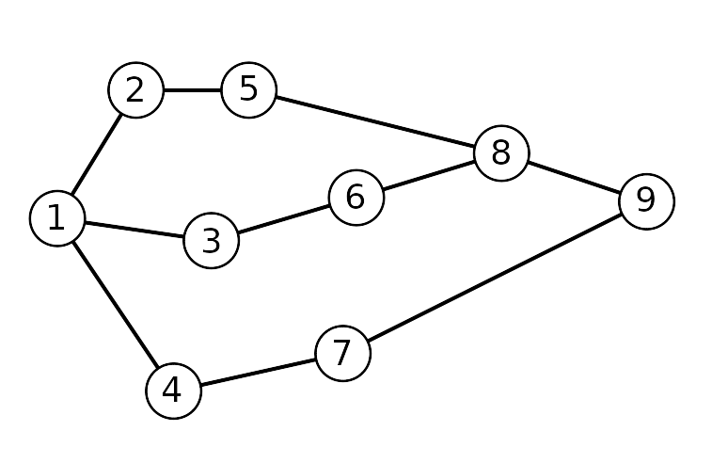
Example
Table of Node 1:
Dest. | Neighbor | Hops | Seq. No.
1 | 1 | 0 | 17
2 | 2 | 1 | 2
3 | 3 | 1 | 15
4 | 4 | 1 | 43
5 | 2 | 2 | 9
6 | 3 | 2 | 58
7 | 4 | 2 | 20
8 | 3 | 3 | 23
9 | 4 | 3 | 13

Slide 13
Mesh Protocols
Mobile Adhoc Mesh Networks (MANET)
  Batman-adv
  OLSR
  Babel
  BMX7
(Non Mobile) Mesh Networks
  BGP (Border Gateway Protocol)
    Backbone protocol of the Internet
    Between Internet Service Providers (ISP)
  OSPF
    Inside ISPs
    Uses a spanning tree (ok, not really a mesh)

Slide 14

Distance Vector
E.g. batman-adv
Common approach:
  called Table Driven
  Node maintains table
    Original sender
    Received from neighbor
    Path Cost
  It’s distributed Dijkstra shortest path algorithm

Slide 15
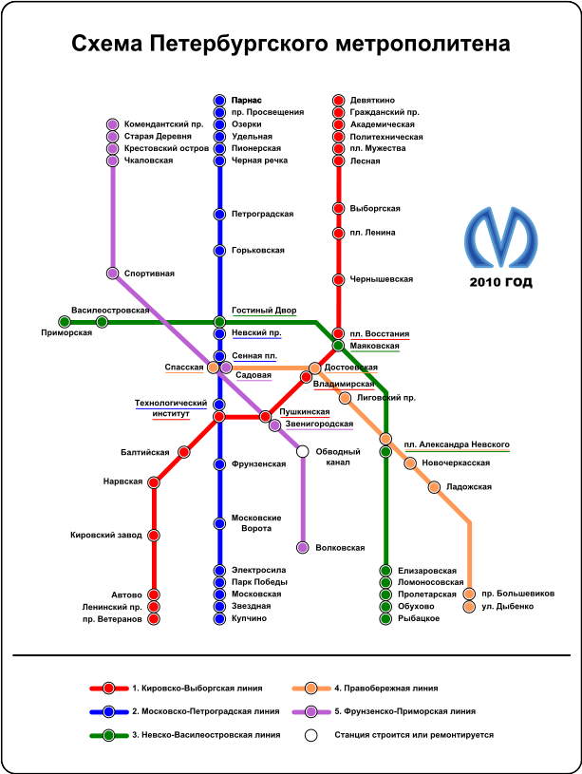
Link State
e.g. OLSR
Whole topology in memory
  Allows whole network path planning
  Allows Policy routing
Hand in Hand with “Source Routing”
  header of packet contains whole path
  Pro: More control over the path to take
    Policy Routing!
  Cons: Inflexible in case of topology changes

Slide 16

Proactive / Reactive Routing
Why send all the management data when no user data needs to be routed?
Reactive
  Discover routing information when needed
  Useful for low traffic networks
Proactive
  Keep all routing data up to data
  Efficient when there is much user data

Slide 17

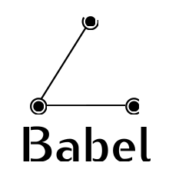

Some Mesh Routing Software
MANET
  Batman-adv: Kernel module / Distance Vector / Layer 2
  Babel: User Space / Distance Vector / Layer 3
  OLSR: User Space / Link State / Layer 3
  BMX7: User Space / Distance Vector / Layer 3 / Source Routing / focus on Policy Routing for security
Other
  BGP: organizational tree / Source Routing / Distance Vector / Layer 3 / focus on Policy Routing for peering costs
  OSPF: Spanning tree / Distance Vector / Layer 3

Slide 18
Scalability
Most MANET protocols that use flooding
  Management traffic growths exponentially O(n^1..2)
  ~1000 Nodes is the limit
  Optimizations (clustering, caching) helps by a factor
Geographic Routing has potential
  If it works...

Slide 19
Geographic Routing (1)
Every Node has coordinate
  GPS or virtual (better/cheaper)
Every Node exchanges management traffic with neighbors only
  Constant management traffic
  Independent of network size!
Promises really big mobile adhoc mesh networks

Slide 20
Geographic Routing (2)
Routing is usually Greedy
Use local information for routing decision
Hope to archive good global routing path
Might get stuck in local minimum
Backtracking fallback (e.g. Face Routing)

Slide 21
RIP
Routing Information Protocol
Precursor of OSPF
Distance Vector
hop count metric
  Max 16 (used to prevent loops!)
Broadcast whole table every 30 Seconds
  Slow convergence & inefficient

Slide 22
AODV
Ad-hoc On Demand Distance Vector Routing
  Often used as citation in academia
  Descendant of DSDV
Reactive (“On Demand”)
Route Request Packet
Router Reply Packet
(2003)

Slide 23
DSDV
Destination Sequence Distance Vector
Bellman – Ford routing algorithm

Slide 24
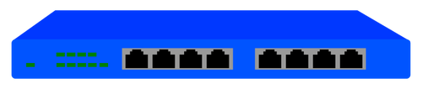

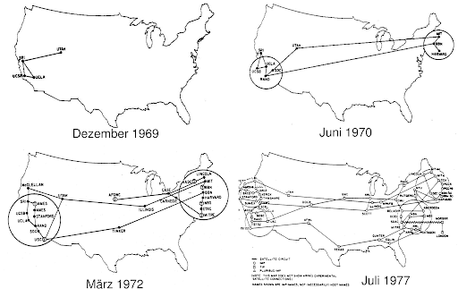
The Internet
Local LAN Level
  Star topology
  Broadcast
ISP/company
  Subnets
  Tree
Internet
  BGP
  Distance Vector

Slide 25
The End
- All images are from publicdomainvectors.org (CC-BY)

Slide 26
Scalability
MANET protocols max out at ~1000 nodes
Lower Barrier O(log n)
  At least need to address every single node
The capacity of wireless networks (2000 - Guptar, Kumar)
  Wireless capacity decreases because of transmission overlap / noise
  Does not apply for when mesh clouds are connected with directional connections

