Slide 1
Introduction to Mesh Routing
Mobile Ad-hoc
Part 2

Slide 2
Now
What is a metric and why do we care?
Challenges of WiFi mesh networking.
The limits of mesh routing.
  Main topic

Slide 3

Path Metric
When is a path better than another?
Routing Metric
  Hops (mostly academic protocols)
  Packet Loss (old batman-adv)
  Bandwidth (batman-adv, olsr)
  Energy

Slide 4




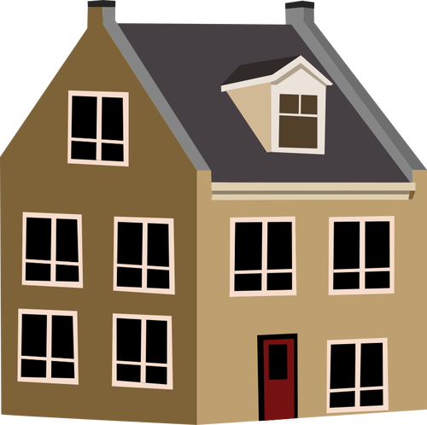


WiFi Challenges
Shared medium
  Traffic halving
Hidden nodes
Range
Packet loss
Reflection

Slide 5
Terminology
Stretch
  Factor between best path vs. selected path
Geometric routing
Power scale law
  A lot of node with many connections
  Few nodes

Slide 6
Limits: Depends
How big can they get
  Depends on usage
    any to any?
    tree structure?
    traffic
  Depends on topology
    Line / Tree / Mesh
  Depends on addressing:
    Static (sort of random and fixed)
    Dynamic (encodes position, might changes)

Slide 7
Limits: Usage
Traffic patterns matters
Example: Manhatten / grid
  One car from each block
    Limited distance travel => scales
    Constant traffic
  1 car per block to random position
    sqrt(number cars) per block => nope
      Capacity: O(W /√ N)
      Paper: Guptar&Kumar
  Power law usage (α > 2) => scales

Slide 8
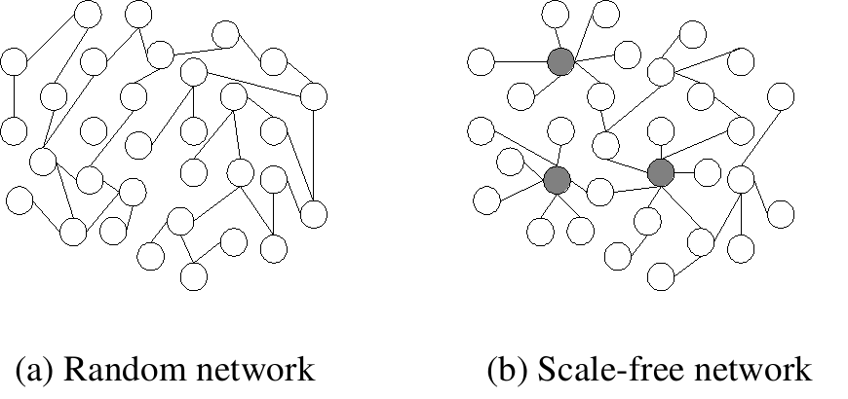
Limits: Topology
Manhatten does not scale well
  Virtual Manhatten != real Manhatten
Backbone
  Highways / Tree
Scale Free network
  Number of connection follows Power Law
  Public transportation
  Nature

Slide 9

Traffic
Management Traffic
  Needs to scale
  Or we are in trouble
  Real World: GPS, Maps
Payload Traffic

Slide 10
Limits: Real Life
From mesh routing protocols with linear
  Management Traffic scales linear per link
  Max out at 500-1000 nodes
But we can do better
  In theory
  Geographic routing for mesh
    O(√N)
  Spanning Tree
    O(√N)

Slide 11
Compact Routing
Study of fundamental trade-off between stretch
Find not the best path, but good path
Distinguish more concepts
https://arxiv.org/abs/0708.2309

Slide 12
Routing Schemes
Name independent
  Node identifier is opaque value => Identifier
  e.g. MAC address, any likely unique value
Named dependent
  Node identifier serves as address => Locator
  e.g. (global) IP address, Location
Protocol needs: Identifier => Locator
  Distributed Hash Table (DHT)

Slide 13
Implementation for Layer 2
e.g. batman-adv
Emulates a virtual network switch
Easy roaming
Needs to be implemented as Kernel Module
Needs to handle lower level protocols (Multicast stuff: ARP, NDP, DHCP)
    Gets noisy if you miss stuff, otherwise it needs to be flooded

Slide 14
Implementation on Layer 3
e.g. OLSR, BGP, BMX7
Easier to implement
User space makes it more portable to other platforms
No roaming without hacks

Slide 15
RIP
Routing Information Protocol
Precursor of OSPF
Distance Vector
hop count metric
  Max 16 (used to prevent loops!)
Broadcast whole table every 30 Seconds
  Slow convergence & inefficient

Slide 16
AODV
Ad-hoc On Demand Distance Vector Routing
  Often used as citation in academia
  Descendant of DSDV
Reactive (“On Demand”)
Route Request Packet
Router Reply Packet
(2003)

Slide 17
DSDV
Destination Sequence Distance Vector
Bellman – Ford routing algorithm

Slide 18
The End
all images:
  publicdomainvectors.org (CC-BY)
Guptar&Kumar (2000)
  https://ieeexplore.ieee.org/abstract/document/825799
Reading recommendation:
  https://inthemesh.com/archive/the-scalability-of-mesh-networks/

