Slide 1
Emulating Huge Mesh Networks
Let’s test
BATMAN-adv, Babel, OLSR1/2, BMX6/7, Yggdrasil and CJDNS

Slide 2

About Me and my Goals
Moritz Warning
Long time FLOSS programmer
  Mostly distributed, mesh, security
  https//github.com/mwarning/
Freifunk since 2011/12
  Network for the people by the people
  .. there are a lot of people
  .. current protocols do not scale that well
Mesh Routing Enthusiast
  We need better protocols

Slide 3
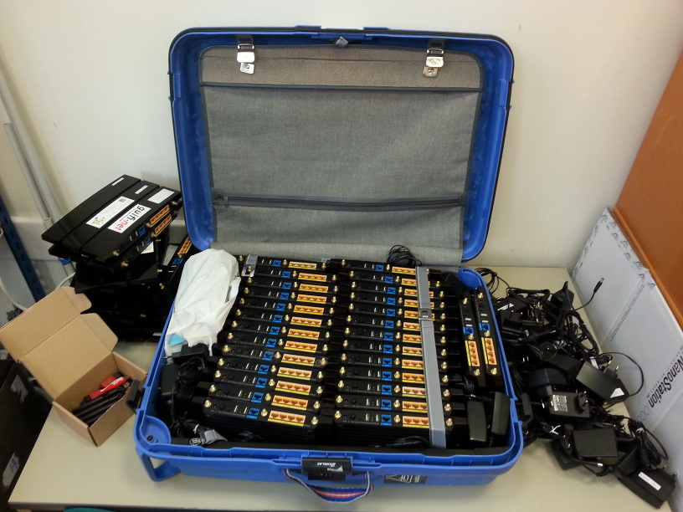
Motivation
Battlemesh
  once a year somewhere in Europe
  ~40 people
Missing Battle
  15-30 Router
  throughput measurement
  not uniform
Virtual Battle
  Comparable to each other
  Test scalability and reachability
  No easy emulation of WiFi characteristics
    radio interference patterns
Battlemesh v10

Slide 4

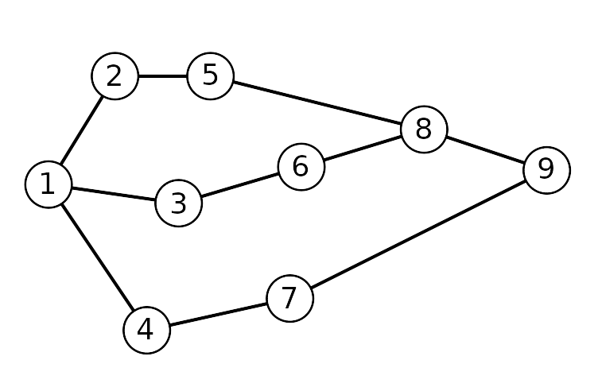
Meshnet-Lab: Introduction
Other emulation/ did not scale well
  I have limited resources
  Let’s through stuff out
Meshnet-lab
  Python (>= 3.6)
  Linux Network Namespaces (>= Linux 4.18)
  ip / ping / ssh
  https://github.com/mwarning/meshnet-lab
CC0 License

Slide 5
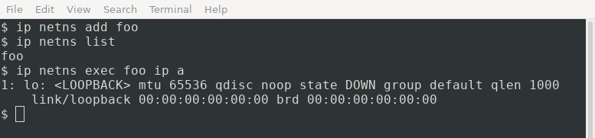
Linux Network Namespace Primer
Building Block for LXC, Docker, etc.
  Other name spaces (about 7?)
On nearly every Linux system

Slide 6
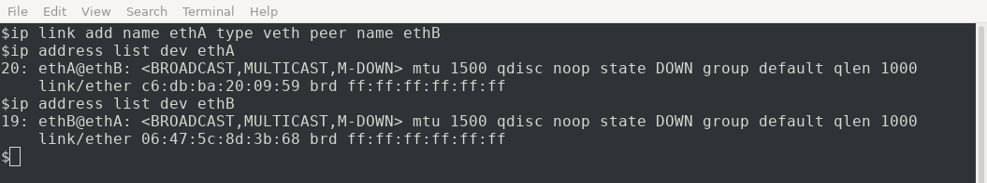
Virtual Cables
Packet that go in, come out the other side

Slide 7
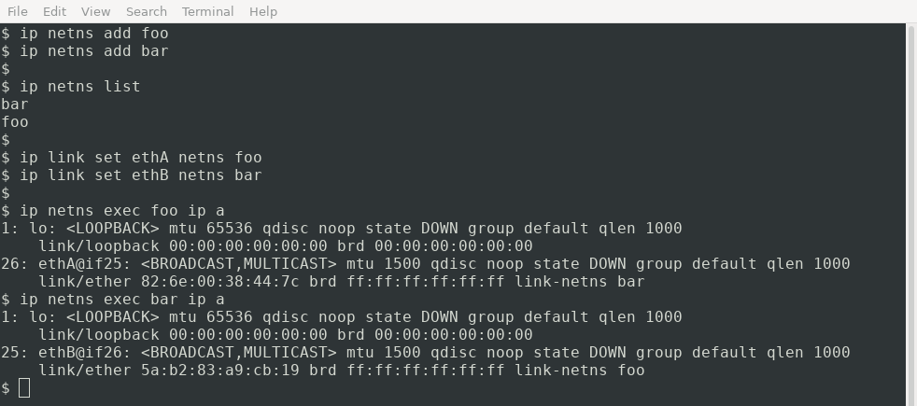
Plug the cables
Move the ends into different network name spaces

Slide 8

Meshnet-Lab: Setup
Python scripts
  network.py (setup network)
  software.py (start mesh routing programs)
    E.g.: protocols/batman-adv_start.sh
All tests are ready to be run on your own computer
  E.g.: tests/benchmark1/run.py
Emulation (imitate behavior)
  No simulation (mimics real device)
  No discrete event

Slide 9
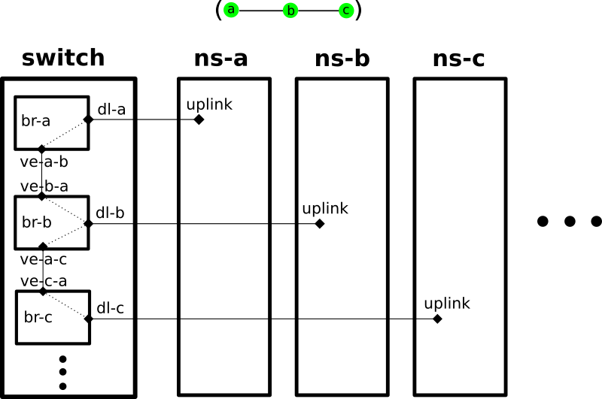
Meshnet-Lab: Internal
The bridges are actually hubs aka dumb switches/bridges!

Slide 10
About the Tests
Tests
  Benchmark, Convergence, Mobility, Scalability
  IPv6
Limitations
  Real time, cannot run faster than real time
  Computer performance might influence results
  No WiFi interference patterns
Test Duration: 1 hour – 1 week!
CPU usage: mostly low + 100% peaks
Distributed: Up to 20 * 1 core machines, because batman-adv!

Slide 11
Tested Versions
Yggdrasil (0.3.14)
Batman-adv (2020.1)
Babel (1.8.3-1)
OLSR1 (0.9.8), IPv4 tested!
OLSR2 (v0.15.1)
BMX6 (v1.0)
BMX7 (v7.1.1)
CJDNS (v20.5)
OSPF did not get it to work – help needed

Slide 12
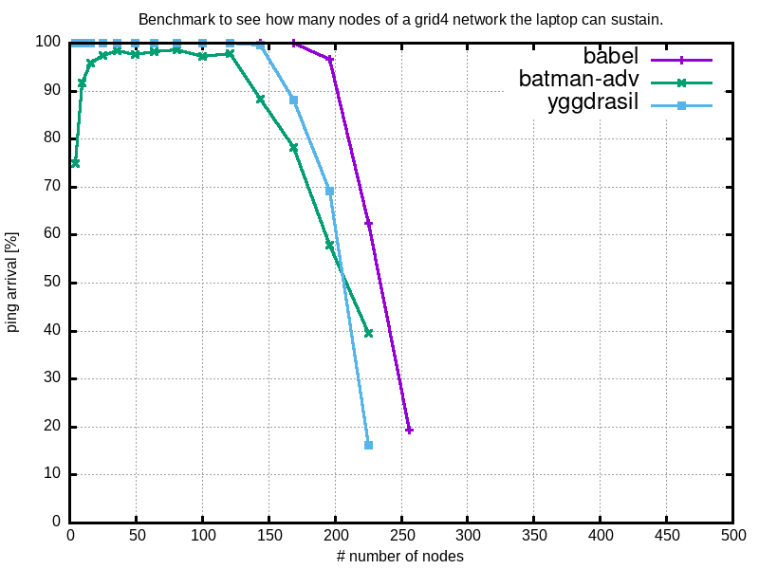
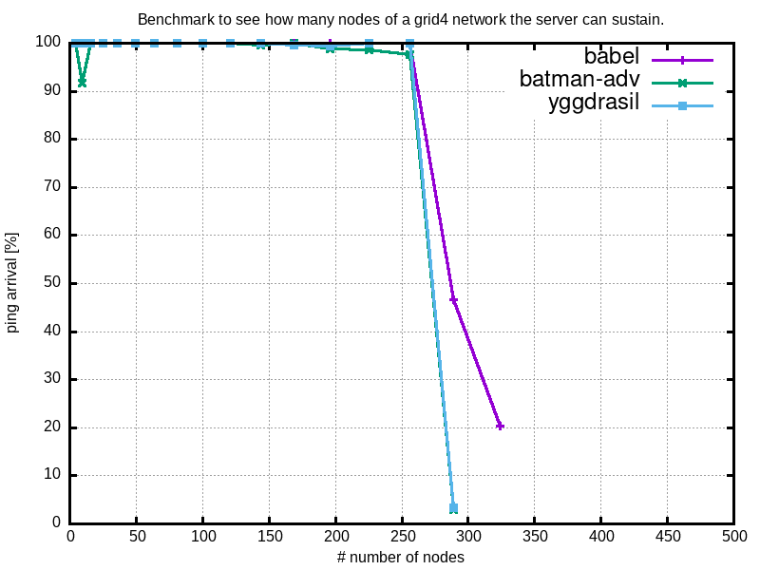
Benchmark
How many systems can we emulate?
Laptop
Server

Slide 13

Measurements
Connectivity / packets arrived (%)
  N random node pairs are selected
    That are not neighbors
    A path exists
  A ping is send
  50% means that half of all pings arrived
Throughput not measured
  Likely to cause CPU side effect
Connections are usually 100 MBit/s and 1ms delay
  Unless stated otherwise

Slide 14
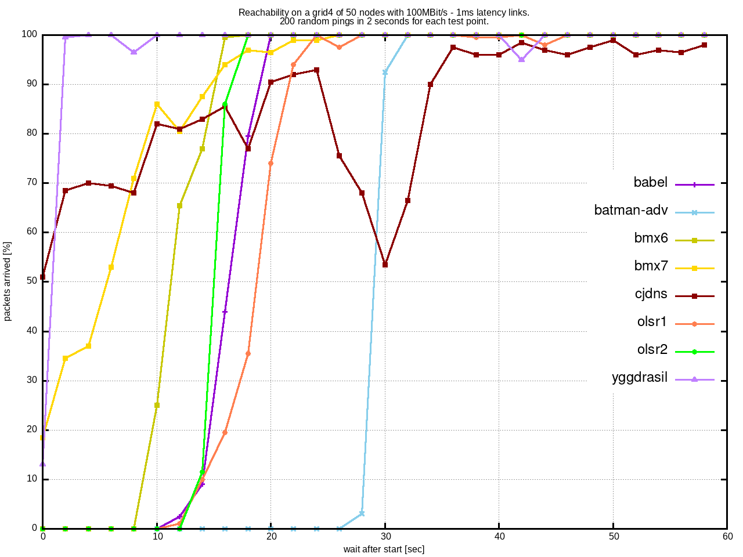
Convergence on a Grid

Slide 15
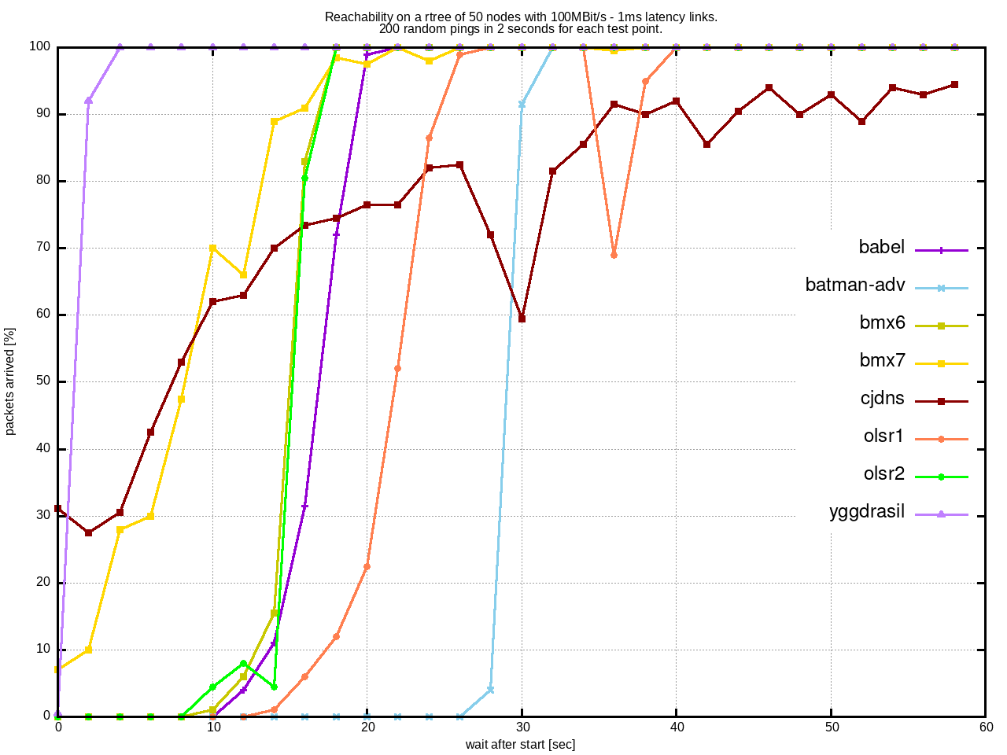
Convergence on a Random Tree

Slide 16
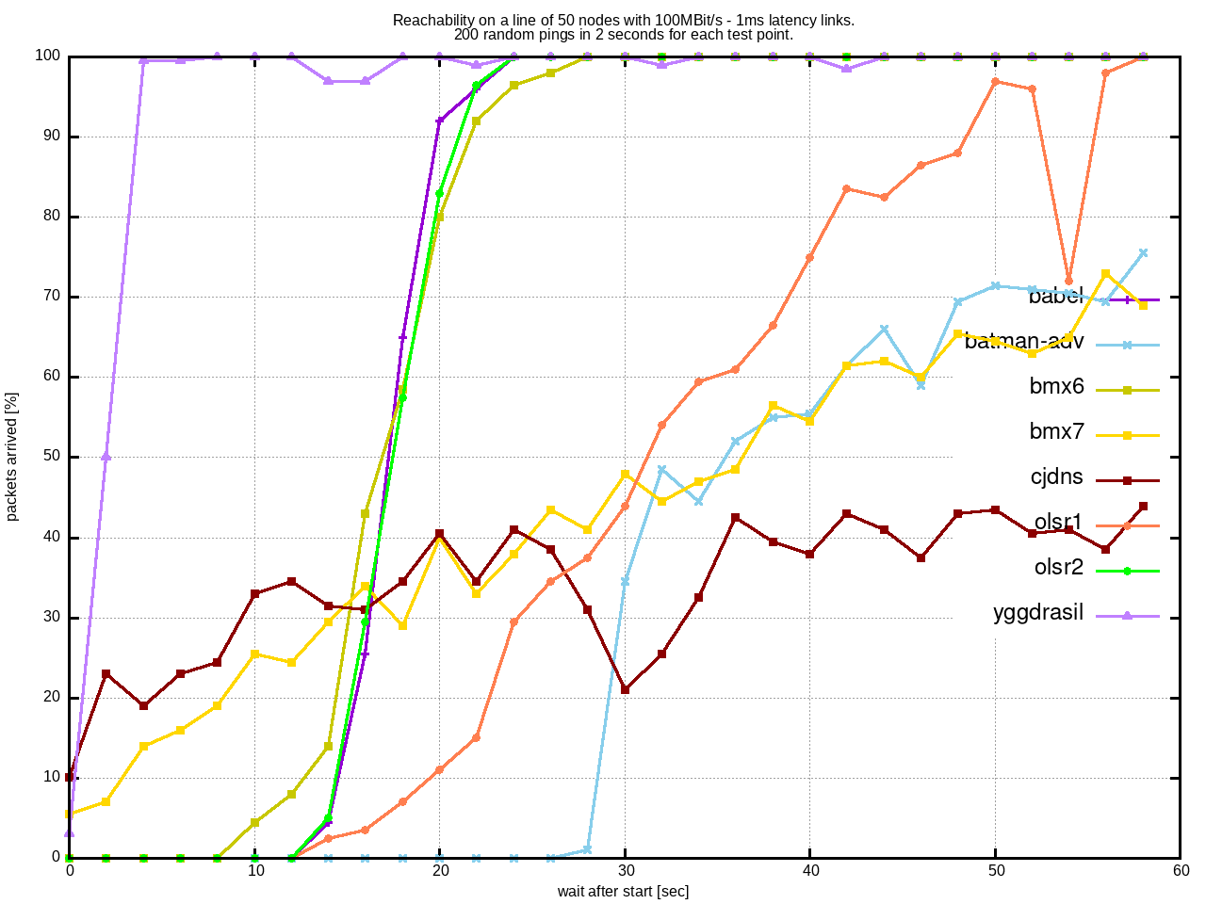
Convergence on a Line

Slide 17
Results: Convergence
default timings are visible
  bmx7, jdns and yggdrasil send quickest
batman-adv is <100% because the maximum hop count is 32
cjdns shows funny behavior
line topologies are pathological

Slide 18
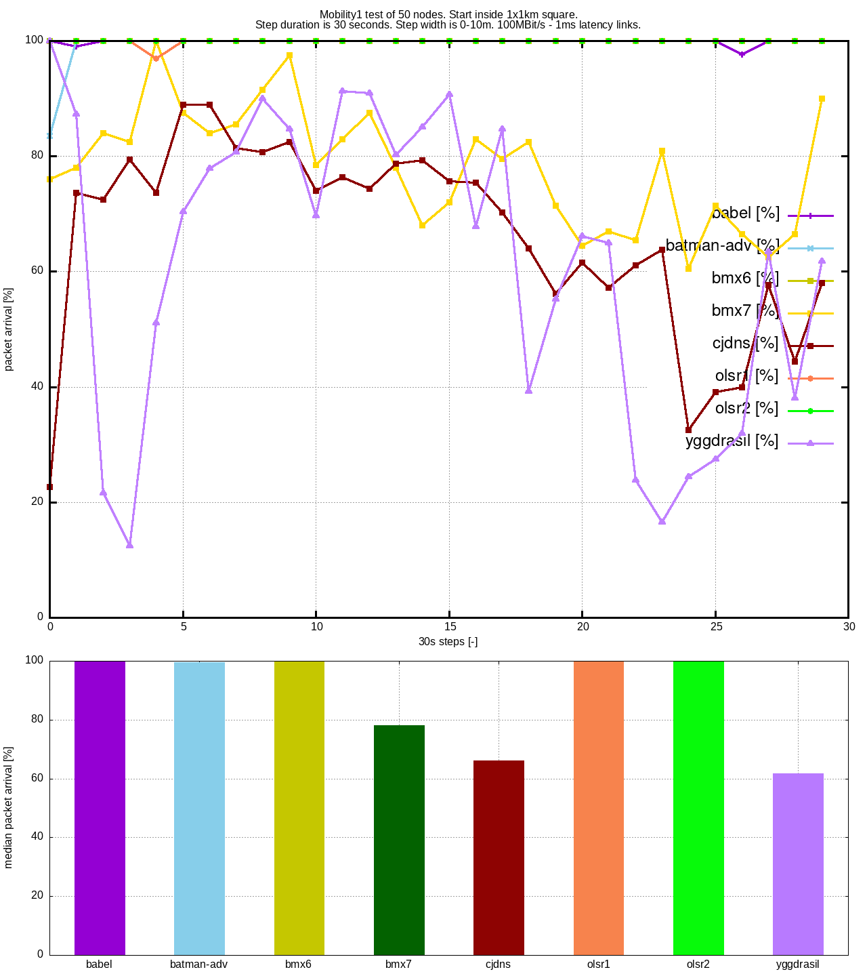
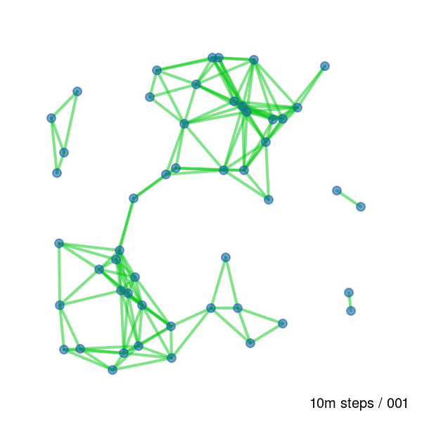
Mobility 1 – 10m steps every 30s
0-1.2 Km/h
Animation – might not work in pdf...

Slide 19
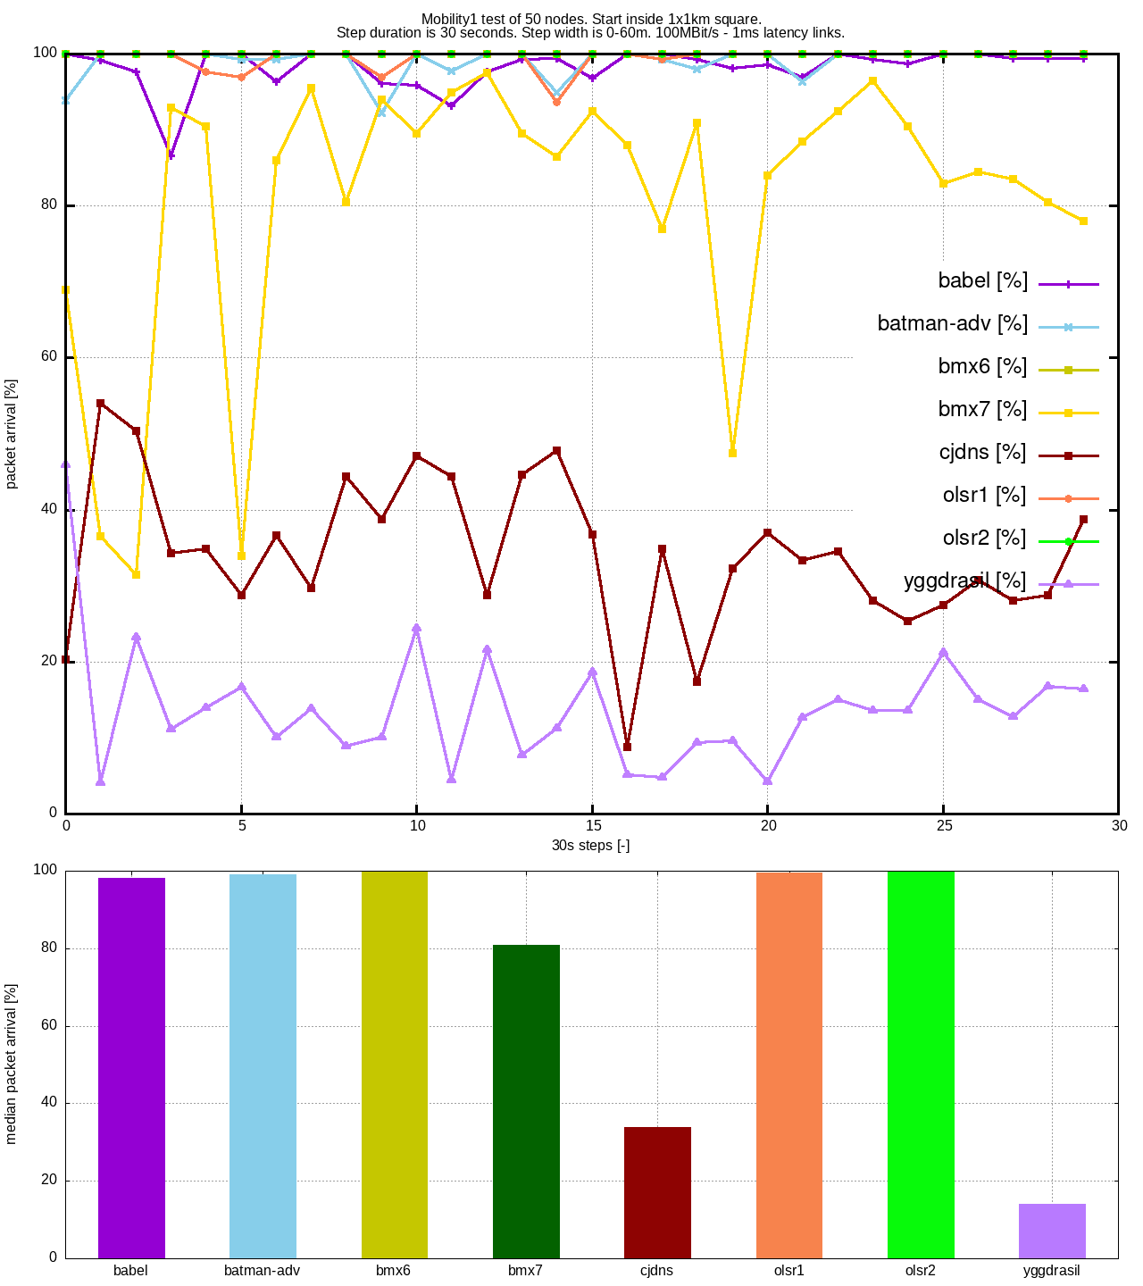

Mobility 1 – 60m steps every 30s
0-7.2 Km/h
Animation – might not work in pdf...

Slide 20
Results: Mobility1
cjdns, yggdrasil and bmx7 are not doing well when it comes to mobility
discussion…?

Slide 21
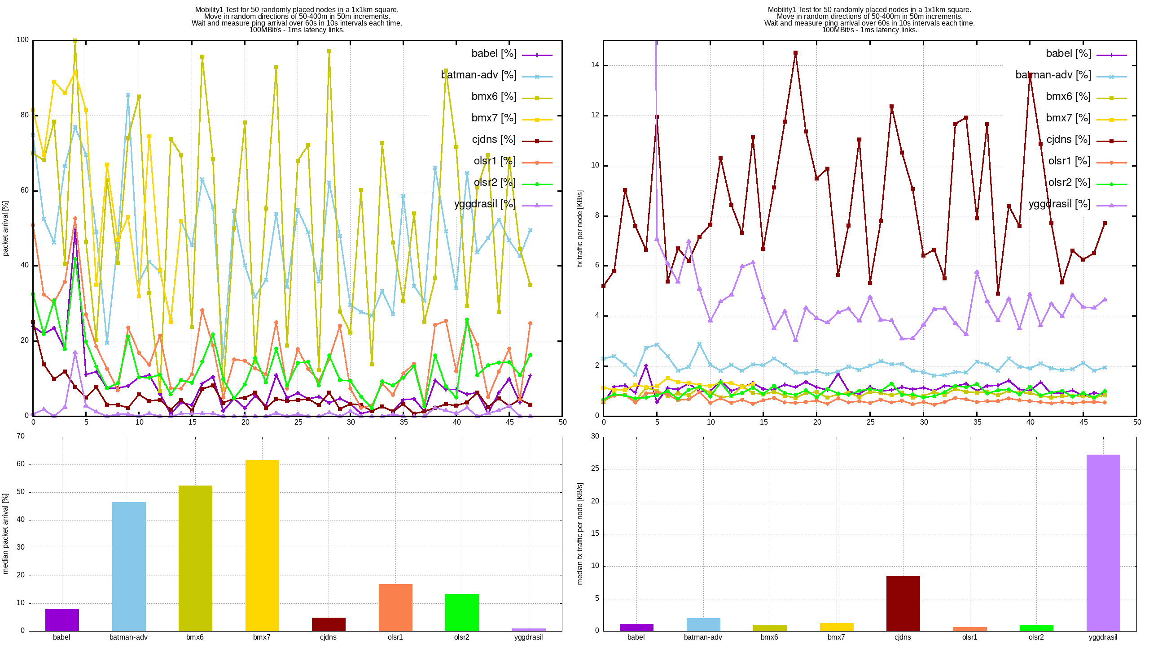
Mobility2

Slide 22
Results: Mobility 2
high mobility scenario
bmx6, bmx7 and batman-adv have good convergence / reachability (>45%)
bmx6 and bmx7 also uses little traffic as well!
olsr1 gets the second place
cjdns and specifically yggdrasil use a lot of management traffic and have has bad convergence
  Yggdrasil is working on improvements!
other protocols use somewhat low traffic, but have bad convergence

Slide 23
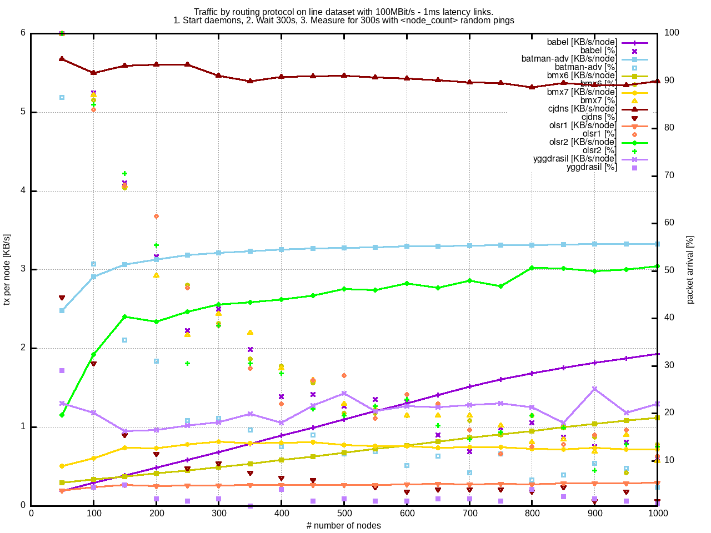
Scalability on a line

Slide 24
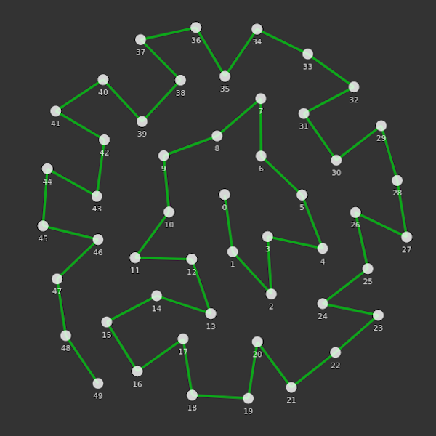
Scalability on a line - Results
Packet loss too high!
  due to metric
  .. other effects?
Traffic data meaningless!

Slide 25
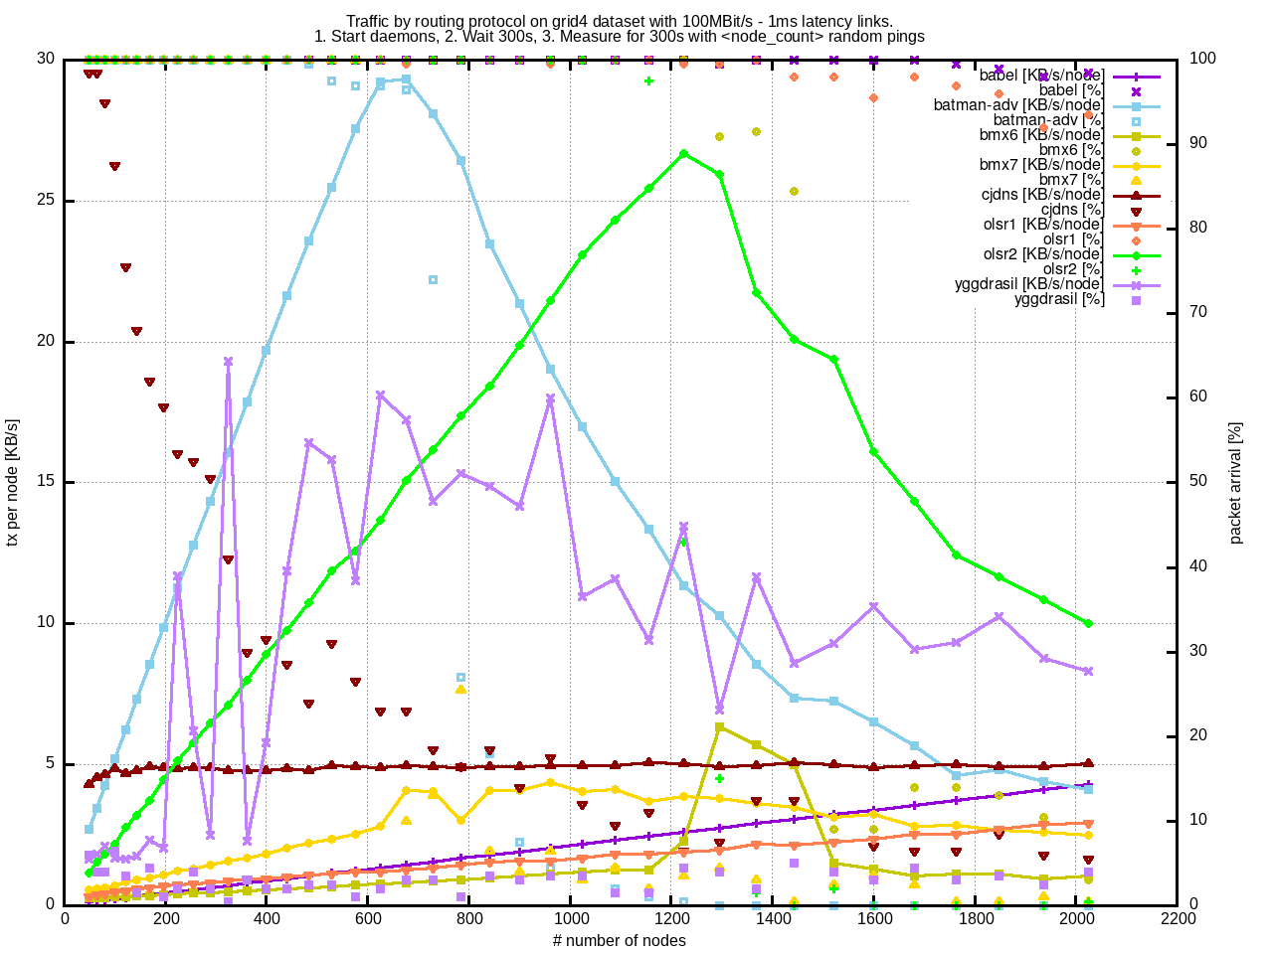
Scalability on a grid

Slide 26
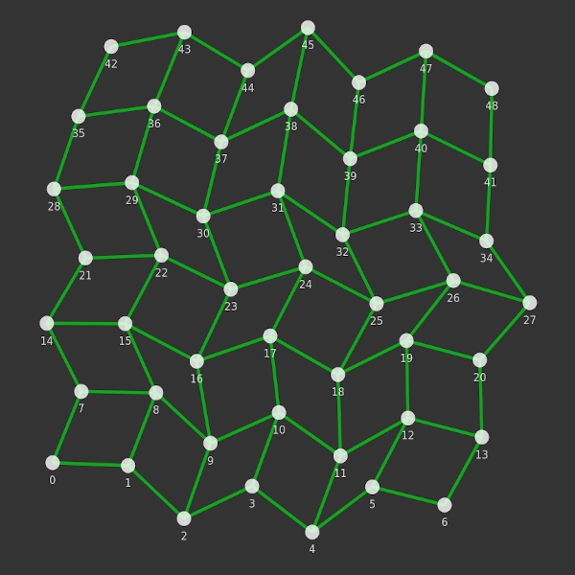
Scalability on a grid - Results
Traffic increase is mostly very linear!
KB/s per 100 nodes
  bmx6: 0.08 KB/s
  babel 0.20 KB/s
  olsr1: 0.31 KB/s
  bmx7: 0.39 KB/s (does not route)
  yggdrasil: 0.65 KB/s
  olsr2: 1.66 KB/s
  cjdns: 0.25 KB/s (not linear / baseline traffic too high?)

Slide 27
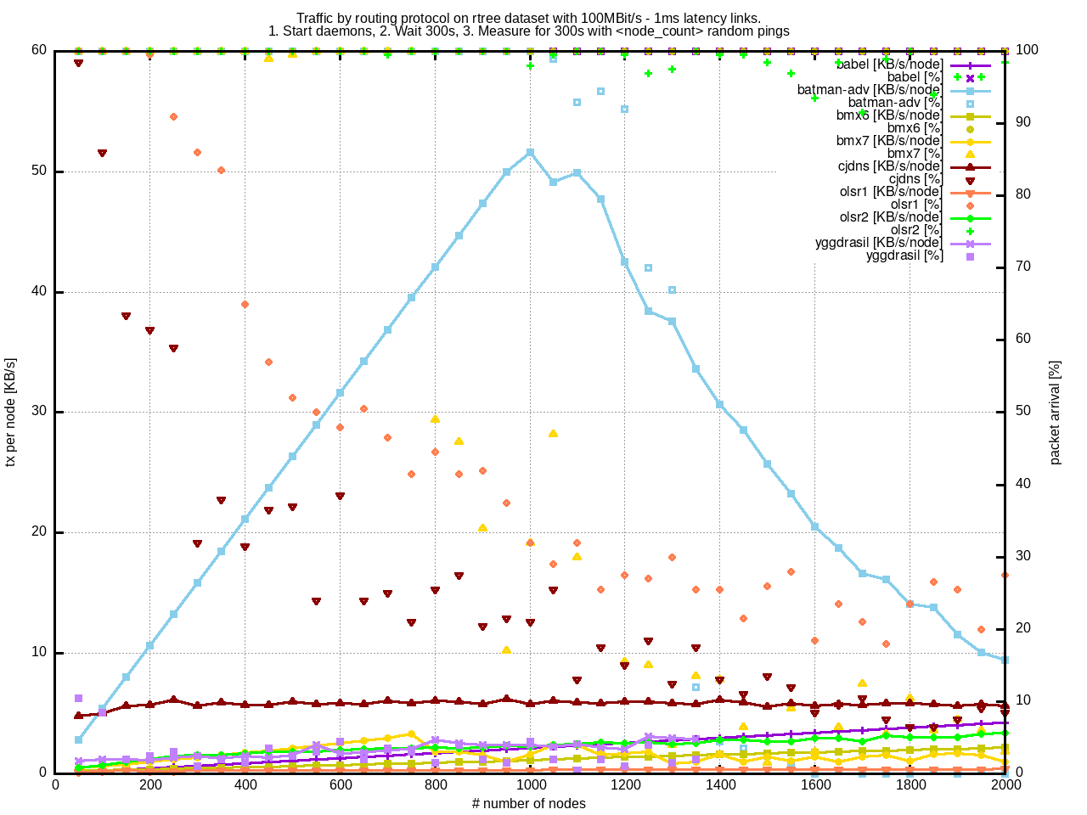
Scalability on a random tree

Slide 28
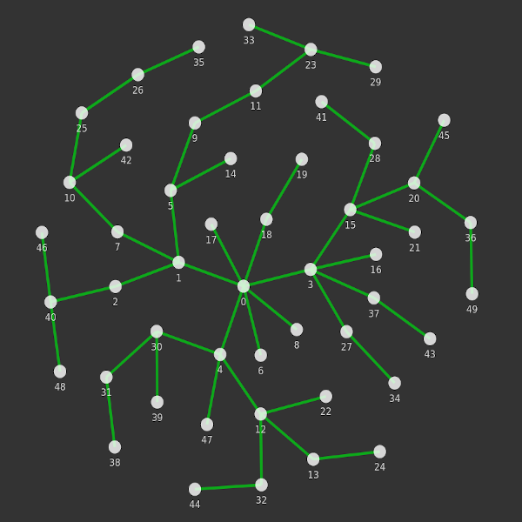
Scalability on a tree - Results
Traffic increase is mostly linear!
Packet loss might be bad scalability
  .. OR the CPU is not fast enough

Slide 29
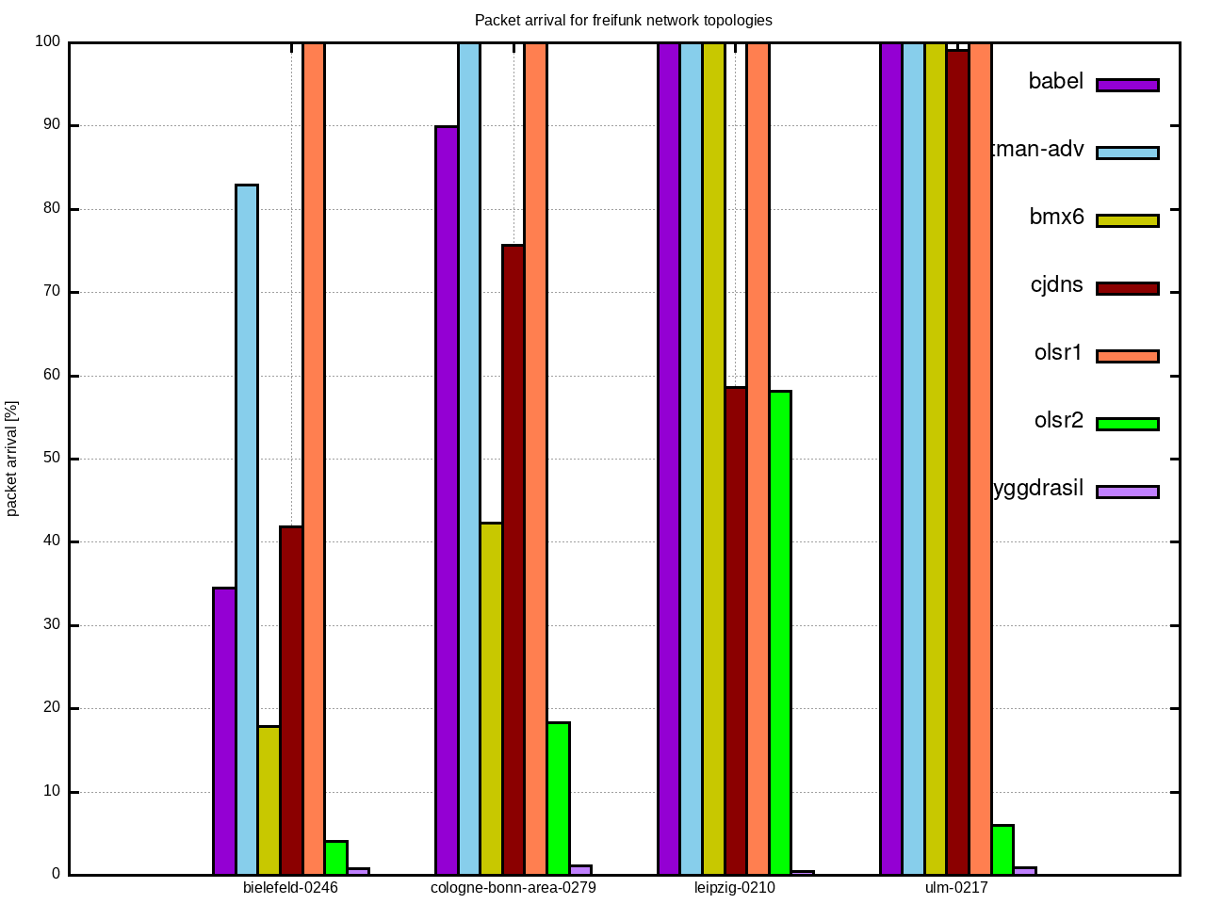
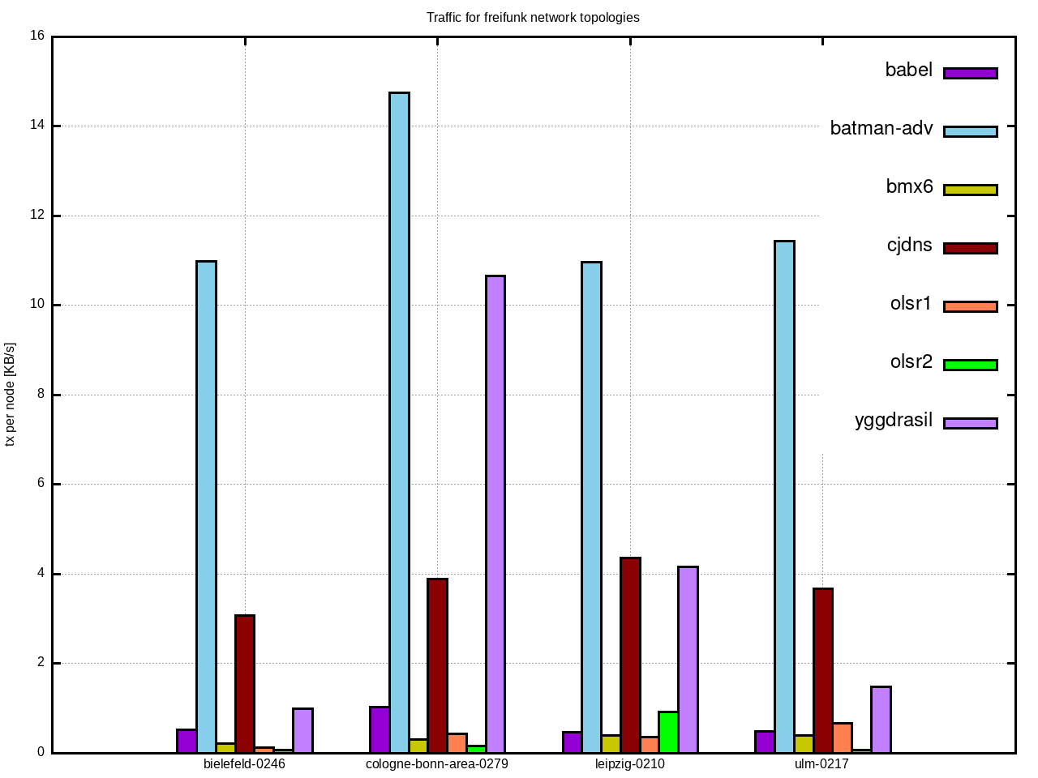
Freifunk Networks
Node Count
Bielefeld: 246, Cologne-Bonn: 279, Leipzig: 210, Ulm 217

Slide 30
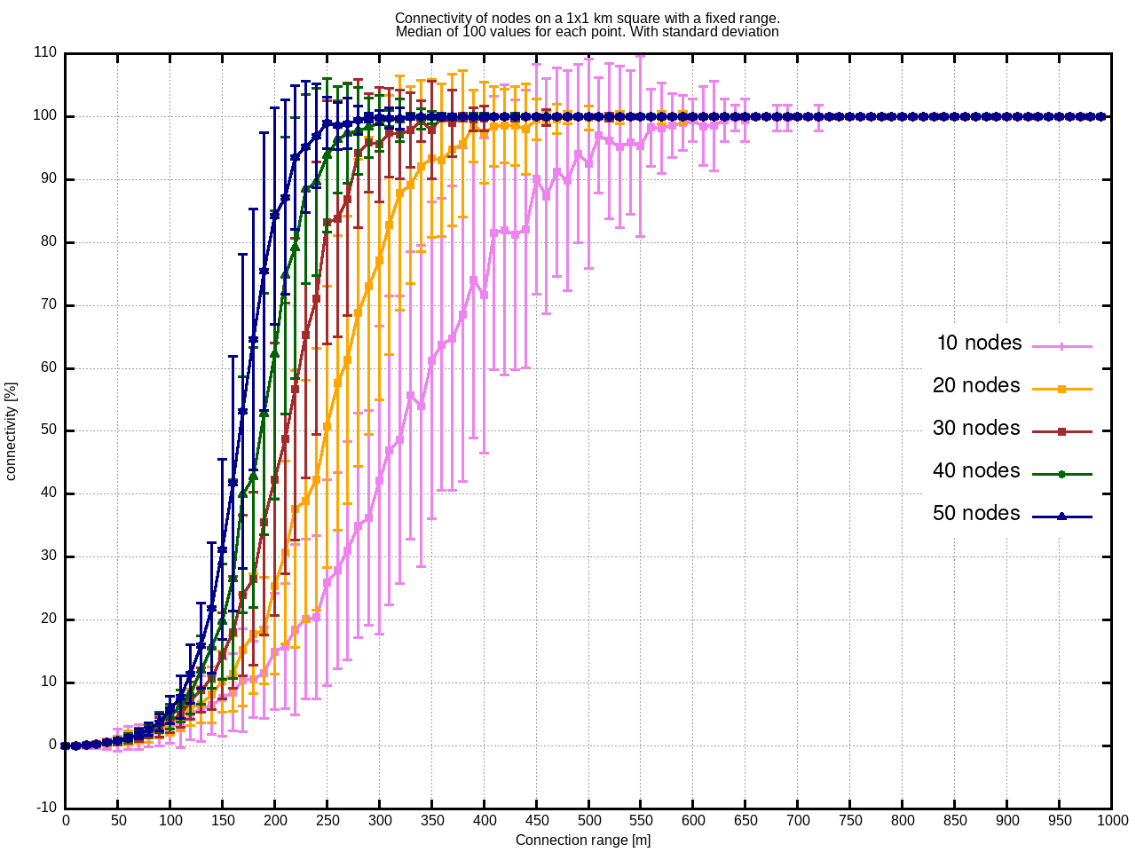
Bonus: Percolation Theory

Slide 31


Questions / Discussion
All images are CC0 / Public Domain
  https://publicdomainvectors.org
Results are online:
  https://github.com/mwarning/meshnet-lab
  You can run it yourself!
...

