Slide 1
Windows Azure Cloud Service Lifecycle
Name
Title
Microsoft Corporation

Slide 2

Presentation Summary
Version: June 2012
Technical Level: 200
Intended Audience: Developers
Intended Time: 60 minutes
Objectives (what do you want the audience to take away):
Understand the development lifecycle for Windows Azure applications
Deploying
Upgrading Applications
Debugging
How to architect applications to ensure minimal downtime
How to automate the entire process

Slide 3
Agenda
Deployment
Minimizing Downtime
Debugging

Slide 4
Deployment

Slide 5
Two Independent Environments
Production
Staging
Notes:
Slide Objective
Windows Azure allows for 2 deployment packages as part of the same project, Production and Staging
Speaking Points
Staging Costs money to use
Flip around
Each package has a unique version for that project.
The “production” package services requests from the website URL. Worker roles operate normally.
Any package in “Staging” will only serve web requests from a temp URL – which is a GUID and is shown below the package. This is great to run smoke tests on.

Slide 6
Stages of Service Deployment
Stage 1: Local development and testing
Stage 2: Test in mixed mode with hosted data
Stage 3: Test in Staging on Windows Azure
Stage 4: VIP Swap to Production
Production
Staging
Compute Emulator
Compute Emulator
Role
Role
Cloud Service
Role
Role
Role
Role
Storage Emulator
Windows Azure Storage Service
Windows Azure Storage Service
Notes:
Slide Objective
Highlight the stages of a typical deployment
Local development
Hybrid of local and Windows Azure
Everything in Windows Azure in staging
Swap from Staging to Production
Speaking Points
Debugging is not currently supported in Windows Azure
Set breakpoints & debug in Local Development Fabric.
Test initially with development storage, but test with Windows Azure storage to test with large volumes of data whilst still keeping your roles local for debugging
Once you are happy with the Worker/Web Roles running locally deploy everything to Staging and run tests in this environment
Once all tests in staging pass, promote everything to production
Worker roles in the “Staging” project are operational – and as such will process messages from queues etc. You should design for this.

Slide 7
Packaging & Deployment
Service Artefacts
Upload to Windows Azure
Microsoft Visual Studio
*.cspkg
Model
Windows Azure Compute Controller
Web Role
Worker Role
Config
*.cscfg
LB
You can also integrate with source control such as TFS and deploy via continuous integration
Visual Studio Tools for Windows Azure now supports one-click deployment. Aimed at rapid build/deploy/test/fix scenarios.
Service
Service
Notes:
Slide Objective
CODE – PACKAGE – UPLOAD – DEPLOY
Shows how service makes it from code living in Visual Studio to a running deployed instance in Windows Azure
Show how Roles are packaged up and uploaded with the config to Windows Azure
Speaking Points
Code is compiled, then packaged into a single file. This is the service package.
This, along with the configuration/service model – are deployed via the web portal.
Notes
Visual Studio 11 with the updated tools now supports automated seamless package/upload/deploy using Service Mngt Api

Slide 8
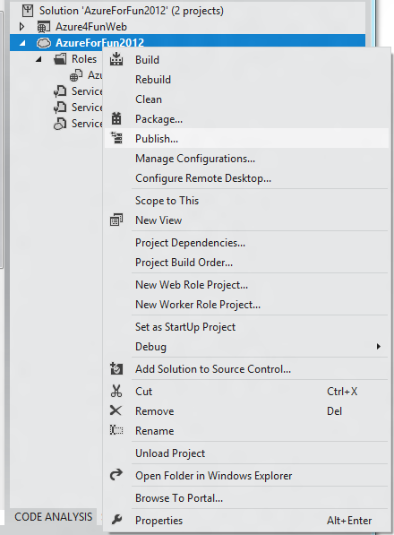
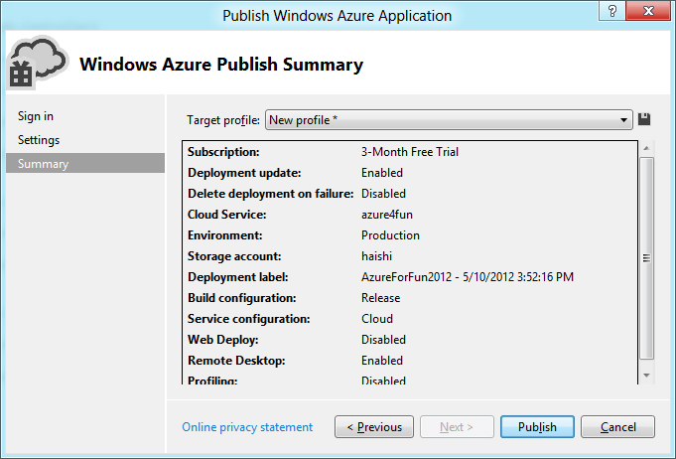
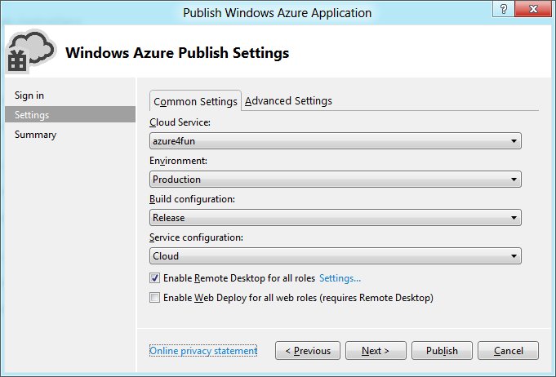
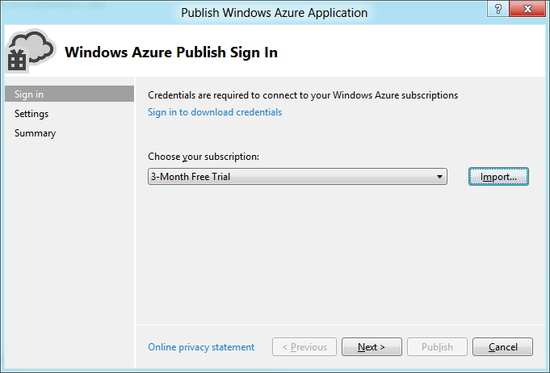
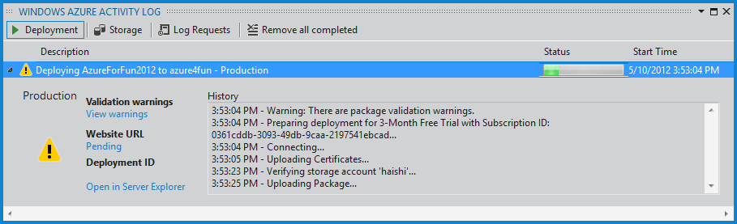
Deploying a Cloud Service from Visual Studio
Publish to either Production or Staging
Package only or Deploy to Windows Azure
Three things needed
Windows Azure subscription
Windows Azure hosted service
Windows Azure storage account
Uses x509 certificate authentication
Notes:
Slide Objective
Demonstrating the Publish and Deploy features included with Visual Studio 11
Speaking Points
A Windows Azure subscription.
When you first sign up to Windows Azure a subscription is created and associated with your Live ID
To find your subscription ID, navigate to the Account page in the Developer Portal. Subscription ID appears in the Support Information section at the bottom of the page.
A Windows Azure hosted service.
Before you can deploy your cloud service, you need to create a hosted service for that deployment.
The hosted service provides the two deployment slots, Staging and Production, to which you can deploy your cloud service.
A Windows Azure storage account.
When you deploy your cloud service through Visual Studio, the service package is first uploaded to a blob through the specified storage account,
then deployed to Windows Azure from the Blob service

Slide 9
Geo-Location & Affinity Groups
Dependent resources
Ensures geo-location in single datacentre
Can specify sub-region also (Recommended)
Affinitized
Explicitly define sub-region on service by service basis
Specific Geo-located
Windows Azure chooses sub-region
(Not Recommended)
Un-Affinitized
Affinity and Geo-Location Settings are Immutable
Notes:
Slide Objective
Highlight the different options available when deploying services to Windows Azure around Affinity Groups
Speaking Points
Windows Azure Storage can be geo located, meaning you can choose in which geographical region it will be hosted
Different geographical regions have different implications when it comes to cost
Reason for geo-location
Legal
Business Continuity / Backup
Associate data with Windows Azure services through an ‘Affinity Group’
Affinity Group helps the Windows Azure Fabric Controller keep services & data close together within the data centre
Reason for affinity grouping is Performance
The Windows Azure data-centre’s are so large that by having data and services located near each other can improve performance
Fewer network hops
lower communication times

Slide 10
Guest OS Versioning
Windows Azure Runs on Base OS
Base OS revised regularly
Best practice is to specify OS version
Get latest version by default – using version ‘*’ gets auto-updates
Use osVersion attribute
To determine version in the cloud view config data in cloud
<ServiceConfiguration serviceName="CloudService1“ osVersion="WA- GUEST-OS-1.2_201003-01“>
Releases posted here: http://msdn.microsoft.com/ee924680
Release | CHANGES
WA-GUEST-OS-1.0_200912-01 | Patches
WA-GUEST-OS-1.1_201001-01 | Patches
WA-GUEST-OS-1.2_201003-01 | Patches URL Rewriting and Compression .NET 4.0 RC
WA-GUEST-OS-1.3_201004-01 | Patches, .NET 4, URL Rewrite 2
Notes:
Slide Objective
Windows Azure runs on a base operating system
This guest operating system is updated regularly
Guest OS Version can be and should be specified in the service configuration file
Speaking Points
Best practice is to always specify the version of the OS to run on.
Roles will try to run on the latest available version if you don’t specify a version
To ensure that your service works as expected, you must deploy it to a release of the Windows Azure guest operating system that is compatible with the version of the Windows Azure SDK with which you developed it.
“It works on my machine” – something working on local development fabric and not in the cloud could be a result of incompatibilities
All role instances defined by your service will run on the guest operating system version that you specify
Services may be subject to upgrades to the underlying Windows Azure root operating system from time to time.
Mandatory and cannot be postponed.
An upgrade to the root OS recycles your running role instances, taking them through their shutdown sequences and then restarting them.

Slide 11
Windows Azure Service Management API
REST based
Uses X509 client certificates for client authentication
Hosted Services
Storage Accounts
Certificates
Affinity Groups
System Info
View, Create, Delete Deployment
Swap Deployment
Modify configuration
Scale Up/Scale Up
Upgrade deployment
Walk Upgrade Domain
List Accounts
Get Account Properties
Get Account Keys
Regenerate Keys
List
Add
Get
Delete
List
Get Properties
Get OS Version
Notes:
Slide Objective
Introduce the Service Management API
List a few of the functions that can be achieved
Speaking Points
Programmatic access to much of the functionality available through the Windows Azure Portal
You can manage;
Storage accounts
Hosted services
Service deployments
Affinity Groups
REST based
Performed over SSL
Authenticated through use of X509 certs
Accessed from
A Role running within Windows Azure
Any HTTPS request

Slide 12
Tools
Windows Azure Tools for Visual Studio
CSPack
CSRun
CSManage
Powershell Cmdlets
Notes:
Slide Objective
Introduce the different tools available to developers around developing, deploying and managing applications and services in Windows Azure
Each of the tools will be drilled in to in more detail in the slides that follow

Slide 13
Windows Azure Tools for Visual Studio
Project Templates
User Interface Extensions
Storage Explorer
Server Explorer
Integrated Deployment
IntelliTrace Debugging
Profiling Support
Notes:
Slide Objective
Introduce capabilities of the Windows Azure Tools for Visual Studio
Speaking Points
Windows Azure tools for Visual Studio extend Visual Studio
Enables the creation, building, debugging, running, packaging, deploying web apps and services for Windows Azure
Visual Studio 2008 & 2010 support
Storage Explorer
an extension to the Visual Studio Server Explorer window
provides read-only access to blob and table data in your Windows Azure storage accounts
Compute Explorer
an extension to the Visual Studio Server Explorer window
provides a read-only view of deployment status for your hosted services in Windows Azure
IntelliTrace debugging
log extensive debugging information while deployed to Windows Azure.
can use the IntelliTrace logs to step through your code in Visual Studio as though it were running in Windows Azure

Slide 14
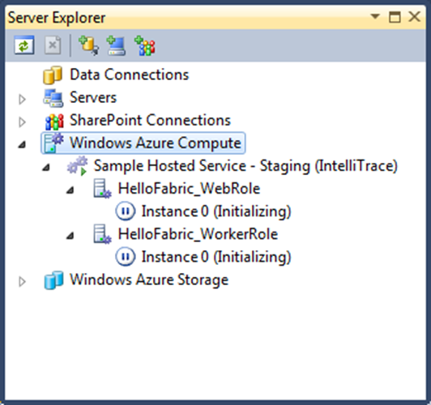
Windows Azure Compute Explorer
View & Monitor deployments from Visual Studio
Not possible to Start or Stop role instances
Uses x509 Certificate Authentication
Refreshes automatically by querying Windows Azure at regular intervals
Notes:
Slide Objective
Show the Windows Azure Compute Explorer
Speaking Points
Compute Explorer
an extension to the Visual Studio Server Explorer window
provides a read-only view of deployment status for your hosted services in Windows Azure

Slide 15
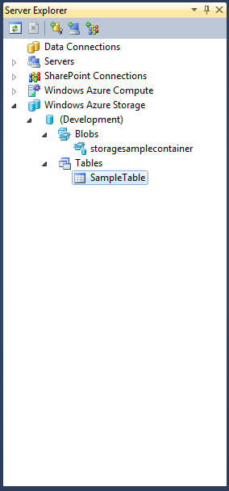
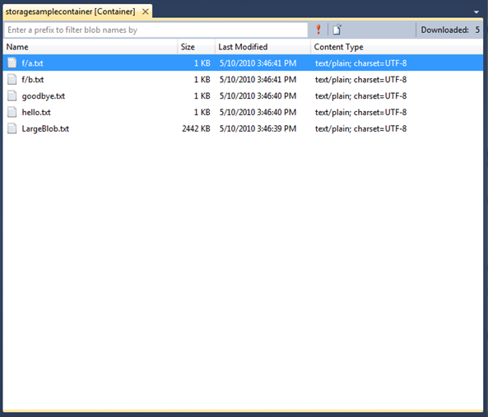
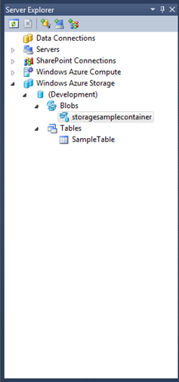
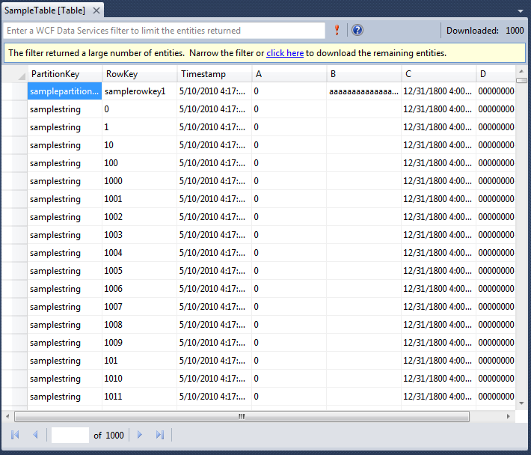
Windows Azure Storage Explorer
An extension to the Visual Studio Server Explorer
View data from Windows Azure Storage
Download Asynchronously
Blob data cached locally
Notes:
Slide Objective
Show the Windows Azure Storage Explorer
Speaking Points
Storage Explorer
An extension to the Visual Studio Server Explorer window
Provides read-only of blob & table data in your Windows Azure storage accounts
Data is cached locally and only refreshed when change is detected

Slide 16
CSPack.exe
Part of the Windows Azure SDK
Command line tool; called by VS.NET tools
Packages your service for deployment
Explicitly name & set location of Service Package
Package for Cloud Deployment
cspack HelloFabric\ServiceDefinition.csdef
/role:HelloFabric_WebRole; HelloFabric_WebRole
/out:HelloFabric.cspkg
cspack HelloCloudService.csdef
/role:HelloCloudServiceWebRole; HelloCloudService
/generateConfigurationFile:HelloCloudService.cscfg
/out:HelloCloudServicePackage
/copyOnly
Package for Dev Fabric Deployment
Notes:
/out: <file | directory> This option indicates the output format and location for the role binaries.
/role:<rolename>;<role-binaries-directory>; This option specifies the directory where the binaries for a role reside and the DLL where the entry point of the role is defined.
The command line may include one /role option for each role in the service definition file.
/copyOnly files are copied into a folder hierarchy whereas omitting this flag would produce a .cspkg formatted file that would be used as a deployment package for deploying to Windows Azure

Slide 17
CSRun.exe
Command line tool; called by VS.NET tools
Deploys Service to Development Fabric
Manages Running Service
Dump the logs of deployed instances
Control the state of the Development fabric
Control Development Storage Service
Run + Open Browser
csrun myservice.csx myservice.cscfg /launchbrowser
csrun /devfabric: shutdown csrun /devfabric: clean
csrun /devstore: start
Stop & Clear persistent state e.g. LocalStorage
Start Dev Storage

Slide 18
X.509 Certificates
Management Service uses certificates for authentication
Self-signed
Any valid X.509 v3 with key length >= 2048 bits
makecert -r -pe -a sha1 -n CN=AzureMgmt -ss My -sky exchange "AzureMgmt.cer"
Creates a new self-signed certificate, writes it to the "AzureMgmt.cer" file in the current directory and saves it to the CurrentUser\My certificate store.
Notes:
Slide Objective
Understand the role that certificates play in Windows Azure
Speaker notes To ensure that access to the Service Management API is secure, you must first associate a certificate with your subscription.
The management service uses the certificate to authenticate requests.
You can use a self-signed certificate or one signed by a certification authority.
Any valid X.509 v3 is suitable as long as its key length is at least 2048 bits
Generating a Self-Signed Certificate
To ensure that access to the Service Management API is secure, you must first associate a certificate with your subscription.
The management service uses the certificate to authenticate requests. You can use a self-signed certificate or one signed by a certification authority. Run the following command to generate and install the certificate:
makecert -r -pe -a sha1 -n CN=AzureMgmt -ss My -sky exchange -b 04/30/2010 -e 12/31/2039 "AzureMgmt.cer“
Notes
http://www.syringe.net.nz/2010/05/03/WindowsAzureCertificatesForSelfManagementScenarios.aspx

Slide 19
Preparing to use Management API
Make / Acquire Certificate
Pay attention to ValidFrom, Local date could differ from Server
Prepare the Windows Azure Account
Upload certificate to Windows Azure account
Associate up to 5 certificates per account
Notes:
Slide Objective
Understand the steps required to call the management API
Speaker Notes
The Windows Azure Management API uses x509 certificates to authenticate callers. In order to make a call to the API you need to have a certificate with both public and private key at the client and the public key uploaded into the Azure portal. But, if you then want to call the management API from your Windows Azure VMs then you’ll also need to install the cert into the instances by defining them in the service definition This post will show you how.
We’ll be creating a self signed certificate, then uploading that certificate into the Windows Azure management portal. Finally we’ll add the certificate to our service model to ensure that Windows Azure installs the certificate into our VM instance when it is started.
Notes
Full How To here
http://www.syringe.net.nz/2010/05/03/WindowsAzureCertificatesForSelfManagementScenarios.aspx

Slide 20
Preparing to use Management API
Retrieve Thumbprint Id
Retrieve Subscription Id
Manipulate Services
By explicit service name or;
Enumerate services using management API
Notes:
Slide Objective
Understand the steps required to call the management API
Speaker Notes
The Windows Azure Management API uses x509 certificates to authenticate callers. In order to make a call to the API you need to have a certificate with both public and private key at the client and the public key uploaded into the Azure portal. But, if you then want to call the management API from your Windows Azure VMs then you’ll also need to install the cert into the instances by defining them in the service definition This post will show you how.
We’ll be creating a self signed certificate, then uploading that certificate into the Windows Azure management portal. Finally we’ll add the certificate to our service model to ensure that Windows Azure installs the certificate into our VM instance when it is started.
Notes
Full How To here
http://www.syringe.net.nz/2010/05/03/WindowsAzureCertificatesForSelfManagementScenarios.aspx

Slide 21
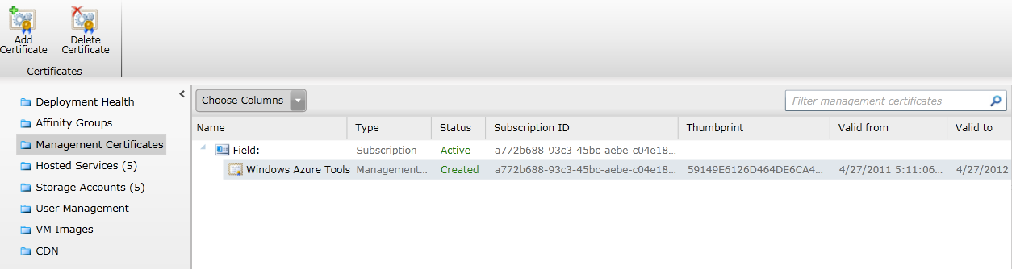
Managing Certificates

Slide 22
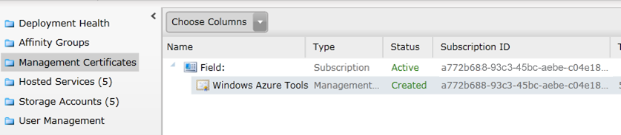
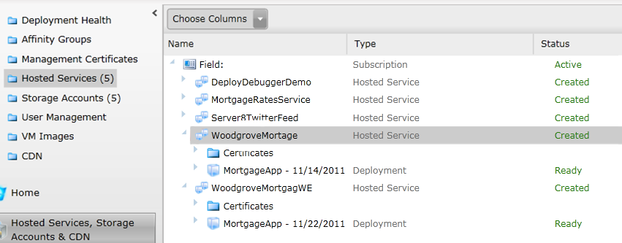
Subscription Id and Service Name

Slide 23
CSManage.exe http://tinyurl.com/azuresamples
Wrapper for the Service Management API
Manage credentials for Storage Accounts
Delete running Services
View configuration of Deployments
Put subscription id and certificate thumbprint in csmanage.exe.config
Suspend a named staging deployment
csmanage /update-deployment /hosted-service :<service>
/slot:staging /status:suspended
csmanage /delete-deployment /hosted-service :<service>
/slot:staging
csmanage /create-deployment /hosted-service:<service>
/slot:production
/name:<name>
/label:<label>
/package:$(BlobStorageEndpoint)packages/ServicePackage.cspkg
/config:$(SolutionDir)\ServiceConfiguration.cscfg
csmanage /update-deployment /hosted-service:<service>
/slot:staging /status:running
Delete a named staging deployment
Create a new deployment into production using a package in Blob storage
Run a named staging deployment
Notes:
Slide Objective
Introduce CSManage
Speaker Notes
What is csmanage? → wraps Service Management API
a tool to manage your deployments and services, using the Windows Azure Service Management API
Where do I get it?
On Codeplex
http://code.msdn.microsoft.com/windowsazuresamples
What does it do?
A command line tool to wrap the Service management API
Run Service
csmanage /update-deployment /hosted-service:<service> /slot:staging/status:running

Slide 24
PowerShell Cmdlets http://wappowershell.codeplex.com
Wrap the Service Management API
With pipelining the output from one command can be used as input to the next
Setup some variables incl. certificate thumbprint
$cert = Get-Item cert:\CurrentUser\My\D6BE55AC439FEA8CBEBAFF432BDC0780F1BD00CF
$sub = "CCCEA07B-1E9A-5133-8476-3818E2165063"
$servicename = 'myazureservice'
$package = "c:\publish\MyAzureService.cspkg"
$config = "c:\publish\ServiceConfiguration.cscfg"
Add-PSSnapin WAPPSCmdlets
Get-HostedService $servicename -Certificate $cert -SubscriptionId $sub |
Get-Deployment -Slot Production |
Set-DeploymentStatus 'Running' |
Get-OperationStatus -WaitToComplete
Get-HostedService $servicename -Certificate $cert -SubscriptionId $sub |
Get-Deployment -Slot Production |
Set-DeploymentConfiguration {$_.RolesConfiguration["WebUx"].InstanceCount += 1}
Add Azure Snapin
get service
get production slot
set status to running
wait for async operation to finish
Scale out production by 1 instance
Notes:
Slide Objective
Introduce The Windows Azure Powershell Cmdlets
Speaker Notes
A set of PowerShell cmdlets wrapping the Windows Azure Service Management API and Diagnostics API.
Script out your deployments, upgrades, and scaling of your Windows Azure applications as well as set and manage your diagnostics configuration.
Every call to the Service Management API requires an X509 certificate and the subscription ID for the account.
PowerShell allows output of each command to be piped to another command. Notice how the operations above are piped and chained together
Actions that can be performed
Deploy & upgrade hosted services
Remove your hosted services
Manage your storage accounts
Manage your certificates
Configure your diagnostics
Transfer diagnostics information

Slide 25
Automating Your Deployment
Setting up the Service
MSBuild
CSPack.exe
Upload Package to Storage
CSManage.exe / PowerShell Cmdlet
Deploy
Run
Notes:
Slide Objective
Introduce The Windows Azure Powershell Cmdlets
Speaker Notes
This slide talks to an end to end automated deployment process.
The tools out lined above should allow developers to created scripted build and deployment processes that
Build the project
Package the project with CSPack
Deploy the package into the Dev fabric for testing using CSRun
Upload the package to Windows Azure storage
Create a deployment using the Powershell Cmdlets and the package in storage
Test against the cloud based deployment
VIP Swap or roll an upgrade

Slide 26
Automating Your Deployment
Test
CSManage.exe / PowerShell Cmdlet
Suspend
Delete
MS Build Script Example:
http://tinyurl.com/4uhal5t
Notes:
Slide Objective
Introduce The Windows Azure Powershell Cmdlets
Speaker Notes
This slide talks to an end to end automated deployment process.
The tools out lined above should allow developers to created scripted build and deployment processes that
Build the project
Package the project with CSPack
Deploy the package into the Dev fabric for testing using CSRun
Upload the package to Windows Azure storage
Create a deployment using the Powershell Cmdlets and the package in storage
Test against the cloud based deployment
VIP Swap or roll an upgrade

Slide 27
Minimizing Downtime
Notes:
Slide Objective
Discuss achieving very high availability with Windows Azure
Speaker Notes
When you have an application running at the scale intended for Windows Azure applications you probably want to ensure that it is available as much as possible.
Often aiming for 5 9s availability
To achieve this your approach needs to take in to account how you upgrade your applications whilst keeping them available.
The platform you’re building on also needs to take this in to account and ensure it offers features and functionality under the covers to support your efforts.
Windows Azure has a number of features baked in to the Fabric to assist.
Let’s take a look at some of these in detail.
Notes
Patterns for highly available systems in Windows Azure http://msdn.microsoft.com/en-us/magazine/dd727504.aspx

Slide 28
Fault & Upgrade Domains
Fault Domains
Represent groups of resources anticipated to fail together
i.e. Same rack, same server
Fabric spreads instances across fault domains
Default of 2
Upgrade Domains
Represents groups of resources that will be upgraded together
Specified by upgradeDomainCount in ServiceDefinition
Default of 5
Fabric splits Upgrade Domains across Fault Domains and Across Roles
Notes:
Slide Objective
Discuss achieving very high availability with Windows Azure
Speaker Notes
Fault Domain is a physical unit of failure, and is closely related to the physical infrastructure in the data centers.
In Windows Azure the rack can be considered a fault domain. However there is no 1:1 mapping between fault domain and rack.
Windows Azure Fabric is responsible to deploy the instances of your application in different fault domains.
Obviously this only applies if you run more than 1 instance
Right now Fabric makes sure that your application uses at least 2 (two) fault domains, however depending on capacity and VM availability it may happen that it is spread across more than that.
As a developer u have no direct control over how many fault domains your application will use but the way you configure it may impact your availability
Upgrade Domain is a logical unit, which determines how particular service will be upgraded.
The default number of upgrade domains that are configured for your application is 5 (five). You can control how many upgrade domains your application will use through the upgradeDomain configuration setting in your service definition file (CSDEF).
Windows Azure Fabric ensures that particular upgrade domain is not within single fault domain
That is Upgrade domains are orthogonal to fault domains
Roles are then spread out over upgrade domains and fault domains. Subject to running a reasonable number of instances this removes the risk of a single point of failure

Slide 29
Example Service Model for Upgrade
Web Role
Worker Role
Web Role
Web Role
Four Instances
Four Instances
Notes:
Slide Objective
Introduce the very basic service model that we’ll be working with as we discuss fault and upgrade domains
Speaker Notes
We’ll be looking at fault an upgrade domains in the context of a very simple service
The model defines two roles- a worker and a we role
Each of these is running four instances

Slide 30
Fault and Upgrade Domains
Fault Domain
Fault Domain
Rack
Rack
Web Role
Web Role
U/G Domain #1
VM
VM
U/G Domain #2
VM
VM
Worker Role
Worker Role
U/G Domain #1
VM
VM
U/G Domain #2
VM
VM
Notes:
Slide Objective
Provide a graphical view of fault and upgrade domains
Speaker Notes
You can se that our service is well spread out across both fault and upgrade domains
The loss of a fault domain will not cause a failure of our service nor will the restart or change of an upgrade domain cause a failure of our service
Notes
Useful pre-reading here.
http://blog.toddysm.com/2010/04/upgrade-domains-and-fault-domains-in-windows-azure.html

Slide 31
VIP Swap
Swap Virtual IPs between the two slots
Production becomes Staging
Staging becomes Production
Allows to quickly swap environments
Essential for when service model has changed
Exception: Changing public endpoints requires delete deployment
No downtime incurred
Developer Portal & Service Management API
Maintains the same external IP address
For the Best User Experience Invest in warming up the same number of instances in Staging before swapping in to Production
Notes:
Objective
Introduce the VIP Swap mechanism
Speaker Notes
VIP swapping allows for minimal downtime upgrades by running two deployment slots
The load balancer is re-wired when a VIP swap is performed to change the deployment slot that is listening on the production URL (the production IP address also remains unchanged during a VIP swap)
You can upgrade your service by deploying a new package to the staging deployment slot and then swapping the staging and production deployments.
This type of upgrade is called a Virtual IP or VIP swap, as it swaps the addresses of the two deployments.
Both deployments remain online during the swap process.
If u do a VIP swap you should aim to be running the same number of instances in both slots prior to the swap
Ensure instances in staging are running and warmed (consider using inter role communication to warm up instances)
Do not want to VIP Swap a 100 instance role and suddenly grind to a halt while the machines JIT your code.
VIP-Swap is done between the Production and Staging deployments in Windows Azure
During VIP-Swap the VIP of the Production deployment is assigned to the Staging deployment, and the VIP of the Staging deployment is assigned to the Production one
(both VIPs are swapped – hence the term VIP-Swap)
Notes
Performing VIP Swap Upgrades
http://msdn.microsoft.com/en-us/library/ee517253.aspx

Slide 32
VIP Swap Upgrade
Deployment
Web Role
Worker Role
VM
VM
Load Balancer:
VM
VM
Prod
Prod
Deployment
Stage
Stage
Web Role
Worker Role
VM
VM
VM
VM
Notes:
Provides a diagrammatic view of a VIP Swap
Start with just the production slot deployed
Perform a deployment into the staging slot
The VIP swap is then performed repointing the IPs at the load balancer level.

Slide 33
In-Place Upgrade
Performs a rolling upgrade on live service
Leverages Upgrade Domains
Developer Portal & Service Management API
Automatic or Manual
Operating System Patches
Always assume you will have old and new versions of your service running side by side. Write version aware code!
Notes:
Slide Objective
Introduce rolling upgrades
Speaker Notes
A rolling upgrade redeploys your service 1 upgrade domain at a time.
Service model must be identical (ie. No new roles, no changes in .csdef, etc.)
If you specify manual, you then need to call the Walk Upgrade Domain operation to initiate the upgrade process for each upgrade domain
Note that you must walk the upgrade domains in sequence, beginning with the domain whose ID is 0. Attempting to walk upgrade domains out of sequence returns an error
Lose 50% of capacity if using 2 Upgrade Domains.
If you using 10 upgrade domains, you would lose 10% of your application at any one point
Notes
In Place Upgrades
http://msdn.microsoft.com/en-us/library/ee517255.aspx

Slide 34
In-Place Upgrade
Rack
Rack
Web Role
Web Role
#1
VM
VM
Load Balancer:
#2
VM
VM
Prod
Worker Role
Worker Role
#1
VM
VM
#2
VM
VM
Notes:
Animates an InPlace Upgrade

Slide 35
Debugging

Slide 36
Debugging a Service in Development
Debugging only supported in Development Fabric
Visual Studio attaches to all instances when debugger starts
Can edit configuration whilst debugging
Managed Debugger by Default
Native Code Debugging is supported
Notes:
Slide Objective
Introduce debugging of a service deployment
Speaker Notes
You can modify your service's configuration while it is running in the debugger.
However, if you add additional instances of a role to your service while it is running, the debugger does not automatically attach to the new running processes.
To debug the new instances, you must explicitly attach to their processes.
From the Debug menu, select Attach to Process, then select the new RdRoleHost.exe processes and click Attach.
By default, web and worker roles will be debugged using the managed debugger.
To turn on native code debugging in a web role, display the project properties for the web role project by right-clicking the project name in Solution Explorer and choosing Properties.
In the property pages for the web role project, select the Web property page, and select the Native Code checkbox.
Notes

Slide 37
IntelliTrace
Intended for Debug Scenarios Only
Requires .NET 4 & Visual Studio 2010 Ultimate
Must be enabled when publishing service
Child processes cannot be IntelliTrace debugged
Notes:
Slide Objective
Introduce debugging of a service deployment
Speaker Notes
One feature of the June 2010 Windows Azure Tools + SDK is the integration of IntelliTrace to allow you to debug issues that occur in the cloud.
With IntelliTrace debugging, you can log extensive debugging information for a role instance while it is running in Windows Azure.
Use the IntelliTrace logs to step through your code from within Visual Studio as though it were running in Windows Azure.
IntelliTrace records key code execution and environment data while your service is running, and allows you to replay the recorded data from within Visual Studio
Should be used in debug deployments only. D not enable in production
When IntelliTrace is enabled, when a role process exits, it is not restarted and it is put into the “Unresponsive” state instead. This allows you to get the IntelliTrace logs for the failure.
Notes
Good walkthrough here
http://blogs.msdn.com/b/somasegar/archive/2010/06/07/peering-into-the-cloud-with-intellitrace.aspx
MSDN Notes here
http://msdn.microsoft.com/en-us/library/ff683671.aspx

Slide 38
IntelliTrace
Logs are collected to a file in file system on VM
Logs downloaded via Server Explorer in Visual Studio
Replay events in Visual Studio
Notes:
Slide Objective
Introduce debugging of a service deployment
Speaker Notes
One feature of the June 2010 Windows Azure Tools + SDK is the integration of IntelliTrace to allow you to debug issues that occur in the cloud.
With IntelliTrace debugging, you can log extensive debugging information for a role instance while it is running in Windows Azure.
Use the IntelliTrace logs to step through your code from within Visual Studio as though it were running in Windows Azure.
IntelliTrace records key code execution and environment data while your service is running, and allows you to replay the recorded data from within Visual Studio
Should be used in debug deployments only. D not enable in production
When IntelliTrace is enabled, when a role process exits, it is not restarted and it is put into the “Unresponsive” state instead. This allows you to get the IntelliTrace logs for the failure.
Notes
Good walkthrough here
http://blogs.msdn.com/b/somasegar/archive/2010/06/07/peering-into-the-cloud-with-intellitrace.aspx
MSDN Notes here
http://msdn.microsoft.com/en-us/library/ff683671.aspx

Slide 39

Profiling
CPU sampling
Instrumentation
Four Collection Methods
.NET Memory Allocation
Concurrency
Notes:
http://msdn.microsoft.com/en-us/library/windowsazure/hh369930.aspx
CPU sampling
This method collects application statistics that are useful for initial analysis of CPU utilization issues. CPU sampling is the suggested method for starting most performance investigations. There is a low impact on the application that you are profiling when you collect CPU sampling data.
Instrumentation
This method collects detailed timing data that is useful for focused analysis and for analyzing input/output performance issues. The instrumentation method records each entry, exit, and function call of the functions in a module during a profiling run. This method is useful for gathering detailed timing information about a section of your code and for understanding the impact of input and output operations on application performance. This method is disabled for a computer running a 32-bit operating system.
.Net Memory Allocation
This method collects .NET Framework memory allocation data by using the sampling profiling method. The collected data includes the number and size of allocated objects.
Concurrency
This method collects resource contention data, and process and thread execution data that is useful in analyzing multi-threaded and multi-process applications. The concurrency method collects data for each event that blocks execution of your code, such as when a thread waits for locked access to an application resource to be freed. This method is useful for analyzing multi-threaded applications.

Slide 40
Intellitrace
demo

Slide 41
Summary
Deployment
Code -> Package -> Upload -> Deploy
Service Management Api
Windows Azure Tools
Automating the entire lifecycle
Minimizing Downtime
Fault and Upgrade Domains
In Place Upgrade vs VIP Swap
Debugging
Development Fabric
IntelliTrace

