Slide 1
Windows Azure Infrastructure as a Service
Speaker
Title
Microsoft Corporation

Slide 2
How Did We Get Here?
PDC2008
Windows Azure CTP
Web/Worker Roles
Partial Trust .NET Only
2/2010
Windows Azure RTM
11/2010
VM Role
Connect
Admin Mode
Startup Tasks
Full IIS
Remote Desktop
11/2009
Full Trust/Native
PHP & Java Support
11/2011
Cross Language SDKs
Java, Node.JS
Eclipse Plugin
2007
Project Red Dog Launched

Slide 3
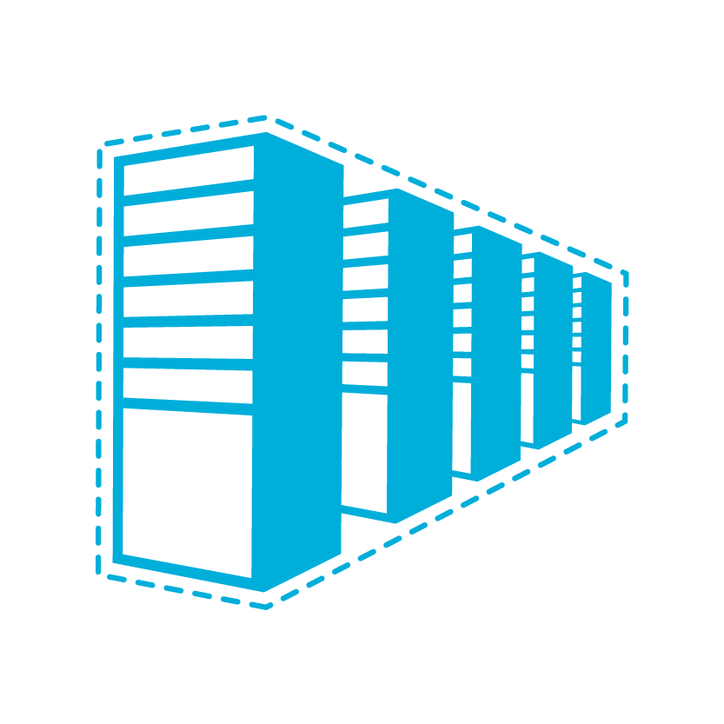
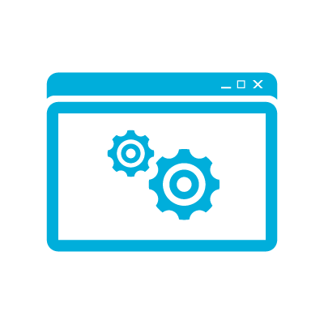
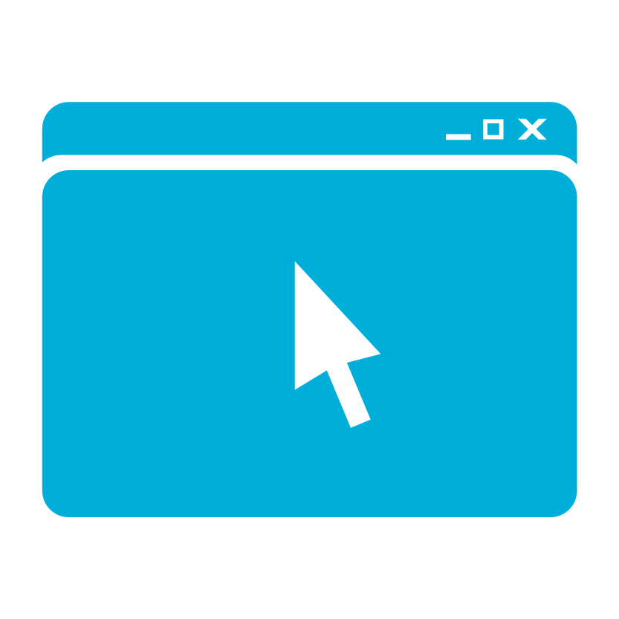
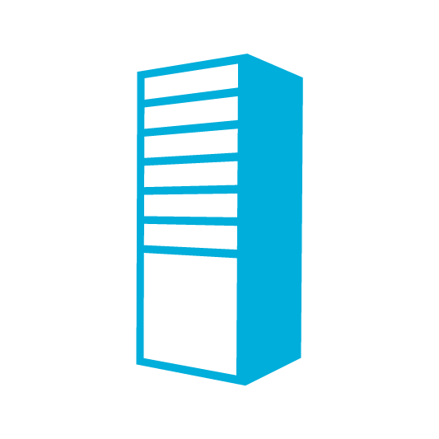
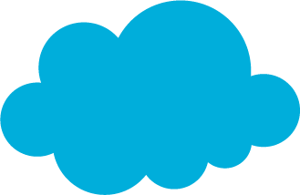
A Continuous Offering From Private to Public Cloud
Physical
Virtual
IaaS
PaaS
SaaS
Notes:
Microsoft provides a continuous solution from private cloud to the public cloud. No matter where you are on your technology roadmap we have a solution to fit your needs.
We are a trusted advisor and platform in the traditional enterprise and ISV space and with the new IaaS offering we are making it easier to bring this same level of trust and ease of use to the public cloud.

Slide 4
Windows Azure Virtual Machines
Support for key server applications and workloads
Easy storage manageability
High availability features
Advanced networking
Integration with compute PaaS
Easy Application Migration
If it requires development, it’s not IaaS
Notes:
Windows Azure Virtual Machines and Virtual Networks support adds the capability to run key server applications and workloads such as Active Directory, SharePoint, SQL Server and most applications that run on a Virtual Machine today.
Adding storage capacity is simple. Either through the portal or PowerShell add up to 16 TBs of storage on an X-Large VM.
Virtual machines allows you to the option of splitting virtual machine loads across multiple racks in the data center using availability sets.
Virtual Networks provide the capability of connecting two cloud services for direct communication. This enables scenarios such as web and worker roles communicating directory with SQL Server.
Application migration is much simpler. In most cases the app will just run without changes on a virtual machine.

Slide 5
IaaS Workloads – all about the app
Line of Business Applications
Custom Applications, CRM, CMS, ERP, Business Intelligence
Application Infrastructure File Servers, Databases, Identity, Source Control
Developer, Test and Staging Environments
Quickly Provision and Un-provision Entire Environments
Hybrid Applications
Applications that span your data center and the cloud
Notes:
With the introduction of Windows Azure Virtual Machines and Virtual Networks there are an entirely new set of workloads that are suitable.

Slide 6
Virtual Machine vs VM Role
 | VM Role | Virtual Machine
Storage | Non-Persistent Storage | Persistent Storage Easily add additional storage
Deployment | Build VHD offsite and upload to storage. | Build VHD directly in the cloud or build the VHD offsite and upload
Networking | Internal and Input Endpoints configured through service model. | Internal Endpoints are open by default. Access control with firewall on guest OS. Input endpoints controlled through portal, service model or API/Script.
Primary Use | Deploying applications with long or complex installation requirements into stateless PaaS applications | Applications that require persistent storage to easily run in Windows Azure.

Slide 7


Images Available at Preview
Windows Server 2008 R2
Windows Server 2008 R2 with
SQL Server 2012 Evaluation
Windows Server 8 Beta
OpenSUSE 12.1
CentOS 6.2
Ubuntu 12.04
SUSE Linux Enterprise Server SP2
Windows
Linux

Slide 8
Getting Started with VMs

Slide 9



Cloud First Provisioning
Getting Started
Select Image and VM Size
New Disk Persisted in Storage
Windows Server
Management Portal
Boot VM from New Disk
Linux
>_
Blob Storage
Extra Small
Small
Medium
Large
X-Large
Scripting
(Windows, Linux and Mac)
Cloud
REST API
Notes:
Cloud First Provisioning means exactly what is says. Building a VM in the cloud first.
You have three methods of starting this process: Build a VM from the portal, from the command line OR programmatically calling the REST API.
Once your choice of provisioning is made you will need to select the image and instance size to start from.
The newly created disk will be stored in blob storage and your machine will boot.

Slide 10
Bring Your Own Server/VHD
On-Premises
Cloud
MyApp.vhd
On Premises Virtual Server
Provision VM from Image or Disk using portal, script or API
Use Case
Forklift Migration of VMs
Sys Prepped Images
VHD Must Be Fixed Disk
* CSUpload Can Convert on Upload
Blob Storage
Upload VHD
Create Disk or
Image
Notes:
This use case is when you already have a “golden image(s)” your company uses for server provisioning or you have a VM running on premises that you would just like to run in our data center. You take the vhd – use CSUpload or System Center App Controller to upload as a page blob to a storage account. From there use the portal to add as an image (sysprepped) or disk (configured VM) and there you can create a VM based off of the vhd.

Slide 11
Imaging VMs in the Cloud
Cloud
Blob Storage
Identical/similar deployment instances using common OS image as start
Base.VHD
Boot
VM
Blob Storage
Customize
VHD
Generalize
VHD
Capture
VM
Capture VM Saves Customized Image to Your Image Library
Notes:
This use case is all about using the capture feature of IaaS to create OS images. The first part you start with a base vhd that you then custom with software binaries, registry settings etc.. You run sysprep.exe and generalize/shutdown the OS. You can then upload it if coming from on-premises or just click the capture button if you created the VM in the cloud.
Capture allows you to take a generalized VM and save the underlying VHD as a new image in your image library.

Slide 12
Image Mobility
On-Premises
Cloud
Blob Storage
MyApp.vhd
Notes:
One of the key benefits of IaaS is flexibility and control. The Windows Azure solution provides the capability of not only moving VHDs TO the cloud but also allows you to copy the VHD back down and run it locally or on another cloud provider. Great for testing out production issues or any other need where you require a copy of the production server.

Slide 13
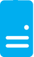
Persistent Disks and Highly Durable
Windows Azure Storage (Disaster Recovery)
Windows Azure Storage
Virtual Machine
Notes:
The OS and Data Disks are stored in Windows Azure storage. So in addition to the data being persistent you also get the benefits of storage which means your VHD is replicated 3X’s locally and also 3X’s in a separate data center in the same region (geo-replication)

Slide 14
Persistent Disks and Highly Durable
Windows Azure Storage (Disaster Recovery)
Windows Azure Storage
Virtual Machine
Virtual Machine
Notes:
This slide simply highlights that if the physical hardware backing your VM goes down a new server will start and pick up the same VHD.

Slide 15
Disks and Images
OS Images
Microsoft
Partner
User
Base OS image for new Virtual Machines
Sys-Prepped/Generalized/Read Only
Created by uploading or by capture
Disks
OS Disks
Data Disks
Writable Disks for Virtual Machines
Created during VM creation or during upload of existing VHDs.

Slide 16
Persistent Disk Management
Capability | OS Disk | Data Disk
Host Cache Default | ReadWrite | None
Max Capacity | 127 GB | 1 TB
Imaging Capable | Yes | No
Hot Update | Cache Setting Requires Reboot | Change Cache Without Reboot, Add/Remove without Reboot.
C:\ = OS Disk
D:\ = Non-Persistent Cache Disk
E:\, F:\. G:\ ... Data Disks
Notes:
Highlight the differences in default cache policy between the OS disk and DataDisk

Slide 17
Virtual Machine Sizes
VM Size | CPU Cores | Memory | Bandwidth | # Data Disks
Extra Small | Shared | 768 MB | 5 (Mbps/S) | 1
Small | 1 | 1.75 GB | 100 (Mbps/S) | 2
Medium | 2 | 3.5 GB | 200 (Mbps/S) | 4
Large | 4 | 7 GB | 400 (Mbps/S) | 8
Extra Large | 8 | 14 GB | 800 (Mbps/S) | 16
Each Persistent Data Disk Can be up to 1 TB

Slide 18
VM Management and Automation
Active Directory Group Policy
Windows Remote Management (WinRM)
SCOM 2012 Support for Managing Virtual Machines
Full REST API for Programmatic Automation and Management
Windows Azure PowerShell Cmdlets 2.3
Cross Platform Scripting (Linux, Mac and Windows)
Windows Azure Monitoring Service (On Roadmap)
Notes:
Simple slide to highlight the different options available for management and automation.

Slide 19
Scripting Capabilities
Full Support for IaaS at spring launch
Windows Azure PowerShell Cmdlets
Cross Platform Scripting Built on node.js
Capabilities
Provisioning, Removal
Reboot, Start
Import and Export VM settings
Support for Windows and Linux VMs
Domain Join at Provision for Windows
Fully Customize VM with Data Disks and Endpoint Configuration
Automate Virtual Network Settings
Notes:
Highlight some of the functionality available to Windows Administrators to automate management / provisioning of virtual machines in the cloud.

Slide 20
Demo
Getting Started with VMs
Notes:
Show Provisioning of a Virtual Machine (Server 2012)
Show a pre-provisioned Virtual Machine with a 1 TB disk attached.
Show them backed by storage using CloudXPlorer
Add another disk through the portal and watch it surface in disk management
Provision a Linux VM and have it “connect” to the existing booted Server 2012 VM and ping to show connectivity

Slide 21
Virtual Machine and Cloud Services

Slide 22
Cloud Services, Roles and Instances Cloud Service is a management, configuration, security, networking and service model boundary
Cloud Service
Web Role
VM₁
VM₂
VM₃
Instances
Roles
Worker Role
VM₄
VM₅
VM…
Notes:
This slide explains web and worker role architecture within a cloud service.
Things to call out:
Each role can have multiple identical instances
You can currently have up to 25 roles per cloud service.

Slide 23
Virtual Machines Virtual Machines are roles with exactly one instance
Implicit Cloud Service
Virtual Machine
VM
Notes:
Virtual Machines work in a similar way.
A cloud service can have up to 25 roles but if that role has a virtual machine there can only be a single instance.
Implicit Cloud service is a reference to the portal. If you only have a single VM the portal will not display the cloud service although it is created and exists.
Add another role (or remove the VM) and the cloud service will show.

Slide 24
Multiple Virtual Machines Multiple Virtual Machines can be hosted within the same cloud service
Cloud Service
Virtual Machine
Virtual Machine
VM
VM
Notes:
When there are multiple VMs in the same cloud service they can communicate directly as they are on the same network.

Slide 25
Virtual Machine Networking

Slide 26
Virtual Machine Names and DNS
Full Control Over Machine Names
Windows Azure provided DNS
Resolves VMs by name within the same cloud service
Machine names are modeled explicitly and registered in the DNS service
Bring Your Own DNS Server
Use your on-premises DNS servers
Deploy a DNS server in Windows Azure
Use public DNS services
Notes:
In Windows Azure previously you did not have control over the VM names. This is a net new.
Windows Azure Provided DNS is also new. Previously you had to use the Windows Azure object model to get the IP addresses of different roles in your deployment.
BYOD allows you to host Active Directory directly in the cloud or when used in conjunction with Virtual Networks (VPN) to build hybrid solutions where AD is hosted on premises and consumed in the cloud or both.

Slide 27
Protocols and Endpoints
UDP Traffic Supported in WA
Load-balanced incoming traffic and allows outbound traffic
Support for All IP-Based Protocols (VM to VM)
Instance-to-instance communication
TCP, UDP and ICMP, dynamic ports
Port Forwarded Endpoints
Direct communication to multiple VMs in the same cloud app
Custom Load Balancer Health Probes
Health check with probe timeouts
HTTP based probing, allowing granular control of health checks
Notes:
UDP is now a supported protocol in WA (previously wasn’t).
Discuss that by default with virtual machines there is an internal endpoint defined with protcol=“all” so essentially all traffic is open between virtual machines.
Windows Server firewall and Linux firewall will still need to be configured to allow traffic.
Health probes allow the load balancer to check a custom HTTP path that tells the LB whether the server is healthy or not. For TCP endpoints no http path is required just the port to connect to.

Slide 28
Port Forwarding Input Endpoints
Cloud App / Hosted Service
Endpoint
Public Port
Local Port
Protocol (TCP/UDP)
Name
PORT 5586
PORT 3389
VM1
LB/IP
PORT 5587
PORT 3389
VM2
Single Public IP Per Cloud Service
Notes:
Input port forwarding is how you can configure direct/non load balanced communication to multiple VMs that have services listening on the same port.

Slide 29
Load Balanced Sets
Cloud App
Endpoint Set
Public Port
Local Port
Protocol (TCP/UDP)
Name
VM1
LBHTTP
PORT 80
LB
VM2
LBHTTP
VM3
LBHTTP
Notes:
Load balanced endpoints allow you to configure the load balance to distribute traffic to multiple VMs. This works with TCP/UDP and you can also configure an HTTP probe with a custom path to test the health of the VM.

Slide 30
Load Balancer Custom Probes
Load Balancer Probe
Set Name
Probe Protocol (HTTP/TCP)
Probe Port
Probe Path
(/healthcheck.aspx)
Looks for HTTP 200
(Omit Probe Path for TCP)
Cloud App
VM1
/healthcheck.aspx
PORT 80
LB
VM2
/healthcheck.aspx
VM3
/healthcheck.aspx
Notes:
Load Balanced Input Endpoints allow you to configure the load balance to distribute traffic to multiple VMs. This works with TCP/UDP and you can also configure an HTTP probe with a custom path to test the health of the VM.

Slide 31
Virtual Machine Availability

Slide 32
Service Level Agreements
99.95% for multiple role instances
4.38 hours of downtime per year
99.9% for single role instances
8.75 hours of downtime per year
What’s included
Compute Hardware failure (disk, cpu, memory)
Datacenter failures - Network failure, power failure
Hardware upgrades, Software maintenance – Host OS Updates
Planned downtime – 6 day notice, 6 hour window, 25 minute downtime
What is not included
VM Container crashes, Guest OS Updates
Notes:
We have now offer an SLA for virtual machines running a single instance. This is different from web/worker roles which require two VMs for an SLA.

Slide 33
Fault and Update Domains
Fault Domains
Represent groups of resources anticipated to fail together
i.e. Same rack, same server
Fabric spreads instances across fault at least 2 fault domains
Update Domains
Represents groups of resources that will be updated together
Host OS updates honor service update domains
Specified in service definition
Default of 5 (up to 20)
Fabric spreads role instances across Update Domains and Fault Domains
Notes:
Slide Objective
Discuss achieving very high availability with Windows Azure
Speaker Notes
Fault Domain is a physical unit of failure, and is closely related to the physical infrastructure in the data centers.
In Windows Azure the rack can be considered a fault domain. However there is no 1:1 mapping between fault domain and rack.
Windows Azure Fabric is responsible to deploy the instances of your application in different fault domains.
Obviously this only applies if you run more than 1 instance
Right now Fabric makes sure that your application uses at least 2 (two) fault domains, however depending on capacity and VM availability it may happen that it is spread across more than that.
As a developer u have no direct control over how many fault domains your application will use but the way you configure it may impact your availability
Upgrade Domain is a logical unit, which determines how particular service will be upgraded.
The default number of upgrade domains that are configured for your application is 5 (five). You can control how many upgrade domains your application will use through the upgradeDomain configuration setting in your service definition file (CSDEF).
Windows Azure Fabric ensures that particular upgrade domain is not within single fault domain
That is Upgrade domains are orthogonal to fault domains
Roles are then spread out over upgrade domains and fault domains. Subject to running a reasonable number of instances this removes the risk of a single point of failure

Slide 34
Fault and Update Domains
Fault Domain
Fault Domain
Rack
Rack
Web Role
UD #1
INSTANCE
INSTANCE
UD #2
INSTANCE
INSTANCE
Worker Role
UD #1
INSTANCE
INSTANCE
UD #2
INSTANCE
INSTANCE
Notes:
Slide Objective
Provide a graphical view of fault and upgrade domains
Speaker Notes
You can se that our service is well spread out across both fault and upgrade domains
The loss of a fault domain will not cause a failure of our service nor will the restart or change of an upgrade domain cause a failure of our service
Notes
Useful pre-reading here.
http://blog.toddysm.com/2010/04/upgrade-domains-and-fault-domains-in-windows-azure.html

Slide 35
Virtual Machine Availability Sets Update Domains are honored by host OS updates
Fault Domain
Fault Domain
Rack
Rack
Virtual Machine
Virtual Machine
Availability Set
IIS1
IIS2
UD #2
UD #1
Availability Set
Virtual Machine
Virtual Machine
SQL1
SQL2
UD #1
UD #2
Notes:
Availability sets tell the Fabric Controller to place VMs in the same set on different racks for faults and in separate upgrade domains for updates.
This essentially tells the FC not to take the guest OS down of all VMs in the same set for host updates.

Slide 36
How Does this Relate to SLA?
Availability Set
Virtual Machine
Virtual Machine
Virtual Machine
SQL Server
SQL Server Primary
SQL Server Secondary
SLA 99.9
SLA >= 99.95
Notes:
Simple: To achieve a 99.95% SLA your application tiers will require multiple VMs in an availability set.

Slide 37

End to End Highly Available Solution
Redundancy at every level
Persistent VM Role
SQL-AVSET
SQL Server
IIS Web Application
IIS-AVSET
Web Role
Internet
SQL Mirroring
LB
IIS Web Application
Persistent VM Role
Web Role
SQL Server

Slide 38
Demo
Configuring Load Balancing and Availability Sets
Notes:
Show a multi-vm web farm
2-Web Servers
2-SQL Servers (mirrored)
Configure Availability Sets
Show Upgrade and Fault Domains in PS
Configure Load Balancing

Slide 39
Windows Azure Virtual Networks

Slide 40



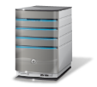


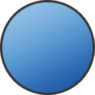
Cross-premise Connectivity
CLOUD
ENTERPRISE
Data Synchronization
SQL Azure Data Sync
Application-layer
Connectivity & Messaging
Service Bus
Secure Machine-to-Machine Network Connectivity Windows Azure Connect
Secure Site-to-Site
Network Connectivity
Windows Azure Virtual Network
IP-level connectivity
Notes:
Microsoft think about the stack to provide connectivity between on-premise and cloud.
Specifically this deck focuses on the last two layers
Servicebus vs connect – SB requires app code change, Connect/Virtual Networks do not.
Virtual Networks are the net new here. They provide site to site connectivity where Connect provided server to server connectivity.
Virtual Networks are the more flexible and powerful option.

Slide 41
Windows Azure Virtual Network
Your “virtual” branch office / datacenter in the cloud
Enables customers to extend their Enterprise Networks into Windows Azure
Networking on-ramp for migrating existing apps and services to Windows Azure
Enables “hybrid” apps that span cloud and their premises
A protected private virtual network in the cloud
Enables customers to setup secure private IPv4 networks fully contained within Windows Azure
IP address persistence
Inter-service DIP-to-DIP communication
Corpnet
Windows Azure
VM 1
VM 2
Subnet 1
Subnet 2
ROLE 1
Notes:
Windows Azure Virtual Networks is our solution to providing hybrid solutions and solutions that require advanced connectivity in the cloud.
Hybrid on-premises to cloud is enabled by using the VPN solution that allows site<->site connectivity allowing machines on premise and machines in the cloud to appear on the same network.
Advanced connectivity solutions are enabled because Windows Azure applications that are deployed in to a virtual network will have persistent IP addresses. This is a requirement for solutions like Active Directory.
Other solutions enabled by virtual networks in the cloud are mixing VMs and web/worker role solutions in the same Windows Azure network. This allows for scenarios like web/worker roles to communicate back to VMs running applications like SQL server.

Slide 42
Virtual Networks Scenarios
Hybrid Public/Private Cloud
Enterprise app in Windows Azure requiring connectivity to on-premise resources
Enterprise Identity and Access Control
Manage identity and access control with on-premise resources (on-premises Active Directory)
Monitoring and Management
Remote monitoring and trouble-shooting of resources running in Windows Azure
Advanced Connectivity Requirements
Cloud deployments requiring persistent IP addresses and direct connectivity across services

Slide 43
Does Your App Need a Virtual Network?
Persistent IP Address Requirements
Virtual Machines deployed into a virtual network have an infinite DHCP lease.
Hybrid On-Premises Cloud Apps
Requirement for connectivity between your data center and the public cloud.
Connectivity between cloud services.
Deploying Active Directory in the Cloud or connecting a PaaS to IaaS Service.
Corpnet
Windows Azure
VM 1
VM 2
Subnet 1
Subnet 2
ROLE 1
Notes:
Windows Azure Virtual Networks provide functionality above and beyond site to site networking.
VNETs also provide persistent IP addresses through an infinite DHCP lease (not static but effectively the same thing).
VNETs also provide the capability of connecting cloud services in the same affinity group directly. This allows for scenarios like web and worker roles to virtual machines running services like SQL Server 2012 or SharePoint.

Slide 44
Supported VPN Device List
Cisco
Juniper
Platform | OS Family | Examples
ASA 5500 Series (Adaptive Security Appliances) | ASA Software 8.4+ | 5505, 5550
ASR 1000 Series Aggregation Services Routers | IOS XE 2.1+ | 1002
ISR Series Integrated Services Routers | IOS 12.2+ | 2801, 2901, 2911
Platform | OS Family | Examples
SRX Series Routers | JunOS 10.2+ | 210, 650
J Series Routers | JunOS 9.4+ | 4350
ISG Series Routers | ScreenOS 6.2+ | SX2
SSG Series Routers | ScreenOS 6.2+ | 550
Generic VPN devices must support
IKE v1
AES 128, 256
SHA1, SHA2

Slide 45
IaaS and PaaS – Better Together
Physical
Virtual
IaaS
PaaS
SaaS
Notes:
Building new PaaS applications is a no-brainer when looking at some of the benefits:
Simplified Deployment and Configuration
Health Model
Easy High Availability
Instance Scalability
OS Patching
Automatic Firewall Configuration
Simple Certificate Deployment
However, building new applications sometimes comes with a dependency on other systems or legacy code.
This has sometimes blocked the development of PaaS applications. The IaaS offering will unblock these types of applications and allow for the two development models to co-exist and directly communicate.

Slide 46

Connecting Applications and VMs
Strengths
Simplicity
Tenant Autonomy
VIP Swap (cloud services)
Easy Local Dev/Test
SQL Data Access Traffic Through Public Endpoint
Load Balancer
80
Cloud Service or Web Site
Weaknesses
Higher Latency
Less Secure Management/Deployment Overhead
Secure Endpoints with Windows Server Firewall
Cloud
Service
2001-1433
SQL Server
Load Balancer
Notes:
This diagram illustrates how you can configure applications such as Windows Azure Web Sites or Cloud Services to connect to applications running on virtual machines without directly putting them on the same virtual network. Note currently Windows Azure Web Sites do not support virtual networks.
The application on the VM will need to have an endpoint opened on it to allow inbound traffic from the other service.
To secure connections it is recommended the firewall on the VM be configured to restrict traffic only from the service.

Slide 47
Connecting Cloud Services with VNET
Strengths
Protect VMs from the open Internet
Lower Latency
VIP Swap (web / worker roles)
Advanced Connectivity Requirements
ContosoVNet (10.0.0.0/8)
Cloud
Service1
80
AppSubnet
(10.0.0.0/16)
Load Balancer
Web or Worker
Weaknesses
VNET Complexity
Windows Azure Provided DNS does not span cloud services
Direct Access via VNET
Cloud
Service 2
SQLSubnet
(10.1.0.0/16)
AD
AD Subnet
(10.2.0.0/16)
SQL Mirror
Notes:
In this scenario a web/worker role is deployed on the same virtual network as the virtual machines.
The benefit is direct connectivity without the need for configuring endpoints on the load balancer.
This is a requirement for scenarios like AD that require persistent IP addresses or lots of ports (RPC/COM+).

Slide 48
Demo
Connecting Cloud Services
Notes:
Deploy a web role that has direct communication with a SQL Server in a VM
Two cloud services
Configuration
Simple VNET
SQL Server in Cloud Service 1
PaaS app in Cloud Service 2
Show the VS.NET VM Management in Server Explorer

Slide 49
Summary
IT Pro experience
Support for key server applications
Easy storage manageability
High availability features
Advanced networking
Integration with compute PaaS
Easy Application Migration
If it requires development, it’s not IaaS

