Slide 1
Linux Running on an Azure Virtual Network
Speaker
Title
Microsoft Corporation

Slide 2
Agenda
Why Linux
Linux Deployments
Understanding a Linux VM
Top Linux Provisioning Scenarios for Customers
Top Linux Scenarios for Partners
Linux Open Source Strategy

Slide 3


Why Linux
Our customers have Linux Workloads that they want to run in Windows Azure
IaaS enables us to satisfy this need

Slide 4
Understanding a Linux VM

Slide 5





Distributions
We will support
SUSE SLES 11 sp2
Open SUSE 12.1
CentOS 6.2 by OpenLogic*
Ubuntu 12.04
Specific versions are endorsed
Integration Components
Testing and validation by partners
Bring other variants at your own risk**
( at GA only)
*Image provided by OpenLogic based on CentOS 6.2
**Integration Work will be needed

Slide 6
Linux Offering
Linux as a first class citizen in Azure
We will focus mainly on Enterprises and ISVs but will also reach out to the community
Open Sourcing critical components
Documenting API
We will offer both Community
and Commercial Distributions
You will be able to buy support for the commercial distributions (GA only)

Slide 7
IaaS Enables Linux

Slide 8


What Does Persistent Mean?
Persistent OS Disk
…and highly durable
Windows Azure Storage (Disaster Recovery)
Windows Azure Storage
Virtual
Machine
Notes:
Animate Failure would be cool.

Slide 9

What Does Persistent Mean?
Persistent OS Disk
…and highly durable
Windows Azure Storage (Geo-Replication)
Windows Azure Storage
Virtual
Machine
Virtual
Machine

Slide 10







The Technology to Provision a Platform Image
HyperVisor
Customer’s
Storage Account
Platform Storage Repository
Stock Images
VM
Data
Data Disk
OS
OS Disk
ISO
Provisioning Repository
Cache
Unattend
Storage API
Add Server
Hostname
Password
…
Cache.VHD
Portal (API)

Slide 11
Linux Built on Persistent VM Role
*Some Features not present in Linux at Preview
Linux
Windows
IC
Drivers
SSH Keys
WA Linux Agent
Certs
Windows Setup
Windows Azure Virtual Machines

Slide 12
The Technology to Provision a Linux Platform Image
HyperVisor
Customer’s
Storage Account
Partner Repository
Stock Images
VM
Data
Data Disk
OS
ICs
OS Disk
ISO
Provisioning Repository
Cache
Linux Agent
Unattend
Storage API
Add Server
Hostname
Password
…
Cache.VHD
Portal (API)

Slide 13


Windows Azure Linux Agent
Service Management API
Windows Azure
provided DNS
VM
Host1
Host2
HV1
HV2

Slide 14
Top Linux VM Provisioning Scenarios for Customers
Gallery Experience
Third Party Tool Provisioning
Bring Your Own Linux

Slide 15
Gallery Experience
Lowest barrier of entry
Partner created images
Click through provisioning
Leverage portal to:
Provide Images (VHDs that include ICs and agent)
Associate SSH Keys
Collect configuration information
Drive provisioning

Slide 16
Demo
Quick Create Demo

Slide 17
Third Party Tool Provisioning
Currently Only SUSE
Ease the creation of custom images, configuration and resources
Customize a partner image
Select packages to include
Tool will include the appropriate ICs and Agent
Tool will drive provisioning for Customer if it chooses to provide it access

Slide 18
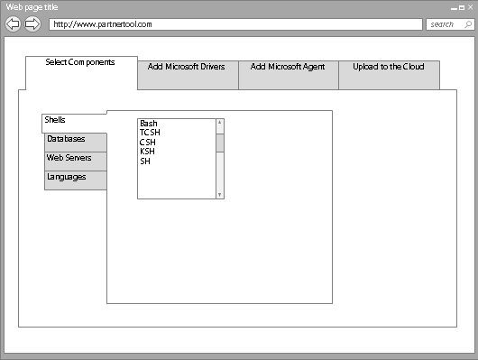

Tool Based Provisioning
XStore
VHD
Customer Personal Image Repository
VHD
VHD
Service Management API
Customer Storage Account
P
O
R
T
A
L
VM
VM2

Slide 19

Bring Your Own Linux
Expert Customers that want to tweak , customize, create images based on supported* distributions
Customer will
Use Hyper-V to install Distribution
Add ICs and Agent
Generate the VHD
Capture configuration
Generate resources
Upload and start instance
Linux Native: Tools, libraries, scripts

Slide 20
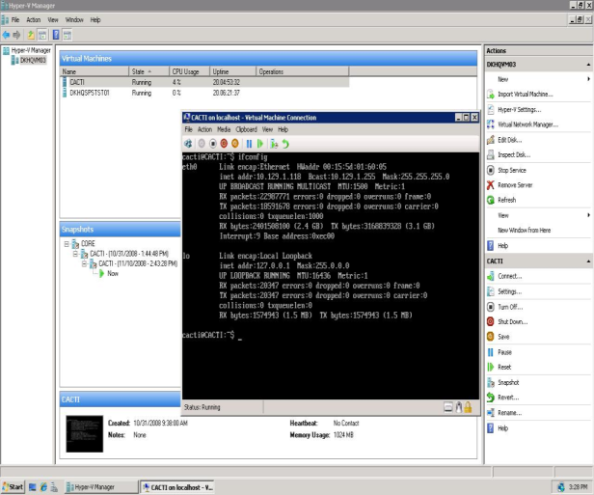
Bring Your Own Linux
XStore
VHD
Customer Personal Image Repository
VHD
Service Management API
Customer Storage Account
P
O
R
T
A
L
VHD
VM

Slide 21
Linux on Azure Open Source Strategy
Open Source Linux Agent
Fully documented APIs
For Linux IT professionals provisioning and management operations:
Native scripts
Native libraries (open sourced)
Native tools (open sourced)
For Linux developers
Client Libraries
Documented interfaces

Slide 22
Top Linux Scenarios for Partners
Creating a Partner Supported Image
Creating a Third Party Provisioning Tool
Creating and Managing Linux Images for Customers

Slide 23
Creating a Partner Supported Image
Same Bring your own Linux operations
Register as a partner (Small, select number of partners)
Publish image in your own repository
Register the image with the platform so that it is listed
Support that image*

Slide 24
Creating a Partner Supported Image
Partner Personal
Storage Account
VHD
VHD
Partner Registration
Azure Platform
Customer Personal Storage Account
Customer VM

Slide 25
Creating a Third Party Provisioning Tool
Provide a distribution that is supported
Create an experience to allow customers to create VHDs
Interface with the service management API
Correctly retrieve and store user credentials
Upload image, configuration and resources
Create and start instances

Slide 26
Creating and Managing Linux Images for Customers
Same Bring your own Linux Operations
Upload and publish image to
Customer’s Personal Repository
Platform Repository
Manage Images and Instances

Slide 27

Creating and Managing Linux Images for Customers
Platform Image Repository
VHD
VHD
Customer Personal Storage Account
VHD
Azure Platform
Customer VM

Slide 28
Linux on Azure Open Source Strategy
Open Source Linux Agent
Fully documented APIs
For Linux IT professionals provisioning and management operations:
Native scripts
Native libraries (open sourced)
Native tools (open sourced)
For Linux developers
Client Libraries
Documented interfaces

