Slide 1
Windows Azure Security and Compliance
Speaker
Title
Microsoft Corporation

Slide 2
Agenda
Background
Data Center / Platform / Application Security
Platform Security
Security Architecture
Security Processes
Compliance
Customer Applications
Q&A

Slide 3
The Inevitable Questions
Is Windows Azure service secure? certified? Processes?
Independent Audits?
Regulatory compliance?
How does WA ensure data isolation? Retention? Recovery? Backup? HW Disposal?
How is the data protected? Who has access to it? Admin privileges?
Monitoring?
Incidence response plan? Notification?
Support 24X7 ? SLA? Performance SLA?

Slide 4
Responsibility for Security
Data Center Layer - Microsoft
Platform Layer - Microsoft
Application Layer - Customer
Some threats are handled by Windows Azure; others remain the responsibility of the customer

Slide 5
Data Center Security

Slide 6



Windows Azure Data Centers
North America Region
Europe Region
Asia Pacific Region
North Central US
Northern Europe
South Central US
Western Europe
East Asia
West US
East US
South East Asia
8 datacenters across 3 continents
Simply select your data center of choice when deploying an application
Notes:
Slide Objective
Understand that Microsoft has a long history in running data centres and online applications. Bing, Live, Hotmail etc….
Understand the huge amount of innovation going on at the data center level
Speaking Points:
Microsoft is one of the largest operators of datacenters in the world
Years of Experience
Large scale trustworthy environments
Driving for cost and environmental efficiently
Windows Azure runs in 3 regions and 6 datacenters today
Data center innovation is driving improved reliability and efficiency
PUE = Power Usage Effectiveness = Total Facility power/IT Systems Power = Indication of efficiency of DC
Under 1.8 is very good, modern cloud DCs approaching 1.2
Multi-billion dollar datacenter investment
700,000+ square foot Chicago and the 300,000+ square foot Dublin, Ireland data centers
Microsoft cloud services provide the reliability and security you expect for your business: 99.9% uptime SLA, 24/7 support.
Microsoft understands the needs of businesses with respect to security, data privacy, compliance and risk management, and identity and access control. Microsoft datacenters are ISO 27001:2005 accredited, with SAS 70 Type I and Type II attestations.
Notes:
http://www.globalfoundationservices.com/
http://blogs.msdn.com/the_power_of_software/archive/2008/06/20/microsoft-s-pue-experience-years-of-experience-reams-of-data.aspx
http://blogs.msdn.com/the_power_of_software/archive/2008/06/27/part-2-why-is-energy-efficiency-important.aspx

Slide 7
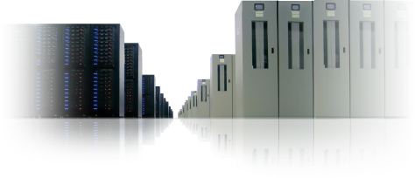
Data Center Security
World-Class Security
Service security starts with the data center
Motion sensors
24×7 secured access
Biometric controlled access systems
Video camera surveillance
Security breach alarms

Slide 8
Platform Security – Security Architecture

Slide 9
WA Design Principle
Fundamental Philosophy
WA has no control over what runs in Guest VMs IMPLIES – Can’t trust Guest VMs
Controls designed with this fundamental philosophy
Resource: Windows Azure Security Overview

Slide 10
Platform Level Threats
An attack on the WA infrastructure could compromise the entire platform
Windows Azure secures its interfaces against attacks over the network
Customer tenants breaking out of their VMs
Attackers successfully impersonating customer administrators or Windows Azure administrators
Customer administrators affecting other than their own tenants

Slide 11
Isolation at multiple levels
Windows Azure network isolated from the rest of Microsoft Corporate Network
Not domain joined
No user / administrator accounts on the VMs
Access through Hop Boxes
Tenant Isolation in a sandbox
Host – Minimal code (e.g: No drivers except approved ones, no graphics modules etc.)
Mutual authentication between internal components

Slide 12
Hypervisor & VM Sandbox
All Guest access to network and disk is mediated by Root VM (via the Hypervisor)
Root VM
Guest VM
Guest VM
Guest VM
Guest VM
Guest VM
Guest VM
Guest VM
Hypervisor
Network/Disk

Slide 13
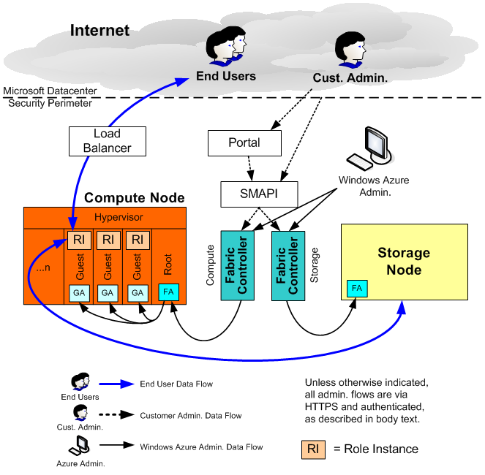
Managing it all through the Fabric Controllers
IaaS VMs – Similar except no GA. FA monitors the container health

Slide 14
Windows Azure Storage
Runs on separate hardware with no network connectivity to compute except (logically)
Requests run over HTTP and optionally over SSL with server authentication
Storage is organized into storage accounts
A single customer may have many storage accounts
Storage Account key controls all access to a storage account

Slide 15
Windows Azure Storage Security
Data from many customers is mixed in a single pool
Access to data in a specific account is only granted to entities having the secret key for that account
Storage keys are randomly generated when the storage account is created (or later at the request of the customer)
A storage account may have two active keys at any given time to support key rollover

Slide 16
Platform Security – Security Processes

Slide 17
Security In Development
Security Development Lifecycle (http://microsoft.com/sdl)
Build Security in the software development process
Threat Models
Design Attestations (technologies in use, effective mitigations implemented)
Security Analysis Tools
Security Bugs
Final Security Review
Every Major release undergoes security review
Review by Security Expert (Microsoft’s TWC partner)
Grey Box Penetration Testing

Slide 18
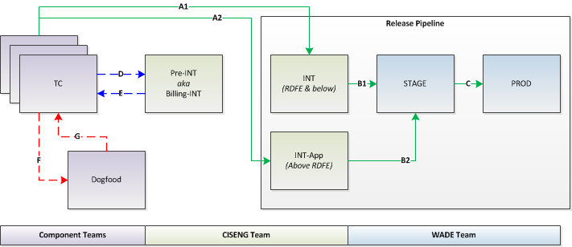
Change & Release Management
Separation of Environments (Logical Diagram)
INT Environment
STG Environment
PROD Environment

Slide 19
Change & Release Management – Software Changes
- Define deployment POR
- Create TFS item
Type | Examples
Major Release | Addition of new service, features, functionality
Minor | Limited scope of change, low impact, bug fixes
Hotfix | Emergency releases
Pre-approved changes | Low risk, pre-approved by shiproom
Support/Script | Tools/scripts (Monitor system health)
Config changes | Changes to config files (Typically not to code)
- INT checklist completed (for Major Release)
- CISENG deploys to INT
- INT exit criteria completed
- WADE deploys to STAGE
- STAGE exit criteria completed
- WADE deploys to PROD

Slide 20
Incident Management process
Detection
Initiating event occurs
Triage
Determine severity based on business impact through the CEN
Assign incident severity in TFS.
Diagnosis
Collect and analyze diagnostic data
Restoration
Assign ownership once record is created in TFS
Document current status in incident record at regular minute intervals
Continually scan for new signals and update severity as appropriate
Validate service restoration through monitoring, partners, and customers
Incident is recorded in TFS through automation or manually (external report)

Slide 21
Incident Management process

Slide 22
Post Incident Analysis, Auditing, Evidences
Post Incident Analysis
Handling Security Incidents
Sev 2 or higher requires a full post-mortem within 14 days
Once an incident is determined to be a security incident it will be logged in TFS in a restricted area path.
Collection of Evidence
Reviews
Report must contain Impact, Severity, Root Cause, Repair Items, Timeline
Procedures followed are similar to non-security incidents
Evidence collected and preserved as necessary throughout the incident management process
All reports stored for a period of 90 days
Automated incident management KPI reports
Notes:
Sample postmortem located here: http://sharepoint/sites/CIS/waps/Shared%20Documents/LiveSite/Postmortems/Synopsis/2011-07-07_DoS%20attack%20against%20SG1PrdApp02.docx

Slide 23
Monitoring and Diagnostics
The following Figure provides a high level overview of MDS Architecture
MA (root OS)
MDS Portal
MDS XStore
MDS
MA (VM)
MDS API
MA (native role)
MDS Alerting (AIMS)
MDS Architecture Diagram
Monitoring Agents (MA) are deployed on each Windows Azure node to monitor a pre-defined set of events, aggregate log events and send the aggregated log information to a centralized MDS database (XStore) either at regular intervals or in real time.

Slide 24
Early Warning System

Slide 25
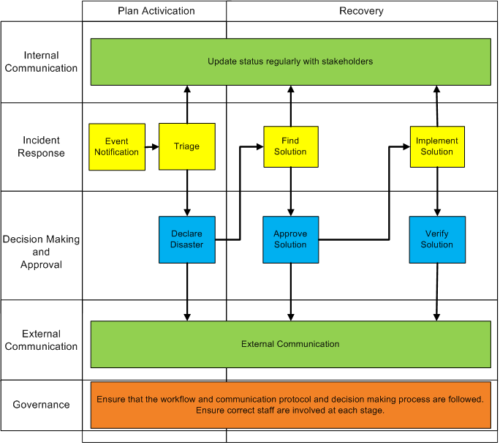
BCP/DRP Workflow

Slide 26
Backup
Backup policy
All critical data have backups outside of region
All backups are monitored
All backup processes are tested at least every 6 mo.
WA owns backup for the following
DNS Records
Last Known Good Build
Platform Certs and Keys
Redundant copies of XStore data
Customer owns off site backup to accommodate software failures, accidental deletes

Slide 27
Access Control
By default – No Administrator / User accounts on VMs
Logging and Monitoring when local accounts are created on VMs
Auditing to assure that unauthorized access will be discovered
Separation of Duties to prevent abuse
Temporary accounts for limited duration (normally 6 to 24 hrs) created for troubleshooting purposes
2-Factor Authentication on Hop boxes
Access levels are reviewed on periodic basis

Slide 28
Common Engineering Criteria
Requirements that must be met by Windows Azure Platform and the services running on platform
Based on Plan / Do / Check / Act
Examples
Encrypt the secrets
Avoid broken encryption algorithms such as MD5
Build resiliency against Denial Of Service Attacks
Backups / Recovery / Restoration Mechanisms
Build Role based Access into the design

Slide 29
Windows Azure “Compliance”
Goals:
Engineer sustained security, privacy, business continuity into Azure
Features, Ops processes, regulatory, contractual
Manage Compliance validation and establish customer trust in a sustainable and affordable manner
Assure end-to-end scenarios can be validated and that customers can build secure solutions
How:
Security, Privacy, BC requirements define the engineering and operations bars and assure these bars are met
The right features, the right processes, continuous validation
This is always our highest order bit
Compliance testing and independent auditing to established benchmarks provides 3rd party validation that min-bars are met.

Slide 30
Compliance Validation Breadth
Significant Certifications/Audits
ISO 27001/27002
SSAE 16 (formerly SAS 70)
FISMA eventually FedRamp
Others
Industry-Specific
HIPAA Business Associate Agreement– healthcare
PCI DSS – credit card processing
Others
Privacy
Usually driven by regulations and contractual obligations
Customer data-centric
Often Geo-specific
US Safe Harbor, EU model clauses
FISMA
ISO
SSAE
HIPAA
PCI

Slide 31
Azure Compliance Approach
Some Key Tenets
Azure – One Service
Program office
Be excellent first – if you have an issue, fix it; document
Excellence implies engineering and automation
A single, well defined governance model
Complete scenarios
Repeatable and efficient
Continuous improvement on all axes
Comprehensive and driven by customer need
Scenario definition
Tools and automation
Taxonomy, Policies, Standards, SOPs
Templates, Guidance, SDK
Common engineering requirements
Audit Management and continuous monitoring
Cost and efficiency management
Team 0
Team 2
Team N
Cross Microsoft:
Dependency Relationships on multiple dimensions e.g. GFS, O365
Share knowledge and tools
Cross dependencies
V-teams and SLAs needed
Engineering and Ops Affinity
Engineering Requirements
Operationally – specific SOPs

Slide 32
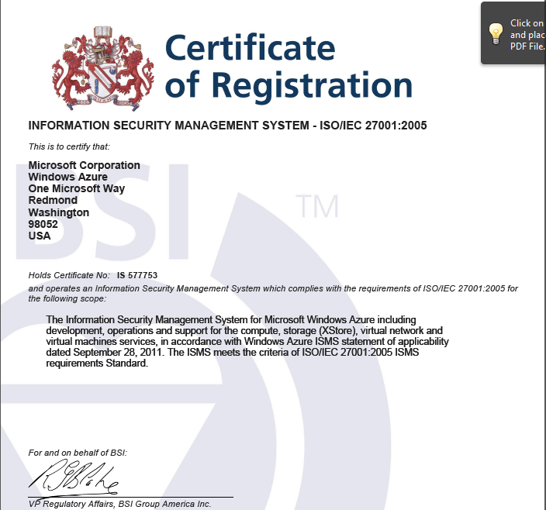
WA CORE ISO 27001 Certified

Slide 33
WA Compliance
Core Platform ISO 27001 Certified
Services Scope
Compute
Storage (XStore)
Virtual Network
What it means
133 requirements
Confidentiality
Integrity
Availability
Independent third party audit and verification
SSAE 16 (SOC 1) Type II – Same services in scope as ISO
Controls tested over a period of time

Slide 34
Customer Applications

Slide 35
Threats Windows Azure Customer Still Must Worry About
Customer Admin
Users
Windows Azure
Customer Tenant

Slide 36
Attacks on a Customer’s Tenant
A tenant is much like an application deployed on-premises . If there are bugs in its code, it can be compromised over the network
Must mitigate vulnerabilities in the applications such as Cross Site Scripting, Buffer Overflow etc.
Conduct Penetration tests on Applications
Must harden the IaaS VMs
Resource: Security Best Practices for Developing Windows Azure Applications
Windows Azure
Customer Tenant
Users

Slide 37
Abuse of Privilege by a Customer Administrator
Customer administrators are authorized to update the code and access the data belonging to customer tenant
Customer must protect the customer storage account keys
Customers should implement deployment practices as carefully as they would for applications in their own data centers

