Slide 1
Windows Azure Infrastructure as a Service
Speaker
Title
Microsoft Corporation

Slide 2
How Did We Get Here?
PDC2008
Windows Azure CTP
Web/Worker Roles
Partial Trust .NET Only
2/2010
Windows Azure RTM
11/2010
VM Role
Connect
Admin Mode
Startup Tasks
Full IIS
Remote Desktop
11/2009
Full Trust/Native
PHP & Java Support
11/2011
Cross Language SDKs
Java, Node.JS
Eclipse Plugin
2007
Project Red Dog Launched
Notes:
A general overview of some of the progress of Windows Azure that highlights some of the efforts around on-ramping applications and providing cross platform/language ease to enabling applications to run in the PaaS service model. Virtual Machines takes this approach dramatically further. Instead of changing your application to run in the cloud we provide the tools for your application to just run.

Slide 3
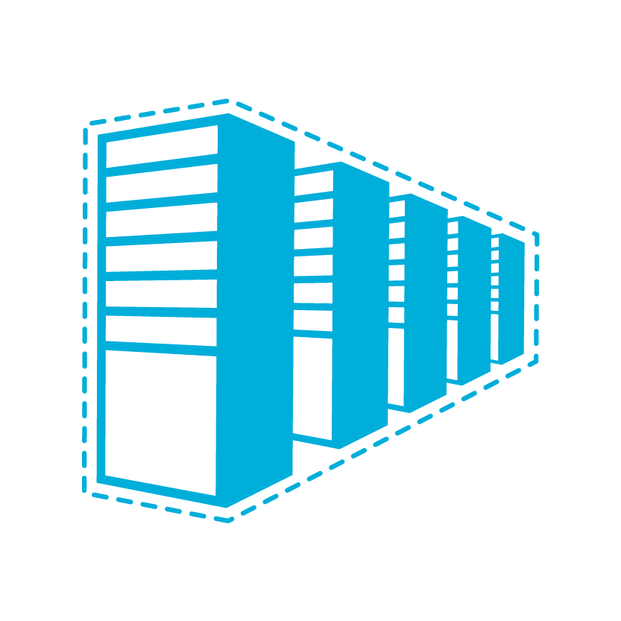

Infrastructure as a Service
The spring release of Windows Azure Infrastructure as a Service introduces new functionality that allows full control and management of virtual machines along with an extensive virtual networking offering.
If deploying an application requires a developer’s involvement, it’s not IaaS
Notes:
Expanding Windows Azure capabilities to provide infrastructure as a service
Provides us with a full continuum of offerings
Brings us relative parity with Amazon, who focuses on IaaS
IaaS Details
Durable virtual machines with Windows Server or Linux
Commercial and community Linux distributions
Select from a library of images or bring your own
E.g. Select an image with SQL Server
Licensing approach
Support SharePoint, SQL Server & Active Directory within IaaS images
Enable deployments containing both PaaS and IaaS services
Create virtual private networks (VPNs) between on-premise servers and Windows Azure
Single Instance SLA (99.9%)
Planned Upgrade Notification Support
Integration between on-premises and public cloud
Easily create a hybrid virtual private network (VPN) between on-premise servers and Windows Azure
Public / Private cloud symmetry
Write apps to common APIs and services that are available within both Windows Azure and on-premise Windows Server

Slide 4
Cloud Models
On Premises
Infrastructure
(as a Service)
Platform
(as a Service)
Software
(as a Service)
You manage
Applications
Applications
Applications
Applications
Data
You manage
Data
Data
Data
Runtime
Runtime
Runtime
Runtime
Managed by Microsoft
You manage
Middleware
Middleware
Middleware
Managed by Microsoft
Middleware
O/S
O/S
O/S
O/S
Managed by Microsoft
Virtualization
Virtualization
Virtualization
Virtualization
Servers
Servers
Servers
Servers
Storage
Storage
Storage
Storage
Networking
Networking
Networking
Networking
Notes:
Slide Objectives:
Explain the differences and relationship between IaaS, PaaS, and SaaS in more detail.
Speaking Points:
Here’s another way to look at the cloud services taxonomy and how this taxonomy maps to the components in an IT infrastructure.
Packaged Software
With packaged software a customer would be responsible for managing the entire stack – ranging from the network connectivity to the applications.
IaaS
With Infrastructure as a Service, the lower levels of the stack are managed by a vendor. Some of these components can be provided by traditional hosters – in fact most of them have moved to having a virtualized offering.
Very few actually provide an OS
The customer is still responsible for managing the OS through the Applications.
For the developer, an obvious benefit with IaaS is that it frees the developer from many concerns when provisioning physical or virtual machines.
This was one of the earliest and primary use cases for Amazon Web Services Elastic Cloud Compute (EC2).
Developers were able to readily provision virtual machines (AMIs) on EC2, develop and test solutions and, often, run the results ‘in production’.
The only requirement was a credit card to pay for the services.
PaaS
With Platform as a Service, everything from the network connectivity through the runtime is provided and managed by the platform vendor.
The Windows Azure best fits in this category today.
In fact because we don’t provide access to the underlying virtualization or operating system today, we’re often referred to as not providing IaaS.
PaaS offerings further reduce the developer burden by additionally supporting the platform runtime and related application services.
With PaaS, the developer can, almost immediately, begin creating the business logic for an application.
Potentially, the increases in productivity are considerable and, because the hardware and operational aspects of the cloud platform are also managed by the cloud platform provider, applications can quickly be taken from an idea to reality very quickly.
SaaS
Finally, with SaaS, a vendor provides the application and abstracts you from all of the underlying components.

Slide 5


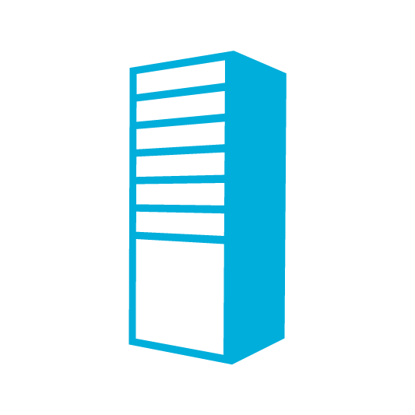
A Continuous Offering From Private to Public Cloud
Physical
Virtual
IaaS
PaaS
SaaS
Notes:
Microsoft provides a continuous solution from private cloud to the public cloud. No matter where you are on your technology roadmap we have a solution to fit your needs.
We are a trusted advisor and platform in the traditional enterprise and ISV space and with the new IaaS offering we are making it easier to bring this same level of trust and ease of use to the public cloud.

Slide 6
Windows Azure Virtual Machines
Support for key server applications and workloads
Easy storage manageability
High availability features
Advanced networking
Integration with compute PaaS
Easy Application Migration
If it requires development, it’s not IaaS
Notes:
Windows Azure Virtual Machines and Virtual Networks support adds the capability to run key server applications and workloads such as Active Directory, SharePoint, SQL Server and most applications that run on a Virtual Machine today.
Adding storage capacity is simple. Either through the portal or PowerShell add up to 16 TBs of storage on an X-Large VM.
Virtual machines allows you to the option of splitting virtual machine loads across multiple racks in the data center using availability sets.
Virtual Networks provide the capability of connecting two cloud services for direct communication. This enables scenarios such as web and worker roles communicating directory with SQL Server.
Application migration is much simpler. In most cases the app will just run without changes on a virtual machine.

Slide 7


Images Available at Preview
Windows Server 2008 R2
Windows Server 2008 R2 with
SQL Server 2012 Eval
Windows Server 8 Beta
OpenSUSE 12.1
CentOS 6.2
Ubuntu 12.04
SUSE Linux Enterprise Server SP2
Windows
Linux

Slide 8
Virtual Machine vs VM Role
 | VM Role | Virtual Machine
Storage | Non-Persistent Storage | Persistent Storage Easily add additional storage
Deployment | Build VHD offsite and upload to storage. | Build VHD directly in the cloud or build the VHD offsite and upload
Networking | Internal and Input Endpoints configured through service model. | Internal Endpoints are open by default. Access control with firewall on guest OS. Input endpoints controlled through portal, service model or API/Script.
Primary Use | Deploying applications with long or complex installation requirements into stateless PaaS applications | Applications that require persistent storage to easily run in Windows Azure.

Slide 9
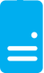
Persistent Disks and Highly Durable
Windows Azure Storage (Disaster Recovery)
Windows Azure Storage
Virtual Machine
Notes:
The OS and Data Disks are stored in Windows Azure storage. So in addition to the data being persistent you also get the benefits of storage which means your VHD is replicated 3X’s locally and also 3X’s in a separate data center in the same region (geo-replication)

Slide 10
Persistent Disks and Highly Durable
Windows Azure Storage (Disaster Recovery)
Windows Azure Storage
Virtual Machine
Virtual Machine
Notes:
This slide simply highlights that if the physical hardware backing your VM goes down a new server will start and pick up the same VHD.

Slide 11
Disks and Images
OS Images
Microsoft
Partner
User
Base OS image for new Virtual Machines
Sys-Prepped/Generalized/Read Only
Created by uploading or by capture
Disks
OS Disks
Data Disks
Writable Disks for Virtual Machines
Created during VM creation or during upload of existing VHDs.

Slide 12
Demo
Getting Started with VMs
Notes:
Show Provisioning of a Virtual Machine (Server 2012)
Show a pre-provisioned Virtual Machine with a 1 TB disk attached.
Show them backed by storage using CloudXPlorer
Add another disk through the portal and watch it surface in disk management
Provision a Linux VM and have it “connect” to the existing booted Server 2012 VM and ping to show connectivity

Slide 13



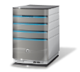



Cross-premise Connectivity
CLOUD
ENTERPRISE
Data Synchronization
SQL Azure Data Sync
Application-layer
Connectivity & Messaging
Service Bus
Secure Machine-to-Machine Network Connectivity Windows Azure Connect
Secure Site-to-Site
Network Connectivity
Windows Azure Virtual Network
IP-level connectivity
Notes:
Microsoft think about the stack to provide connectivity between on-premise and cloud.
Specifically this deck focuses on the last two layers
Servicebus vs connect – SB requires app code change, Connect/Virtual Networks do not.
Virtual Networks are the net new here. They provide site to site connectivity where Connect provided server to server connectivity.
Virtual Networks are the more flexible and powerful option.

Slide 14
Windows Azure Virtual Network
Your “virtual” branch office / datacenter in the cloud
Enables customers to extend their Enterprise Networks into Windows Azure
Networking on-ramp for migrating existing apps and services to Windows Azure
Enables “hybrid” apps that span cloud and their premises
A protected private virtual network in the cloud
Enables customers to setup secure private IPv4 networks fully contained within Windows Azure
IP address persistence
Inter-service DIP-to-DIP communication
Corpnet
Windows Azure
VM 1
VM 2
Subnet 1
Subnet 2
ROLE 1
Notes:
Windows Azure Virtual Networks is our solution to providing hybrid solutions and solutions that require advanced connectivity in the cloud.
Hybrid on-premises to cloud is enabled by using the VPN solution that allows site<->site connectivity allowing machines on premise and machines in the cloud to appear on the same network.
Advanced connectivity solutions are enabled because Windows Azure applications that are deployed in to a virtual network will have persistent IP addresses. This is a requirement for solutions like Active Directory.
Other solutions enabled by virtual networks in the cloud are mixing VMs and web/worker role solutions in the same Windows Azure network. This allows for scenarios like web/worker roles to communicate back to VMs running applications like SQL server.

Slide 15
Windows Azure Virtual Network Scenarios
Hybrid Public/Private Cloud
Enterprise app in Windows Azure requiring connectivity to on-premise resources
Enterprise Identity and Access Control
Manage identity and access control with on-premise resources (on-premises Active Directory)
Monitoring and Management
Remote monitoring and trouble-shooting of resources running in Windows Azure
Advanced Connectivity Requirements
Cloud deployments requiring persistent IP addresses and direct connectivity across services

Slide 16



Bringing Workloads to the Cloud
On Premises
Production
SQL Farm
IIS Servers
SharePoint
PaaS Roles
S2S VPN tunnels
AD / DNS
S2S VPN Device
File Servers
Local AD
SQL VMs
Exchange

Slide 17
Demo
Application Migration

Slide 18
IaaS and PaaS – Better Together
Physical
Virtual
IaaS
PaaS
SaaS
Notes:
Building new PaaS applications is a no-brainer when looking at some of the benefits:
Simplified Deployment and Configuration
Health Model
Easy High Availability
Instance Scalability
OS Patching
Automatic Firewall Configuration
Simple Certificate Deployment
However, building new applications sometimes comes with a dependency on other systems or legacy code.
This has sometimes blocked the development of PaaS applications. The IaaS offering will unblock these types of applications and allow for the two development models to co-exist and directly communicate.

Slide 19
IaaS and PaaS Side by Side
Connect Cloud Apps via VIPs
Easily compose services by connecting public endpoints
Direct Connectivity Using Virtual Networking
For advanced connectivity scenarios such as Active Directory or DCOM
Mixed Mode: Azure Roles and VMs in the Same Cloud Service
Simple, secure and highly efficient method of using IaaS and PaaS side-by-side
Notes:
Compare the current mixed mode developer models

Slide 20

Connecting Applications and VMs
Strengths
Simplicity
Tenant Autonomy
VIP Swap (cloud services)
Easy Local Dev/Test
SQL Data Access Traffic Through Public Endpoint
Load Balancer
80
Cloud Service or Web Site
Weaknesses
Higher Latency
Less Secure Management/Deployment Overhead
Secure Endpoints with Windows Server Firewall
Cloud
Service
2001-1433
SQL Server
Load Balancer
Notes:
This diagram illustrates how you can configure applications such as Windows Azure Web Sites or Cloud Services to connect to applications running on virtual machines without directly putting them on the same virtual network. Note currently Windows Azure Web Sites do not support virtual networks.
The application on the VM will need to have an endpoint opened on it to allow inbound traffic from the other service.
To secure connections it is recommended the firewall on the VM be configured to restrict traffic only from the service.

Slide 21
Connecting Cloud Services with VNET
Strengths
More Secure
Low Latency
Cloud App Autonomy
VIP Swap (stateless roles)
Advanced Connectivity Requirements
ContosoVNet (10.0.0.0/8)
Cloud
Service1
80
FrontEndSubnet
(10.0.0.0/16)
Load Balancer
WA Web Role
Weaknesses
VNET Complexity
No Windows Azure provided DNS
Direct Access via VNET
Cloud
Service 2
SQLSubnet
(10.1.0.0/16)
AD
AD Subnet
(10.2.0.0/16)
SQL Mirror
Notes:
In this scenario a web/worker role is deployed on the same virtual network as the virtual machines.
The benefit is direct connectivity without the need for configuring endpoints on the load balancer.
This is a requirement for scenarios like AD that require persistent IP addresses or lots of ports (RPC/COM+).

Slide 22
Mixed Mode: PaaS/IaaS in the Same Cloud Service
Strengths
Windows Azure provided DNS
Low latency connectivity
Single deployment, update and management unit
Weakness
No VIP Swap (coming in the future)
Cloud
Service
Virtual Machine
80
WA Web Role
Load Balancer
Available at General Availability
Notes:
The biggest benefit of this model is simplicity.
Connecting web and worker roles in the same cloud service as virtual machines allows direct connectivity and name resolution without the requirement to deploy a virtual network.

Slide 23
oneservice
Spring Launch
Notes:
A core motivation of our releases is to have “One Service” that we deliver to customers.
Previously:
Multiple adminstration tools
Multiple developer SDKs
Multiple API design pattersn
Multiple REST service formats
Started with the Fall release:
Updated SDK (available on Git Hub)
Developer Center
Integrated marketing and billing experience
Easy and risk-free trial, with billing caps
The Spring release will continue to take this to a new level, and we’ll talk about this in more detail, but examples include
Modern, clean Management Portal, accessible from any device
Frictionless web development experience
Continuous delivery
Develop using a Mac or Linux
Persistent (durable) VMs running Windows or Linux

Slide 24

Roadmap
Timeframe covered
2009
2010
2011
2012
2013
Easy
Account Management: Sign-up, trials/offers, billing info
Monitoring: Application health, notifications
Development & Deployments: Tools, APIs, services, SDKs
Open & Flexible
Virtual Machines: Migrate private/public cloud, centrally manage, persistent (Windows & Linux)
Expanded Developer Language Support : .NET, Node.js, Java, PHP
Expanded Client Support: Windows, Mac & Linux through Git, and Rest APIs
Enterprise Ready
SQL Azure: Performance, scalability, size, troubleshooting, hybrid scenarios
Big Data: Data Analysis on/off Premise, Real-time Monitoring, Complex Event Processing, Hadoop
Microsoft Product Integration: Office 365, Active Directory & System Center
Notes:
This slide maps the top new features/investments in Windows Azure to the core positioning pillars (may need to adjust what we surface based on the engagement). The important thing here is to talk about the big things and not get lost in a detailed laundry list of stuff that’s coming.

