Slide 1
Windows Azure Virtual Networks
Speaker
Title
Microsoft Corporation

Slide 2
Agenda
Endpoints and Connectivity
New Features Supported by the Load Balancer
DNS and Name Resolution

Slide 3
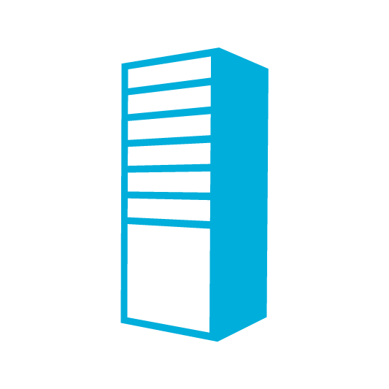
Overview: Connectivity in Azure
Input Endpoint
LB
Internal Endpoint

Slide 4
Use Any IP Protocol in a Deployment
Internal endpoints are open by default with VMs
(Firewalls are not)
IP Traffic

Slide 5
Use Any IP Protocol in a Deployment
Port forwarding
LB
UDP Traffic

Slide 6
Port Forwarding
Windows Azure Role Instances
…
IN_1
IN_1
IN_1
Internet
Direct Connectivity to Individual Role Instances
Load Balanced
Traffic
Web Clients
Controller Service
Web Clients

Slide 7
Load Balancer: Default Health Probe
LB
VM
VM
Azure
Agent
Azure
Agent
Role Status
Role Status
Customer
Application
Customer
Application

Slide 8
Load Balancer: Custom Health Probe
LB
VM
VM
Azure
Agent
Azure
Agent
Role Status
Role Status
Customer
Application
Customer
Application

Slide 9
Windows Azure provided DNS
TestVM1
TestVM2
Who is TestVM2?
10.1.1.1
Who is TestVM2?
Who is TestVM2?

Slide 10
DNS Scenarios
Windows Azure DNS Scenarios
Use your own DNS Scenarios
A. Client-server applications using persistent VMs
C. Hybrid connectivity with on-premise (DNS on-premise)
On-Premises Machine
On-Premises Machine
Persistent VM Role
Persistent VM Role
Persistent VM Role
Active Directory
Web Tier
SQL Reporting Service
SQL Analysis Service
SQL Service
UI Process Components
Active Directory
On-Premises Machine
Business Components & Entities
SQL Service
Active Directory
Domain joined to On-Premises Network
B. Stateless roles with persistent VMs
D. SharePoint with custom DNS (persistent VM)
IIS Web Application
Persistent VM Role
Local DNS
DC
DNS
Web Role 1
Persistent VM Role
Open User Access (Website)
Persistent VM Role
SQL Service
SharePoint FrontEnd
Persistent VM Role
IIS Web Application
Persistent VM Role
SQL
LB
LB
Web Role 2
SQL Mirroring
Persistent VM Role
Internet
IIS Web Application
SharePoint FrontEnd
Persistent VM Role
Persistent VM Role
SQL
Search and Indes
Web Role 3
SQL Service
Internet

Slide 11


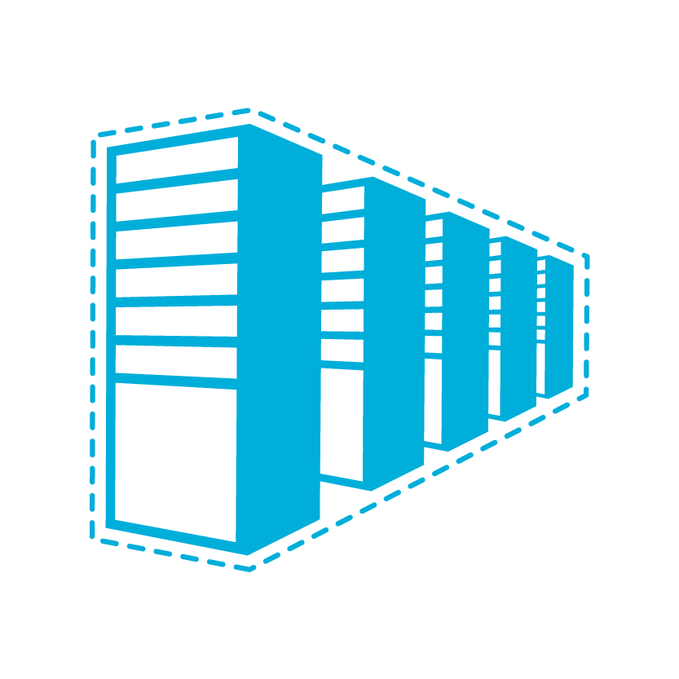

Windows Azure Connectivity Options
CLOUD
ENTERPRISE
Data Synchronization
SQL Data Sync
Application-Layer
Connectivity & Messaging
Service Bus
Secure Machine-to-Machine Network Connectivity Windows Azure Connect
Secure Site-to-Site
Network Connectivity
Windows Azure Virtual Network
Secure Site-to-Site
Network Connectivity
Windows Azure Virtual Network

Slide 12
Windows Azure Virtual Networks
Your “virtual” branch office / datacenter in the cloud
Enables customers to extend their Enterprise Networks into Windows Azure
Networking on-ramp for migrating existing apps and services to Windows Azure
Enables customers to run “hybrid” apps that span cloud and their premises
A protected private virtual network in the cloud
Enables customers to setup secure private IPv4 networks fully contained within Windows Azure
IP address persistence
Inter-service DIP-to-DIP communication

Slide 13
The “virtual” branch office
The Branch Office
The Corp. HQ
SQL Servers
IIS Servers
S2S VPN tunnel
S2S VPN Device
The Virtual Network
in Windows Azure
AD / DNS
S2S VPN Device
S2S VPN tunnel
Exchange
BRK Gateway

Slide 14
Virtual Network Features
Customer-managed private virtual networks within Windows Azure
“Bring your own IPv4 addresses”
Control over placement of Windows Azure Roles within the network
Stable IPv4 addresses for VMs
Hosted VPN Gateway that enables site-to-site connectivity
Automated provisioning & management
Support existing on-premises VPN devices
Use on-premise DNS servers for name resolution
Enables customers to use their on-premise DNS servers for name resolution
Enables VMs running in Windows Azure to be joined to corporate domains running on-premise (use your on-premise Active Directory)

Slide 15
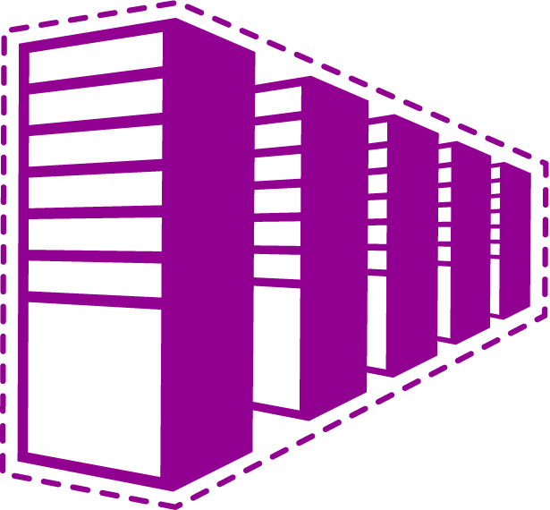
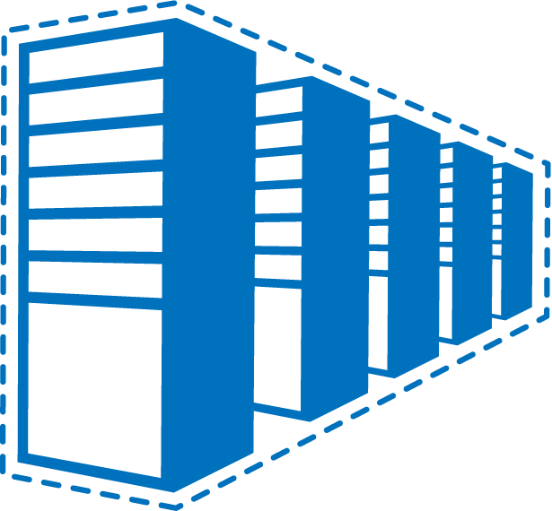
Example: Contoso’s Deployment
Contoso Production VNet in Windows Azure (10.1.0.0/16)
The Corp. HQ (10.0.0.0/16)
10.2.2.0/24
10.2.3.0/24
SQL Farm
IIS Servers
131.57.23.120
65.52.249.22
10.1.0.4
10.1.1.4
10.0.0.10
10.0.0.11
S2S VPN tunnels
Contoso Test in Windows Azure (10.2.0.0/16)
AD / DNS
S2S VPN Device
Exchange
BRK Gateway
10.2.2.0/24
10.2.3.0/24

Slide 16
The Scenarios

Slide 17
Virtual Network Scenarios
Hybrid Public/Private Cloud
Enterprise app in Windows Azure requiring connectivity to on-premise resources
Enterprise Identity and Access Control
Manage identity and access control with on-premise resources (on-premises Active Directory)
Monitoring and Management
Remote monitoring and trouble-shooting of resources running in Windows Azure
Advanced Connectivity Requirements
Cloud deployments requiring persistent IP addresses and direct connectivity across services

Slide 18
Application Migration
The Corp. HQ
WA Web Role
SQL Farm
IIS Servers
VPN Tunnel
App Servers
AD / DNS
Notes:
Enable customers to extend their Enterprise Networks into Windows Azure
Networking on-ramp for migrating existing apps onto Windows Azure
Support “hybrid” apps that span cloud and on-premises
Key Features
Customer-managed private virtual networks within Windows Azure
“Bring your own IPv4 addresses”
Control over placement of Windows Azure Roles within the network
Stable IPv4 addresses for VMs
Hosted VPN Gateway that enables site-to-site connectivity
Automated provisioning & management
Support existing on-premises VPN devices
BYO on-premise DNS servers
Enables customers to use their on-premise DNS servers for name resolution
Enables VMs running in Windows Azure to be joined to corporate domains running on-premise (use your on-premise Active Directory)

Slide 19
Monitoring
The Corp. HQ
WA Web Role
SQL Farm
IIS Servers
VPN Tunnel
Monitoring Service
AD / DNS
Notes:
Enable customers to extend their Enterprise Networks into Windows Azure
Networking on-ramp for migrating existing apps onto Windows Azure
Support “hybrid” apps that span cloud and on-premises
Key Features
Customer-managed private virtual networks within Windows Azure
“Bring your own IPv4 addresses”
Control over placement of Windows Azure Roles within the network
Stable IPv4 addresses for VMs
Hosted VPN Gateway that enables site-to-site connectivity
Automated provisioning & management
Support existing on-premises VPN devices
BYO on-premise DNS servers
Enables customers to use their on-premise DNS servers for name resolution
Enables VMs running in Windows Azure to be joined to corporate domains running on-premise (use your on-premise Active Directory)

Slide 20
SharePoint in Windows Azure
On Premises
Windows Azure Virtual Network
Persistent VM Role
DC
DNS
Local DNS
10.8.8.x
Use Accounts
Persistent VM Role
SharePoint FrontEnd
DC
DNS
Server Account
Persistent VM Role
SQL
LB
SQL Mirroring
Persistent VM Role
SharePoint FrontEnd
Persistent VM Role
Persistent VM Role
SQL
Search and Indes
Persistent Desk
Internet
Domain Joined to On-Premises Network

Slide 21
Mixed Mode with VNet
Persistent VM Role
Persistent VM Role
Business Components & Entities
SQL
Web Role
Persistent Disk
LB
SQL Mirroring
Persistent VM Role
Business Components & Entities
Web Role
Persistent VM Role
Persistent Disk
SQL

Slide 22
Hosting Multiple Customers with Overlapping Address Spaces
Coke (10.0.0.0/16)
Coke’s VNet in Windows Azure (10.1.0.0/16)
131.57.23.120
SQL Farm
IIS Servers
S2S VPN Device
65.52.249.22
Svc1
10.1.2.0/24
Svc2
10.1.3.0/24
Exchange
AD / DNS
Pepsi (10.0.0.0/16)
Coke’s VNet in Windows Azure (10.1.0.0/16)
132.27.23.20
SQL Farm
IIS Servers
S2S VPN Device
65.52.249.22
Svc1
10.1.2.0/24
Svc2
10.1.3.0/24
Exchange
AD / DNS

Slide 23
How Do I Setup Virtual Networks?

Slide 24
Configuring Virtual Networks
Windows Azure Portal (API)
Network Admin
Network configuration
CorpOffice
Deployment package
IT Admin
ContosoCorpOffice (10.0.0.0/16)
ContosoVNet (10.1.0.0/16) → MyAffinityGroup
FrontEndSubnet
(10.1.1.0/24)
ADSubnet
(10.1.2.0/24)
SQLSubnet
(10.1.3.0/24)
Cisco ASA GW 131.57.23.45
SQLSubnet
(10.1.3.0/24)
BESubnet
(10.1.4.0/24)
GW IP
65.57.23.45
DNS2 10.0.0.21
DNS1 10.0.0.20

Slide 25
Portal Experience, APIs and Service Models
Portal
Wizard to create, and update virtual networks
Manage GW Lifecycle
APIs and Scripting
REST APIs
PowerShell Cmdlets
Service Model
Network Configuration
Operations on Net Config
Set Network Configuration
Get Network Configuration
Operations on GW Manager
Create Gateway
Delete Gateway
Get Gateway
Get Gateway SharedKey
Reset Gateway SharedKey
List Connections
Connect To Local Network Site
Disconnect From Local Network Site
Test Local Network Site
Get Operation Status
List Operation Status

Slide 26
Setting up Virtual Networks
demo

Slide 27
Virtual Networks V1 Feature Set

Slide 28
Supported VPN Device List
Cisco
Juniper
Platform | OS Family | Examples
ASA 5500 Series (Adaptive Security Appliances) | ASA Software 8.4+ | 5505, 5550
ASR 1000 Series Aggregation Services Routers | IOS XE 2.1+ | 1002
ISR Series Integrated Services Routers | IOS 12.2+ | 2801, 2901, 2911
Platform | OS Family | Examples
SRX Series Routers | JunOS 10.2+ | 210, 650
J Series Routers | JunOS 9.4+ | 4350
ISG Series Routers | ScreenOS 6.2+ | SX2
SSG Series Routers | ScreenOS 6.2+ | 550
Generic VPN devices must support
IKE v1
AES 128, 256
SHA1, SHA2

Slide 29
Note on GW redundancy and availability
Only single IPsec tunnel supported per Virtual Network
Gateway tenant on Azure side has 2 instances (active-passive mode)
Only one public IP address for tunnel establishment
A pair of VPN devices can be a redundant pair using industry standard protocols
HSRP
VRRP

Slide 30
Limits (for V1 release)
Subscription Limits
One Network Configuration per subscription
Up to 5 VNets and 5 sites per subscription
One VNet per Affinity Group
Up to 9 DNS Servers per subscription
Virtual Network Site
Can use addresses defined in RFC1918
Can connect to only one site
No limit on subnets
Local Network Site
Public and Private IP addresses allowed
Only one gateway IP per site
Gateway
One GW tenant per Vnet (managed by the Windows Azure)
Only one active tunnel between site and VNet
No address space overlaps

Slide 31
Limitations of V1 offering
Virtual Network
Cross-prem connectivity
Only IPv4 addresses allowed
No support for MCAST / BRCAST
No support for BYO MAC address
No support for assigning static IP addresses for VMs
No active routing support (BGP)
No support for forced tunneling
No dynamic updates to virtual network address space
No support for IKE v2
No support for cert. based auth.
No support for 2-factor auth.
No support for software-based VPN solutions

Slide 32
The Differences
Networks in customers’ premises
Virtual Networks in Windows Azure
Customers have full control L2 and up
MAC address specification and VLANS supported
Static and DHCP address assignments supported
MCAST, BRCAST supported
Routing has to be configured explicitly
Trust boundary = VLAN boundary
Several modes of VPN connectivity supported (SSL, Ipsec, …)
WAN optimizers can be used to optimize cross-premise connectivity over the network
Customers can specify only some L3 properties
No support for MAC and VLANs
Only Azure-managed DHCP address assignments
No support for MCAST and BRCAST
Routing is implicit
Trust bundary = VNet boundary
Only Ipsec with IKEv1 supported
No support for WAN Optimizers

