Slide 1
Advanced Diagnostics and Troubleshooting for Windows Azure
Name
Title
Microsoft Corporation

Slide 2
Agenda
Windows Azure Diagnostics for Application Monitoring
Windows Azure PowerShell Cmdlets for Diagnostics
Configuring and Analyzing Diagnostic Data
Debugging and Troubleshooting Windows Azure Applications

Slide 3
Windows Azure Diagnostics
Distributed Application Monitoring and Data Collection
Choose what to collect & when to collect it
Event Logs, Trace Logs, Performance Counters
IIS Web/Failed Request Logs, Crash Dumps,
Other Log files (custom apps, other web/app servers)
Cloud Friendly
Manage multiple role instances centrally
Scalable
Remotely Configurable
(Not a replacement for Outside-In Monitoring)

Slide 4
Diagnostics: Single Server vs. the Cloud
Single Server
Static Environment
Single well-known instance
Traceable local transactions
Local Access Feasible
All in one TS session
Data & tools co-located
In-Place Changes
Cloud
Dynamic Environment
Multi-instance, elastic capacity
Distributed work loads
Local Access Infeasible
Many nodes
Distributed, scaled-out data

Slide 5
How Does It Work (in a nutshell)?
Role Instance Starts
Diagnostic Monitor Starts
Monitor is configured
Imperatively at Start time
Remotely any time
Configuration is saved in Storage
Monitor buffers data locally
User can set a quota (FIFO)
User initiates transfer to storage from local buffer
Scheduled
On Demand
Role Instance
Role
Diagnostic
Monitors
Local directory storage

Slide 6

Remote Configuration
Role Instance
Poll Interval
Role
Diagnostic
Monitors
Local directory storage

Slide 7
Diagnostic Data Locations
WAD-Control-Container
Contains XML Configuration for each Role Instance in the Service
Diagnostic Data | Location in Storage
Windows Event Logs | WADWindowsEventLogsTable
Performance Counters | WADPerformanceCountersTable
Windows Azure Logs | WADLogsTable
Diagnostic Infrastructure Logs | WADDiagnosticInfrastructureLogsTable
IIS Logs | wad-iis-logfiles - WADDirectoriesTable (index entry)
IIS Failed Request Logs | wad-iis-failedreqlogfiles - WADDirectoriesTable (index entry)
Crash Dumps | wad-crash-dumps - WADDirectoriesTable (index entry)
Custom File Based Logs | (must be configured) - WADDirectoriesTable (index entry)

Slide 8
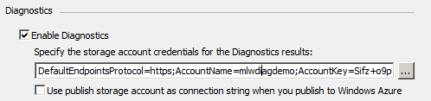
Configuring Diagnostics
Enable Programmatically using DiagnosticMonitor.Start()
Enable Declaratively Using the Diagnostics Module
Configuring Diagnostics
DiagnosticsMonitor/RoleInstanceDiagnosticManager
diagnostics.wadcfg (XML Configuration File)
Diagnostic Tools:
Azure MMC, Operations Manager , Cerebrata, many others…
Windows Azure PowerShell Cmdlets

Slide 9
Diagnostic Monitor (Role Startup)
DiagnosticMonitorConfiguration dc =
DiagnosticMonitor.GetDefaultInitialConfiguration();
dc.WindowsEventLog.DataSources.Add("Application!*");
dc.WindowsEventLog. ScheduledTransferLogLevelFilter =
LogLevel.Error;
dc.WindowsEventLog.ScheduledTransferPeriod =
System.TimeSpan.FromMinutes(5.0);
// add other sources
DiagnosticMonitor.Start("DiagnosticsConnectionString", dc);
Start off with default configuration
Determine what to log and when to transfer to storage
Start the monitor

Slide 10
RoleInstanceDiagnosticManager (anytime)
CloudStorageAccount storage = CloudStorageAccount.Parse(…);
RoleInstanceDiagnosticManager rdm = new
RoleInstanceDiagnosticManager(storage, DeploymentId,
RoleName, RoleInstanceId);
DiagnosticMonitorConfiguration config = rdm.GetCurrentConfiguration();
dc.WindowsEventLog.DataSources.Add("Application!*");
dc.WindowsEventLog. ScheduledTransferLogLevelFilter =
LogLevel.Error;
dc.WindowsEventLog.ScheduledTransferPeriod =
TimeSpan.FromMinutes(5.0);
// add other sources
rdm.SetCurrentConfiguration(config);
Initialize
RoleInstanceDiagnosticManager
Get Current Config
What to log and when to transfer it to storage
Set Current Config

Slide 11
Understanding Diagnostics Configuration
Common Properties
OverallQuotaInMB
BufferQuotaInMB (per source)
ScheduledTransferPeriodInMinutes (per source)
ScheduledTransferLogLevelFilter
Windows Event Logs, Windows Azure Logs
Diagnostic Infrastructure Logs)
Subscriptions
Windows Event Logs (Application, System etc... )
Performance Counters (Counter Specifier, Sample Interval)
Directories (Path, Container and DirectoryQuotaInMB)

Slide 12
PowerShell Cmdlets for Windows Azure
Download Diagnostic Data
Convert Performance Counters to BLG format
Blobs/CSV Data for the Rest
Delete/Clean Diagnostic Data in Storage
Other New Functionality
Hosted Services
Storage Accounts
Affinity Groups
SQL Azure
Storage Analytics
Download from Storage Containers
NEW Functionality

Slide 13
Diagnostics with PowerShell
Add-PsSnapin WAPPSCmdlets
get-hostedservice –servicename $name –cert $cert –subscriptionid $id |
get-deployment $deploymentSlot |
Get-DiagnosticAwareRoles -StorageAccountName $acc -StorageAccountKey $key |
foreach {
# Configure diagnostics for each role instance in the role
$_ | Set-WindowsEventLog …
$_ | Set-PerfmonLog …
$_ | Set-FileBasedLog …
$_ | Set-InfrastructureLog …
$_ | Set-WindowsAzureLog …
}

Slide 14
Windows Azure Diagnostics
demo

Slide 15
Debugging Windows Azure Apps
Where Does My Code Run?
Windbg.exe –pn ???

Slide 16
WAHostBootStrapper.exe
Full IIS Host (<sites>)
Hosted Web Core (No <sites>)
Startup Tasks
IISConfigurator.exe
WAIISHost.exe
Web Role Startup
WAWebHost.exe
Web Role Startup
ASP.NET Code
WAWorkerHost.exe
Worker Role Code
Diagnostics Agent
W3WP.exe
ASP.NET Code
Other Frameworks
PHP etc..
Optional – Custom Executable Started by Worker Role
Remote Access Agent
Other Frameworks
PHP etc..
Remote Forwarder Agent
Load Balancer
External Requests

Slide 17
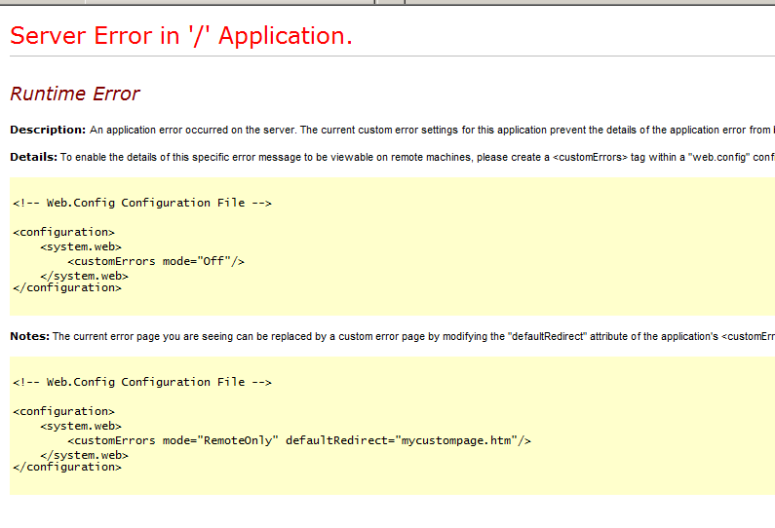
Debugging Unhandled Exceptions
First Line of Defense
Exception Handling/Tracing
CrashDumps.EnableCollection(bool)
Doesn’t Support ASP.NET Well
Worker Role Process Only
Visual Studio Intellitrace
Non Production (for VS2010 anyways)
Allows Playback of Execution Environment
Managed Code Only
Traditional Tools – ADPlus/DebugDiag/WinDBG

Slide 18
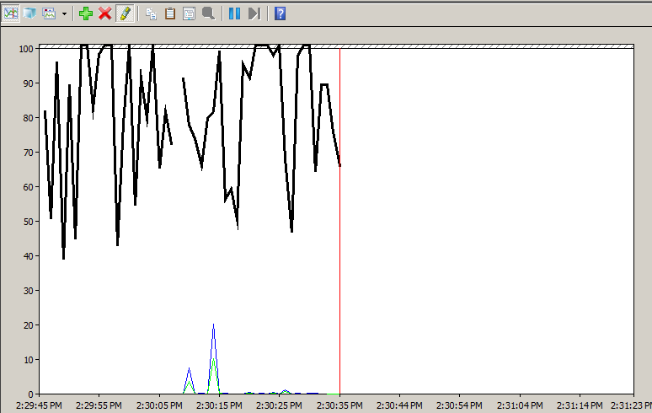
Troubleshooting Performance Problems
Analyzing Performance Counter Data
High CPU Utilization, Disk Queuing,
Memory Leaks etc..
Using the Visual Studio Profiler
Inefficient Code, Memory Leaks, “Hot Areas”
Conditional Tracing
Track Call Times of Suspect Code
Gaining insight into your app with Storage Analytics
Why do I read/write to/from that blob so much?

Slide 19
Logging Call Times – (Cheap profiler…)
BooleanSwitch perfSwitch = new BooleanSwitch("perfSwitch", "perfSwitch“, RoleEnvironment.GetConfigurationSettingValue(“TestPerfSwitch"));
Stopwatch sw = null;
if (perfSwitch.Enabled) {
sw = new Stopwatch();
sw.Start();
}
// lengthy operation
if (perfSwitch.Enabled) {
sw.Stop();
System.Diagnostics.Trace.WriteLine("Method time (ms): " + sw.ElapsedMilliseconds);
}

Slide 20
Troubleshooting Startup Tasks
Understand the architecture
Simple, Foreground and Background Startup Tasks
Logging output of batch file commands
command > cmdOutput.txt
Weird PowerShell Errors? osFamily=“2” to use PowerShell 2.0
Runs the Server with Server 2008 R2
Ensure that added content is marked “Copy Always”
Use RDP and test locally from the E: drive
exit /b 0

Slide 21
Debugging Tips & Tricks
demo

Slide 22
Other Resources
WA PowerShell Cmdlets Download and Tips –
http://michaelwasham.com and http://wappowershell.codeplex.com
Logging exceptions to blob storage example:
http://blog.smarx.com/posts/printf-here-in-the-cloud
TraceListener to Storage Tables:
http://blog.smarx.com/posts/lightweight-tracing-to-windows-azure-tables
For In-Depth Information on Logging and Tracing See the June 2010 Issue of MSDN Magazine: “Take Control of Logging and Tracing in Windows Azure”
Monitoring Windows Azure with Operations Manager
http://aka.ms/AzureSCOM2007
Cerebrata – Diagnostics Manager and other great Windows Azure Tools
http://www.cerebrata.com/

Slide 23
Thank You

